Slide 1
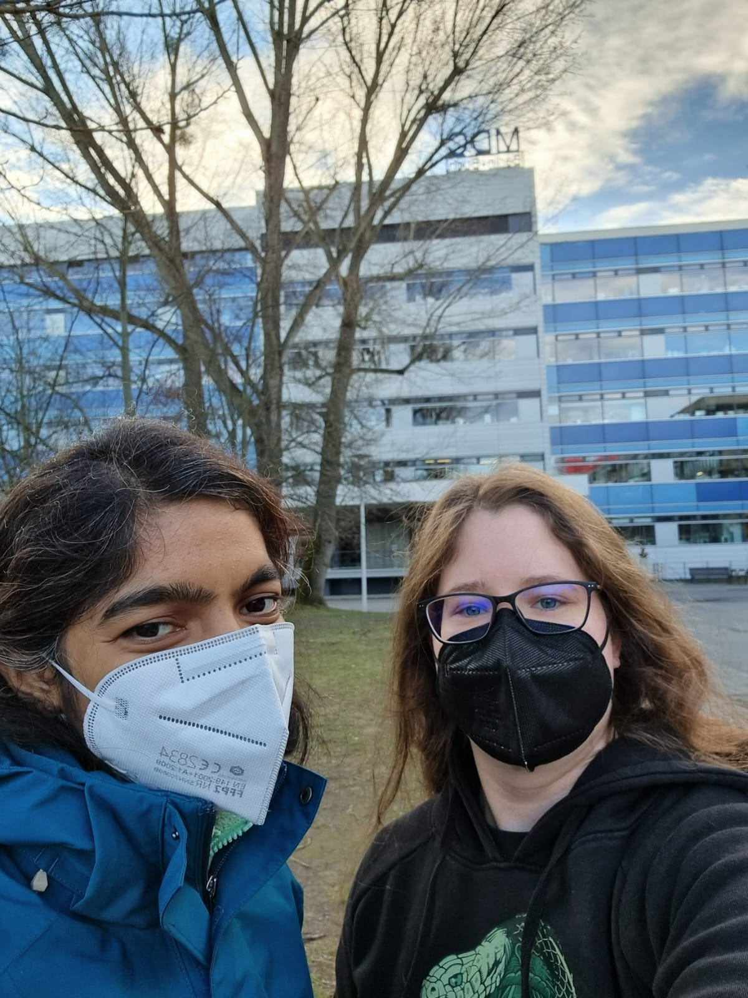

What can we learn about our health using machine learning?
Madhu Nagathihalli Kantharaju
Image Data Analysis
MDC, Berlin
Anna Sophie Welter
Proteome Dynamics
MDC, Berlin
Further Questions? Mail to:
madhu.nagathihallikantharaju@mdc-berlin.de
annasophie.welter@mdc-berlin.de
Github 2023: https://github.com/MadhuKantharaju/mintec2023
Github 2022: https://github.com/annaw995/open_science/tree/ecm_workshop

Slide 2

Your Background
Do you have any programming experience (which language)?
How do you associate with Machine Learning (ML)?
Can you think of any use of ML for health?
Can you imagine any problems with using ML in health?

Slide 3
What can we learn about our health using machine learning?
Anna Sophie Welter
Proteome Dynamics
MDC, Berlin
annasophie.welter@mdc-berlin.de

Slide 4



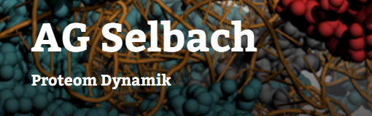
My scientific background
Bachelor in Biology
Thesis in marine biology
Master in Molecular Biology (at least officially)
Thesis in Bioinformatics/ML
Working at µCT Lab in Naturkundemuseum and in drug efficacy prediction in Charité during studies
Currently PhD in Protein Dynamics

Slide 5
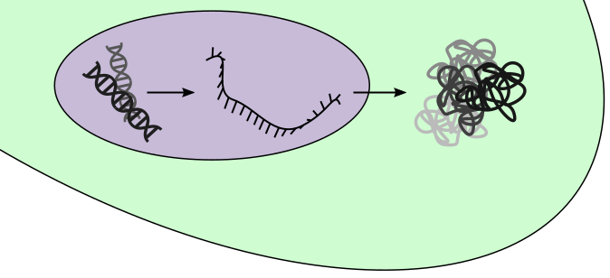
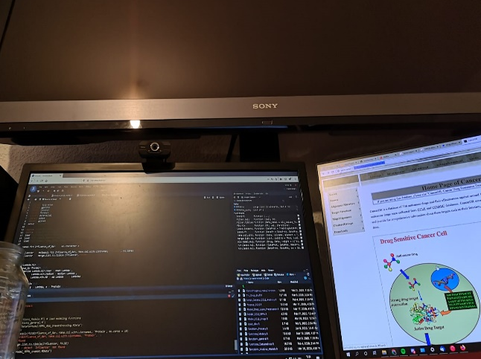
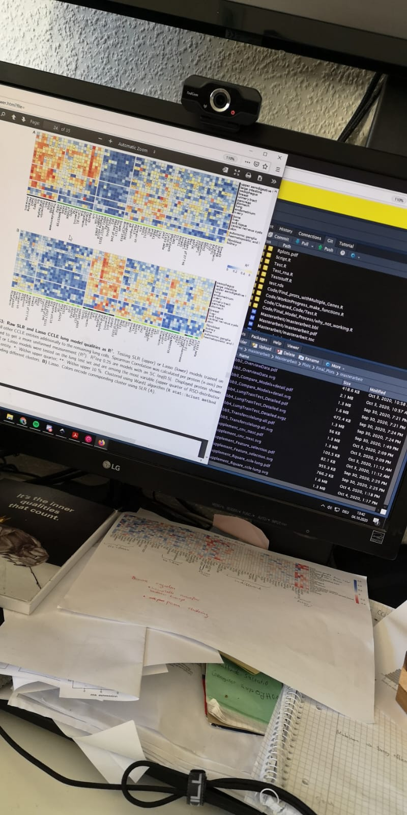
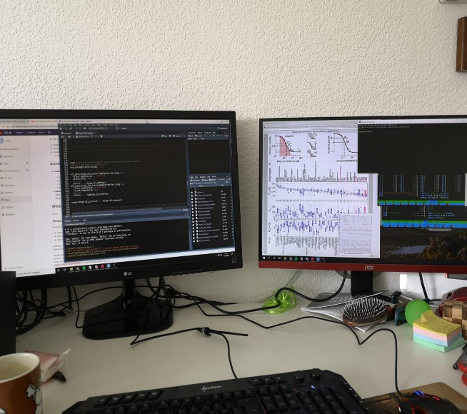
Master project – Predicting protein levels in cancer
Drugs act on (phospho)protein levels which are not measured
Poor correlation between expression of (phospho)protein and encoding mRNA¹
¹Gygi et al. (1999): Correlation between Protein and mRNA Abundance in Yeast. Molecular and Cellular Biology;

Slide 6
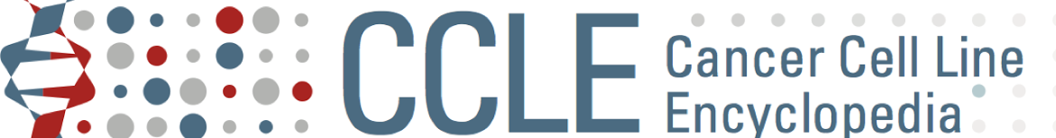

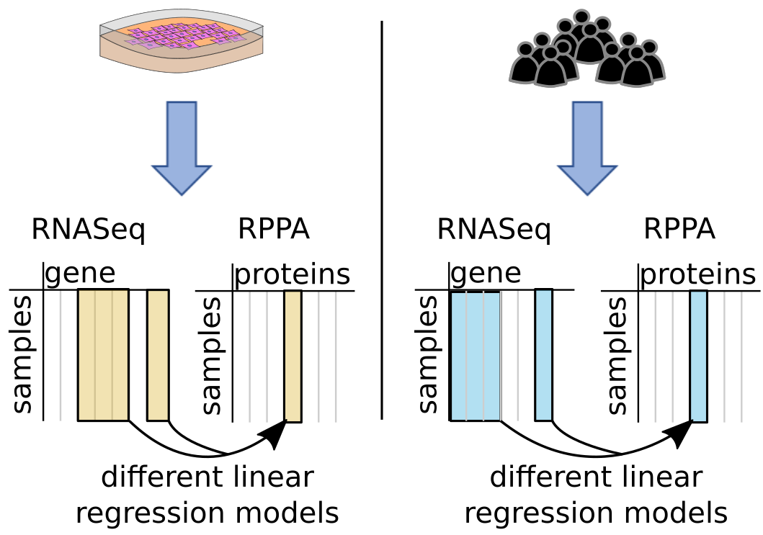



Master project – Predicting protein levels in cancer
Different ML algorithms
Different ML algorithms

Slide 7
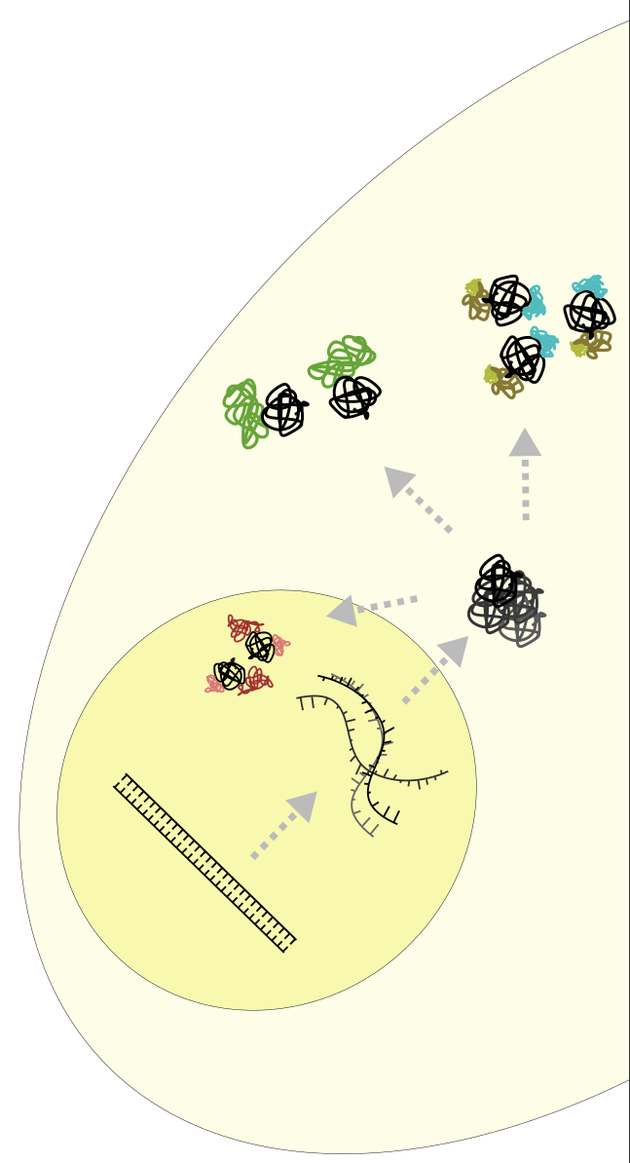






PhD project – Towards high-throughput analysis of protein-protein-interactions
Protein-Protein-Interactions regulate cellular signaling and are abberant in many cancers
Understanding change in PPI might lead to discovery of new drug targets^{1,2}
Implementing a screening in clinical settings might allow better treatments
Understanding disease needs high amounts of data of different levels so we aim to implement mass spectrometry (MS)
German consortium aiming to implement MS in clinics:
MSCoreSys - Massenspektrometrie in der Systemmedizin
https://www.mscoresys.de/
¹Lu et al. (2020): Recent advances in the development of protein–protein interactions modulators: mechanisms and clinical trials.
²Socinski et al. (2018): Atezolizumab for First-Line Treatment of Metastatic Nonsquamous NSCLC.

Slide 8









Using Mass Spectrometry to analyse proteins

Slide 9
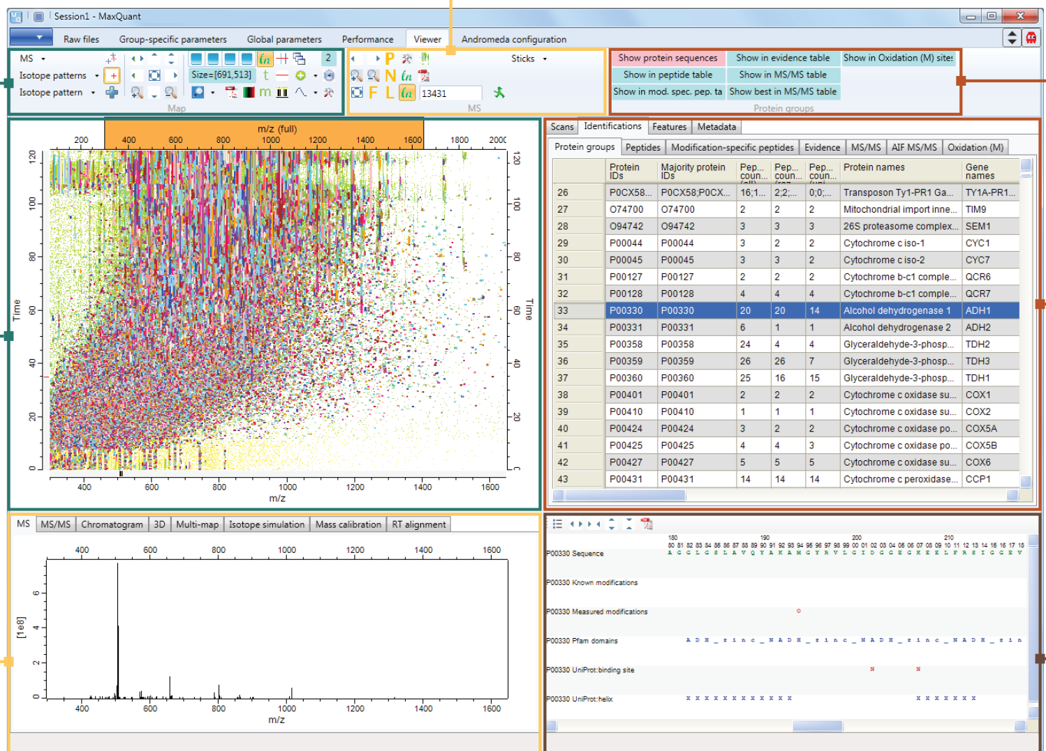
Bioinformatic software neccessary for data processing
Nowadays going through spectra by hand is not possible anymore
Use pattern recognition & complicated Deep Learning Algorithms to identify proper peaks
Search data bases to deduct proteins
Use algorithms to quantify (peak intensity is no absolute quantity)
Most Famous Softwares: MaxQuant, Spectronaut, DIA-NN
Picture from MaxQuant Website: https://www.maxquant.org/

Slide 10
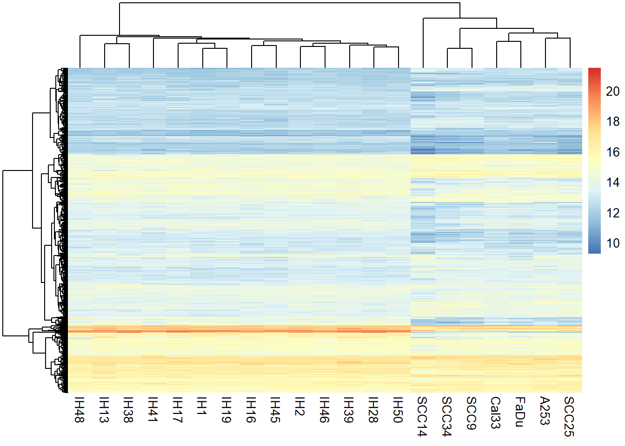
Use own bioinformatic skills to analyse the data
Data processing
Data Overview
Statistics
Machine Learning
Picture from MaxQuant Website: https://www.maxquant.org/

Slide 11

Personal Take Home Messages
You don’t need to know what you want to do after finishing school.
Use every opportunity you have to check out different fields!
It’s never too late to learn programming (and it’s very useful)

Slide 12
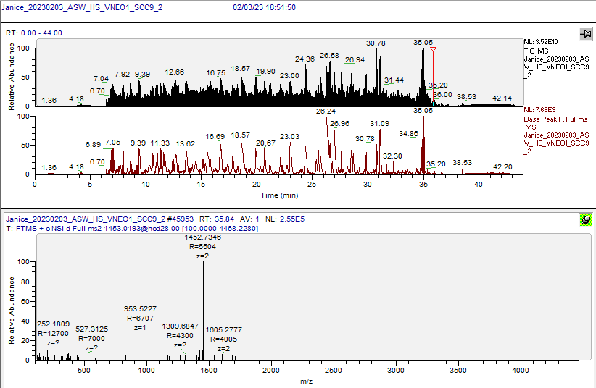
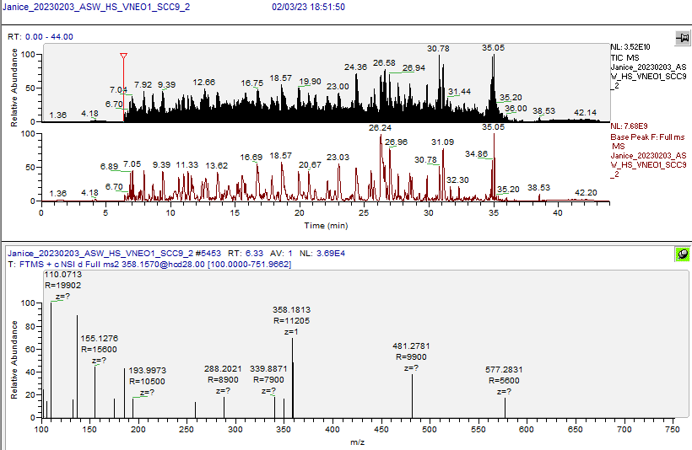
A simple run - short, no Multiplexing, no TimsTof ca 40,000 Spectra of interest
Picture from MaxQuant Website: https://www.maxquant.org/

