Slide 1



Best Practices for Deploying AWS Services: EC2, RDS, VPC, DynamoDB, and ALB
Presented by:- Madhurima Sit

Slide 2


What is AWS?
Amazon Web Services (AWS) is a cloud platform that offers a wide range of services to help businesses and individuals store data, run applications, and manage servers over the internet instead of needing physical hardware. It allows you to access computing power, storage, and databases on demand, paying only for what you use. AWS is flexible, scalable, and secure, making it easier to build websites, mobile apps, and big data projects, all while reducing costs and improving efficiency.

Slide 3

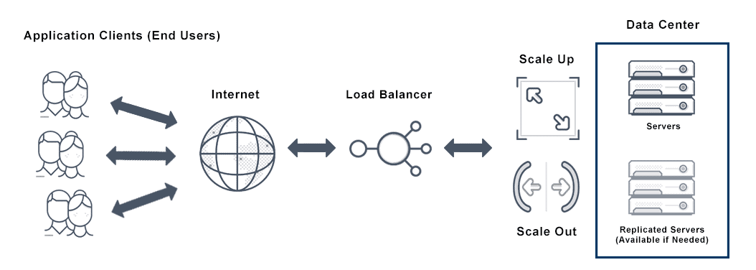
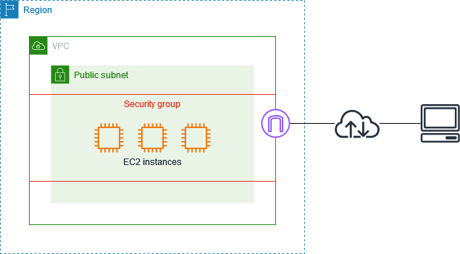
Best Practices for EC2
AUTO SCALING – Automatically the number of EC2 instances based on traffic patterns and demand to ensure optimal performance and cost efficiency. This helps maintain application stability and responsiveness.
APPLY SECURITY GROUPS-
This restricts access based on IP address, port, and protocol, enhancing the security of your environment.

Slide 4
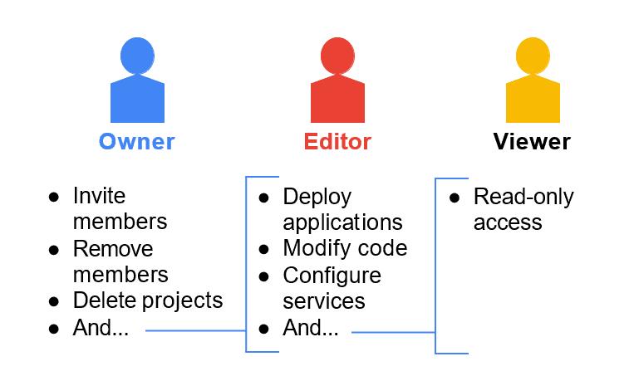


Best Practices for EC2
IMPLEMENT IAM Roles –
Assign roles to instances for secured and controlled access to AWS services.
OPTIMIZE COSTS–
Choosing instance types that match your workload requirements & use Reserved Instances or Savings Plans to reduce costs.
REGULAR BACKUPS- This ensures you can quickly restore your environment in case of data loss or corruption.

Slide 5
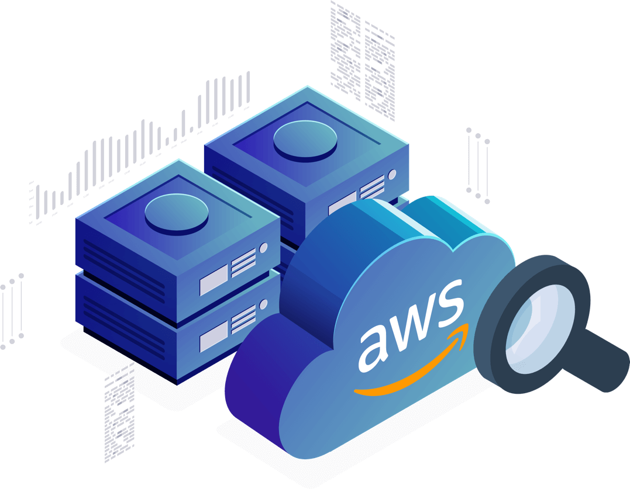
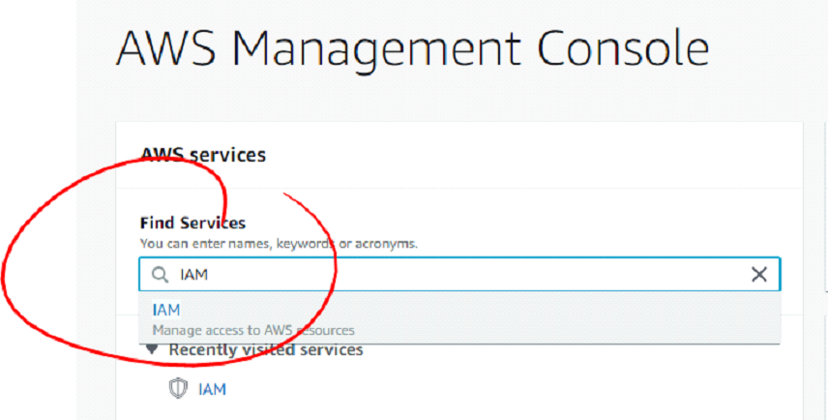

Best Practices for RDS
MONITORING RESOURCES
To keep an eye on important metrics like RAM, CPU, replica lag, and storage utilization, use Amazon CloudWatch. Configure alerts to be notified when deployment capacity is approaching or when usage patterns shift.
REGULAR IAM CREDENTIAL ROTATION
KEEP YOUR DATABASE ENGINE VERSIONS UPDATED
Update your database engine frequently to the most recent version to take advantage of security patches and new features for best performance.
Change your IAM credentials regularly to improve security. Updating secret keys and access keys regularly reduces the risk of having compromised or out-of-date credentials.

Slide 6
Best Practices for VPC
Deploy resources across multiple Availability Zones (AZs) to ensure high availability and fault tolerance.
DESIGN VPC ARCHITECTURE
USE AVAILABILITY ZONES
SETUP INTERNET GATEWAY AND NAT GATEWAY
AUTOMATE VPC DEPLOYMENT
Design your VPC with separate public and private subnets for different resources, and choose a scalable CIDR block, avoiding overlaps with other networks.
Use Infrastructure as Code (IaC) tools like AWS CloudFormation or Terraform to automate the deployment and management of your VPC infrastructure.
Set up an Internet Gateway for public subnet access to the internet and a NAT Gateway for private subnet access without direct exposure.

Slide 7

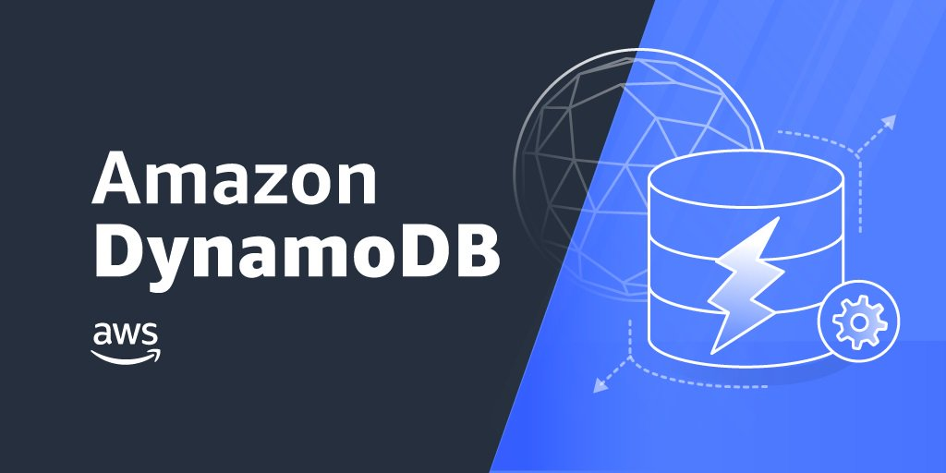
Best Practices for DynamoDB
OPTIMIZE FOR ACCESS PATTERNS- Design tables with efficient partition keys and avoid hot partitions.
ENABLE ON-DEMAND MODE For unpredictable workloads, use on-demand capacity mode to avoid over-provisioning.
USE AUTO SCALING- Enable auto-scaling to adjust throughput capacity based on demand.
Monitor Performance- Set up CloudWatch alarms and enable DynamoDB Streams for real-time insights.

Slide 8
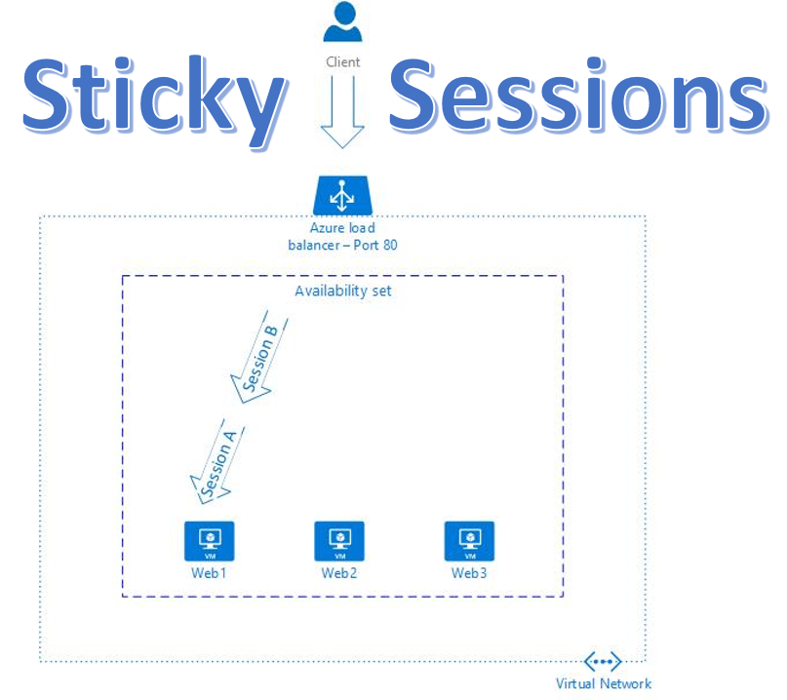
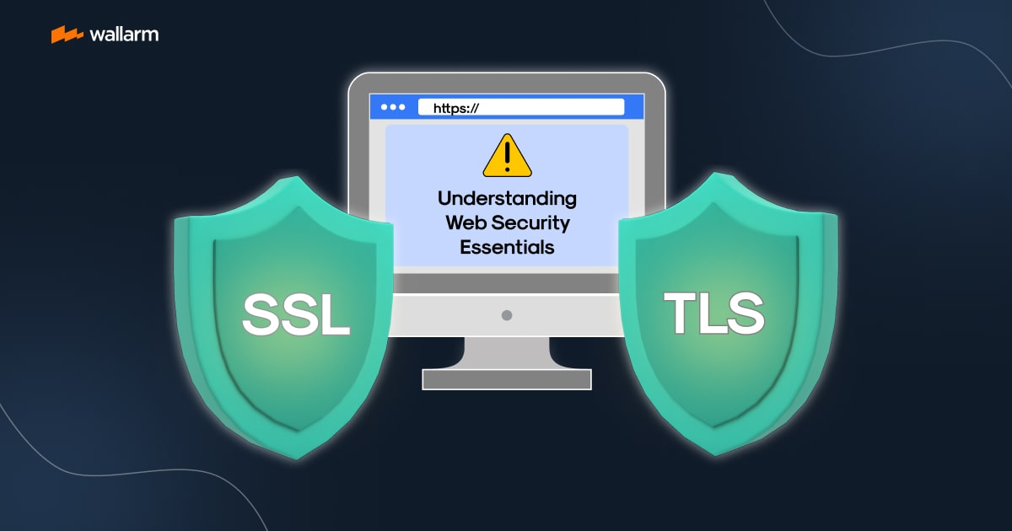
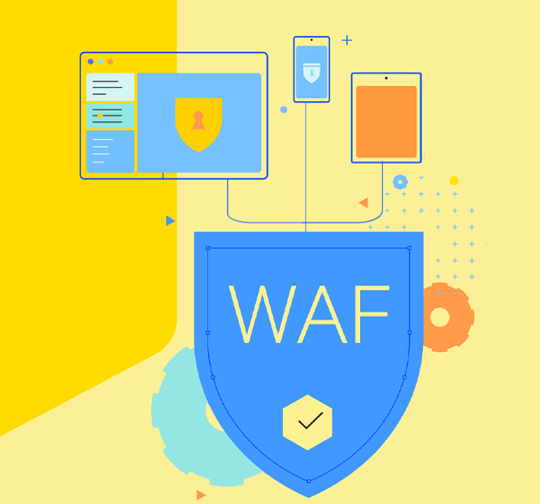
Best Practices for Application Load Balancer
Enable Sticky Sessions (Session Persistence): For session-based applications, use stickiness to maintain a user session with a specific target.
Use Path-Based and Host-Based Routing: Use rules to route traffic based on URL path or host for microservices architectures.
Use SSL/TLS for Secure Communication: Terminate SSL at the load balancer to ensure encrypted traffic.
Enable Access Logs: Store and analyze access logs in S3 for monitoring and troubleshooting.
Optimize Target Group Configuration: Distribute traffic evenly across multiple instances or containers to prevent overloading.
Integrate with WAF (Web Application Firewall): Protect your applications from common web exploits with AWS WAF.

Slide 9



madhurimasit61@gmail.com

