Slide 1
Evaluation of regression metrics using regression algorithms
By
Gurrala Madhu Mohan Vamsi

Slide 2
Abstract
A simple linear regression algorithm only works when the relationship between the data is linear. But suppose we have non-linear data, then linear regression will not be able to draw a best-fit line. Simple regression analysis fails in such conditions.
Hence, we use polynomial regression to overcome this problem, which helps identify the curvilinear relationship between independent and dependent variables.

Slide 3
Problem statement
On taking different regression algorithms, apply it to 50_Startups dataset. Divide the dataset into training & testing sets and apply different regression metrics and choose the best model among them.

Slide 4
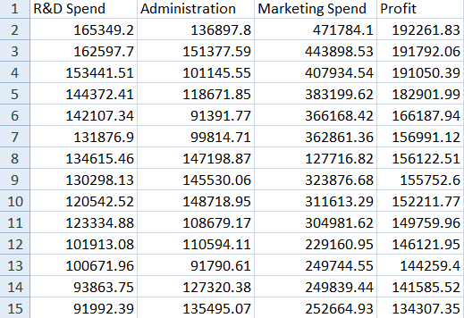
Dataset
This is a 50_Startups dataset. The size of this dataset is 4*50. Here, R&D Spend, Administration, Marketing Spend are independent variables and treated as input attributes. Profit is a dependent variable and treated as output variable.

Slide 5
Introduction
Machine learning algorithms
Supervised learning
Classification
Regression
Unsupervised learning
Clustering
Association
Linear regression
Non - linear regression
Simple Linear Regrssion
Multiple Linear Regression
Polynomial Regression

Slide 6
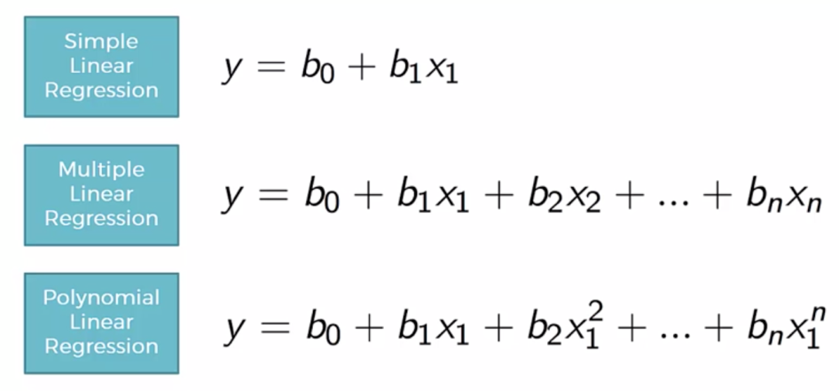
Techniques
Simple Linear Regression(SLR)
Multiple Linear Regression(MLR)
Polynomial Regression(PR)

Slide 7
Linear Regression
When we have a dataset with one predictor variable and one response variable, we often use simple linear regression to quantify the relationship between the two variables.
However, simple linear regression (SLR) assumes that the relationship between the predictor and response variable is linear. Written in mathematical notation, SLR assumes that the relationship takes the form:
y= b₀+b₁x

Slide 8
Polynomial regression
But in practice the relationship between the two variables can actually be nonlinear and attempting to use linear regression can result in a poorly fit model.
One way to account for a nonlinear relationship between the predictor and response variable is to use polynomial regression, which takes the form:
y = b₀ + b₁x + b₂x_{2 + … +} b_{n}x^{n}
In this equation, n is referred to the degree of the polynomial.

Slide 9
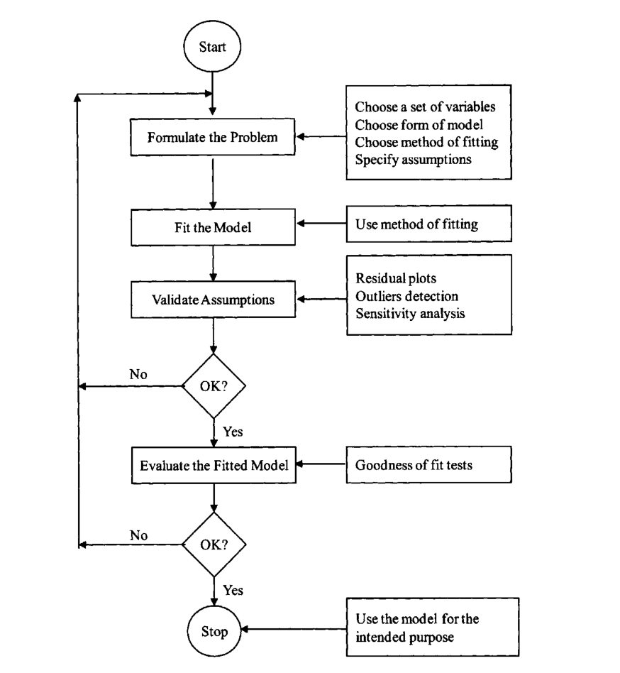
Architecture

Slide 10
Implementation
Import libraries
Load dataset
Assign values to X and y
Divide into training and testing data
Apply polynomial regression method
Import linear regression method
Apply regression metrics

Slide 11
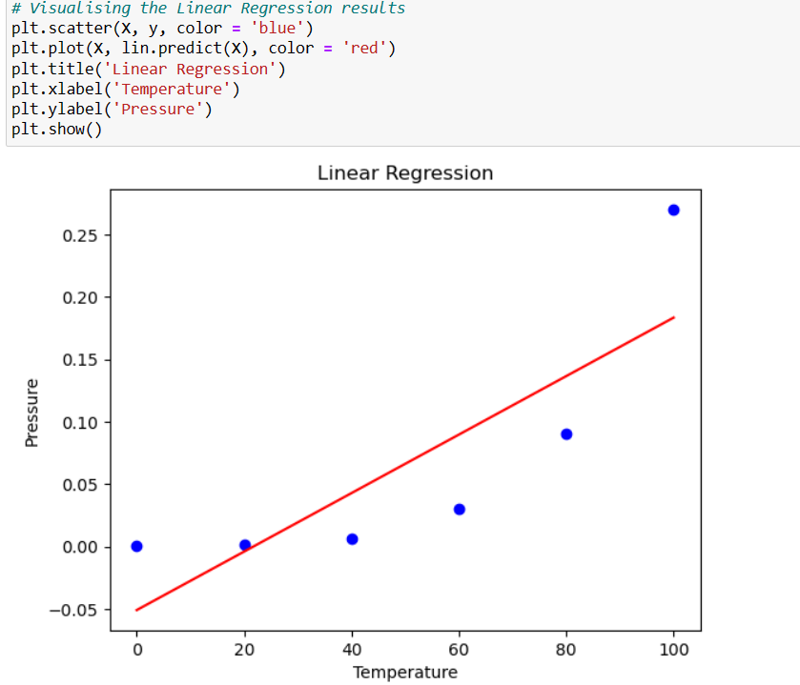
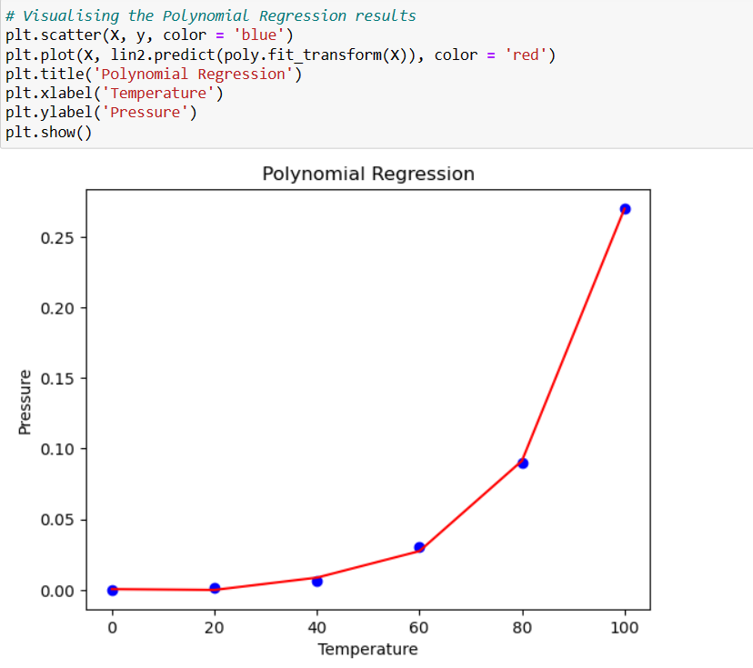
Comparison graph

Slide 12

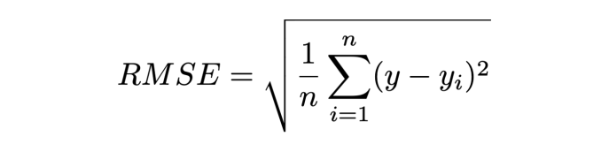
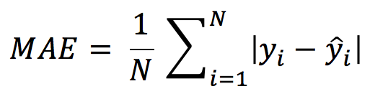
Methodology
Mean Squared Error (MSE)
Root Mean Squared Error (RMSE)
Mean Absolute Error (MAE)

Slide 13
Results
Regression Types/Regression metrics | Mean Absolute Error | Mean Squared Error | Root Mean Squared Error
Linear Regression | 6738.115908022101 | 67857068.45576176 | 8237.540194485351
Multiple Regression | 6771.031866712217 | 67760693.23706304 | 8231.688358840065
Polynomial Regression | 7055.6882037483565 | 70641183.7076138 | 8404.830974363125

Slide 14
Conclusion
After comparing, we conclude that SLR and MLR are also Polynomial regression with a single degree. And the Polynomial regression equation is Linear equation with n^{th} degree. So if we add a degree to our linear equations, then it will be converted into Polynomial Linear Equations.

Slide 15
THANK YOU...!!

