Slide 1


SIMATS ENGINEERING
SAVEETHA INSTITUTE OF MEDICAL AND TECHNICAL SCIENCES
CAPSTONE PROJECT PRESENTATION
CSA1602 – COMPILER DESIGN
LEXI-Farm: AI-Based Smart Farming Application with Compiler Optimization Using Constant Folding and Dead Code Elimination
Guided By
Presented By
Dr N Deepa
192324281 – R. MONIKA 192365019-M. NIHARIKA
192371066 – M. MADHU RUSHWIKA
2026

Slide 2
SIMATS ENGINEERING
SAVEETHA INSTITUTE OF MEDICAL AND TECHNICAL SCIENCES
INTRODUCTION
Why Smart Farming?
LEXI-Farm Approach
Modern agriculture generates large volumes of soil, weather and crop data.
Farmers need timely decisions for crop selection, irrigation and yield planning.
AI/ML can convert agricultural parameters into actionable recommendations.
Smart-farming applications also need efficient decision-making software.
Module 1 analyzes farmer and environmental inputs using AI/ML logic.
The recommendation is converted into farming decision code.
Module 2 applies Constant Folding and Dead Code Elimination.
Module 3 compares original and optimized code and reports performance.
Core idea: Predict → Generate → Optimize → Analyze
02

Slide 3
SIMATS ENGINEERING
SAVEETHA INSTITUTE OF MEDICAL AND TECHNICAL SCIENCES
PROBLEM STATEMENT
Existing Challenges
Proposed Solution – LEXI-Farm
Manual farming decisions may not fully use available soil and environmental data.
Selecting suitable crops and irrigation levels from multiple parameters is difficult.
AI-generated decisions must be converted into executable application logic.
Generated decision code may contain constant expressions and unused statements.
Unnecessary operations can increase code size and runtime work, especially on edge/IoT devices.
Use AI/ML-style analysis to recommend suitable crops and farming actions.
Generate farming decision logic from the recommendation.
Optimize the generated logic using Constant Folding.
Remove unused statements using Dead Code Elimination.
Measure code reduction and optimization results in a final performance dashboard.
Problem → Intelligent Recommendation → Efficient Decision Logic
03

Slide 4
SIMATS ENGINEERING
SAVEETHA INSTITUTE OF MEDICAL AND TECHNICAL SCIENCES
LITERATURE REVIEW
Study / Year | Focus | Key Contribution | Relevance / Gap
Wolfert et al. (2017) | Big Data in Smart Farming | Reviewed data-driven agriculture and the role of analytics in farm decision-making. | Supports the smart-farming data layer.
Liakos et al. (2018) | Machine Learning in Agriculture | Surveyed ML applications for crop, soil, disease and yield-related tasks. | Supports AI-based recommendation.
Kamilaris & Prenafeta-Boldú (2018) | Deep Learning in Agriculture | Reviewed deep-learning methods for agricultural image and data analysis. | Shows scope for future disease/vision modules.
Aho et al. (2006); Cooper & Torczon (2011) | Compiler Optimization | Established compiler analysis and optimization concepts used to improve generated code. | Motivates Constant Folding and Dead Code Elimination.
04

Slide 5
SIMATS ENGINEERING
SAVEETHA INSTITUTE OF MEDICAL AND TECHNICAL SCIENCES
SYSTEM ARCHITECTURE
FARMER INPUT N, P, K, pH, Temperature, Humidity, Rainfall, Moisture
MODULE 1 AI / ML ANALYSIS
AI RECOMMENDATION Crop + Confidence + Farming Parameters
MODULE 2 CODE GENERATION
FARMING DECISION CODE
COMPILER OPTIMIZATION PIPELINE
Source Code
Lexical Analysis
Parsing
AST
Constant Folding
Dead Code Elimination
Optimized Code
MODULE 3 RESULT & PERFORMANCE ANALYSIS Original Code vs Optimized Code • Reduction • Optimization Status
05

Slide 6
SIMATS ENGINEERING
SAVEETHA INSTITUTE OF MEDICAL AND TECHNICAL SCIENCES
MODULE 1 – FARMER INPUT & AI RECOMMENDATION
INPUT
OUTPUT
Nitrogen (N)
Phosphorus (P)
Potassium (K)
Soil pH
Temperature
Humidity
Rainfall
Soil Moisture
Farm Area / Location
Recommended Crop: Rice
AI Confidence: 94%
Expected Yield: 5.8 tons/acre
Irrigation Requirement: High
Water Requirement: 50 units
Soil Suitability: Excellent
Farming Decision: Irrigation control logic required
AI / ML PROCESSING
MODULE 1 OUTPUT → automatically becomes MODULE 2 INPUT
06

Slide 7
SIMATS ENGINEERING
SAVEETHA INSTITUTE OF MEDICAL AND TECHNICAL SCIENCES
MODULE 2 – COMPILER OPTIMIZATION ENGINE
INPUT FROM MODULE 1
GENERATED FARMING CODE
OPTIMIZATION
Recommended Crop: Rice
Rainfall: 200 mm
Water Requirement: 50 units
Irrigation: High
AI Confidence: 94%
Generate farming decision code automatically.
int rainfall = 200; int threshold = 100 + 100; int water = 10 * 5; int unused = 500; if (rainfall >= threshold) { irrigation(water); }
Lexical Analysis
Parsing
AST Generation
Constant Folding
Dead Code Elimination
Optimized Code Output
100 + 100 → 200 | 10 × 5 → 50 | unused statement → removed
07

Slide 8
SIMATS ENGINEERING
SAVEETHA INSTITUTE OF MEDICAL AND TECHNICAL SCIENCES
MODULE 3 – RESULT & PERFORMANCE ANALYSIS
INPUT
PERFORMANCE COMPARISON
FINAL OUTPUT
Module 1 AI Recommendation
Original Farming Decision Code
Optimized Farming Decision Code
Constant Folding Count
Dead Code Removal Count
BEFORE 7 lines
AFTER 6 lines
Crop: Rice
AI Confidence: 94%
Optimized Code: Generated
Code Reduction: 14.28%
Optimization Status: Successful
Final Farming Decision: Efficient irrigation logic
Code Reduction
14.28%
Constants Folded: 2 Dead Code Removed: 1 Status: SUCCESS
MODULE 3 produces the final integrated project result.
08

Slide 9
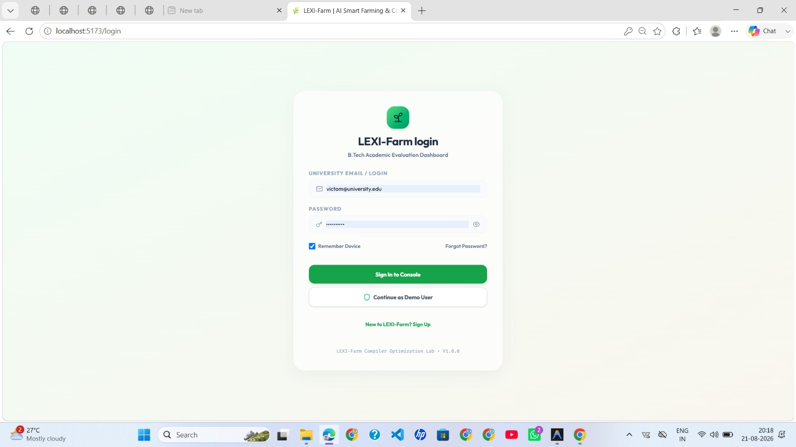
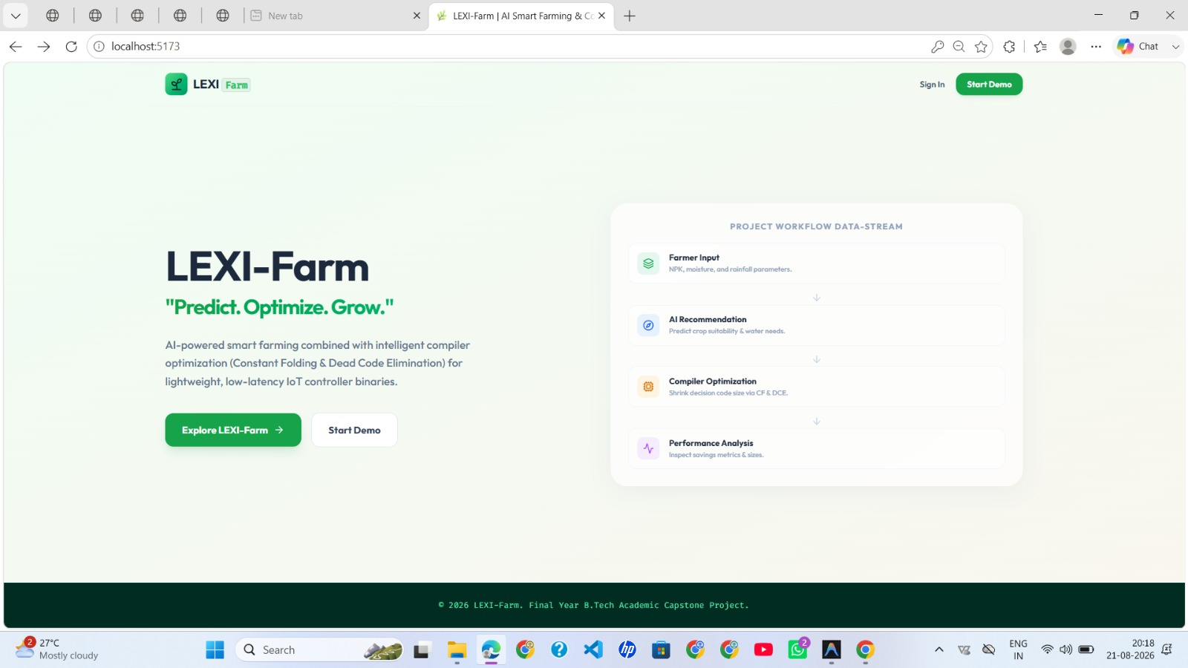
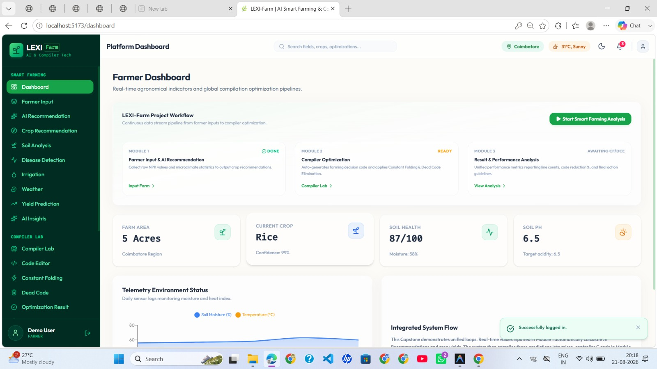

Slide 10
SIMATS ENGINEERING
SAVEETHA INSTITUTE OF MEDICAL AND TECHNICAL SCIENCES
CONCLUSION
LEXI-Farm – Integrated Outcome
LEXI-Farm integrates AI-based smart farming recommendations with compiler optimization.
Module 1 transforms farmer, soil and environmental data into an actionable farming recommendation.
Module 2 converts the recommendation into decision logic and optimizes it using Constant Folding and Dead Code Elimination.
Module 3 compares the original and optimized code and presents measurable performance results.
The architecture provides a clear connection between Artificial Intelligence, Smart Agriculture and Compiler Design.
The approach can be extended to IoT sensors, edge devices, real-time farm monitoring and additional compiler optimization techniques.
Predict → Optimize → Analyze → Improve
09

Slide 11
SIMATS ENGINEERING
SAVEETHA INSTITUTE OF MEDICAL AND TECHNICAL SCIENCES
THANK YOU

