Slide 1
Java Lab: Introduction
Madhu Amarnath
Assistant Professor
Department of CSE
SRM Institute of Science and Technology

Slide 2
Java Development Kit
To run Java applications and applets, you need JRE.
To develop Java applications and applets, you need the JDK.
JDK = Development tools + JRE
Development tools: Compiler, Debugger and other tools
Java Runtime Environment = JVM + Java Class Libraries
Java Virtual Machine (JVM)
Contains Class Loader, Runtime data areas, Interpreter, JIT Compiler etc.
Translates the byte code into executable machine code

Slide 3
Java Installation and Configuration
JDK Download Link: http://www.oracle.com/technetwork/java/javase/downloads/index.html
Download Long Term Support (LTS) Release
LTS Releases: JDK 21, JDK 17, JDK 11, JDK 8
Download any of the Compressed Zip Archive/Installer/MSI Installer
Preferably Installer
Setting Environment Variables
Set Path variable (Not Required in recent releases)
Set the Classpath variable (Not Required)

Slide 4
Java Versions
Java 9 and above does not support 32-bit Windows OS.
Windows OS/Processor Size | JDK | Eclipse
32-bit | Minimum JDK 8 Windows x86 | Eclipse IDE Java EE 2018-09 R Packages (Latest)
64-bit | Minimum JDK 11 Windows x64 Installer | Eclipse IDE Java EE 2022-09 R Packages (Latest)
64-bit | Minimum JDK 17 Windows x64 Installer | Eclipse IDE Java EE 2023-03 R Packages (Latest)
64-bit | Minimum JDK 21 Windows x64 Installer | Eclipse IDE Java EE 2024-06 R Packages (Latest)

Slide 5
Path Variable
Path is an environment variable specifying a set of directories where executable programs (with file extension of ".exe", ".bat" or ".com") are located.
Executable programs can be invoked from a command shell ("cmd.exe").

Slide 6
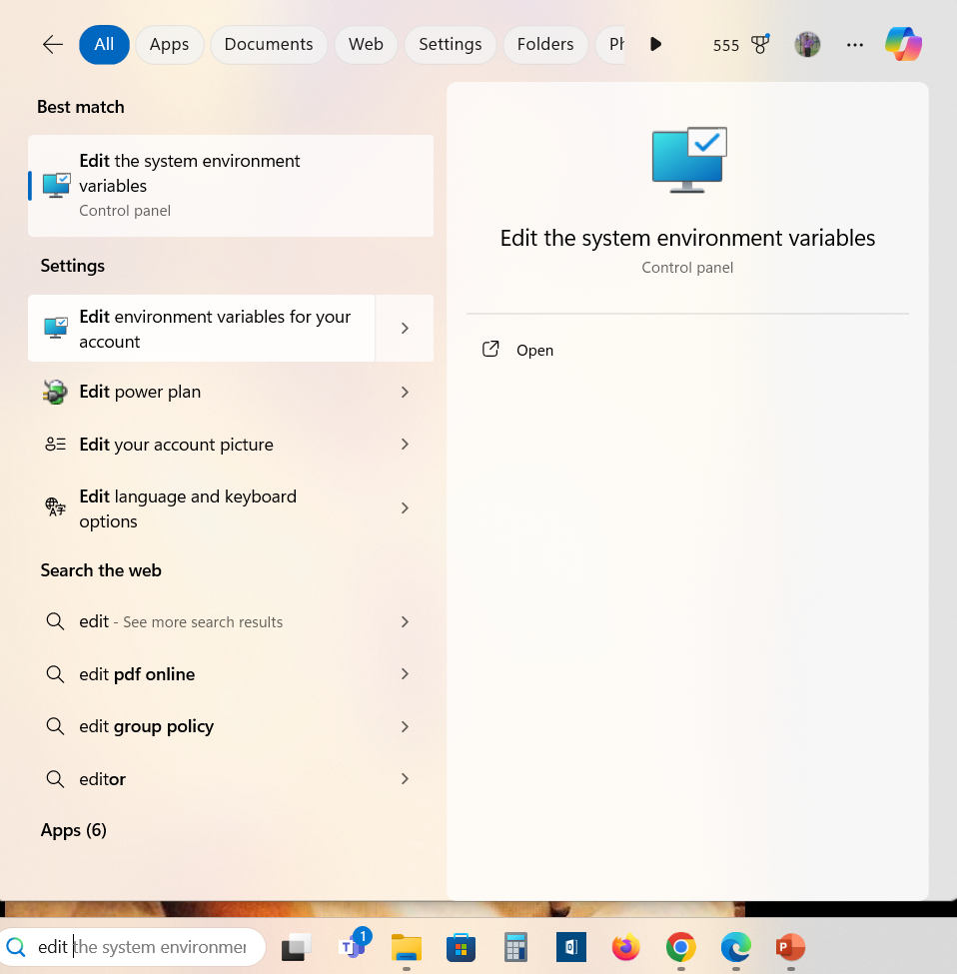
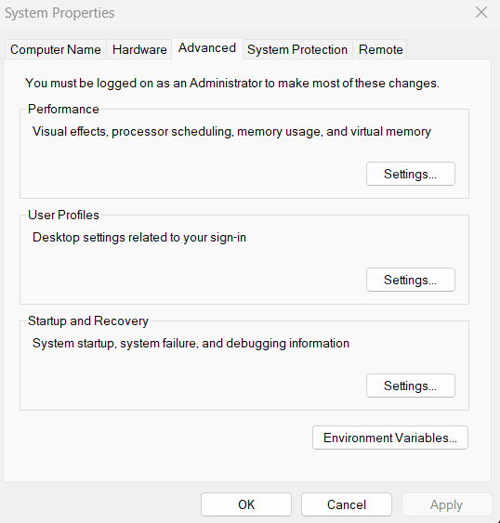


Setting Environment Variables

Slide 7
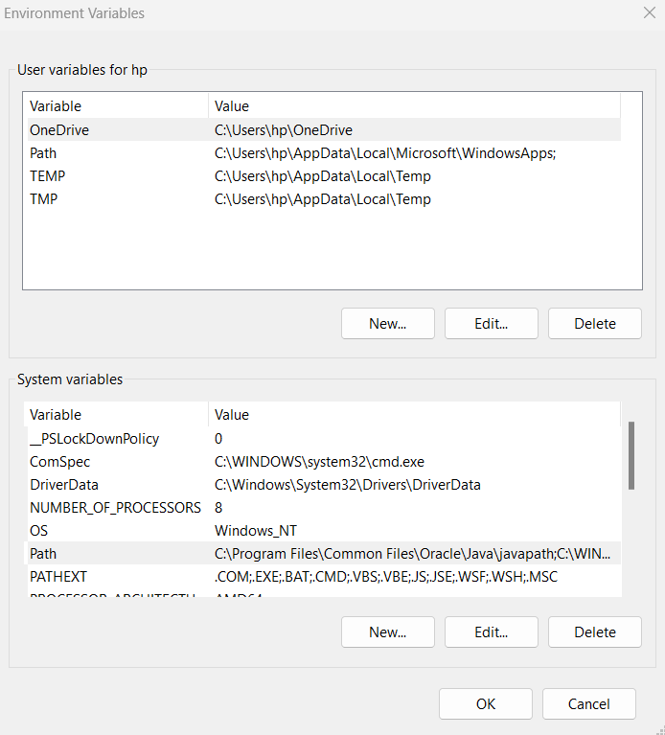
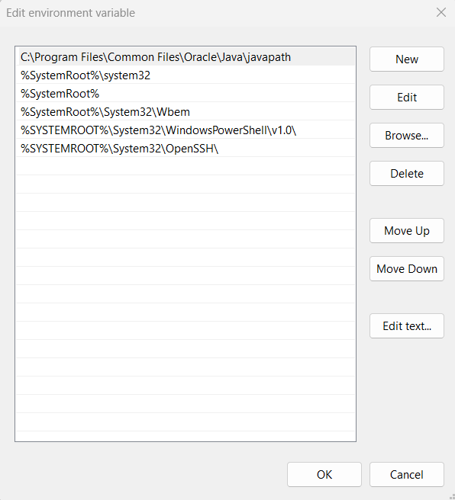

Setting Environment Variables

Slide 8
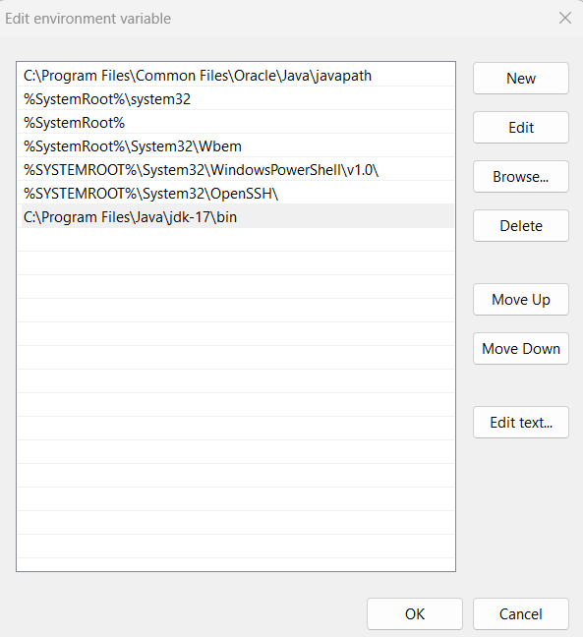

Setting Environment Variables
Click Edit to edit Path variable under System variables
Then click New to enter the location of the JDK bin directory
C:\Program Files\Java\jdk-17\bin

Slide 9
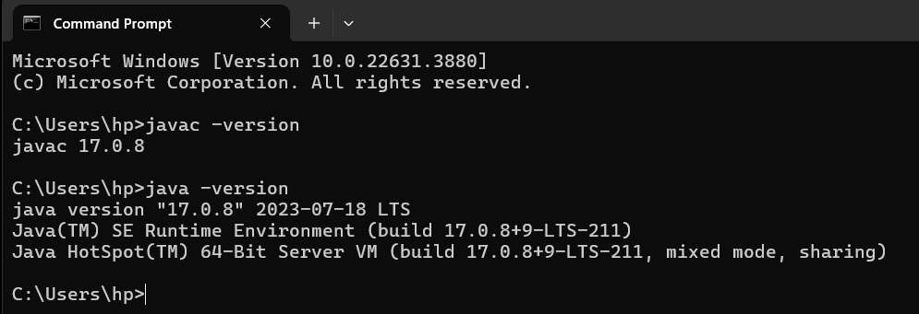
Checking JDK and JRE version

Slide 10
Java Compilation Flow Diagram

Slide 11
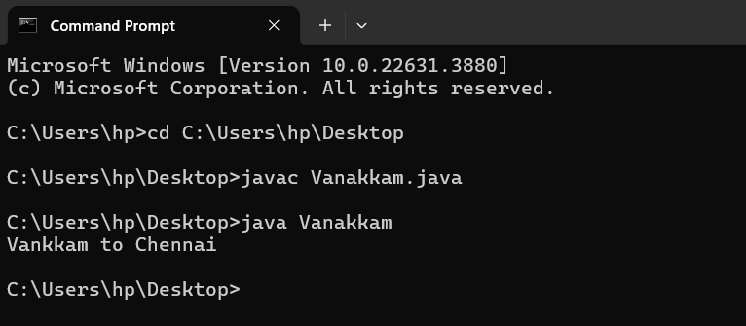
Compiling and Executing Java Desktop Application
Compiling
javac FileName.java
Execution
java MainClassName

Slide 12
Eclipse IDE Download
Download Eclipse IDE from:
https://www.eclipse.org/downloads/packages/
Eclipse Documentation:
https://help.eclipse.org/2024-06/index.jsp

Slide 13
MySQL
MySQL Community Downloads
Download Link: https://dev.mysql.com/downloads/installer/
Download the second link (Not the web-community)

Slide 14
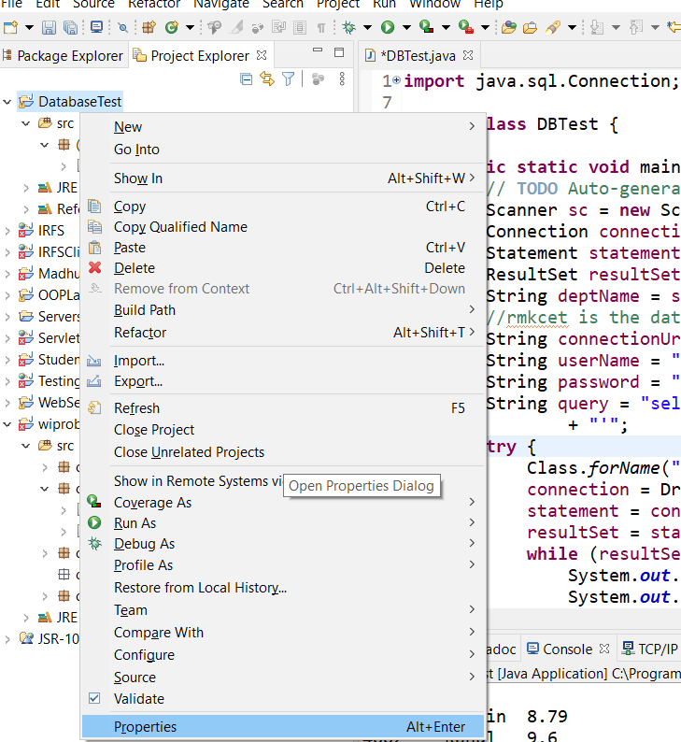
Adding JDBC JAR

Slide 15
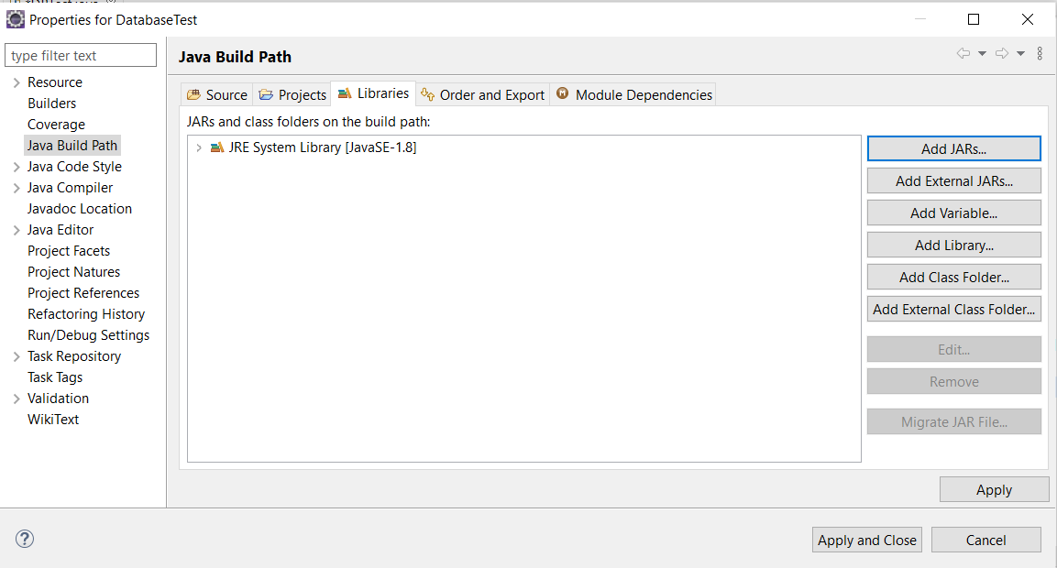
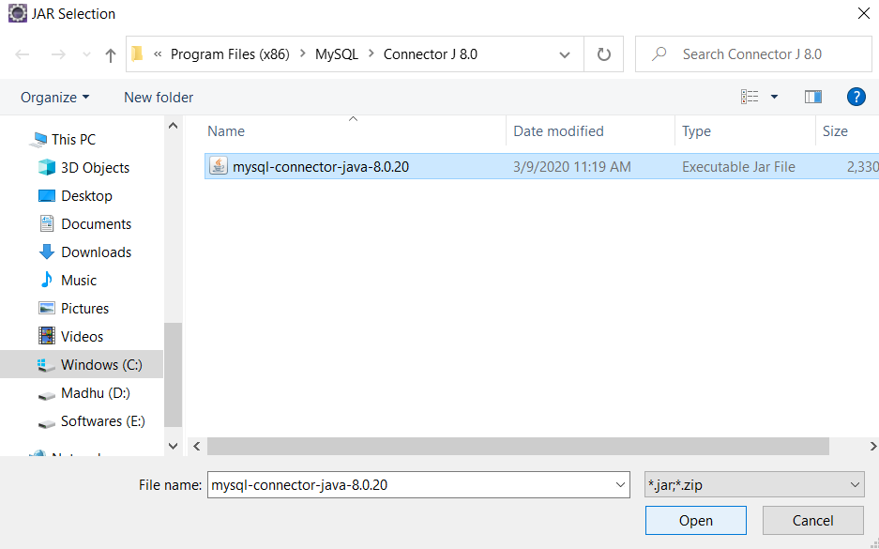
Adding JDBC JAR

Slide 16
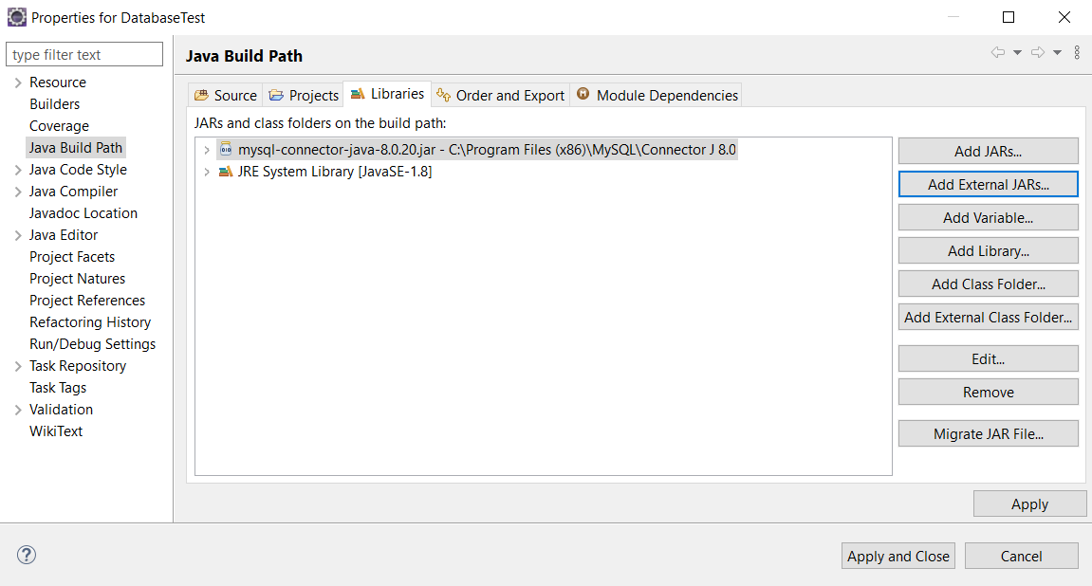
Adding JDBC JAR

