Slide 1
C# introduction (Anders Hejlsberg)

Slide 2
C# is pronounced as "C-Sharp". It is an object-oriented programming language provided by Microsoft that runs on .Net Framework and .NET core.
By the help of C# programming language, we can develop different types of secured and robust applications:
Window applications
Web applications
Distributed applications
Web service applications
Database applications etc.
C# programming language is influenced by C++, Java, Eiffel, Modula-3, Pascal etc. languages.

Slide 3
Difference between java and c#
Java | C#
Java programming language is designed to be run on a Java platform, by the help of Java Runtime Environment (JRE). | C# programming language is designed to be run on the Common Language Runtime (CLR).
In java, built-in data types that are passed by value are called primitive types. | In C#, built-in data types that are passed by value are called simple types.
Arrays in Java are direct specialization of Object. | Arrays in C# are specialization of System.
Java doesn't support goto statement. | C# supports goto statement.
Java doesn't support structures | C# supports structures

Slide 4
Features of C#
Simple
Modern
Object Oriented
Type Safe
Structured Programming language
Fast Speed

Slide 5
Simple
Pointers are missing in c# (pointer types are not tracked by the default garbage collection)
Integer values of 0 and 1 are no longer accepted as boolean values.Boolean values are pure true or false values in C# so no more errors of "="operator and "=="operator.
It will easy to learn
Easy to develop

Slide 6
Modern
C# is not a developed language it is developing language
Each and every updation the C# community add the new features that they are very trending in the present situation
The confusion concepts that will be discarded or manage in a meaningful manner

Slide 7
Object Oriented
C# is an object-oriented programming language, thereby providing re-usability of existing code and reducing code redundancy
It supports major object-oriented programming features such as, inheritance, polymorphism, classes, objects, generics etc.
(int,float, double) are not objects in java but C# has introduces structures(structs) which enable the primitive types to become objects.

Slide 8
Type Safe
One can not use an uninitialized variable.
It enforces overflow checking in arithmetic operations.
Dynamically allocated objects and arrays are initialized to zero.
It supports automatic garbage collection.
In C# we cannot perform unsafe casts like convert double to a boolean.

Slide 9
Structured Programming Language:
In c# we can break our project into sub parts called as methods
It is very easy to maintain and update
If one module is not working it will effect the entire project

Slide 10
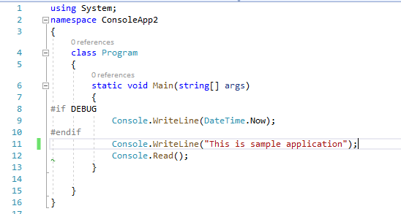
C# Example: Using namespace

Slide 11
Program: is the class name. A class is a blueprint or template from which objects are created. It can have data members and methods. Here, it has only Main method.
static: is a keyword which means object is not required to access static members. So it saves memory.
void: is the return type of the method. It does't return any value. In such case, return statement is not required.
Main: is the method name. It is the entry point for any C# program. Whenever we run the C# program, Main() method is invoked first before any other method. It represents start up of the program.
string[] args: is used for command line arguments in C#. While running the C# program, we can pass values. These values are known as arguments which we can use in the program.
System.Console.WriteLine("Hello World!"): Here, System is the namespace. Console is the class defined in System namespace. The WriteLine() is the static method of Console class which is used to write the text on the console.

Slide 12
C# Variable
A variable is a name of memory location. It is used to store data. Its value can be changed and it can be reused many times.
It is a way to represent memory location through symbol so that it can be easily identified.
Rules for defining variables
A variable can have alphabets, digits and underscore.
A variable name can start with alphabet and underscore only. It can't start with digit.
No white space is allowed within variable name.
A variable name must not be any reserved word or keyword e.g. char, float etc.

Slide 13
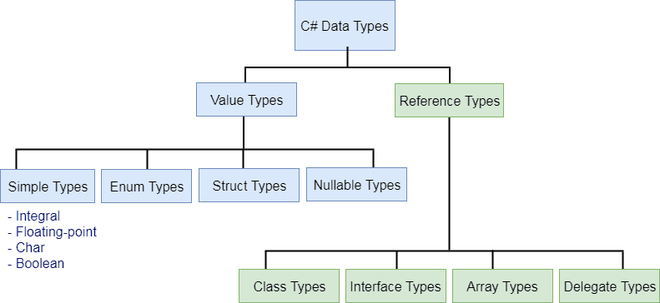
C# - Data Types

Slide 14
Type | Description | Range | Suffix
byte | 8-bit unsigned integer | 0 to 255
sbyte | 8-bit signed integer | -128 to 127
short | 16-bit signed integer | -32,768 to 32,767
ushort | 16-bit unsigned integer | 0 to 65,535
int | 32-bit signed integer | -2,147,483,648 to 2,147,483,647
uint | 32-bit unsigned integer | 0 to 4,294,967,295 | u
long | 64-bit signed integer | -9,223,372,036,854,775,808 to 9,223,372,036,854,775,807 | l
ulong | 64-bit unsigned integer | 0 to 18,446,744,073,709,551,615 | ul
float | 32-bit Single-precision floating point type | -3.402823e38 to 3.402823e38 | f
double | 64-bit double-precision floating point type | -1.79769313486232e308 to 1.79769313486232e308 | d
decimal | 128-bit decimal type for financial and monetary calculations | (+ or -)1.0 x 10e-28 to 7.9 x 10e28 | m
char | 16-bit single Unicode character | Any valid character, e.g. a,*, \x0058 (hex), or\u0058 (Unicode)
bool | 8-bit logical true/false value | True or False
object | Base type of all other types.
string | A sequence of Unicode characters
DateTime | Represents date and time | 0:00:00am 1/1/01 to 11:59:59pm 12/31/9999

Slide 15
Alias vs .NET Type
The predefined data types are alias to their .NET type (CLR class) name. The following table lists alias for predefined data types and related .NET class name.
Alias | .NET Type | Type
byte | System.Byte | struct
sbyte | System.SByte | struct
int | System.Int32 | struct
uint | System.UInt32 | struct
short | System.Int16 | struct
ushort | System.UInt16 | struct
long | System.Int64 | struct
ulong | System.UInt64 | struct
float | System.Single | struct
double | System.Double | struct
char | System.Char | struct
bool | System.Boolean | struct
object | System.Object | Class
string | System.String | Class
decimal | System.Decimal | struct
DateTime | System.DateTime | struct

Slide 16
String Formatters

Slide 17
Data and Time
CHARACTER | DESCRIPTION | USAGE | EXAMPLE
d | Short Date | {0:d} | 19-03-2021
D | Long Date | {0:D} | 19 March 2021
t | Short Time | {0:t} | 06:49:20
T | Long Time | {0:T} | 06:49:20
f or F | Long Date Time | {0:f} | 19 March 2021 06:49:00
g or G | Short Date Time | {0:g} | 19-03-2021 06:49:44
M | Short Date | {0:M} | March 19
r | RFC1123 Date Time String | {0:r} | Thu, 19 March 2021 06:49:22 GMT
s | Sortable Date/Time | {0:s} | 2021-03-19T06:49:11
u | Universal Sortable Date | {0:u} | 2021-03-19 06:49:49Z
U | Universal full date | {0:U} | 19 March 2021 00:18:55
Y | Year month pattern | {0:Y} | March, 2021

Slide 18
Short date:
C.W("{1:d}",datetime,data); //output : 5/12/2021
Long date:
C.W("{0:D}",datetime); //output : Wednesday, May 12, 2021
Short Time:
C.W("{0:t}",datetime); //output : 6:15 AM
Long time:
C.W(“{0:T}”,datetime); //output : 6:15:24 AM
Long Date Time:
C.W(“{0:f (or) F}”,datetime); //output :Wednesday, May 12, 2021 6:20 AM
Short Date Time:
C.W(“{0:g (or) G}”,datetime); //output : 5/12/2021 6:22 AM
Universal Date and Time:
C.W(“{0:U}”,datetime); //output :Wednesday, May 12, 2021 6:20 AM
Year Month pattern:
C.W(“{0:Y}”,datetime); //output : May 2021

Slide 19
Character | Description | Usage | Example
c | Currency | {0:c} | $ 75,674.74
e | Scientific | {0:e} | 7.567474e+004
f | Fixed Point | {0:f} | 75674.74
g | General | {0:g} | 75674.73789621
n | Thousand Separator | {0:n} | 75,674.74

Slide 20
Operators
An operator is a symbol that tells the compiler to perform specific mathematical or logical manipulations.
Arithmetic Operators
Relational Operators
Logical Operators
Bitwise Operators
Assignment Operators
Misc Operators

Slide 21
Arithmetic Operators
Assume variable A holds 10 and variable B holds 20 then
Operator | Description | Example
+ | Adds two operands | A + B = 30
- | Subtracts second operand from the first | A - B = -10
* | Multiplies both operands | A * B = 200
/ | Divides numerator by de-numerator | B / A = 2
% | Modulus Operator and remainder of after an integer division | B % A = 0
++ | Increment operator increases integer value by one | A++ = 11
-- | Decrement operator decreases integer value by one | A-- = 9

Slide 22
Relational Operators
This operators compares the relationship between the two operands
Operator | Description | Example
== | Checks if the values of two operands are equal or not, if yes then condition becomes true. | (A == B) is not true.
!= | Checks if the values of two operands are equal or not, if values are not equal then condition becomes true. | (A != B) is true.
> | Checks if the value of left operand is greater than the value of right operand, if yes then condition becomes true. | (A > B) is not true.
< | Checks if the value of left operand is less than the value of right operand, if yes then condition becomes true. | (A < B) is true.
>= | Checks if the value of left operand is greater than or equal to the value of right operand, if yes then condition becomes true. | (A >= B) is not true.
<= | Checks if the value of left operand is less than or equal to the value of right operand, if yes then condition becomes true. | (A <= B) is true.

Slide 23
Logical Operators
Logical operators will works on between the two conditions
Operator | Description | Example
&& | Called Logical AND operator. If both the operands are non zero then condition becomes true. | (A && B) is false.
|| | Called Logical OR Operator. If any of the two operands is non zero then condition becomes true. | (A || B) is true.
! | Called Logical NOT Operator. Use to reverses the logical state of its operand. If a condition is true then Logical NOT operator will make false. | !(A && B) is true.

Slide 24
Bitwise Operators
Bitwise operator works on bits and perform bit by bit operation
p | q | p & q | p | q | p ^ q
0 | 0 | 0 | 0 | 0
0 | 1 | 0 | 1 | 1
1 | 1 | 1 | 1 | 0
1 | 0 | 0 | 1 | 1

Slide 25
Operator | Description | Example
& | Binary AND Operator copies a bit to the result if it exists in both operands. | (A & B) = 12, which is 0000 1100
| | Binary OR Operator copies a bit if it exists in either operand. | (A | B) = 61, which is 0011 1101
^ | Binary XOR Operator copies the bit if it is set in one operand but not both. | (A ^ B) = 49, which is 0011 0001
~ | Binary Ones Complement Operator is unary and has the effect of 'flipping' bits. | (~A ) = -61, which is 1100 0011 in 2's complement due to a signed binary number.
<< | Binary Left Shift Operator. The left operands value is moved left by the number of bits specified by the right operand. | A << 2 = 240, which is 1111 0000
>> | Binary Right Shift Operator. The left operands value is moved right by the number of bits specified by the right operand. | A >> 2 = 15, which is 0000 1111

Slide 26
Assignment Operators
Operator | Description | Example
= | Simple assignment operator, Assigns values from right side operands to left side operand | C = A + B assigns value of A + B into C
+= | Add AND assignment operator, It adds right operand to the left operand and assign the result to left operand | C += A is equivalent to C = C + A
-= | Subtract AND assignment operator, It subtracts right operand from the left operand and assign the result to left operand | C -= A is equivalent to C = C - A
*= | Multiply AND assignment operator, It multiplies right operand with the left operand and assign the result to left operand | C *= A is equivalent to C = C * A
/= | Divide AND assignment operator, It divides left operand with the right operand and assign the result to left operand | C /= A is equivalent to C = C / A
%= | Modulus AND assignment operator, It takes modulus using two operands and assign the result to left operand | C %= A is equivalent to C = C % A
<<= | Left shift AND assignment operator | C <<= 2 is same as C = C << 2
>>= | Right shift AND assignment operator | C >>= 2 is same as C = C >> 2
&= | Bitwise AND assignment operator | C &= 2 is same as C = C & 2
^= | bitwise exclusive OR and assignment operator | C ^= 2 is same as C = C ^ 2
|= | bitwise inclusive OR and assignment operator | C |= 2 is same as C = C | 2

Slide 27
Miscellaneous Operators
Operator | Description | Example
sizeof() | Returns the size of a data type. | sizeof(int), returns 4.
typeof() | Returns the type of a class. | typeof(StreamReader);
& | Returns the address of an variable. | &a; returns actual address of the variable.
* | Pointer to a variable. | *a; creates pointer named 'a' to a variable.
? : | Conditional Expression | If Condition is true ? Then value X : Otherwise value Y
is | Determines whether an object is of a certain type. | If( Ford is Car) // checks if Ford is an object of the Car class.
as | Cast without raising an exception if the cast fails. | Object obj = new StringReader("Hello");StringReader r = obj as StringReader;

Slide 28
Operator Precedence in C#
The higher the precedence of operator is, the higher it appears in the table

Slide 29
Category | Operators | Associativity
Postfix Increment and Decrement | ++, -- | Left to Right
Prefix Increment, Decrement and Unary | ++, --, +, -, !, ~ | Right to Left
Multiplicative | *, /, % | Left to Right
Additive | +, - | Left to Right
Shift | <<, >> | Left to Right
Relational | <, <=, >, >= | Left to Right
Equality | ==, != | Left to Right
Bitwise AND | & | Left to Right
Bitwise XOR | ^ | Left to Right
Bitwise OR | | | Left to Right
Logical AND | && | Left to Right
Logical OR | || | Left to Right
Ternary | ? : | Right to Left
Assignment | =, +=, -=, *=, /=, %=, &=, |=, ^=, <<=, >>= | Right to Left

Slide 30
Branching Control Statements
If
If-else
Nested if
If- elseif
switch

Slide 31
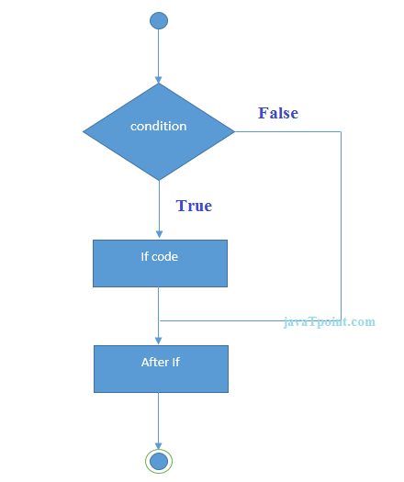

Slide 32
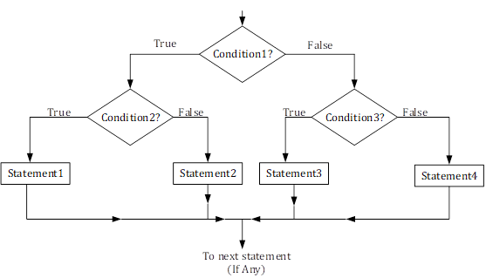

Slide 33
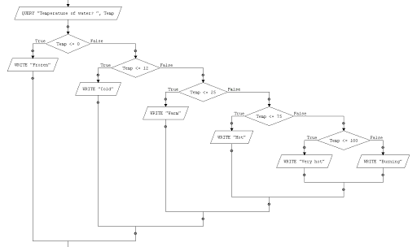

Slide 34
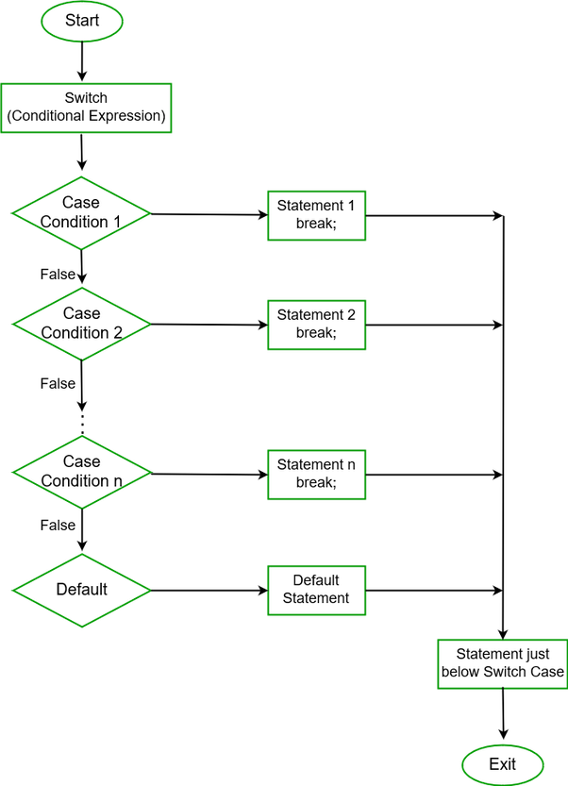

Slide 35
Methods
Methods with return type
Methods without return type
Methods without return type and with arguments
Methods with return type and with arguments
Syn: [Access Modifier] [return Type] [Name](arguments…)
{
}

Slide 36
Arrays
It is a collection of similar data types
In this we can store the number of elements
Array index starts with the 0
Arrays can be represented by []
Syn : datatype[] name = new datatype[]{….};
For multidimentional array
Datatype[,] name = new datatype[1,3];

Slide 37
Arrays can be
Single dimentional Array
2D Array
3D Array
Jagged Array (different column elements for each row)

Slide 38
List
Like as arrays it can store the continuous elements but we need not worry about the size of the list
Syn : List<Type> name = new List<Type>();
There are set of methods that can be provided by the List class

Slide 39
Dictionary
In Dictionary each value have the keys
The duplication of the keys will not be supported
We can access the values by using keys
Syn : Dictionary<KayType,ValueType> name = new Dictionary<>();

Slide 40
Structures
structure is a user defined type
In structure can consists of structure members and member functions and constructures.
Structure is a value type
It can do same tasks as class do
All the value types are constructed under the structures

Slide 41
Syn :
Public struct Demo
{
variables;
methods()
{
}
}
//Initilization of structure
Demo d;
Or
Demo d = new Demo();

Slide 42
Object Oriented Programming

Slide 43
Access Modifiers
In c#, Access Modifiers are the keywords used to define an accessibility level for all types and type members.
The following are the different types of access modifiers available in the c# programming language.
Public
Private
Protected
Internal

Slide 44
Public Access Modifier
In c#, the public modifier is used to specify that access is not restricted, so the defined type or member can be accessed by any other code in the current assembly or another assembly that references it.

Slide 45
Private Access Modifier
The private data members and member functions that only accessible with in the class
Every method and members in the class and structures are private

Slide 46
Protected Access Modifier
The protected access modifier will give only permissions to the its derived class
It only accessible on with in class and its derived class

Slide 47
Internal Access Modifier
The accessibility of members are within the project or namespace
By default all the classes are internal
We can not internal methods on other project

Slide 48
Protected Internal Access Modifier
In this if any one is satisfied it will give the access
For example if a method is declared as protected internal then that class is inherited outside of the project
It checks protected is accessible and internal is not accessible
In the both it satisfies protected then it will gives the permision

Slide 49
Encapsulation

Slide 50
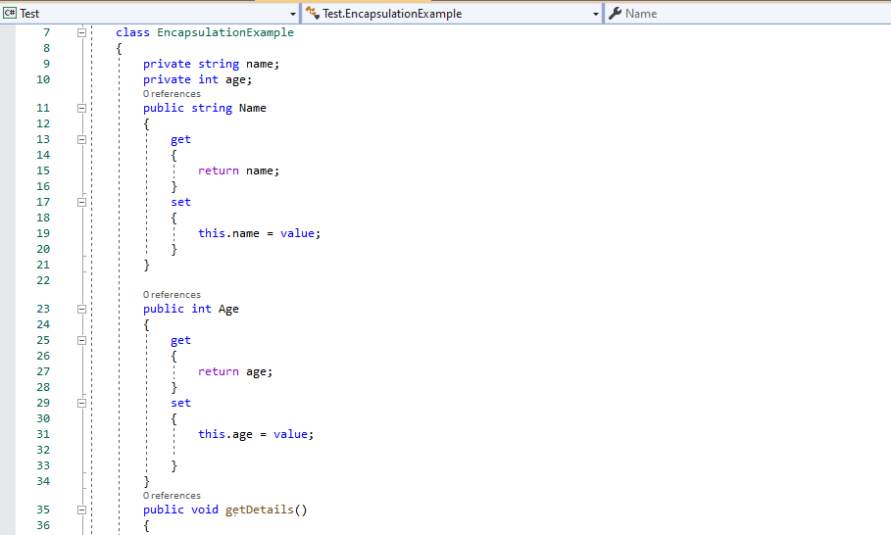
In c#, Encapsulation is a process of binding the data members and member functions into a single unit. In c#, the class is the real-time example for encapsulation because it will combine various types of data members and member functions into a single unit.

Slide 51
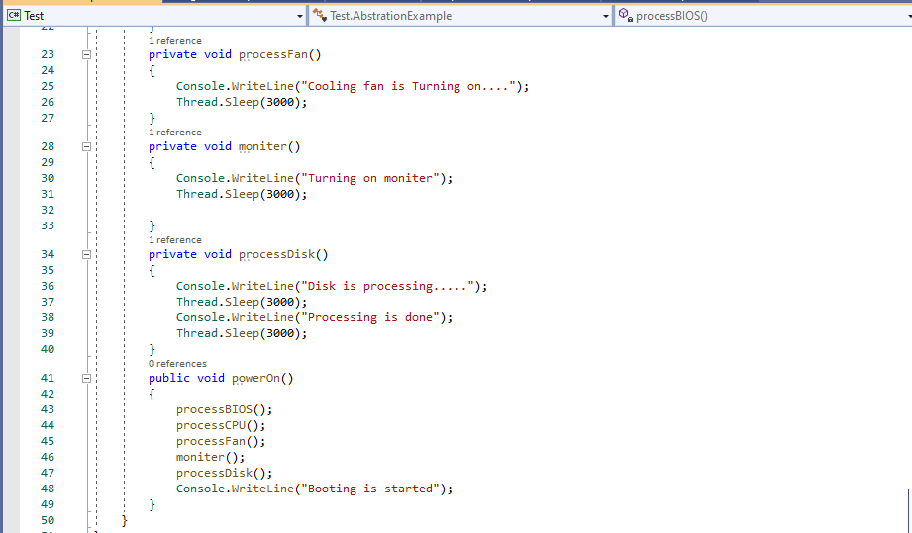
Abstraction
In c#, Abstraction is a principle of object-oriented programming language (OOP), and it is used to hide the implementation details and display only essential features of the object.

Slide 52
Inheritance
Acquiring the properties of another class by holding the properties of his class
There are four types of inheritance
Single inheritance
Multi level inheritance
Multiple inheritance
Hybrid inheritance

Slide 53
Polymorphism
In c#, Polymorphism means providing an ability to take more than one form, and it’s one of the main pillar concepts of object-oriented programming after encapsulation and inheritance.

Slide 54
Class and objects

Slide 55
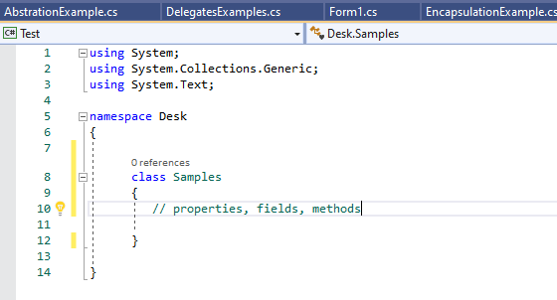
Class
Class is a user defined type
Class is a collection of different data types and methods
Creating a class

Slide 56
Creating an object of class A
Syn : A obj = new A();
(or)
if a class contains the method say then we can call it with anonymous object
Syn : new A().say();

Slide 57
Constructor
Constructor is special member function in a class
It will automatically invoked when we create the instance of the class
The main aim of constructor is to assign the class members to its default values
Constructor doesn’t return anything
There are Three types of constructors
Default
Copy
Parameter

Slide 58
NameSpace
Namespace is a container which can consists of set of classes, structures, interfaces and methods
We can use the namespace within the other project by using the keyword “using”

Slide 59
Interfaces
In the interface we need not to define a method
We can only declare the method
By default all the methods are declared in the interface are public abstract
We can not instantiate the interfaces
Interfaces can be implemented by both structures and classes

Slide 60
Why interfaces
Imagine we have two classes A and B
Class A and Class B have Common variable that is X=20
These two classes are extended by class C
If I want call a variable X from c the Conflict will occur that is Which X variable I call
This is called multiple inheritance
C# does not support the multiple inheritance
To overcome this we use interfaces

Slide 61
Inheritance
Acquiring the properties of another class by having his propery
Types of inheritance
Single inheritance
Multi level inheritance
Multiple inheritance
Hierarchical inheritance
Hybrid inheritance

Slide 62
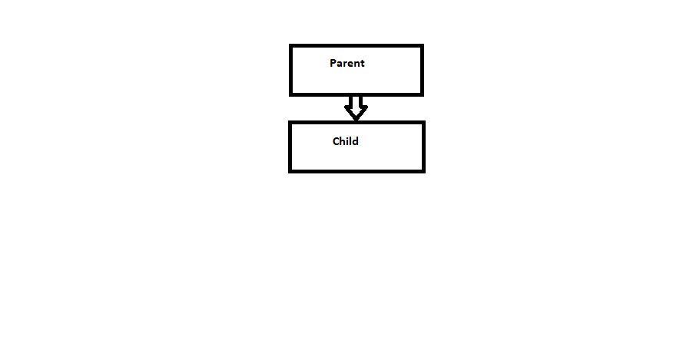
Single inheritance

Slide 63
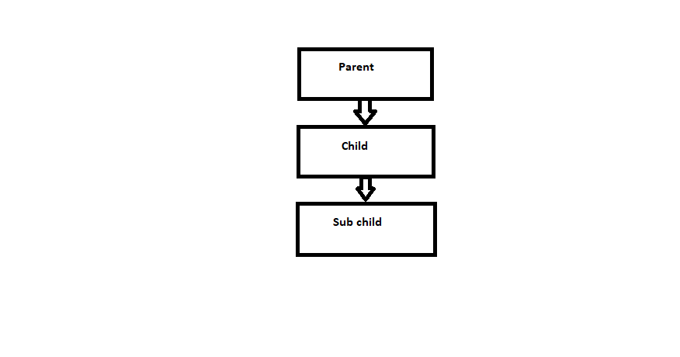
Multi Level inheritance

Slide 64
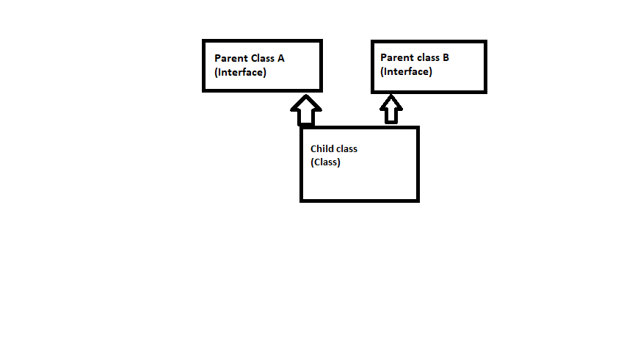
Multiple Inheritance
Note: multiple inheritance is not supported in c#
We can achieve it by using interfaces

Slide 65
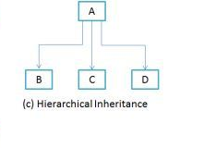
Hierarchical inheritance

Slide 66
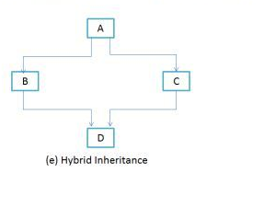
Hybrid inheritance
It is combination of both single and multiple inheritance

Slide 67
Method overloading
Same method name with the different parameters
It is comes under the early binding or static binding

Slide 68
Method Overriding
We can use the same method name with same parameters can be used
To achieve overriding concept we need to use virtual and override
Virual keyword is used to give the permission to the child class to over ride it
We can override the parent class method with the override keyword

Slide 69
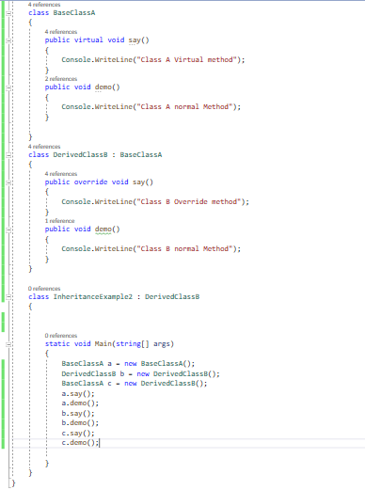
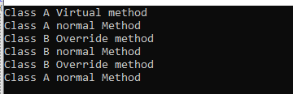

Slide 70
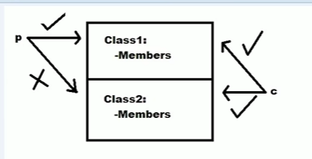
Rule 1: Class A will not have permission purely defined methods in the child class
Rule 2: Class A will Know his override method

