Slide 1


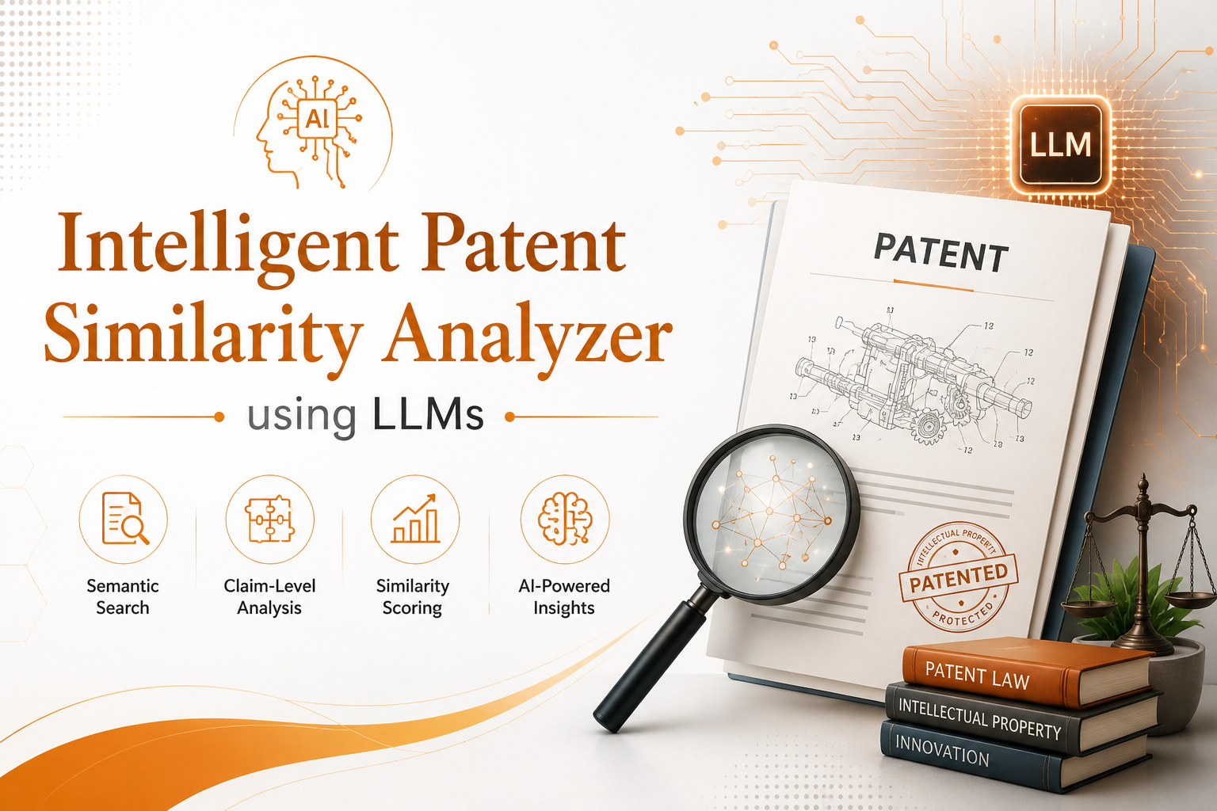
TEAM : 21
AMI1411
Project Phase I
DATE : 31 - Aug - 2026
TEAM MEMBERS :
HARISH M (927623BAM021)
MADHUARAVIND P (927623BAM032)
MOUNEESH R (927623BAM035)
Guided By:
Mrs.R.Elankeerthana
ASSISTANT PROFESSOR

Slide 2
PROBLEM DEFINITION & MOTIVATION
Patent searching is time-consuming and complex, especially when analyzing large patent collections.
Traditional keyword-based search may fail when different terminology is used to describe similar inventions.
Existing similarity systems often provide a similarity score without explaining which technical features or claim elements are similar.
Manually comparing patent claims, prior-art documents, and technical differences requires significant expert effort.
There is a need for an AI-assisted, explainable approach that can understand the semantic meaning of patent claims.

Slide 3
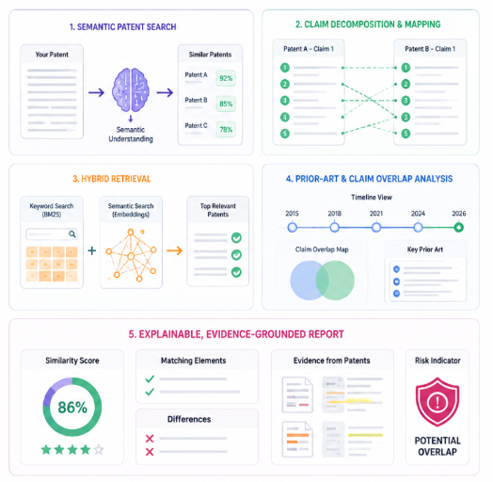
OBJECTIVE
Identify semantically similar patents by understanding the technical meaning beyond keyword matching.
Decompose patent claims into technical elements and map corresponding elements across similar patents.
Combine semantic embeddings with keyword-based retrieval to improve the accuracy and relevance of patent search.
Analyze prior-art relationships and potential claim overlaps using AI-assisted comparison and chronological evidence.
Generate explainable, evidence-grounded reports highlighting similarities, differences, supporting evidence, and potential intellectual-property risks.

Slide 4
LITERATURE SURVEY
No. | Paper Title & Year | Authors | Merits | Demerits | Innovation in Proposed System
1 | A Semantic Query Expansion-Based Patent Retrieval Approach (2013) | Feng Wang, Lanfen Lin, Shuai Yang, Xiaowei Zhu. | Improves patent retrieval using domain-specific semantic query expansion. | Mainly focuses on query expansion; does not provide detailed claim-level comparison. | Semantic retrieval + terminology understanding to identify patents beyond exact keyword matches.
2 | Comparison and Analysis of Embedding Methods for Patent Documents (2021) | Arousha Haghighian Roudsari, Jafar Afshar, Suan Lee, Wookey Lee | Evaluates different embedding techniques. | Evaluation focuses mainly on representation/classification; does not provide an integrated patent comparison system. | Patent-specific semantic embeddings + similarity retrieval for finding technically related patents.
3 | Patent Citation Network Simplification and Similarity Evaluation Based on Technological Inheritance (2023) | Zhipeng Qiu, Zheng Wang | Combines patent claims, TF-IDF vectors and citation relationships to evaluate technological similarity and inheritance. | Relies mainly on traditional vector representation and citation networks; limited semantic/LLM-based explanation. | Claim similarity + citation/relationship analysis + prior-art timeline in one workflow.

Slide 5
LITERATURE SURVEY
No. | Paper Title & Year | Authors | Merits | Demerits | Innovation in Proposed System
4 | Augmented Intelligence for State-of-the-Art Patent Search (2022) | Ana Hafner, Nadja Damij, Dolores Modic | Demonstrates the potential of AI and semantic search for improving patent prior-art searching compared with Boolean keyword search. | Focuses on supporting search rather than detailed claim-element mapping and evidence-grounded reasoning. | Hybrid keyword + semantic retrieval followed by claim-level analysis.
5 | Artificial Intelligence Reducing the Intricacies of Patent Prior Art Search (2023) | Poonam Rawat, Kapil Joshi, Kanishka Vaish, Rajesh Singh, Samta Kathuria, Aditya Verma | Shows how AI can assist keyword suggestion, document retrieval, ranking and visualization to reduce manual prior-art search effort. | Discusses AI-assisted prior-art search but does not provide a complete claim-mapping and explainable LLM platform. | Automated prior-art analysis + evidence-based LLM explanation for faster patent review.

Slide 6
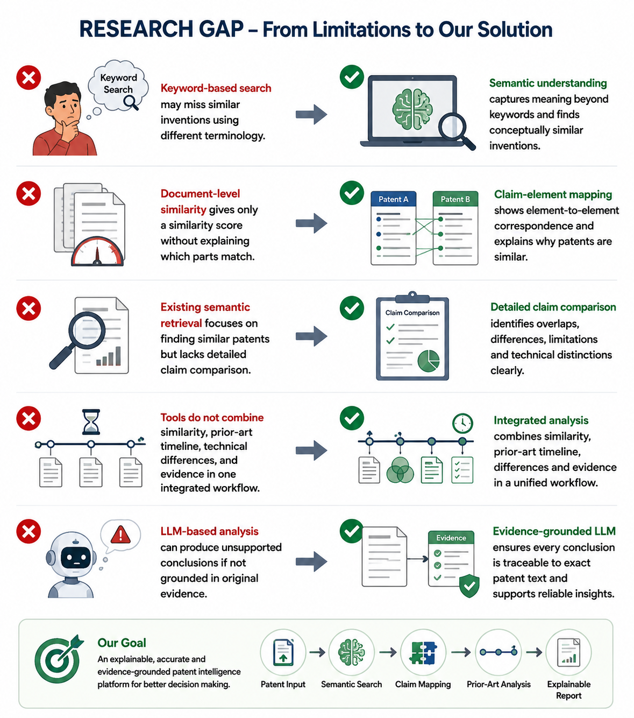
RESEARCH GAP
Keyword-based patent search may miss semantically similar inventions described using different technical terminology.
Document-level similarity models often provide a similarity score without showing which claim elements actually overlap.
Existing semantic retrieval approaches generally focus on finding similar patents, but provide limited support for detailed claim-to-claim comparison.
Patent analysis tools do not always combine similarity, prior-art chronology, technical differences, and supporting evidence in one workflow.
LLM-based analysis can produce unsupported conclusions if the generated explanation is not grounded in the original patent evidence.

Slide 7
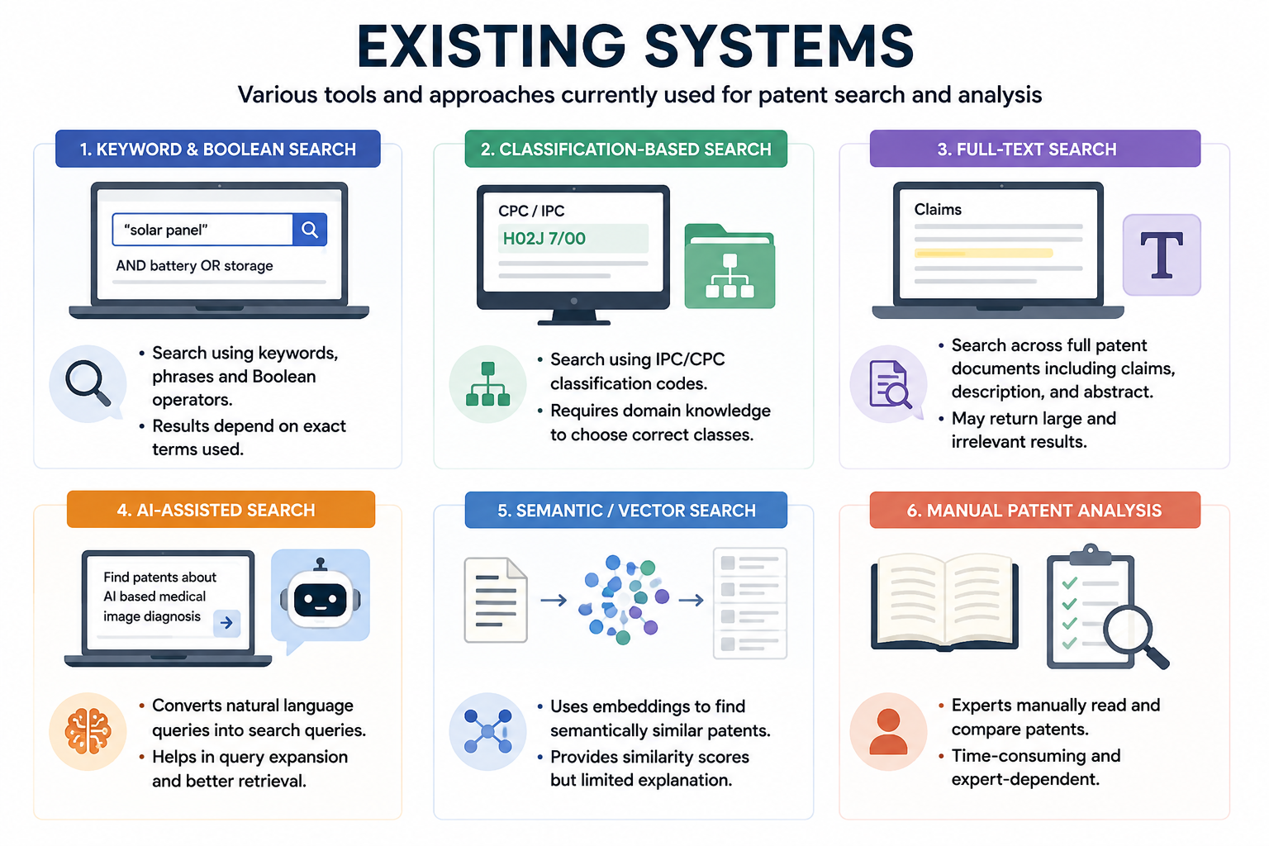
EXISTING SYSTEM
Semantic equivalents can still be difficult to identify comprehensively.
Similarity results may not clearly show which claim elements correspond.
Users must manually compare technical features and differences.
Search, prior-art timeline and claim analysis are not necessarily presented as one integrated workflow.
AI-generated explanations require evidence grounding to avoid unsupported conclusions.

Slide 8
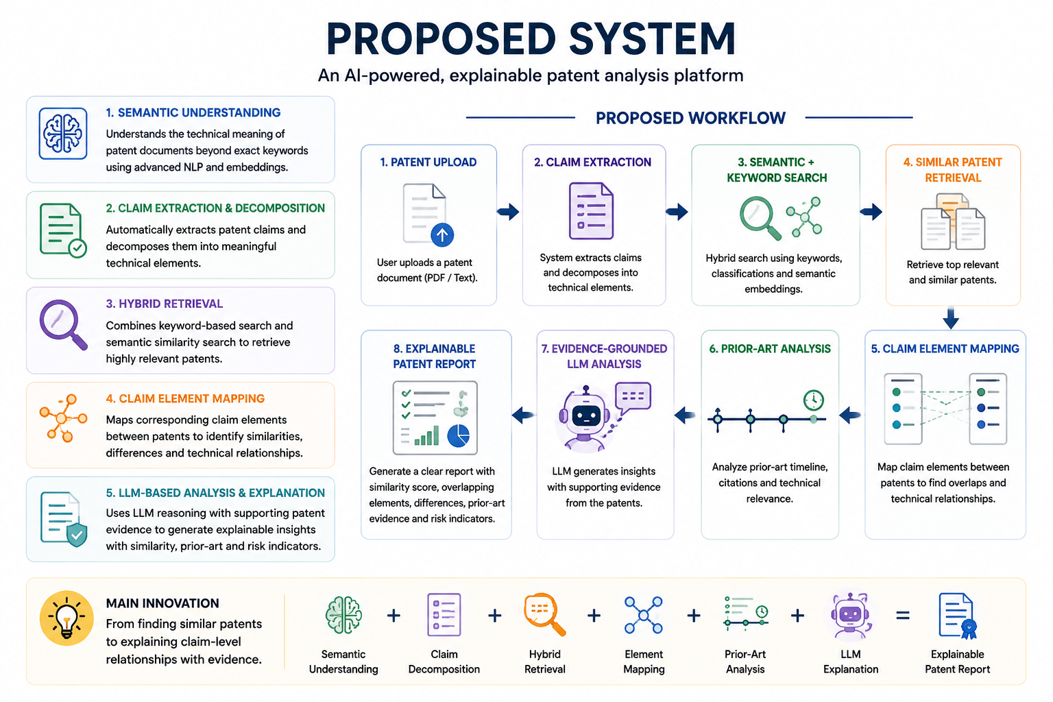
PROPOSED SYSTEM
AI-powered patent analysis platform that understands the semantic meaning of patent documents beyond exact keywords.
Automatically extracts and decomposes patent claims into meaningful technical elements for detailed comparison.
Uses hybrid retrieval by combining keyword-based search with semantic embeddings to identify highly relevant patents.
Maps corresponding claim elements between patents and identifies similarities, differences, and technical relationships.
Uses LLM-based reasoning with supporting patent evidence to generate an explainable analysis report containing similarity, prior-art evidence, and potential claim-overlap indicators.

Slide 9
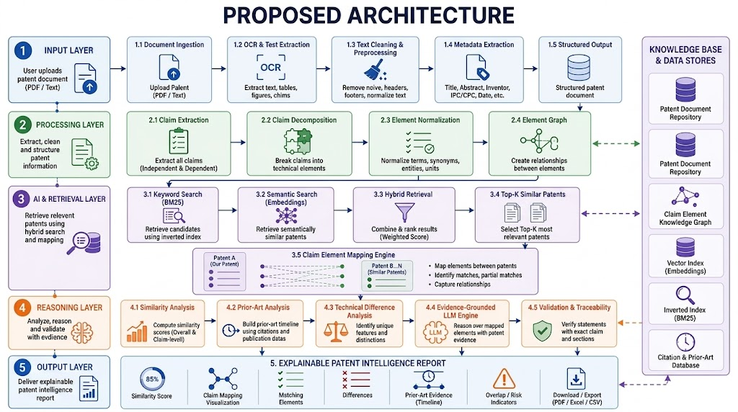
PROPOSED ARCHITECTURE

Slide 10

LIST OF MODULES
Patent Document Ingestion
Patent Preprocessing
Claim Extraction & Decomposition
Hybrid Patent Retrieval
LLM-Based Analysis & Reasoning
Similarity & Risk Analysis
Explainable Report Generation

Slide 11
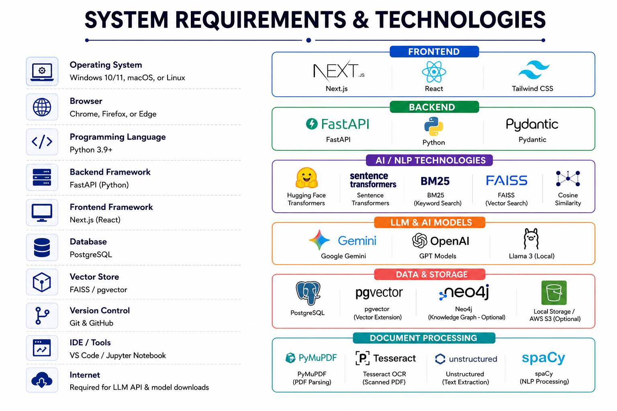
SYSTEM REQUIREMENTS & TECHNOLOGIES

Slide 12
INITIAL DESIGN & PROGRESS
Patent Upload Interface Upload patent documents in PDF/text format for analysis.
Patent Processing Pipeline Designed the workflow for text extraction, cleaning, metadata extraction and claim identification.
Claim Analysis Design Designed claim decomposition into individual technical elements.
Semantic Retrieval Design Planned hybrid retrieval using BM25 + semantic embeddings to identify relevant patents.
Explainable Analysis Dashboard Designed the output for claim mapping, similarity scores, prior-art evidence and technical differences.

Slide 13
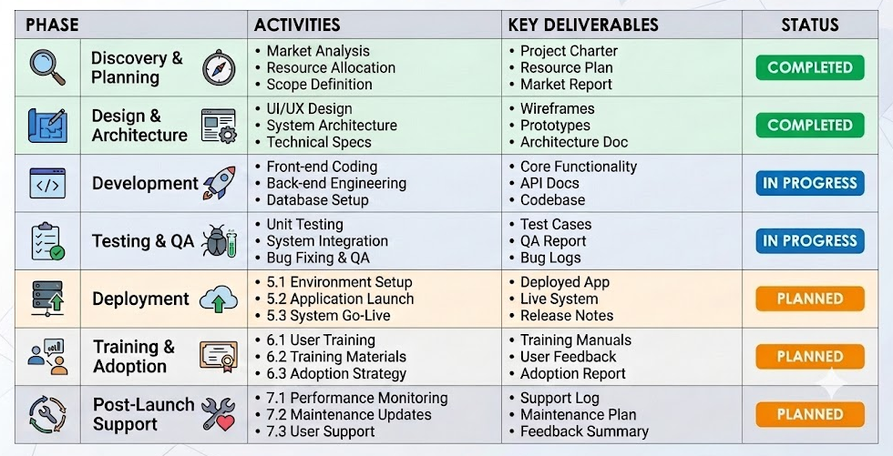
TIMELINE

Slide 14
EXPECTED OUTCOME
Semantic Patent Retrieval Identify patents with similar inventions even when different terminology is used.
Claim-Level Comparison Break claims into technical elements and identify corresponding elements between patents.
Prior-Art Intelligence Identify relevant earlier patents and present their relationships through a chronological timeline.
Explainable AI Analysis Provide clear explanations of similarities, differences, and potential claim overlaps rather than only a similarity score.
Automated Patent Intelligence Report Generate a structured report containing similarity scores, claim mapping, prior-art evidence, differences, and potential overlap indicators.

Slide 15
