Slide 1
Credit Card Default Prediction

Slide 2
Problem Statement
Financial threats are displaying a trend about the credit risk of commercial banks as the incredible improvement in the financial industry has arisen. In this way, one of the biggest threats faced by commercial banks is the risk prediction of credit clients. The goal is to predict the probability of credit default based on credit card owner's characteristics and payment history.

Slide 3
Tools Used
Pandas
Numpy
Seaborn
Matplotlib
Plotly
SKLearn

Slide 4
APPROACHES
Data Cleaning
Exploratory Data Analysis
Feature vs Target
Feature and Target Selection
Splitting the Dataset
ML Models
Best Model Selection
Feature Importance

Slide 5
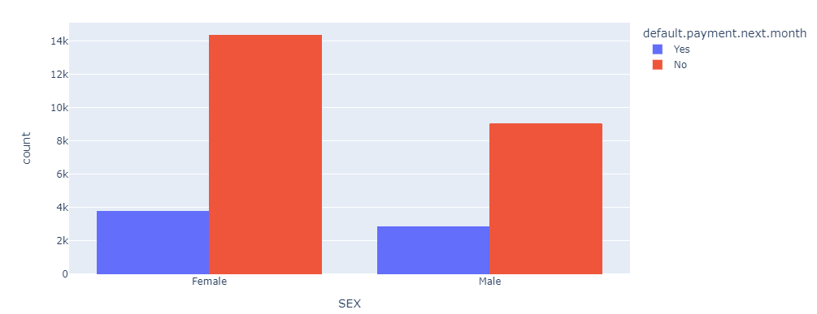
EDA Insights
From the below graph, it is evident that the Males are more expected to default compared to Females.

Slide 6
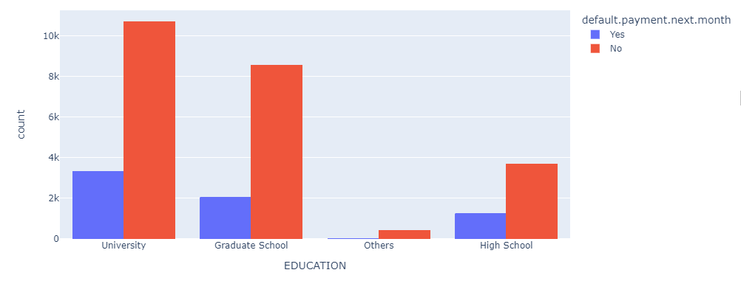
From the below graph it can be seen that the Highly Educated people also make default.

Slide 7
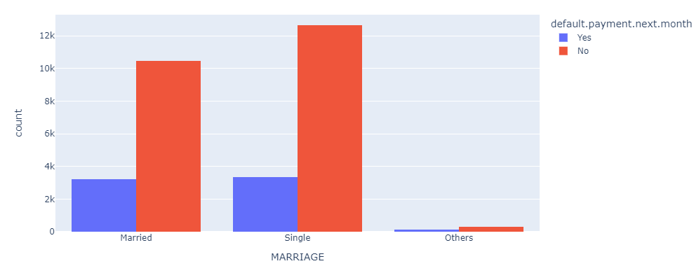
From the below graph, we can see that the married person are more likely to default next month.

Slide 8
Best ML Model
Since it is a Classification problem most of the classification algorithms like Logistic Regression, Decision Tree Classifier, Random Forest Classifier, Ada Boost, Gradient Boost and KNN have been used. Finally, based on the accuracy score Random Forest have been taken as the best model to predict the target.

Slide 9
Evaluation Metrics of the Model
The following evaluation metrics has been used
accuracy_score
classification_report
confusion_matrix
mean_squared_error

Slide 10
Feature Importance
Once the best model has been chosen as the Random Forest Classifier Feature importance has been executed to find out the best features which impact the Target the most and the features which does not provide much contribution has been removed.
Initially, there were 24 features and finally only 21 features were used to predict the Target.

