Slide 1
Employee Data Analysis using Excel
STUDENT NAME : MADHUBALA. S
REGISTER NO : 312211044 , asunm1423312211044
DEPARTMENT : III B.COM (Commerce)
COLLEGE : DR.MGR Janaki College of arts and
science for women.

Slide 2
PROJECT TITLE
Employee Performance Analysis using Excel

Slide 3


AGENDA
Problem Statement
Project Overview
End Users
Our Solution and Proposition
Dataset Description
Modelling Approach
Results and Discussion
Conclusion
3/21/2024 Annual Review

Slide 4

PROBLEM STATEMENT
Performance analysis is essential for improving efficiency and ensuring optimal outcomes in any system, process, or individual task. It enables the identification of bottlenecks and inefficiencies, allowing for targeted improvements and better resource utilization. By analyzing performance data, decision-makers gain valuable insights to make informed choices and refine strategies.

Slide 5

PROJECT OVERVIEW
This project aims to analyze employee performance using Excel as a tool for efficient data management and visualization. The key objectives are to evaluate individual and team performance metrics, identify trends, and generate actionable insights. Excel will be used to input, organize, and analyze data such as attendance, task completion, sales targets, and client feedback. Key features like conditional formatting, filtering, and pivot tables will help highlight top performers, areas needing improvement, and overall team productivity.

Slide 6

WHO ARE THE END USERS?
Employer
Employee
Different organisation
It sectors
Firms
Company

Slide 7

OUR SOLUTION AND ITS VALUE PROPOSITION
Filtering - To find out the missing values
Conditional Formatting - To find out the blank
Values
Pivot table - Uses for summarising and analysing
Chart - Visually Represents a data to reveal trends

Slide 8
Dataset Description
EMPLOYEE DATA SET - KAGGLE
26 FEATURE
FEATURE-9 FEATURE
EMPLOYEE ID- CATEGORICAL DATA
GENDER-MALE, FEMALE
PERFORMANCE LEVEL-ORDINAL DATA
BUSINESS UNIT-REFERENCE DATA SET
NAME-NOMINAL DATA
RATING-NUMERICAL VALUE

Slide 9

THE "WOW" IN OUR SOLUTION
Conditional Formatting: Highlights specific values, uses data bars, and color scales for visual representation.
Filtering: Displays only relevant rows, applies multiple conditions, and filters by date or value range.
IFS
EG: IFS( Z8≥5,"VERY HIGH",Z8≥4,"HIGH",Z8≥3,"MEDIUM",TRUE,"LOW")
3/21/2024 Annual Review
‹#›

Slide 10
MODELLING
DATA COLLECTION: KAGGLE WAS THE SOURCE WHICH WAS USED TO COLLECT DATA ALMOST 26 FEATURE WAS COLLECTED AND 9 FEATURES WERE USED IN EXCEL..
DATA CLEANING: THE COLLECTEUSING CONDITIONAL FORMATTING AND FILTER.
TECHNIQUES:
CONDITIONAL FORMATTING:BY USING THIS BLANK CELLS WERE FOUND AND HIGHLIGHTED.
FILTER: BY USING THIS FILTER THE BLANK VALUES WERE REMOVED.
RESULTS: THE RESULT WAS CALCULATED ON THE BASIS OF PERFORMANCE OF THE EMPLOYEE
PIVOT TABLE: THE PIVOT TABLE WAS DONE USING THE FOLLOWING:-
✓ FILTER:GENDER CODE
✓ COLUMNS: PERFORMANCE LEVEL
✓ ROWS:BUSINESS UNIT
✓ VALUES:COUNT OF FIRST NAMES.
CHART : THE CHART CHOOSEN FOR THE ABOVE DATA IS BAR GRAPH
BY USING TREND LINE, THE LINEAR WAS SET AT VERY HIGH VALUE AND EXPONENTIAL WAS SET UP AT L UP AT LOW
‹#›

Slide 11
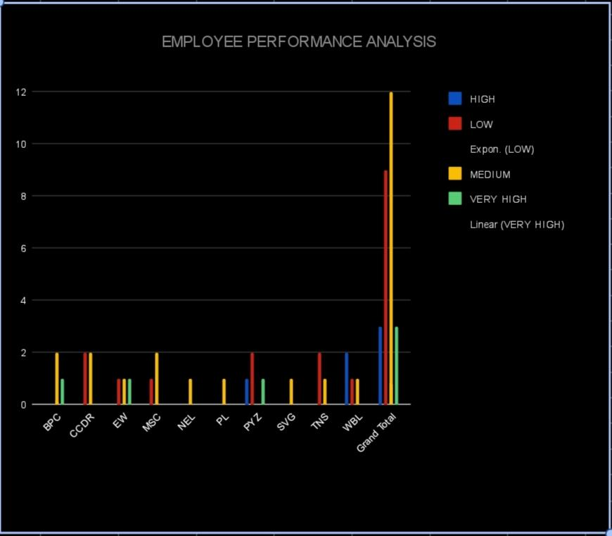
RESULTS
‹#›

Slide 12
Conclusion
In conclusion, employee performance analysis is a vital tool for identifying strengths, areas for improvement, and aligning individual goals with organizational objectives. It helps in making informed decisions about promotions, training needs, and resource allocation. Regular performance analysis fosters a culture of continuous improvement, enhances productivity, and ultimately contributes to the overall success of the organization.

