Slide 1

ELECTRONIC NOSE–BASED DETECTION OF
ONION FRESHNESS
USING A MOS SENSOR ARRAY AND
MACHINE LEARNING CLASSIFICATION
IIT MANDI · MAY–JULY 2026
Summer Internship 2026 · Final Presentation
Centre for Human–Computer Interaction, School of Computing & Electrical Engineering
Madhuhrita Saha
Institute of Engineering & Management, Kolkata
Supervisor Prof. Shubhajit Roy Chowdhury
Professor, SCEE, IIT Mandi
Mentor Vinod Shrivastava
PhD Scholar, SCEE, IIT Mandi
Notes:
[0:00-0:30 | 30 s]
Good morning. I'm Madhuhrita Saha from IEM Kolkata. Over the past two months at the Centre for Human-Computer Interaction at IIT Mandi, under Prof. Shubhajit Roy Chowdhury and my mentor Vinod Shrivastava, I built a low-cost electronic nose that grades onion freshness non-destructively.
[Stand still. Eye contact. Don't rush.]

Slide 2
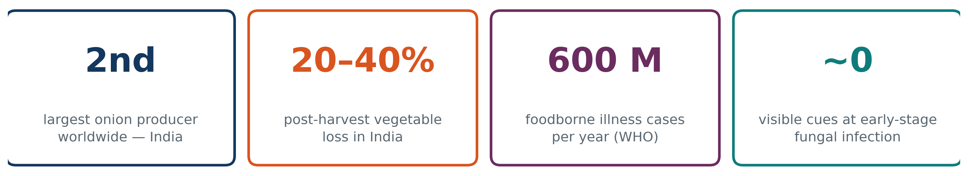
THE PROBLEM
Motivation and Objective
Early-stage fungal infection — Fusarium, Aspergillus, Botrytis — colonises the bulb interior before any visible discolouration, so visual inspection fails exactly when detection matters most.
CONVENTIONAL
LABORATORY
THIS WORK
Visual / sensory inspection
Subjective; misses early infection
GC-MS, HPLC
Accurate but destructive and slow
Electronic nose + ML
Non-destructive, real-time, on-device
Objective: a standalone, low-cost E-nose that grades onion freshness into four classes, non-destructively and entirely on-device.
E-Nose for Onion Freshness · Madhuhrita Saha · CHCI Lab, SCEE, IIT Mandi
1
Notes:
[0:30-1:40 | 70 s]
- India is the second-largest onion producer in the world. Post-harvest losses run 20 to 40 percent, largely because cold-chain infrastructure is thin in hill regions like Himachal.
- The WHO puts foodborne illness at roughly 600 million cases a year. For onions the hazard is fungal infection - Fusarium, Aspergillus, Botrytis - and mycotoxin contamination.
- The core problem: early-stage infection colonises the interior with NO visible discolouration. Visual inspection fails exactly when detection matters most.
- Three columns: conventional inspection is subjective; GC-MS is accurate but destructive, slow and expensive; the E-nose sits between them.
TRANSITION: "So the objective was a standalone, low-cost device. Here is what I built."

Slide 3
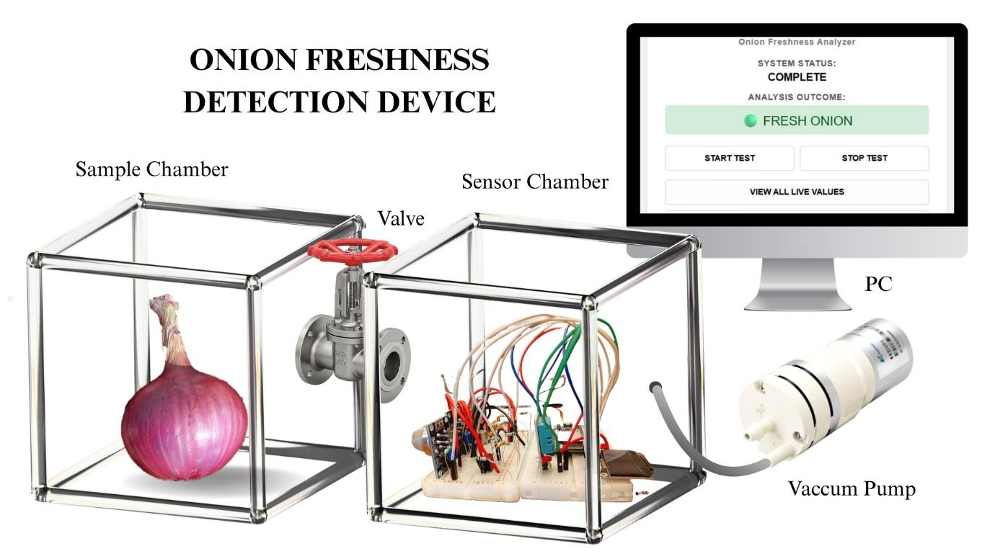
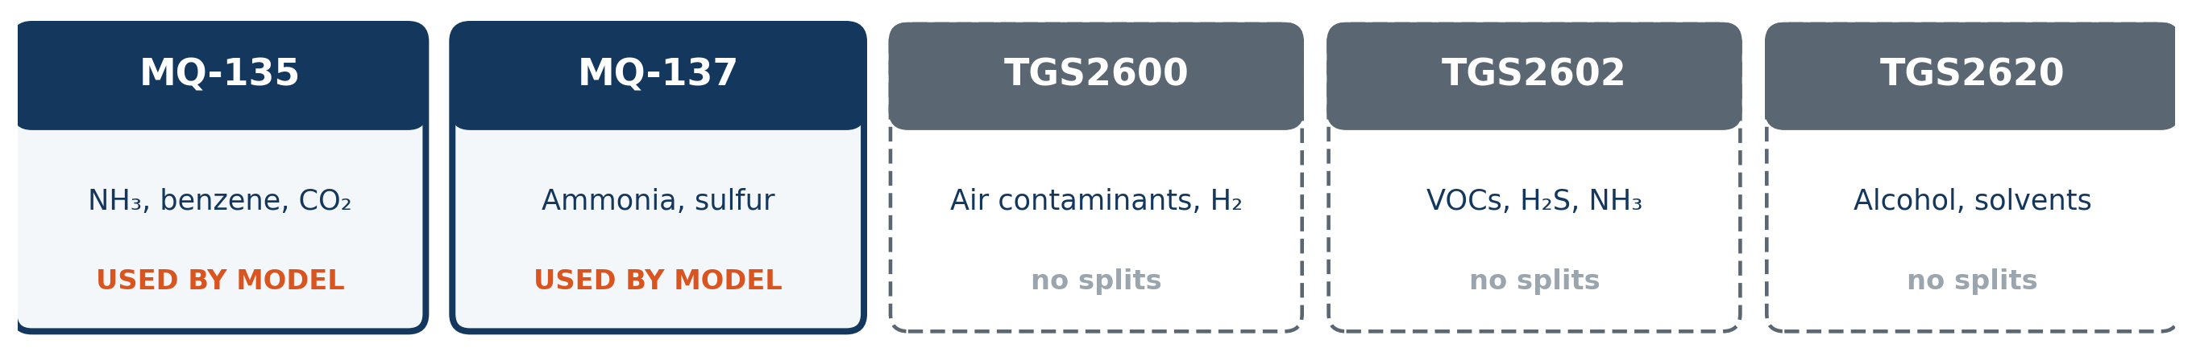
DESIGN
System Architecture and Hardware
Compute
ESP32 · dual-core 240 MHz · 12-bit ADC · 4 MB flash. Acquisition, feature extraction and inference all run on-device.
Interface
Self-hosted Wi-Fi access point and web dashboard at 192.168.4.1; OLED readout; CSV logged to flash.
Offline
MATLAB training; model returns as a JSON node array — no firmware recompilation.
Fig. 10 — Sample chamber → valve → sensor chamber → pump
₹5,960 total hardware cost · acrylic chambers fabricated in-house · inert PTFE gas path
E-Nose for Onion Freshness · Madhuhrita Saha · CHCI Lab, SCEE, IIT Mandi
2
Notes:
[1:40-3:00 | 80 s]
- Walk the photo left to right: the onion sits in the sample chamber and accumulates headspace for six hours. The valve opens, and the vacuum pump draws that headspace across the sensor chamber. Both chambers I fabricated in-house from 5 mm cast acrylic in the mechanical workshop here.
- Compute: an ESP32 - 240 MHz, 12-bit ADC. Acquisition, feature extraction and inference ALL run on the device.
- Interface: the ESP32 hosts its own Wi-Fi access point and dashboard. Connect a phone, press Start Test, read the result. No laptop, no cloud, no internet.
- Offline: training happens in MATLAB, but the model returns as a JSON file - no recompiling.
- The sensor strip: five MOS sensors with deliberately OVERLAPPING sensitivities. No single sensor detects spoilage - it's the composite pattern, which is how biological olfaction works.
- Note the orange labels: only MQ-135 and MQ-137 were used by the final model. I'll come back to that.
KEY: whole build is ₹5,960.

Slide 4
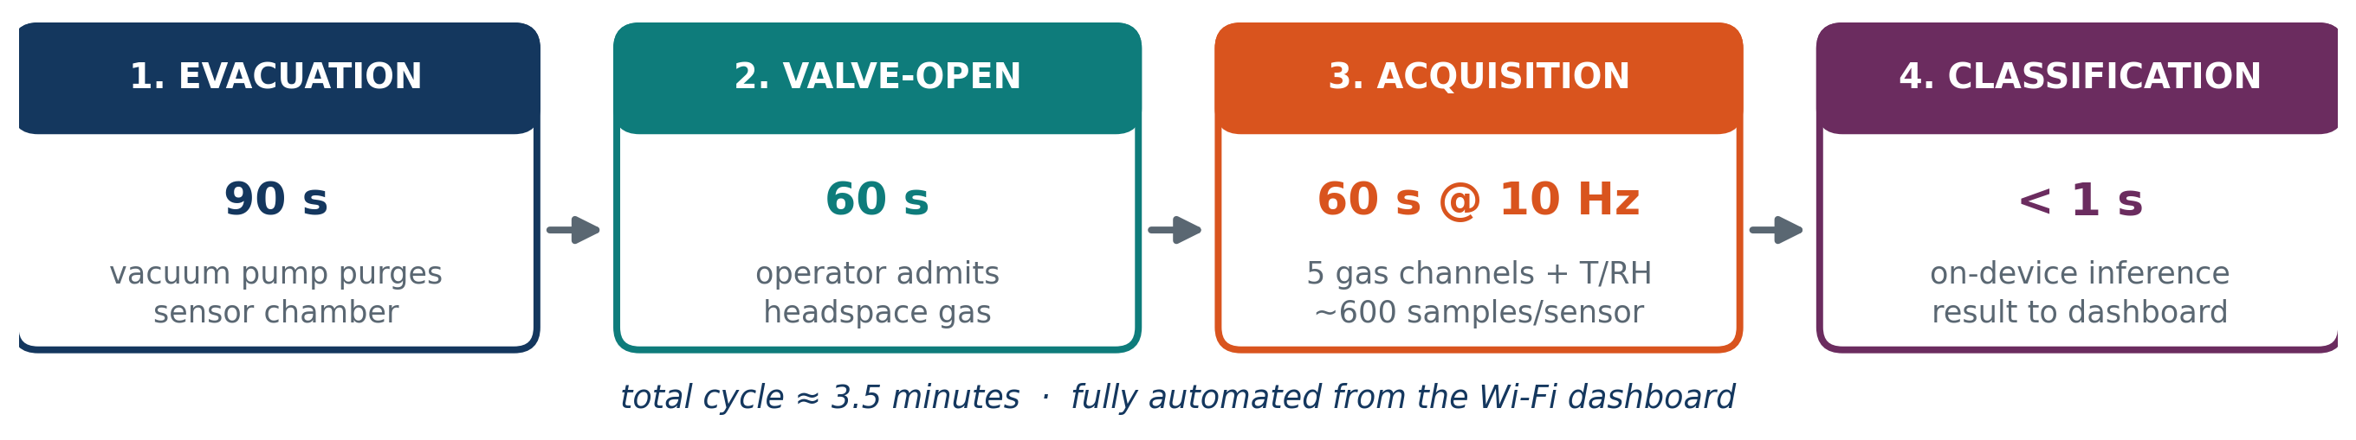
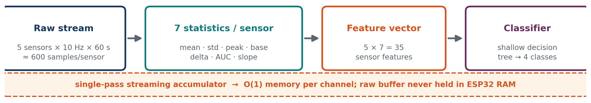
METHODOLOGY
Measurement Protocol and Feature Extraction
EXPERIMENTAL DESIGN
3 onions × 4 classes × 5 replicates = 60 observations, Days 0/2/4/6
SAMPLE PREPARATION
Ethanol sterilised; spoilage by scoring + 48 h at 30 °C
ON-DEVICE CONSTRAINT
Single-pass accumulator; O(1) memory per channel
E-Nose for Onion Freshness · Madhuhrita Saha · CHCI Lab, SCEE, IIT Mandi
3
Notes:
[3:00-4:10 | 70 s]
- One button triggers a fixed four-stage cycle: 90 seconds of pump evacuation, 60 seconds for the operator to open the valve, 60 seconds of acquisition at 10 Hz - about 600 samples per sensor - then classification in under a second. Three and a half minutes, fully automated.
- Second row - the data pipeline. 600 raw samples per sensor is neither necessary nor tractable on a microcontroller. Each window collapses to seven statistics per sensor: mean, standard deviation, peak, baseline, delta, area under the curve, slope. Five sensors times seven gives a 35-feature vector.
- The engineering point in the orange strip: the firmware computes these as a single-pass streaming accumulator with constant memory. The full buffer is never held in RAM. That is what makes it fit on an ESP32.
- Bottom cards: 60 observations, three onions, four classes, five replicates, sampled Days 0, 2, 4 and 6.
FLAG IT: "Note that each class was sampled on its own day. Remember that - it becomes the most important finding in this talk."

Slide 5
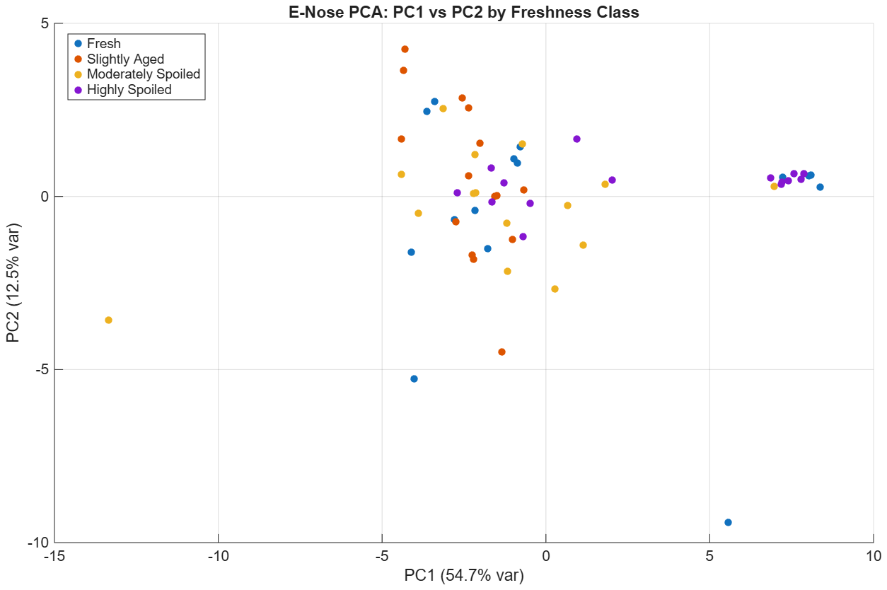
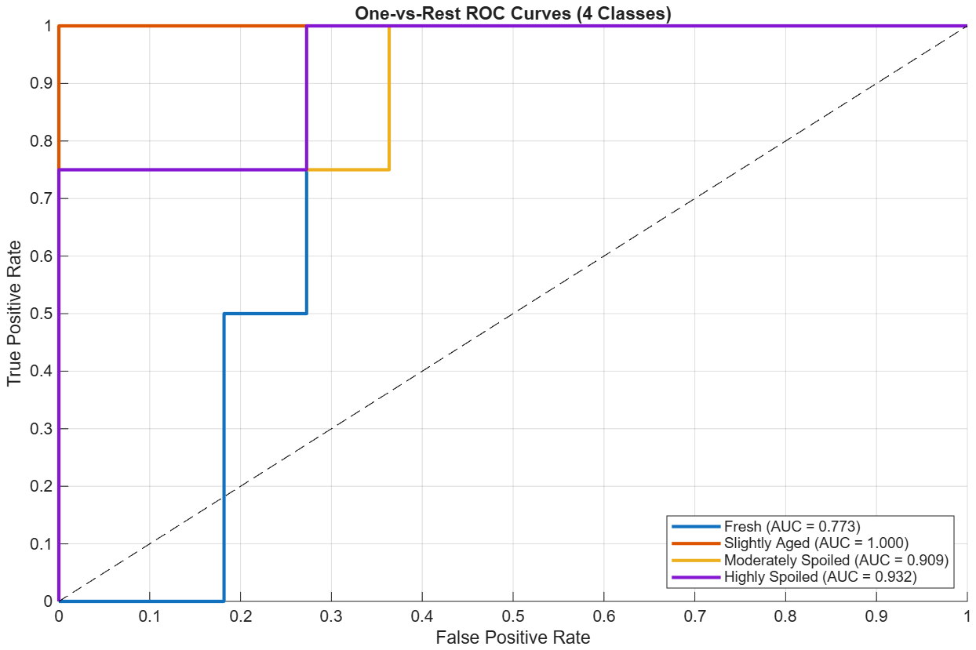
RESULTS
Phase 1 — Exploratory Analysis
All 37 features (35 sensor statistics + humidity + temperature) — an upper-bound reference, never intended for deployment.
Fig. 3 — PCA: PC1 vs PC2 by freshness class
Fig. 6 — One-vs-rest ROC curves, Random Forest
76.3%
variance in first 3 PCs
Substantial
inter-class overlap
75.0%
Random Forest CV accuracy
0.903
macro one-vs-rest AUC
Encouraging on paper — until the feature importances were inspected.
E-Nose for Onion Freshness · Madhuhrita Saha · CHCI Lab, SCEE, IIT Mandi
4
Notes:
[4:10-5:10 | 60 s]
- Phase 1 used everything - all 37 features, including humidity and temperature. This was an upper-bound reference, never intended for deployment.
- PCA on the left: the first three components capture 76.3 percent of the variance. But look at the scatter - only partial clustering, substantial overlap. Only Highly Spoiled forms a distinct group on the right.
- The Random Forest reached 75.0 percent cross-validated with a macro AUC of 0.903. On paper that looks respectable.
- But when I inspected which features the ensemble actually relied on, mean humidity and mean temperature ranked among the most important predictors.
[Pause.] "And that is where this project became interesting."

Slide 6
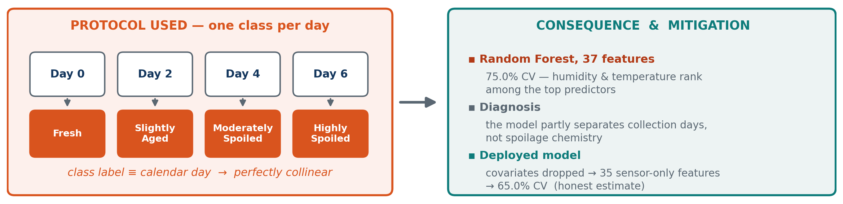
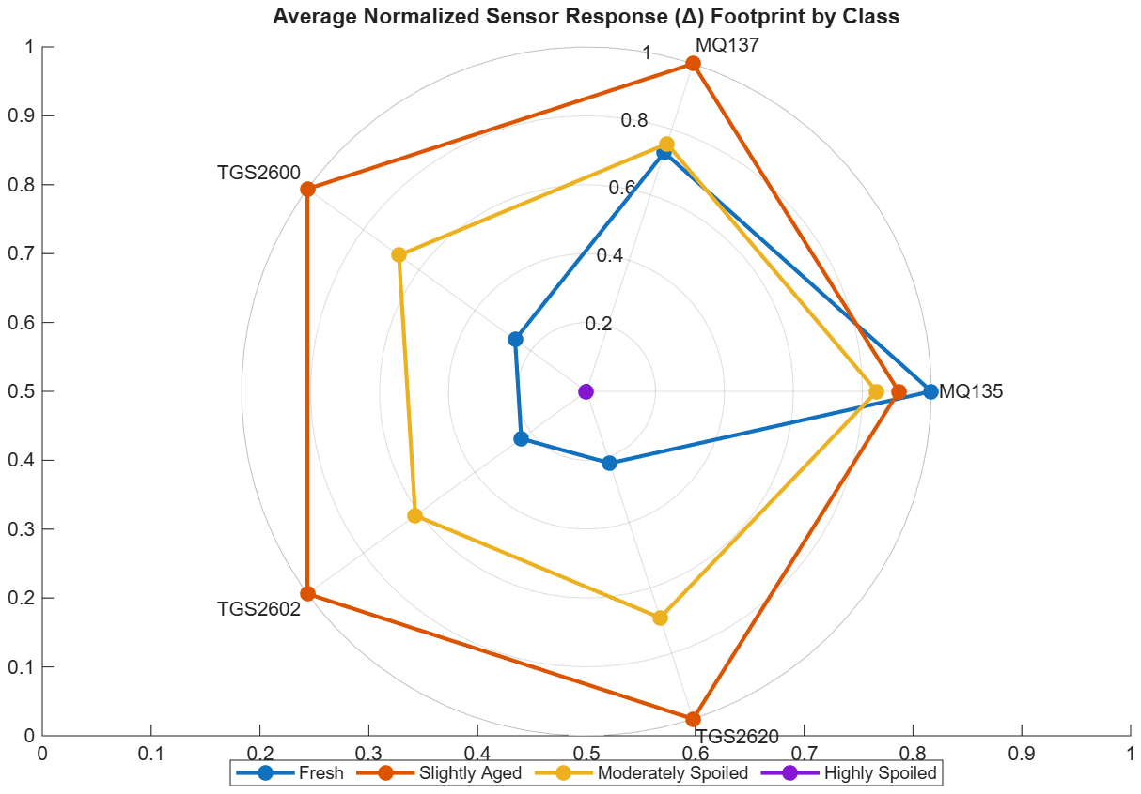
RESULTS
The Central Finding: a Day/Class Confound
CORROBORATING EVIDENCE
Highly Spoiled shows the lowest mean response on every channel — an inversion of the spoilage–VOC relationship the literature expects.
The explanation is not chemistry, but the same day/humidity confound acting on the sensor baselines.
Fig. 7 — Mean normalised response amplitude by class
Reported rather than concealed — this diagnosis is itself a substantive outcome of the project.
E-Nose for Onion Freshness · Madhuhrita Saha · CHCI Lab, SCEE, IIT Mandi
5
Notes:
[5:10-6:20 | 70 s] ** CENTREPIECE - confidence, not apology **
- Recall the protocol: Fresh on Day 0, Slightly Aged on Day 2, and so on. One class per calendar day. The class label is therefore perfectly collinear with the day of measurement.
- Anything varying with time - ambient humidity, temperature, sensor baseline drift - is statistically indistinguishable from the freshness label. So part of that 75 percent is the model discriminating between COLLECTION DAYS, not spoilage states.
- The radar plot corroborates it. Highly Spoiled shows the LOWEST mean response on every single channel - an inversion of what the whole literature expects, since rotting material should emit MORE volatiles, not fewer. The explanation isn't chemistry; it's the same confound acting on the sensor baselines.
- So I excluded both environmental covariates and retrained from scratch.
SAY THIS: "I'm reporting this rather than hiding it, because diagnosing the confound is itself a substantive outcome - it directly determines how the next dataset must be collected."

Slide 7
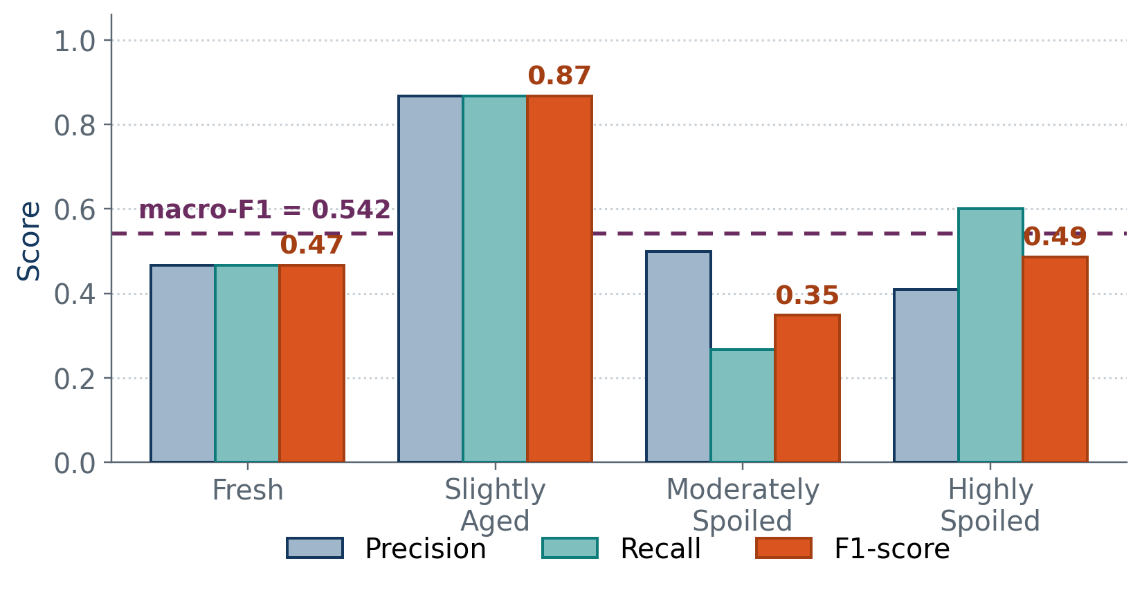
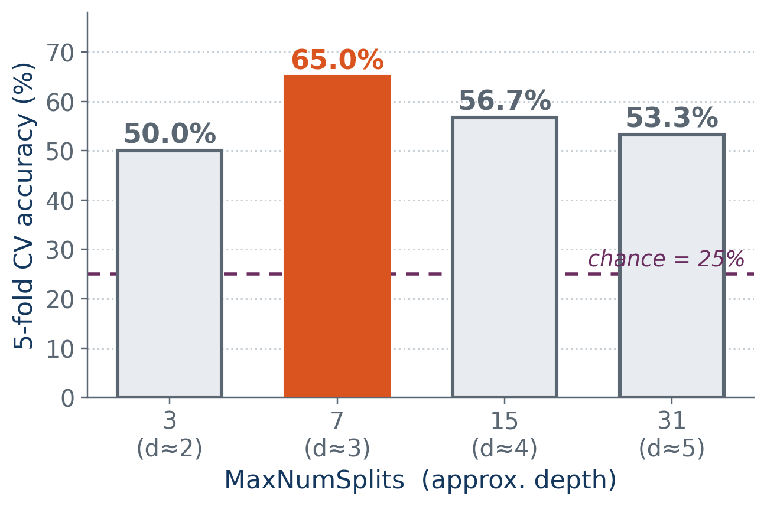
RESULTS
Phase 2 — Deployed Classifier
65.0% cross-validated accuracy · macro-F1 = 0.542 · chance = 25%
35 sensor-only features, environmental covariates excluded. Out-of-fold predictions, not the inflated 83.3% training accuracy.
Table 3 — CV accuracy vs tree complexity
Table 4 — Per-class precision, recall and F1
Slightly Aged is most reliable (F1 = 0.867); Moderately Spoiled weakest (F1 = 0.348)
Tree splits only on MQ135 / MQ137 — the three TGS channels contributed none
E-Nose for Onion Freshness · Madhuhrita Saha · CHCI Lab, SCEE, IIT Mandi
6
Notes:
[6:20-7:20 | 60 s]
- Phase 2: 35 sensor-only features, environmental covariates excluded. 65.0 percent cross-validated accuracy, macro-F1 0.542, against a chance baseline of 25 percent.
- Important - that's from out-of-fold predictions. Training-set accuracy was 83.3 percent, but with n = 60 that's inflated by overfitting and I don't report it as a result.
- Left chart: I swept tree complexity. Seven splits, effective depth three, won at 65 percent. Deeper trees overfit and got worse - expected with 60 observations.
- Right chart: performance is uneven. Slightly Aged is very reliable at 0.87. Moderately Spoiled is weakest at 0.35, confused with both neighbours - chemically sensible, since intermediate states have a less distinct signature than the extremes.
- Bottom right: the tree splits only on MQ135 and MQ137. The three TGS sensors contributed nothing.

Slide 8
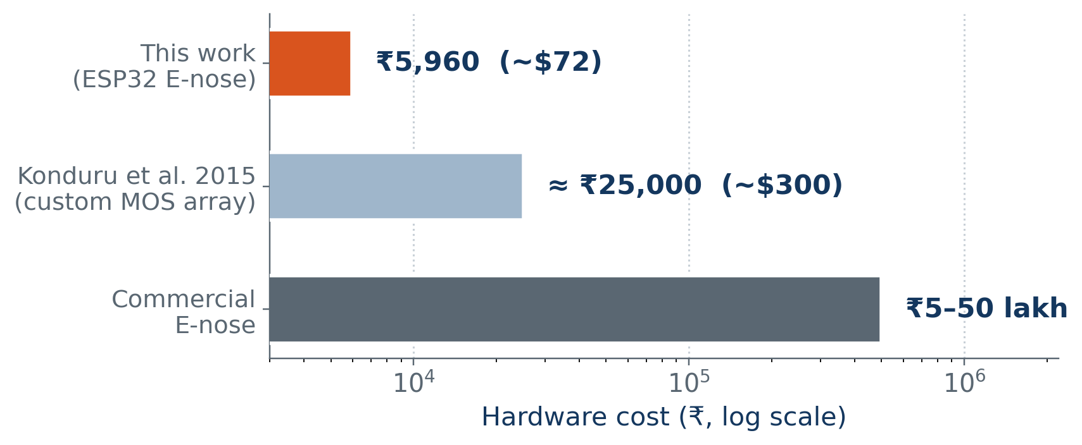
CRITICAL APPRAISAL
Limitations, Cost and Next Steps
LIMITATIONS
FUTURE WORK
▪ Day/class confound
each class sampled on one distinct day
▪ Deconfound the protocol
interleave all four classes per session; expand n
▪ Small sample
n = 60, three biological replicates per class
▪ Recover the TGS channels
recalibrate; relative-response baseline correction
▪ Two-channel reliance
robustness to sensor drift unvalidated
▪ Benchmark classifiers
SVM-RBF, k-NN against the tree baseline
▪ No pure-culture inoculation
natural microflora only
▪ Formalise for publication
consolidate into the planned conference paper
₹5,960 (~$72 USD)
≈ 4× below the comparable published MOS array, and two to three orders of magnitude below commercial instruments — practical for resource-constrained storage settings.
E-Nose for Onion Freshness · Madhuhrita Saha · CHCI Lab, SCEE, IIT Mandi
7
Notes:
[7:20-8:40 | 80 s]
- Four limitations, name them quickly: the day/class confound; small sample at n = 60; reliance on only two of five channels, so robustness to sensor failure is unvalidated; and no pure-culture inoculation - I used natural microflora.
- Four next steps, mapped one to one: interleave all four classes within every collection session and expand the dataset; recalibrate the TGS channels and try relative-response with relative baseline correction, which the literature identifies as best practice; benchmark SVM-RBF and k-NN against this baseline; and formalise the work into the planned conference paper.
- On cost: ₹5,960, about 72 dollars. Roughly four times cheaper than the comparable published MOS array, and two to three orders of magnitude below commercial instruments at five to fifty lakh rupees.
KEY LINE: "Because the model ships as JSON, every one of these improvements deploys without touching the hardware or firmware."

Slide 9
SUMMARY
Conclusion
An end-to-end, edge-deployable E-nose pipeline — from raw VOC sensing to a displayed classification result — was designed, fabricated, trained and deployed within the two-month internship.
SYSTEM
METHOD
RESULT
VALUE
Five-sensor MOS array on ESP32 in a custom acrylic chamber; automated four-stage cycle; Wi-Fi dashboard.
35 streaming features; PCA and Random Forest exploration; a constrained tree deployed as JSON.
65.0% CV accuracy, macro-F1 0.542; a day/class confound identified, quantified and mitigated.
₹5,960 build; ML classification advanced from a planned phase to a completed component.
CLOSING REMARK
The honest 65% — obtained after removing the covariates that inflated the 75% benchmark — is more useful to this laboratory than an impressive number that would not survive a change of measurement day.
Thank you — questions and discussion are welcome.
E-Nose for Onion Freshness · Madhuhrita Saha · CHCI Lab, SCEE, IIT Mandi
8
Notes:
[8:40-9:30 | 50 s]
- To summarise: an end-to-end, edge-deployable E-nose pipeline - from raw VOC sensing to a displayed classification result - was designed, fabricated, trained and deployed within two months. Machine learning moved from a planned future phase to a completed, evaluated component.
- Four cards: the system, the method, the result, and the value.
CLOSING LINE (deliberate, then stop): "The honest 65 percent - obtained after removing the covariates that inflated the 75 percent benchmark - is more useful to this laboratory than an impressive number that would not survive a change of measurement day."
- Thank you. My thanks to Prof. Roy Chowdhury and Vinod Shrivastava, and to the CHCI Lab and the workshops at IIT Mandi.
[Smile. Pause. Let the first question come.]

