Slide 1
DS & Visualization
Project – 2
Madhukara

Slide 2
Architecture
CSV file
Sqlite
Server
Client
JSON on HTTP
Flask
D3.JS
JSON
SqliteDB
SqlAlchemy
D3JS TechAn
library
Analyzed plots on browser

Slide 3
CSV file format
<id> <Date> <Open><High><Low><Close><Volume>
Sample
id Date Open High Low Close Volume
1 12/27/2017 170.100006 170.779999 169.710007 170.600006 21498200
2 12/28/2017 171 171.850006 170.479996 171.080002 16480200
3 12/29/2017 170.520004 170.589996 169.220001 169.229996 25884400
4 1/2/2018 170.160004 172.300003 169.259995 172.259995 25555900
5 1/3/2018 172.529999 174.550003 171.960007 172.229996 29517900
6 1/4/2018 172.539993 173.470001 172.080002 173.029999 22434600

Slide 4
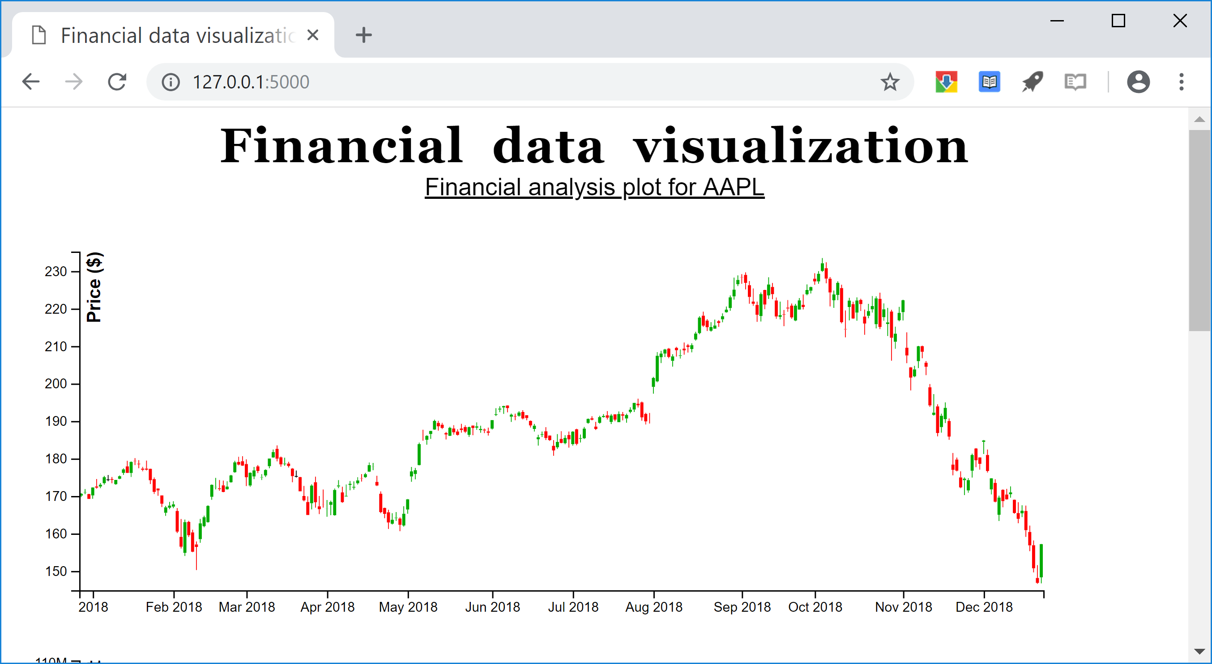
Visualization - 1

Slide 5
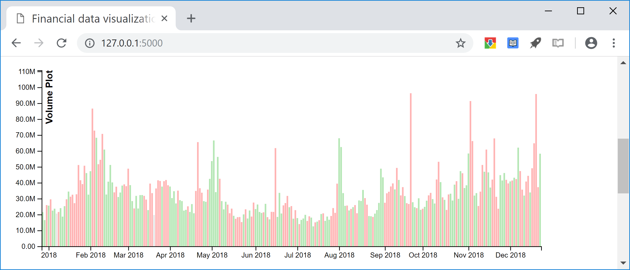
Visualization - 2

Slide 6
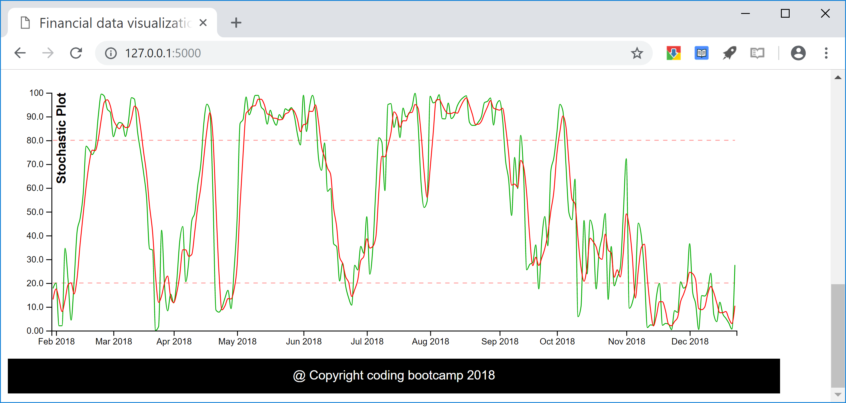
Visualization - 3

Slide 7
Steps to realize the design
Server
Obtain CSV file from Yahoo finance
Convert csv file to sqlite database file using sqlite utility
Use SqlAlchemy to read the database content
Flask + Sqlite + Python to deliver JSON content
Client
D3.js to read the JSON content from server
Use bootstrap template to place the responsive plots
Use Techan.js library to plot the data
As window resizes, re-fetch the data from flask and re-draw

