Slide 1

Prompt Engineering Techniques and Langchain: Advancing AI Interaction
Notes:
AI-generated content may be incorrect. --- In this presentation, we will explore the innovative field of prompt engineering and its relationship with Langchain. This combination is pivotal in enhancing AI interactions, making them more effective and user-friendly.

Slide 2

Agenda
Introduction to Prompt Engineering
LLM & Prompts
Prompt Techniques
Langchain Overview
Notes:
We will begin with an introduction to prompt engineering, covering its definition, importance, and applications in AI. Next, we will discuss core techniques used in prompt engineering. Then, we will provide an overview of Langchain, its features, and its integration with AI models. Finally, we will examine the role of Langchain in prompt engineering and look at future trends in this evolving field.

Slide 3
Introduction to Prompt Engineering
Notes:
Prompt engineering is the art and science of designing inputs to AI systems to elicit the most accurate and relevant responses. Understanding its importance is crucial for enhancing AI's performance.

Slide 4
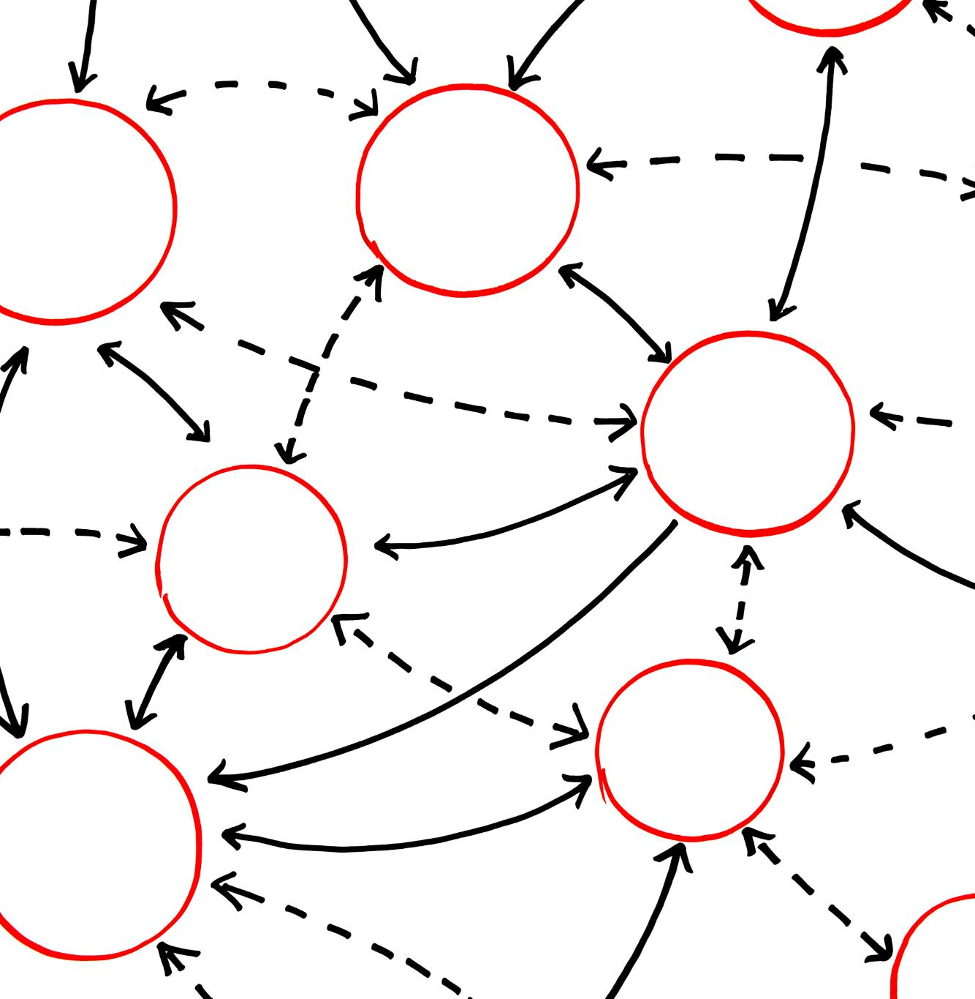
Definition and Importance
What is Prompt Engineering?
Prompt engineering is the process of designing inputs to AI models that help guide their responses effectively.
Significance of Prompt Engineering
Effective prompt engineering maximizes the effectiveness of AI interactions, enhancing overall productivity and outcomes.
Notes:
Prompt engineering involves crafting prompts that can significantly influence the output of AI models. Its importance lies in maximizing the effectiveness of AI interactions, leading to more productive outcomes.

Slide 5
Basic Principles and Methodologies
Clarity in Prompts
Clarity is essential in prompt engineering as it helps the AI understand the user's intent without ambiguity.
Contextual Relevance
Providing context is crucial for effective prompt engineering, enabling the AI to give more accurate and relevant responses.
Conciseness in Messaging
Conciseness helps in delivering messages efficiently, ensuring that prompts are not overly verbose or complex.
Explicit Instructions
Clearly define the format, style and structured of the output
Specify the Task clearly
Clearly define the Task to be done by LLM
Notes:
Effective prompt engineering relies on several foundational principles and methodologies, including clarity, context, and conciseness. These elements ensure that the AI understands the prompt accurately.

Slide 6
LLM & Prompts
Notes:
Prompt engineering is the art and science of designing inputs to AI systems to elicit the most accurate and relevant responses. Understanding its importance is crucial for enhancing AI's performance.

Slide 7
LLM Training Process
Data Collection & Pre-processing
Very crucial step typically done by data scientists/Data Engineers
Pre-Training
Fundamental Steps typically done by ML researchers
Domain Adoption
Optional step requires domain expert, ML researchers
Lots of data is required general knowledge
LLM learns basic general language, grammar, patterns, semantics and syntax of language
Requires domain specific dataset. Like Legal, education etc.
Instruct Tuning
Required steps typically executed by prompt Engineers, ML Engineers
Further refines the pre-trained model to work on specific instructions
Targeted for specific tasks
Human Alignment
Essential steps done by ethics & safety experts
Optimization & Compression
Ensures LLM response is aligned with human values, ethics & safety
Model is trained to remove biases, misinformation, offensive language etc.
RLHF is one technique used
Recommended step done by ML Engineers, MLOps team
It reduces overall cost of processing, deployment & improves performance, lowers hosting cost
Evaluation & Validation
This is done by QA & Engineering Team
Benchmarking is done against few parameters like Accuracy, biases, robustness, hallucination etc.

Slide 8
Relevance of Prompts in Instruct Training Phase
Clarity & Specificity
Purpose: Crafting precise prompts ensures the model understands the task correctly and generates relevant responses.
Impact: Clear and specific prompts improve the model's ability to follow instructions accurately, enhancing task performance.
Task Diversity
Purpose: Exposing the model to a variety of well-crafted prompts during training helps it generalize better across different types of instructions.
Impact: A diverse set of prompts enables the model to handle a wide range of user queries effectively.
Response Quality
Purpose: Effective prompt engineering ensures that the responses generated during training are of high quality and contextually appropriate.
Impact: High-quality responses during training lead to better model performance and more reliable outputs in real-world applications.
Efficiency
Purpose: Optimized prompts can reduce the need for extensive training data by making each example more informative.
Impact: This leads to more efficient use of computational resources and faster convergence during training.

Slide 9
Relevance of Prompts in Human Alignment Phase
Relevance
Purpose: Prompt engineering helps align the model’s outputs with human expectations and societal norms.
Reducing Bias
Purpose: Carefully designed prompts can mitigate biases in the model’s responses by steering it toward neutral and fair outputs.
Improving Safety
Purpose: Prompts can be engineered to avoid harmful or inappropriate content, enhancing the safety of the model’s outputs.
User Experience
Purpose: Well-designed prompts can lead to more natural and engaging interactions with the model.
Impact: This alignment ensures that model responses are useful, ethical, and acceptable to users.
Impact: Reducing bias is essential for building trustworthy AI systems that provide equitable and unbiased information.
Impact: Ensuring safety is crucial for user trust and the responsible deployment of AI systems.
Impact: A better user experience increases user satisfaction and the overall effectiveness of the AI system.

Slide 10
Prompt Techniques
Notes:
To achieve optimal results in AI interactions, several core techniques are utilized in prompt engineering. These techniques help refine and enhance the prompts used in AI systems.

Slide 11
Zero Shot Prompting
LLMs today, trained on large amounts of data and tuned to follow instructions, can perform tasks zero-shot (i.e., without requiring prior examples).
Example: Sentiment Classification Using Zero-Shot Prompting
Task / Instructions: Classify the text into positive, negative, or neutral.
Input:
Text: "I would definitely like to visit your place.“

Slide 12
Few Shot Prompting
While large language models (LLMs) exhibit impressive zero-shot capabilities, they often struggle with more complex tasks in a zero-shot setting.
To enhance performance on such tasks, few-shot prompting is employed. This technique leverages in-context learning by providing examples within the prompt to guide the model toward better results. These examples act as conditioning inputs for subsequent tasks where we expect the model to generate more accurate responses.
Example: Price-to-Earnings (P/E) Ratio Classification Using Few-Shot Prompting
Task / Instructions: Classify whether a loan application should be approved, conditionally approved, or rejected based on the applicant’s credit score and income.
Few Shot Examples:
Example Data:
Credit Score = 750, Income = $80,000 → Approved
Credit Score = 680, Income = $50,000 → Conditionally Approved
Credit Score = 600, Income = $30,000 → Rejected

Slide 13
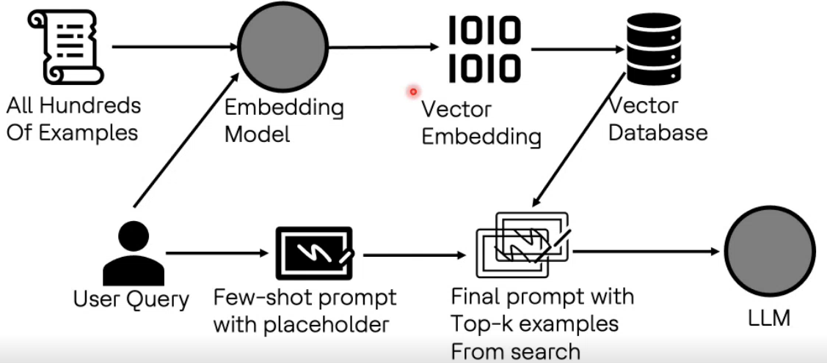
Few Shot Prompting (with hundreds of examples)
There may be situations where hundreds of relevant examples are available, but they cannot be directly used to create a few-shot prompt with all of them due to two primary challenges:
Lost-in-the-Middle – When too many examples are provided, the model may struggle to prioritize relevant information.
Out-of-Context-Length – LLMs have a token limit, meaning too many examples can exceed the input size and become unusable.
To overcome these challenges, a strategies for selecting and utilizing examples efficiently is outlined below:

Slide 14
Chain Of Thought Prompting
Chain-of-thought (CoT) prompting enables complex reasoning capabilities through intermediate reasoning steps. You can combine it with few-shot prompting to get better results on more complex tasks that require step-by-step logical reasoning before responding.
Chain of Thought (CoT) improves reasoning by breaking down complex problems into step-by-step logical steps.
Used for complex tasks like coding, math reasoning, and decision-making problems.
Can be combined with Few-Shot Prompting for even better performance on complex queries.
Example: Chain of Thought (CoT) Prompting for Text Generation
Task:
Generate a well-structured and logical paragraph explaining the impact of climate change on agriculture.

Slide 15
Chain Of Thought Prompting – Cont.
Before directly generating the response, let’s break down the reasoning process:
Define the key points to cover:
Rising temperatures
Changes in rainfall patterns
Impact on crop yields
Increase in extreme weather events
Adaptation strategies
Establish logical flow:
Start with a general introduction to climate change and agriculture.
Explain specific impacts with real-world examples.
Discuss potential solutions and adaptation strategies.
Conclude with a forward-looking statement.

Slide 16
Chain Of Thought Prompting – Cont.
CoT Prompt:
You are an expert in environmental science. Use a Chain-of-Thought (CoT) reasoning approach to generate a well-structured paragraph explaining the impact of climate change on agriculture.
Think through the problem step by step using the following structured format:
<thinking>
Step 1: Introduce climate change and its relevance to agriculture.
Step 2: Explain key impacts (e.g., temperature rise, rainfall change, crop yield reduction).
Step 3: Provide an example of how farmers are adapting to these changes.
Step 4: Conclude with a forward-looking statement on sustainable agriculture.
</thinking>
<reasoning>
Analyze each step logically. If needed, refine the explanation for clarity.
</reasoning>
<output>
Generate the final well-structured paragraph based on your logical breakdown.
</output>
Now, generate the response.

Slide 17
Self-Consistency Prompting
Self-consistency prompting is a technique used to enhance the robustness and reliability of responses generated by language models.
Instead of relying on a single output, the model generates multiple responses to the same prompt.
The most consistent answer across these outputs is selected.
This approach leverages internal consistency in the model, improving the accuracy and quality of responses.
Example: Solve the quadratic equation: x² - 5x + 6 = 0
Generate multiple solution approaches:
1. Solve using the quadratic formula.
2. Solve using factorization.
3. Solve using numerical methods.
Show the step-by-step process for each method and compare the results for consistency.
Select the answer that appears most consistently across the methods.

Slide 18
Self-reflection Prompting
Self-reflection in LLMs refers to the process of iteratively improving responses by allowing the model to evaluate, correct, and refine its output after an initial response.
While the term "reflection" doesn’t imply true human-like introspection, it augments the model’s reasoning by adding feedback loops, leading to better responses.
In this technique, instead of generating a single answer, the model:
Thinks step by step (Chain of Thought).
Reflects on potential errors or improvements.
Adjusts the response based on its reflection
Provides a final, refined answer.

Slide 19
Self-reflection Prompting – Cont.
You are an AI assistant that uses self-reflection to refine a short story. Follow these steps:
1. Generate a short fictional story (3-5 sentences) based on the prompt.
2. Reflect on whether the story is logically coherent, engaging, and clear.
3. Make necessary improvements based on your reflection.
4. Provide the final, refined version of the story.
Use the following format:
<thinking>
[Generate the short story.]
</thinking>
<reflection>
[Analyze whether the story makes sense. Identify inconsistencies, plot gaps, or lack of engagement.]
</reflection>
<adjustment>
[Revise the story to improve coherence and engagement.]
</adjustment>
<output>
[Provide the final, improved version of the story.]
</output>
Now, generate a short story using this process.

Slide 20
Prompt Chaining
To enhance the reliability and performance of LLMs, an essential prompt engineering technique is to decompose tasks into smaller subtasks.
Instead of solving a complex task in one step, the LLM is prompted in stages.
The response to each prompt is fed as input to the next prompt.
This process, known as prompt chaining, creates a sequence of prompt operations to break down the task.
Benefits:
Improves accuracy by breaking tasks into manageable steps.
Prevents errors from accumulating in complex single-shot queries.
Useful for data extraction, summarization, and structured content generation.
Combines multiple LLM responses into a final refined answer.

Slide 21
Prompt Chaining – Cont.
Example: Prompt Chaining as a Research Assistant
Task: Summarize a Research Paper and Extract Key Insights
A research assistant often needs to analyze large papers, extract insights, and present structured information. Instead of prompting an LLM to summarize everything in one step, we use prompt chaining to break it into structured subtasks.
Breaking the Task into Subtasks
Summarize the paper in key sections (Abstract, Introduction, Methodology, Results, Conclusion)
Extract key findings and insights from the results section.
Generate a list of research gaps and potential follow-up studies.
Provide citations in a structured format for further reading.

Slide 22
ReAct Prompting
ReAct (Reasoning + Acting) prompting is a technique used with large language models (LLMs) that combines:
Reasoning → The model generates step-by-step logical traces of thought.
Acting → The model interacts with external sources (like databases or APIs) to fetch relevant information.
Instead of a single static response, the model dynamically thinks, takes action, observes the results, and refines its response iteratively.
Internals:
The model generates reasoning steps, known as "traces", alongside task-specific actions in a back-and-forth manner.
Reasoning traces help the model break down problems, plan steps, and make decisions.
Actions allow the model to interact with external data sources, such as: Search engines , Databases , APIs
This combination of reasoning and action enables the model to adapt dynamically, retrieve relevant data, and refine its response in real time.

Slide 23
ReAct Prompting – Cont.
You are an AI assistant that solves logic puzzles using a ReAct approach. Follow these steps:
**Think through the problem logically** step by step.
**Simulate an action** (e.g., filling, emptying, or transferring water between jars).
**Observe the result** of the action.
**Adjust** the reasoning if needed.
**Continue iterating** until you find a valid solution.
**Provide the final solution.**

Slide 24
ReAct Prompting – Cont.
Use the following structured format:
<thinking>
Step 1: Identify the constraints.
Step 2: Consider different ways to measure 4 liters using the jars.
</thinking>
<action>
[Perform an action, such as filling or transferring water.]
</action>
<observation>
[Observe what changed after the action.]
</observation>
<adjustment>
[Modify the approach if necessary.]
</adjustment>
<output>
[Provide the final correct solution.]
</output>
Now, solve the following puzzle:
"You have a 5-liter jar and a 3-liter jar. How can you measure exactly 4 liters of water?"

Slide 25
Langchain Overview
Notes:
Langchain is a powerful framework designed to simplify the development of applications powered by language models. It provides various tools and features that enhance prompt engineering.

Slide 26

What Is Langchain?
Framework for Developers
Langchain provides a robust framework that simplifies the development process for applications using language models.
Efficient Prompt Management
It streamlines the creation and management of prompts, enhancing the efficiency of building language model applications.
Notes:
Langchain is a framework that enables developers to build applications with language models more efficiently. It streamlines the process of prompt creation and management.

Slide 27

Key Features and Capabilities
Prompt Templates
Langchain provides customizable prompt templates, enhancing the efficiency of AI interactions and development processes.
Memory Management
With robust memory management features, Langchain can store, retrieve, and utilize past interactions effectively.
Chaining Prompts
Langchain allows chaining multiple prompts, enabling complex interactions and enhancing AI's contextual understanding.
Notes:
Langchain offers a range of features, including prompt templates, memory management, and the ability to chain together multiple prompts. These capabilities make it a versatile tool for AI development.

Slide 28

Integration with AI Models
Seamless Integration
Langchain provides seamless integration with a variety of AI models, making it easier for developers to utilize advanced capabilities.
Enhanced Interaction
By leveraging AI model integration, applications can achieve improved interaction, leading to better user experiences.
Improved Performance
Integrating AI models with Langchain enhances the overall performance of applications, optimizing functionality and responsiveness.
Notes:
Langchain seamlessly integrates with various AI models, allowing developers to leverage its capabilities to enhance interaction and improve overall performance in AI applications.

Slide 29
THANK YOU
Notes:
Prompt engineering and Langchain are at the forefront of advancing AI interactions. By understanding and utilizing these techniques, we can enhance the effectiveness of AI systems and improve user experiences.

