Slide 1

Analysis of Indian Tonnage Proportion (Age-Wise)

Slide 2
Introduction
- Overview of the case study
- Objective: Analyzing the proportion of Indian tonnage across different age groups
- Data source: Share of Indian Tonnage Age-Wise (31 Dec 2022)

Slide 3
Data Overview
- Dataset contains:
- Year-wise data from 1975 to 2022
- Coastal, Overseas, and Combined regions
- Proportion of Indian tonnage by age groups: Upto 5 years, 6-15 years, 16-20 years, Over 20 years

Slide 4
Data Cleaning & Preprocessing
- Checking for missing values
- Handling missing data (fillna method)
- Grouping and summarizing data for insights

Slide 5
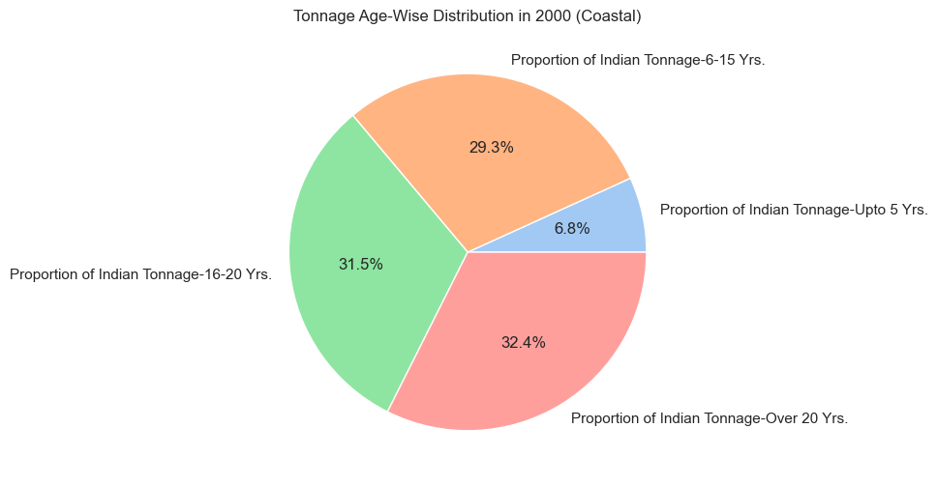
PIE CHART
The pie chart represents the Tonnage Age-Wise Distribution in 2000 (Coastal). It shows how the total Indian tonnage is divided among different age groups:
Over 20 Years (32.4%): The largest share of tonnage belongs to ships older than 20 years.
16-20 Years (31.5%): A significant portion also falls in this age category.
6-15 Years (29.3%): Nearly one-third of the tonnage is between 6-15 years old.
Upto 5 Years (6.8%): The smallest proportion consists of newly built ships.

Slide 6
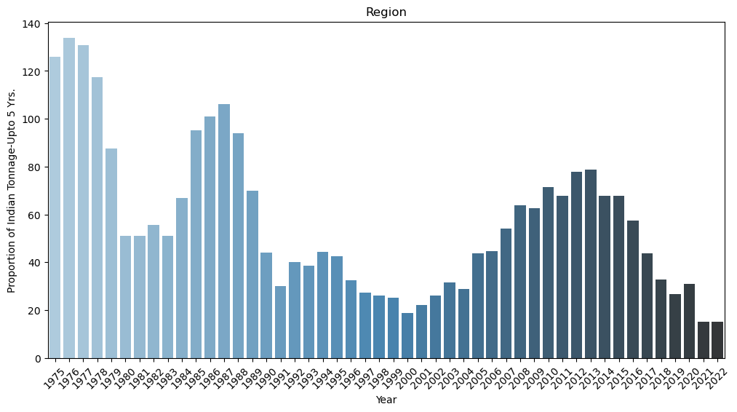
BAR GRAPH
The bar chart represents the Proportion of Indian Tonnage (Upto 5 Years) Over Time from 1975 to 2022. Here are the key insights:
The proportion of new ships (aged ≤5 years) was highest in the late 1970s and mid-1980s, indicating strong fleet renewal during those periods.
A significant decline occurred in the late 1980s and 1990s, showing a slowdown in new ship additions.
From 2005 onwards, a recovery trend is visible, peaking around 2012-2014, suggesting increased investment in newer ships.
After 2015, the proportion declined again, indicating fewer new ships being added to the Indian fleet in recent years.

Slide 7
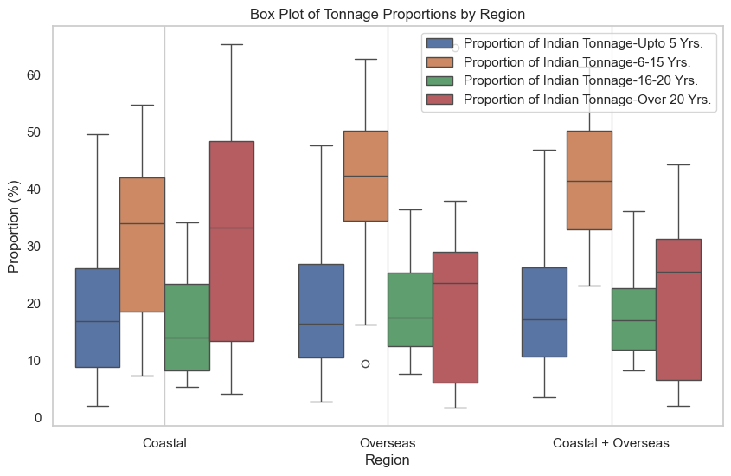
BOX PLOT
The box plot represents the distribution of tonnage proportions by region (Coastal, Overseas, and Combined). Key insights:
Younger ships (Upto 5 years & 6-15 years) have lower median proportions, indicating a smaller share of newer vessels across all regions.
Older ships (16-20 years & Over 20 years) have higher proportions, especially in the Overseas category, showing an aging fleet.
Greater variability in older tonnage proportions suggests fluctuations in ship replacement and procurement trends.
Coastal + Overseas has the highest median for older ships, reinforcing the dominance of aging tonnage.

Slide 8
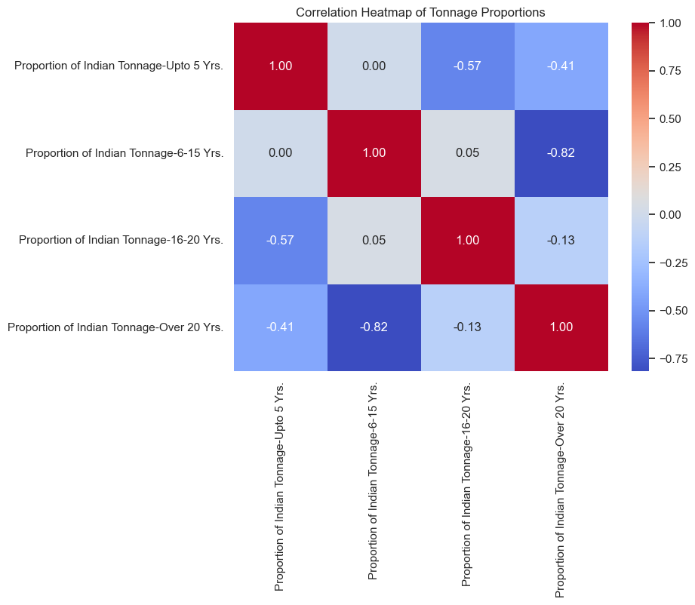
HEATMAP
The correlation heatmap illustrates the relationships between different age groups of Indian tonnage proportions:
Strong negative correlation (-0.82) between 6-15 years and Over 20 years: As the proportion of 6-15-year-old ships increases, the proportion of over 20-year-old ships decreases significantly.
Moderate negative correlation (-0.57) between Upto 5 years and 16-20 years: A higher share of new ships tends to reduce the proportion of 16-20-year-old vessels.
Weak or no correlation (0.05) between 6-15 years and 16-20 years: These two age groups do not significantly impact each other.
Self-correlation (diagonal values = 1.00): Each category is perfectly correlated with itself.

Slide 9
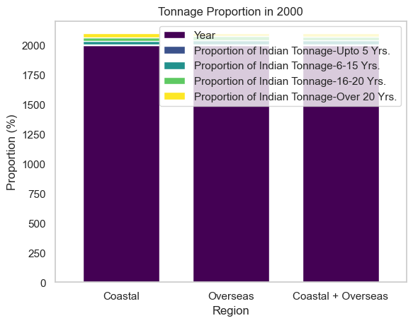
BAR CHART
The smaller color segments on top (blue, green, yellow) correspond to different ship age groups:
Upto 5 years (dark blue)
6-15 years (blue)
16-20 years (green)
The majority of the tonnage is represented in dark purple, likely indicating the total tonnage or an aggregated category.
Over 20 years (yellow)
The legend placement overlaps with the chart, making interpretation slightly difficult.

Slide 10
Key Insights from Data
- Tonnage proportion trends over the years
- Comparison across different regions
- Major shifts in tonnage proportions over time

Slide 11
Data Visualization - Trends Over Time
- Line charts showing tonnage proportion trends from 1975 to 2022
- Highlighting significant changes in each age group

