Slide 1



Sri Sai Vidya Vikas Shikshana Samithi ® SAI VIDYA INSTITUTE OF TECHNOLOGY Approved by AICTE, New Delhi, Affiliated to VTU, Recognized by Govt. of Karnataka Accredited by NBA, New Delhi (CSE, ECE. ISE), NAAC – “A” Grade DEPARTMENT OF COMPUTER SCIENCE & ENGINEERING RAJANUKUNTE, BENGALURU 560 064, KARNATAKA Phone: 080-28468191/96/97/98 * E-mail: hodcse@saividya.ac.in* URL www.saividya.ac.in
DBMS MINI PROJECT
ATM SIMULATION SYSTEM
UNDER THE GUIDANCE;
DR VARUN E
ASSOCIATE PROFESSOR
DEPT OF CSE
SVIT
PRESENTED BY:
MADHUKESH S (1VA23CS090)
MUKUNDA V(1VA23CS100)

Slide 2



INTRODUCTION
A functional ATM system simulation
Database integration (MySQL)
Secure PIN-based authentication 🔒
Transaction processing: 💳
1.Withdrawals
2. Deposits
3 . Balance checks
Real-world DBMS application
USER
DATABASE

Slide 3
Technology Stack
LAYER | TECHNOLOGY | ROLE | ICON
Database | MySQL | Stores users, accounts, transactions | 🗃️
Backend | Python + Flask | Handles logic & API endpoints | 🐍
Frontend | HTML/CSS/JS | Interactive ATM interface | 🌐

Slide 4
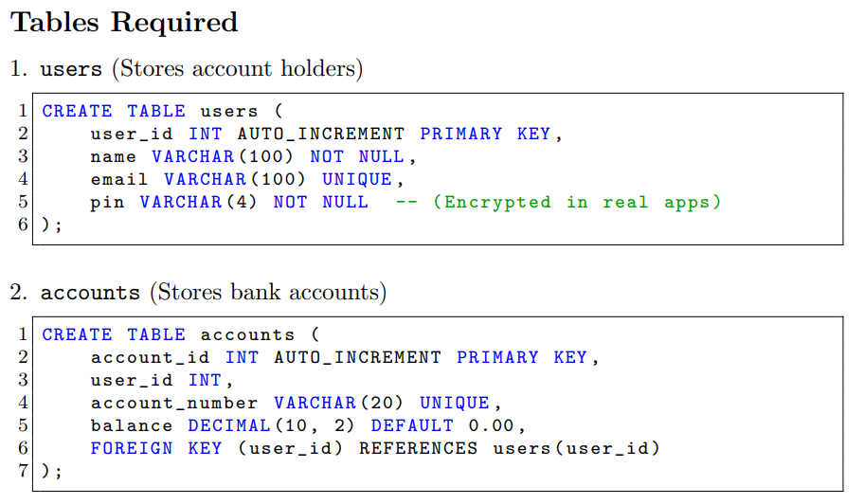
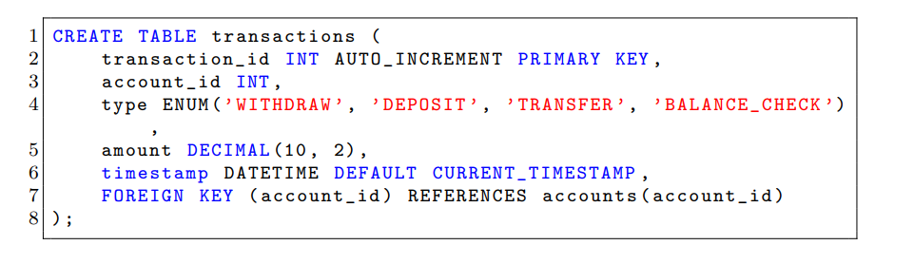
DATABASE DESIGN
🗄️ Schema: Users → Accounts ← Transactions
🔑 Primary Keys: user_id, account_id
🔗 Foreign Keys: user_id → accounts
ER DIAGRAM
users
MANY
accounts
MANY
transactions

Slide 5
Backend &
Frontend Implementation
Key Components
1.Flask API Endpoints-python
-POST `/login` → PIN verification
-POST `/withdraw` → Deducts balance
-POST `/deposit` → Adds funds
-GET `/balance` → Returns account balance
Tech Stack
HTML5 - Structure
CSS3 - Styling
JavaScript - Logic
Fetch API - Backend communication
Database Operations -mysql
- SQL queries (SELECT/UPDATE/INSERT) - Transaction rollback on errors
Key Features
User Authentication (PIN Verification)
Balance Inquiry
Cash Withdrawal
Deposit Money
New user

Slide 6
Connecting MySQL, Python (Flask), and Frontend
Step 1: Set Up the Environment
Install Required Packages:
In cmd
pip install flask flask-mysqldb mysql-connector-python
Ensure MySQL Server is running
Step 2: Configure Flask Backend
Create a Flask app (app.py) in atm-simulation folder
Step 3: Set Up MySQL Database
Step 4: Create Frontend
Step 5: Run the Application
In,cmd select the directory which contains app.py,index.html
run python app.py(cmd)

Slide 7
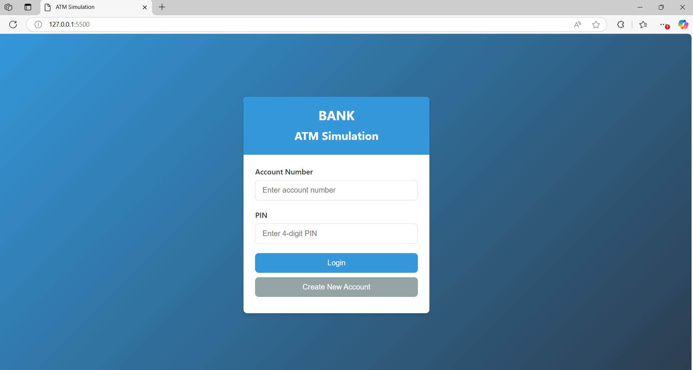
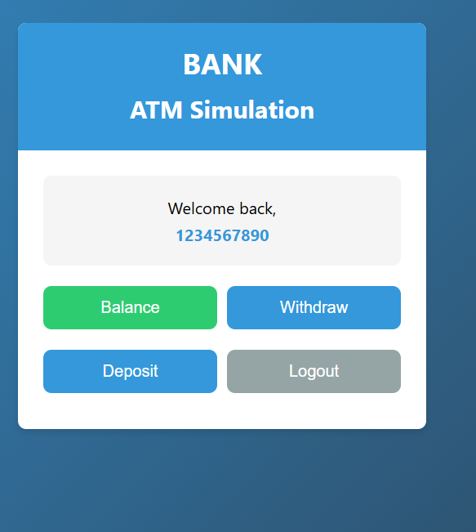
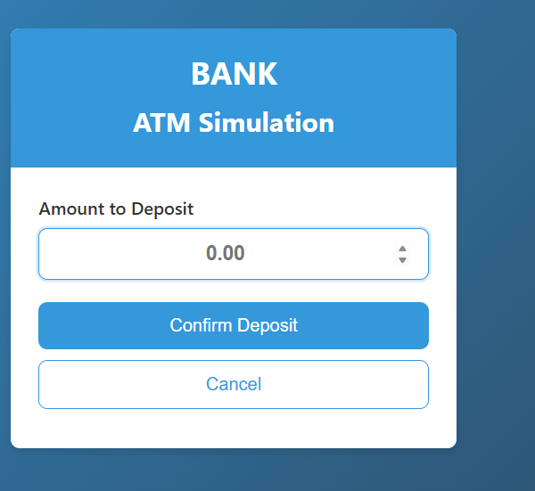
RESULT

Slide 8
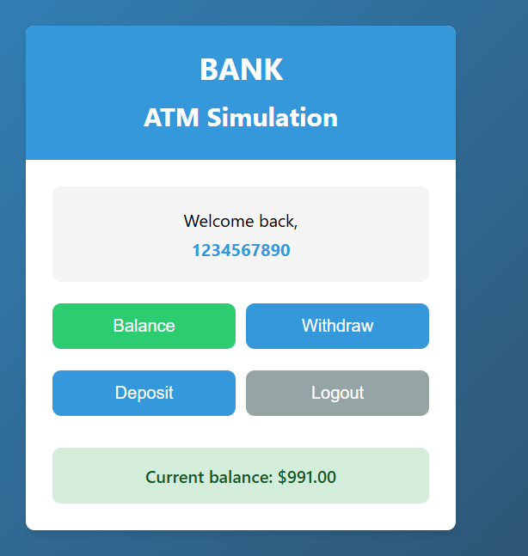
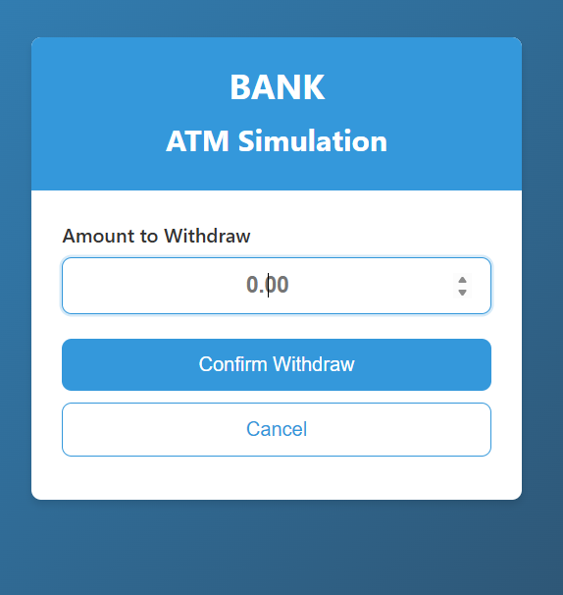
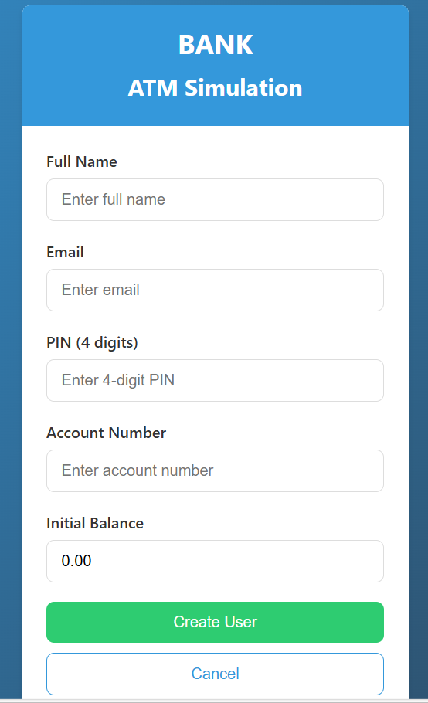

Slide 9
SOURCE CODE
https://github.com/Madhukesh0/atm-simulation.git

