Slide 1

Cloud Computing Project
REVIEW 3
CLOUDSENTINEL
Cloud-Ready Enterprise SIEM & SOC Platform
Presented by
K. Madhu Kiran
N. Dhanunjaya Rao
G. Raja Sekhar
S. Surya
U. Asraf
(24B11CS182)
(24B11CS299)
(24B11CS128)
(24B11CS389)
(24B11CS516)
Department of Computer Science And Engineering
Notes:
Introduce the team and the project: CloudSentinel, a cloud-ready SIEM and SOC platform.

Slide 2




ABSTRACT
CloudSentinel is a cloud-ready SIEM and SOC platform designed to centrally monitor and analyze security logs from firewalls, servers, databases, and VPNs. It normalizes security logs, detects threats such as brute-force attacks and port sweeps, and generates real-time alerts. The platform provides a centralized dashboard for security analysts to monitor events, manage alerts, and handle incidents. It is developed using Java, Spring Boot, React, WebSocket, JWT authentication, and MySQL.
Notes:
CloudSentinel is a cloud-native SIEM and SOC platform. It collects logs from firewalls, servers, databases and VPNs, and gives analysts a single live dashboard.

Slide 3
PROBLEM STATEMENT
Security teams face alert fatigue, with too many alerts to triage.
Attack vectors are distributed across many origins and stages.
Telemetry is fragmented across firewalls, servers, databases and VPNs.
Brute-force attempts, port sweeps and multi-stage breaches often go unnoticed.
Teams need one real-time view of events, alerts and incidents.
Notes:
Three core challenges: alert fatigue, distributed attacks, and telemetry spread across many systems.

Slide 4
OBJECTIVES OF THE PROJECT
Unified Telemetry Ingestion
Collect and normalize raw logs from firewalls, servers, databases and VPNs.
Heuristic & Correlated Threat Detection
Sliding-window rules catch brute force, port sweeps, credential stuffing and multi-stage breaches.
Instant SOC Command & Control
Stream real-time events and alerts over WebSockets to a dark SOC interface.
Full Incident Response Lifecycle
Follow NIST SP 800-61 with timelines, analyst notes and audit logging.
Notes:
Four objectives: ingest, detect, stream, respond.

Slide 5
PROPOSED SOLUTION
CloudSentinel provides a centralized security monitoring platform that collects logs from different sources such as servers, firewalls, databases, and VPNs.
The system converts these logs into a common format and analyzes them using predefined detection rules to identify suspicious activities.
When a potential threat is detected, the system generates an alert and displays it on the SOC dashboard in real time.
Security analysts can investigate alerts, manage incidents, and track their status through the platform.
Notes:
Two roles with role-based access control: Admin for governance and configuration, Analyst for day-to-day triage.

Slide 6
REQUIREMENTS
Functional Requirements
User authentication (JWT & RBAC)
Log ingestion & normalization
Threat detection & alerts
Incident management
Dashboard & reporting (JSON / CSV export)
Non-Functional Requirements
Security
Performance
Scalability
Reliability
Usability
Notes:
Functional requirements describe what the system does; non-functional describe how well it does it.

Slide 7
TECHNOLOGY STACK
Backend Technologies
Language: Java 21 LTS
Framework: Spring Boot 3.3.3
Security: Spring Security 6 with stateless JWT
Database: MySQL
Real-time: Spring WebSocket (STOMP, SockJS)
Frontend Technologies
Framework: React 19, Vite, ES Modules
Styling: Tailwind CSS v4
Charts: Recharts
Icons: Lucide React
Networking: Axios, @stomp/stompjs, SockJS
Notes:
Java 21 and Spring Boot on the backend, React 19 on the frontend. H2 for development, MySQL for production.

Slide 8
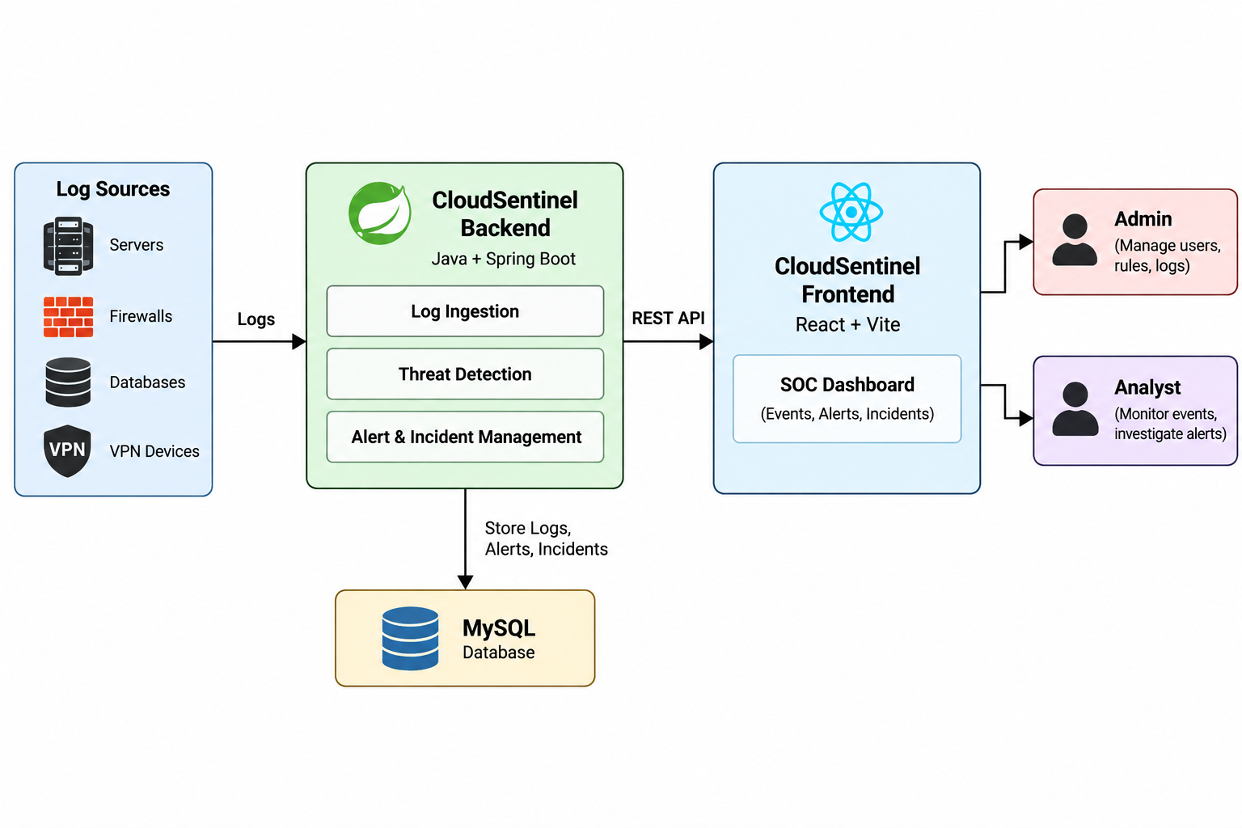
SYSTEM ARCHITECTURE
Notes:
Java 21 and Spring Boot on the backend, React 19 on the frontend. H2 for development, MySQL for production.

Slide 9
SYSTEM WORKFLOW
Log Generation
Firewalls, servers, databases and VPNs generate security logs.
Ingestion & Normalization
Raw logs are converted into the unified SecurityLog schema.
Detection
Sliding-window rules evaluate every event.
Alerting
Alerts stream to the dashboard in real time via STOMP WebSocket.
Triage
Analysts acknowledge, resolve or escalate alerts.
Incident Response
Incidents move from OPEN to INVESTIGATING, RESOLVED and CLOSED (NIST SP 800-61).
Notes:
Follow one log end to end: generated, normalized, detected, alerted, triaged, then handled as an incident.

Slide 10
MODULES
1. User Authentication & Access Control
Secure JWT login with Admin and Analyst roles.
2. Log Ingestion & Management
Collect, normalize, search, and filter security logs.
3. Threat Detection & Alerting
Detect suspicious activities and generate security alerts.
4. SOC Monitoring Dashboard
Display real-time events, KPIs, charts, and alerts.
5. Incident Management
Investigate, track, resolve, and escalate security incidents.
6. Audit & Administration
Manage users, detection rules, telemetry sources, and audit logs.
Notes:
Nine main modules plus settings and global search. Each maps to a page in the UI.

Slide 11
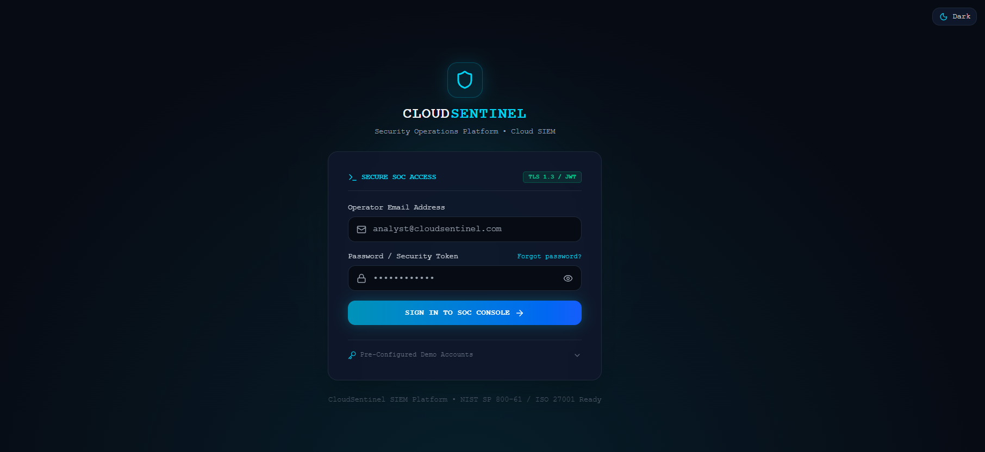
LOGIN PAGE
Notes:
Entry point to the SOC console. Authentication uses signed JWT tokens; demo accounts are available for the review.

Slide 12
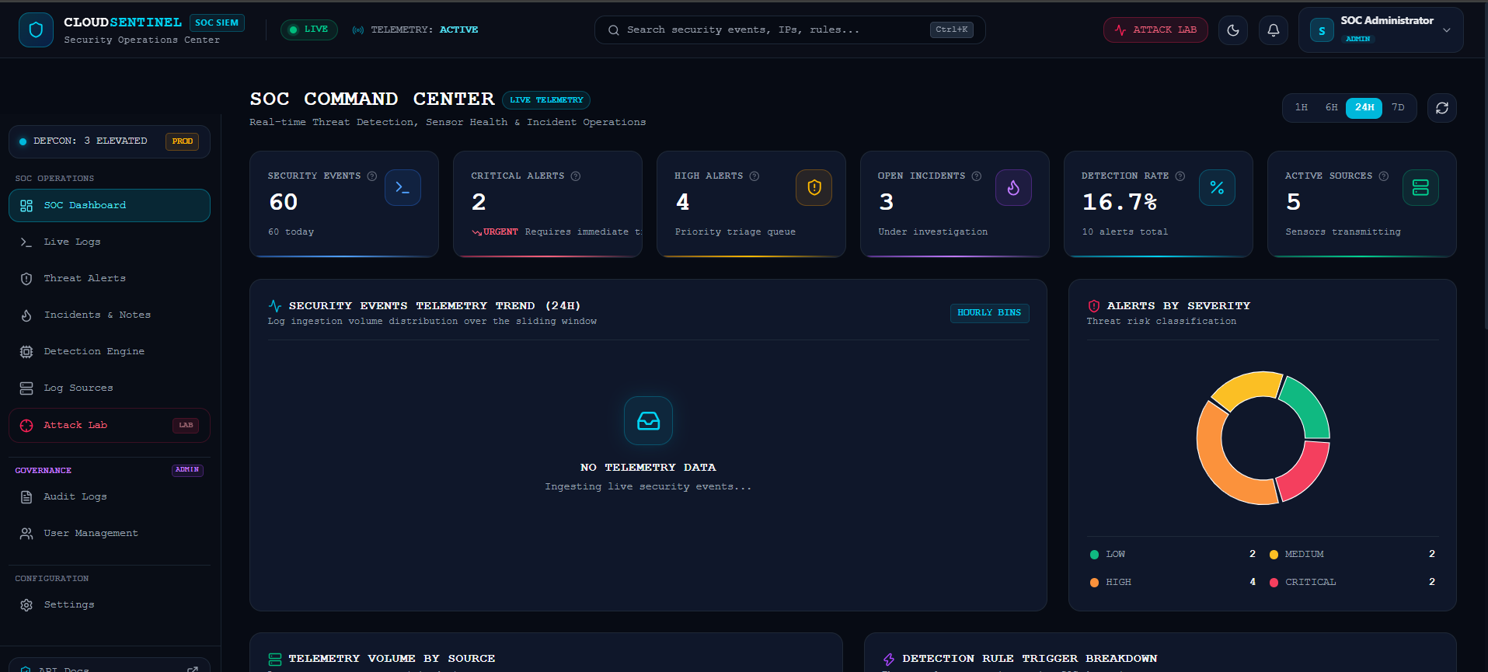
SOC DASHBOARD – ADMIN
Notes:
Admin view of the SOC Command Center. Note the Governance section in the sidebar, visible only to Admins.

Slide 13
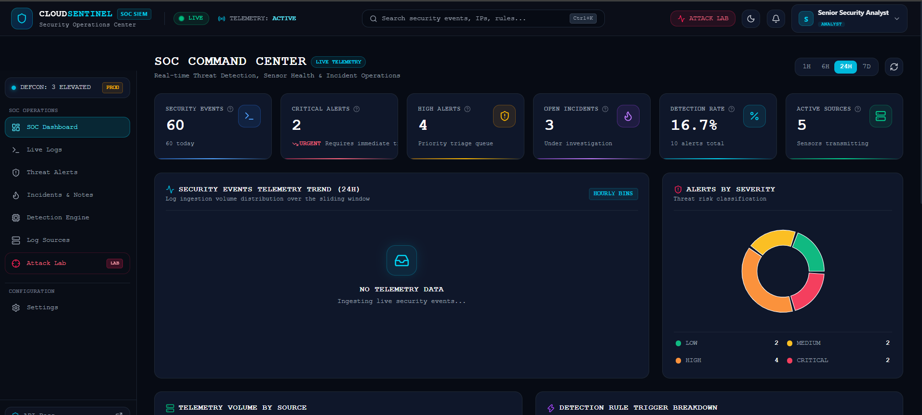
SOC DASHBOARD – ANALYST
Notes:
Analyst view: same dashboard, but the Governance section is hidden. This is role-based access control in action.

Slide 14
CONCLUSION
CloudSentinel centralizes security telemetry from multi-cloud, on-premise and perimeter sources.
By normalizing every log into one schema, the system applies consistent rule-based and multi-stage detection and raises alerts instantly.
Analysts get a real-time SOC dashboard, a full incident lifecycle and audit-ready compliance logs to respond faster.
Notes:
Wrap up: centralize, normalize and detect, respond. Then open for questions.

Slide 15
THANK YOU
Notes:
Thank the audience and invite questions.

