Slide 1

Ministry/Organization Name/Student Innovation: Department of School Education & Literacy (DoSEL), Ministry of Education.
PS Code: RK783 Problem Statement Title: Crowd Sourcing model for preparing large question banks.
Team Name : THE TROUBLESHOOTERS
Team Leader Name: Khushi Sahebrao Nikam
Institute Code (AISHE): Institute Name: Government Polytechnic ,Nashik Theme Name: Miscellaneous

Slide 2
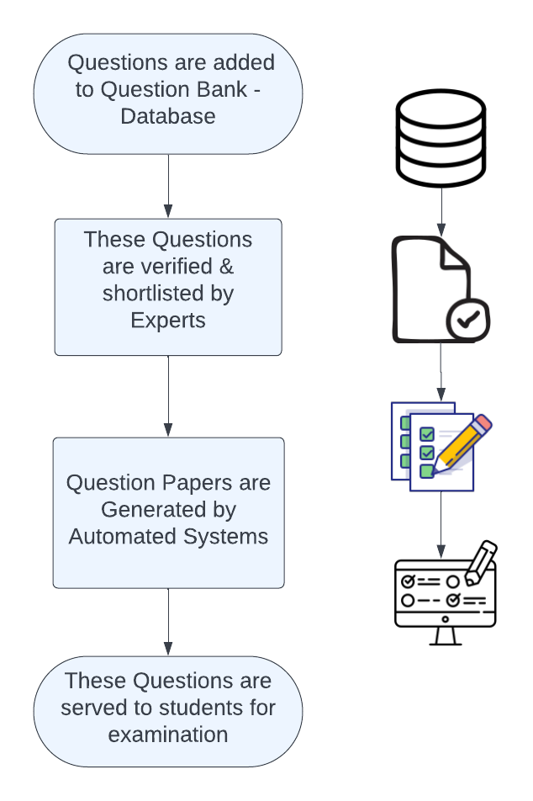
Solution : GenerateQP
A Virtual crowdsourcing platform where :
Questions are added by large number of anonymous Stakeholders.
Large Question Banks are generated
Questions are verified by Experts
Question Paper is generated via Automated System
Technology Stack :
HTML/CSS , Bootstrap Framework
JavaScript
Python
Django

Slide 3
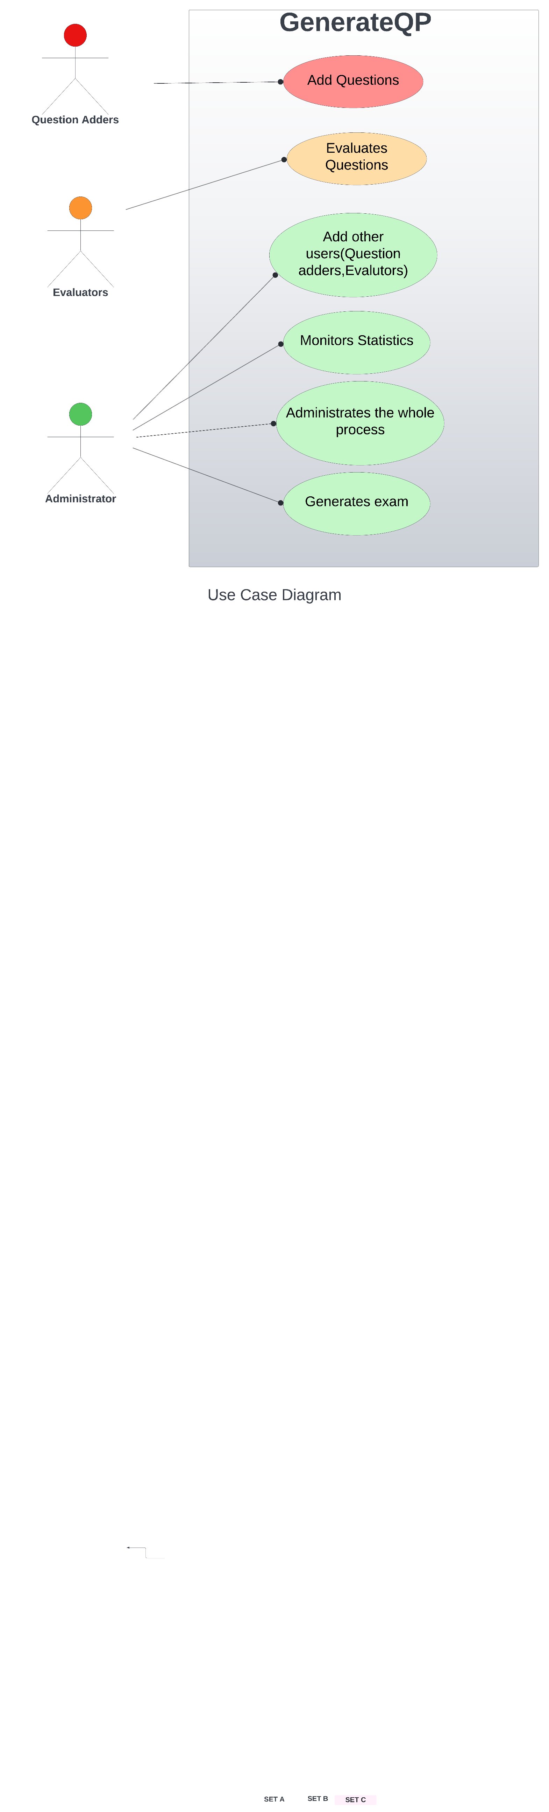

Slide 4
Team Member Details
Team Leader Name: Khushi Sahebrao Nikam (Information Technology): Year (III):
(Diploma)
Team Member 1 Name: Shreya Balbhim Lokare (Information Technology): Year (III):
(Diploma)
Team Member 2 Name: Kiran Balu Dahake (Information Technology): Year (III):
(Diploma)
Team Member 3 Name: Madhukrishna Vinod Nipankar (Information Technology): Year (III):
(Diploma)
Team Member 4 Name: Monali Dadasaheb Hire (Information Technology): Year (III):
(Diploma)
Team Member 5 Name: Pratiksha Rajendra Bargal (Information Technology): Year (III):
(Diploma)

