Slide 1
DATA ANALYTICS PROJECT
E-commerce Customer
Analysis
From raw customer data to clear business answers
3,055 orders • 32 variables
Focus: data understanding, cleaning and 3 problem statements
Presenting by:
Madhu Kunchala
E-commerce Customer Analysis
01

Slide 2
01 • PRESENTATION FLOW
From raw data to business answers
The presentation follows the same journey I used in the notebook.
01
02
03
04
05
UNDERSTAND
CHECK & CLEAN
SET UP THE QUESTIONS
ANALYZE & EXPLAIN
CONCLUDE
→
→
→
→
First, I understand the dataset.
Then, I check data quality.
Next, I identify only the variables needed for each problem statement.
I calculate and compare the required averages.
Finally, I connect the three findings.
Size • columns • data types • statistics
Missing values • duplicates • inconsistent labels • invalid values
Question → required fields → relevant records
Code → graph → result → interpretation
Key findings → recommendations → conclusion
WHAT I WANT THE AUDIENCE TO SEE
I do not start with the answers. I first make the data understandable and reliable, then use it to answer three focused business questions.
E-commerce Customer Analysis
02

Slide 3
02 • UNDERSTANDING
Commands I used before analysis
These commands help me understand what I am working with before making any business conclusion.
df.head()
Preview rows
See what one order looks like.
df.shape
Check size
Shows 3,055 rows and 32 columns.
df.info()
Check structure
Shows column names, data types and non-null counts.
df.describe()
Summarize numeric data
Shows count, mean, minimum, maximum and spread.
df.columns
Identify fields
Shows the variables available for analysis.
E-commerce Customer Analysis
03

Slide 4
03 • QUALITY CHECK
What did I check before cleaning?
The purpose was to avoid letting obvious data-quality problems affect the three comparisons.
50
CHECK
CHECK
CHECK
Duplicates
Missing values
Categories
Invalid numbers
Repeated rows can count the same order more than once.
Important fields such as Profit and Net_Sales may be unavailable.
Labels can contain spaces or different capitalization.
Age, discount, quantity, shipping and rating need logical ranges.
QUALITY-CHECK CODE
How I explain this slide
df.isnull().sum().sort_values(ascending=False)
df.duplicated().sum()
df_clean.duplicated().sum()
df_clean.duplicated().sum()
missing = df_clean.isnull().sum()
missing[missing > 0].sort_values(ascending=False)
“Before analysis, I checked whether the data was complete, repeated, consistently labelled and logically valid. This makes the later averages more trustworthy.”
Goal: clean first → analyze second
E-commerce Customer Analysis
04

Slide 5
04 • CLEANING
Cleaning commands: what they do and why
I kept the cleaning targeted. I did not invent replacement values just to fill gaps.
pd.to_datetime()
Convert Order_Date
Makes the date a real datetime field instead of plain text.
.str.strip()
Remove extra spaces
Prevents the same label being treated as different text.
.str.lower()
Standardize categories
Makes selected categorical values consistent.
drop_duplicates()
Remove repeated rows
Stops duplicate orders from affecting averages.
range checks → NaN
Handle impossible values
Invalid age, discount, quantity, shipping days and ratings are not treated as real values.
E-commerce Customer Analysis
05

Slide 6
05 • RESULT
After cleaning: ready for the three questions
The notebook reduces the raw data from 3,055 rows to 3,005 after duplicate removal, then each question uses the fields it needs.
3,055
50
3,005
Raw dataset
Duplicate removal
Clean dataset
Orders before duplicate removal
Repeated rows removed
Rows remaining
RAW DATA
→
CLEAN DATA
→
QUESTION-SPECIFIC DATA
Speaker line
“Now that the data is prepared, I can move from data quality to the actual business questions.”
E-commerce Customer Analysis
06

Slide 7
06 • ANALYTICAL APPROACH
How I approached the 3 problem statements
After cleaning the data, I used a simple and repeatable process for each question.
1
2
3
4
5
START WITH THE QUESTION
→
PICK THE VARIABLES
→
KEEP VALID RECORDS
→
GROUP & AVERAGE
→
COMPARE
What exactly am I trying to find?
Which category and which metric answer it?
Use dropna() for the required fields.
groupby() the category and mean() the metric.
Sort the averages and identify the highest.
THEN I APPLY THIS PROCESS TO THREE DIFFERENT BUSINESS AREAS
01
PROFITABILITY
02
CUSTOMER VALUE
03
CUSTOMER EXPERIENCE
Group by: Marketing Source
Group by: Customer Segment
Group by: Category
Compare: Average Profit
Compare: Average Net Sales
Compare: Average Customer Satisfaction
E-commerce Customer Analysis
07

Slide 8
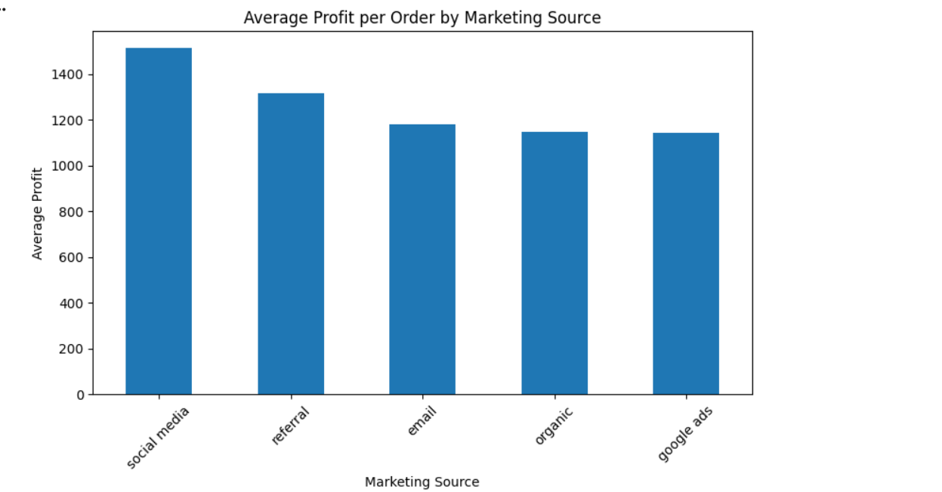
08 • PROBLEM STATEMENT 1
Which marketing source generates the highest average profit per order?
Main idea: compare average Profit across Marketing Source.
MAIN NOTEBOOK CODE
How the code works
profit_by_source = (
problem1_df
.groupby('Marketing_Source')['Profit']
.mean()
.sort_values(ascending=False)
)
profit_by_source
dropna()
keeps only rows where the required fields are available.
groupby()
creates one group for each marketing source.
mean()
calculates the average profit for each group.
sort_values()
puts the highest result first so the answer is easy to identify.
RESULT
Social Media
₹1,512.52 / order
Highest among the five sources.
E-commerce Customer Analysis
08

Slide 9
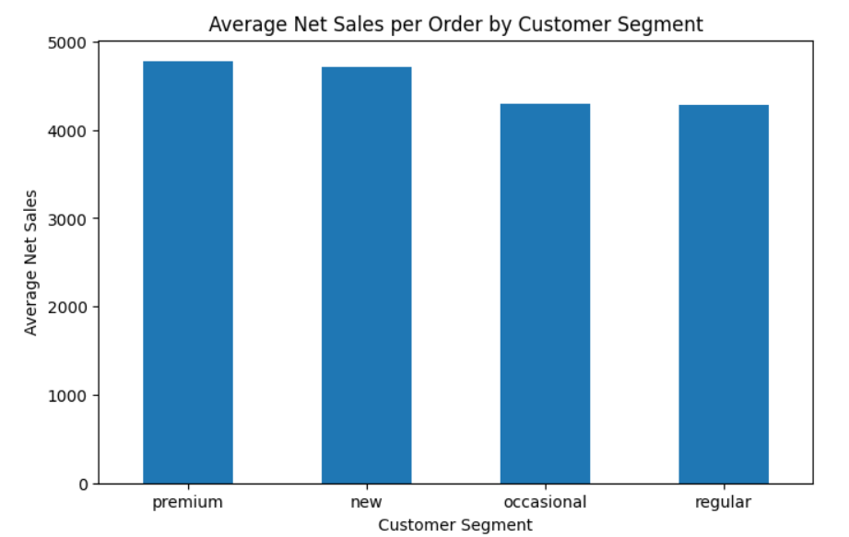
09 • PROBLEM STATEMENT 2
Which customer segment generates the highest average net sales per order?
Main idea: compare average Net Sales across Customer Segment.
MAIN NOTEBOOK CODE
How the code works
sales_by_segment = (
problem2_df
.groupby('Customer_Segment')['Net_Sales']
.mean()
.sort_values(ascending=False)
)
sales_by_segment
dropna()
keeps only rows where the required fields are available.
groupby()
creates one group for each customer segment.
mean()
calculates the average net sales for each group.
sort_values()
puts the highest result first so the answer is easy to identify.
RESULT
Premium
₹4,777.19 / order
Highest average net sales.
E-commerce Customer Analysis
09

Slide 10
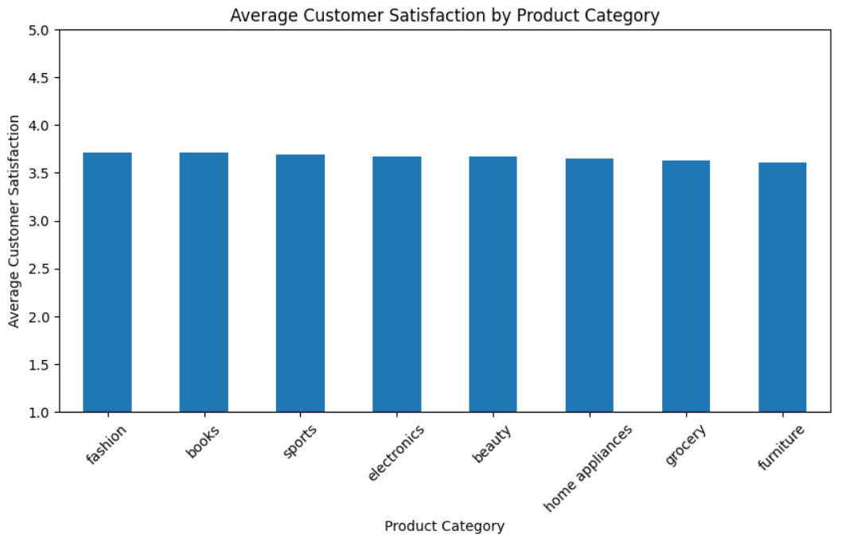
10 • PROBLEM STATEMENT 3
Which product category has the highest average customer satisfaction?
Main idea: compare average Customer Satisfaction across Category.
MAIN NOTEBOOK CODE
How the code works
satisfaction_by_category = (
problem3_df
.groupby('Category')['Customer_Satisfaction']
.mean()
.sort_values(ascending=False)
)
satisfaction_by_category
dropna()
keeps only rows where the required fields are available.
groupby()
creates one group for each category.
mean()
calculates the average customer satisfaction for each group.
sort_values()
puts the highest result first so the answer is easy to identify.
RESULT
Fashion
3.72 / 5
Highest average satisfaction.
E-commerce Customer Analysis
10

Slide 11
10 • COMBINED FINDINGS
Three answers, one business picture
The three problem statements highlight profitability, customer value and customer experience.
Social Media • ₹1,512.52
Premium • ₹4,777.19
Fashion • 3.72/5
Marketing
Customer value
Experience
Highest average profit per order
Highest average net sales per order
Highest average satisfaction
Simple interpretation
Social Media is the strongest source on average profit, Premium is the strongest segment on average net sales, and Fashion has the highest average satisfaction.
Important: these are group averages. They show a useful pattern, but they do not prove that one factor caused another.
E-commerce Customer Analysis
11

Slide 12
11 • RECOMMENDATIONS
What can the business do with these findings?
Recommendations stay close to what the analysis actually supports.
1
2
Review Social Media campaigns
Protect Premium value
Identify which creatives, audiences and offers are linked with stronger profit.
Use retention, cross-sell and personalized offers for the high-value segment.
3
4
Learn from Fashion
Measure beyond averages
Study the customer journey and identify practices that may improve lower-satisfaction categories.
Add spend, conversion, order volume, repeat purchase and lifetime value before major budget decisions.
Speaker line: “These findings are starting points for action. Before making a large decision, I would validate them with deeper business metrics.”
E-commerce Customer Analysis
12

Slide 13
12 • CONCLUSION
The complete analysis in four steps
A clear close: what I did, what I found and what it means.
1
2
3
4
UNDERSTAND
CLEAN
ANALYZE
ACT
Checked the dataset structure and key variables.
Standardized fields, removed duplicates and handled invalid values.
Compared group averages for the three problem statements.
Used the results to suggest focused business actions.
Final findings: Social Media leads average profit • Premium leads average net sales • Fashion leads satisfaction.
Good analytics = understand → clean → compare → explain → act
E-commerce Customer Analysis
13

Slide 14
THANK YOU
Questions & Discussion
E-commerce Customer Analysis
Data → Cleaning → Analysis → Insight
E-commerce Customer Analysis
14

