Slide 1
Customer Segmentation Using Unsupervised Learning
UNSUPERVISED MACHINE LEARNING PROJECT
K-Means, Hierarchical and DBSCAN applied to a churn dataset and a 10,000-customer marketing dataset
Presented by
Team Madhu | Yatheesh | Koteswarao
CALIBO AI ACADEMY
Notes:
Two projects, one theme: finding natural customer groups without labels. Project 1 uses a churn dataset (180 customers). Project 2 uses a marketing dataset (10,000 customers).

Slide 2
Why group customers at all?
One offer for every customer rarely fits. We looked for natural groups in customer data instead.
Project 1 | Churn data
180 customers, 11 features plus a Churn label.
Which kind of customer is more likely to leave?
Objective
Project 2 | Marketing data
Cluster customers without using labels, compare three algorithms, and describe what each group looks like.
10,000 customers, 42 columns.
Do spending and demographic patterns form distinct groups?
Notes:
Customers are different, but a single offer treats them the same. We use clustering (no labels needed) to find groups, then check what makes each group different.

Slide 3
Two datasets, one question
180 x 13
10,000 x 42
Churn dataset
Marketing dataset
 | Churn dataset | Marketing dataset
Size | 184 rows, 4 duplicates removed, 180 left | 10,000 customers, 42 columns
Features | Age, income, tenure, monthly charges, support calls, data usage, satisfaction, contract, payment, region, plan | Spending by product, purchase channels, campaign responses, income, age, family size, membership tier, device
Label | Churn (Yes / No), kept out of clustering | None. Fully unlabelled
Data quality | Messy: missing values, "?" entries, mixed spellings, impossible values | Clean: 0 missing values, but 5 negative incomes and 52 income outliers
Notes:
Churn data is small and messy. Marketing data is large and clean. Churn label was NOT used for clustering; it was only used afterwards to check each group.

Slide 4
Cleaning came before any modelling
Churn data
1
2
3
4
5
Remove duplicates
Fix text labels
Fix bad values
Cap outliers
Encode and scale
184 to 180 rows
8 spellings of contract type become 3
Age -5 or 145, charge 999 replaced with median
IQR capping, no rows lost
One-hot, StandardScaler: 22 features
Marketing data
1
2
3
4
5
Fix bad income
Cap outliers
Date features
Drop columns
Encode and scale
5 negatives replaced with median
52 income outliers capped at IQR limits
Customer_Since to year and month
ID, join date, birth year, 2 constant columns
One-hot, StandardScaler: 53 features
Why it matters: median and IQR capping keep every customer record while limiting the pull of extreme values.
Notes:
All three algorithms are distance-based. Unscaled columns or impossible values (like a charge of 999) would dominate the distances, so cleaning and scaling are required.

Slide 5
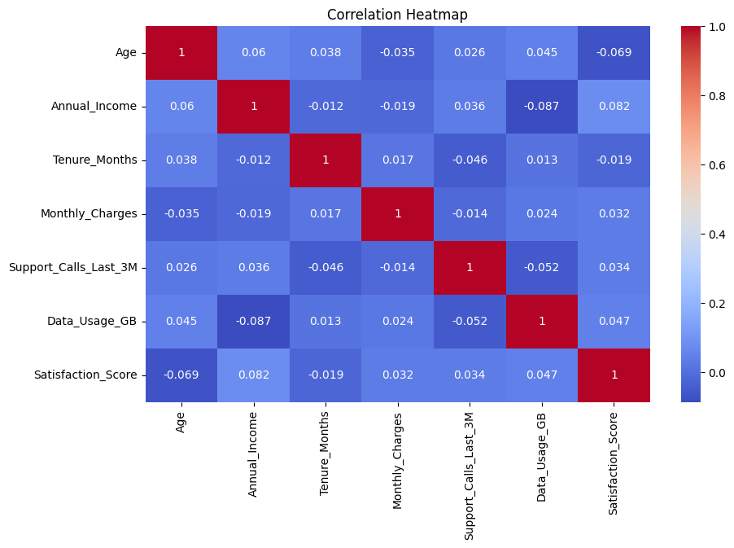
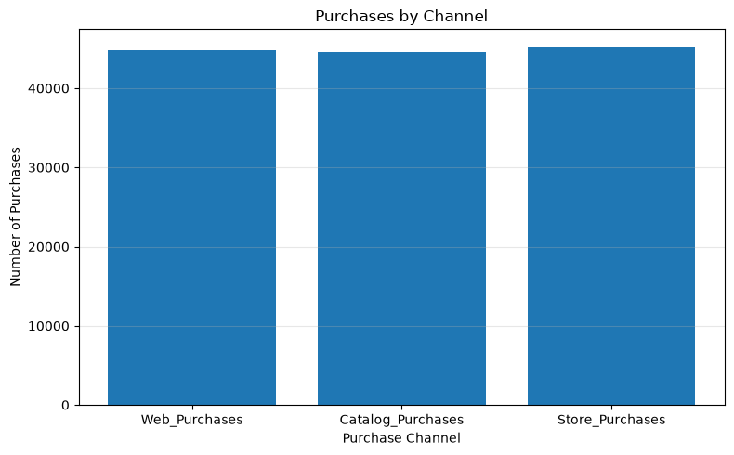
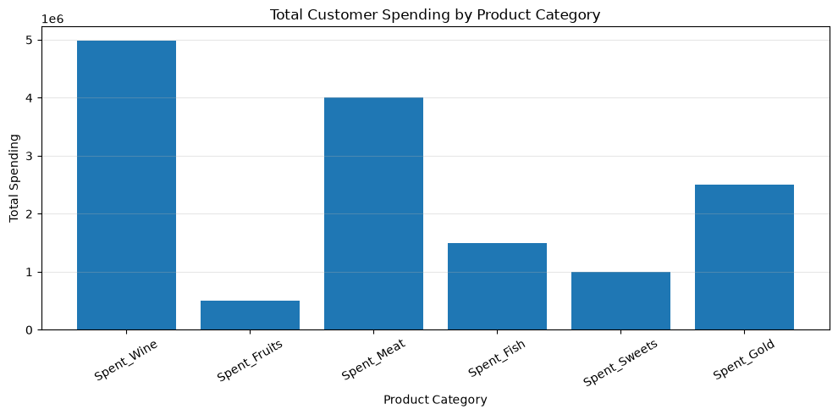
On the surface, customers look alike
MARKETING DATA
MARKETING DATA
CHURN DATA
Wine and meat make up most of the spending.
Web, catalog and store purchases are almost equal.
No two features are strongly related (all |r| below 0.1).
Notes:
These three views set up the problem. Spending is concentrated in wine and meat, channels are evenly used, and no churn feature is strongly correlated with another, so patterns are not visible by eye. We need clustering.

Slide 6
One workflow for both datasets
Raw data
Cleaning
Encode and scale
PCA
K-Means, Hierarchical, DBSCAN
Silhouette and profiling
Churn data
Marketing data
PCA to 2 components, then all three algorithms run on those 2 components.
All 53 scaled features go into clustering. PCA is only used for plotting.
How we judge a result
Silhouette Score (-1 to 1): higher means customers sit closer to their own group than to others. Then we profile each group by its average values.
Notes:
Churn data: PCA reduced the 22 features to 2 components before clustering. Marketing data: all 53 scaled features were clustered directly; PCA was used only to draw the plots. Silhouette Score ranges from -1 to 1; higher means groups are better separated.

Slide 7
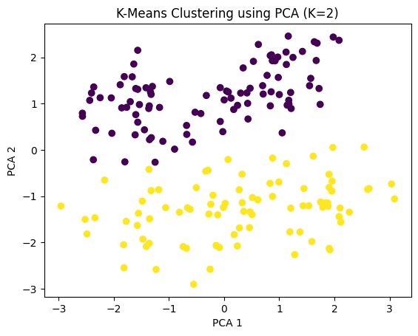
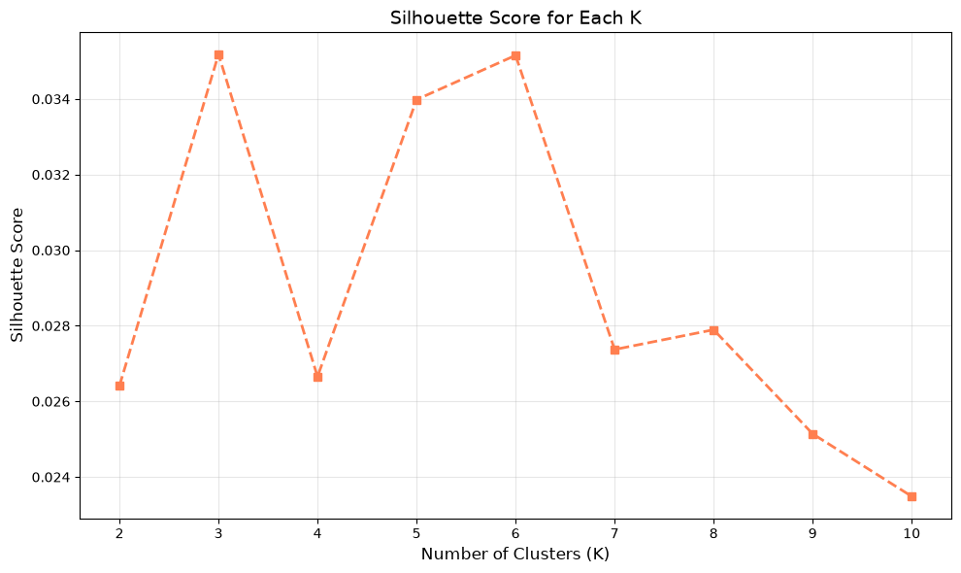
K-Means: the baseline method
What it does
Places K centres and assigns each customer to the nearest one, until nothing changes.
Why we used it
Simple, fast, and works well on scaled numbers. Easy to explain.
Result
Churn: K=2, 94 + 86 customers, silhouette 0.400.
Marketing: K=3, 983 / 3,594 / 5,423 customers, silhouette 0.0352.
Churn data: K=2 on PCA components
Marketing data: silhouette score for each K
Notes:
K-Means assigns customers to the nearest of K centres. For churn data we used K=2 from the elbow plot. For marketing data we tried K=2 to 10 and picked K=3 using the highest silhouette score. Note K=6 scored similarly (0.0352).

Slide 8
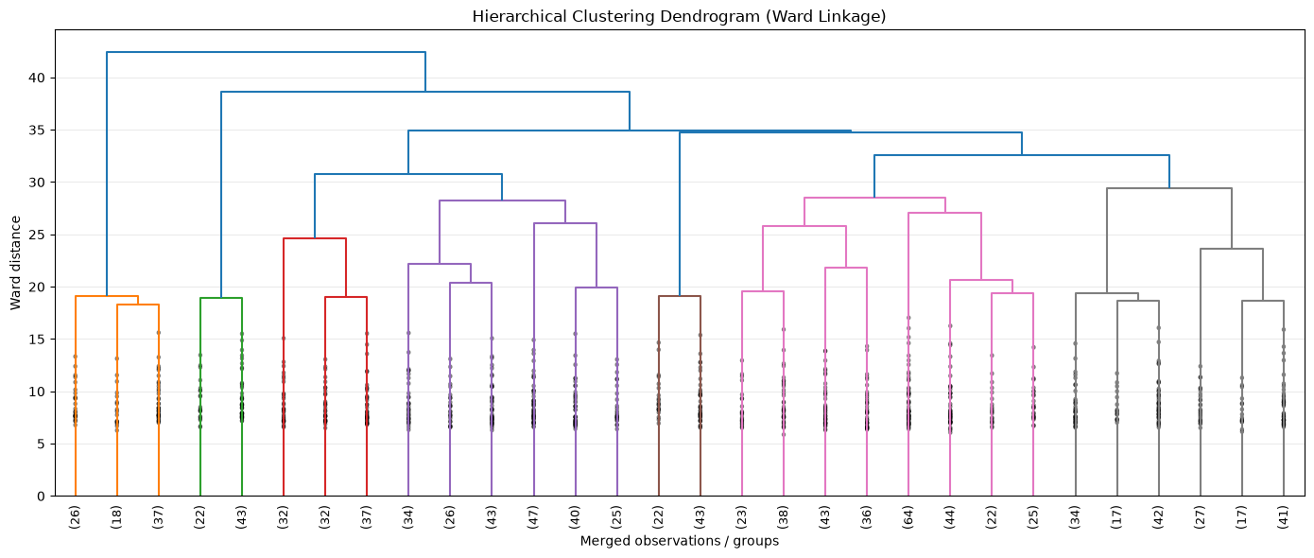
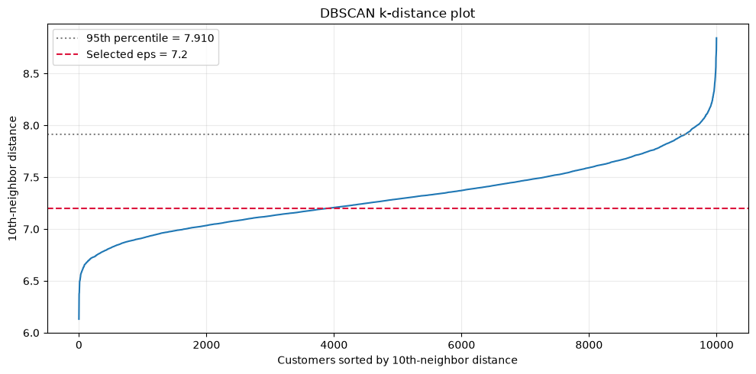
Hierarchical and DBSCAN as cross-checks
Hierarchical (Ward linkage)
DBSCAN
Marketing data dendrogram
Marketing data: k-distance plot, eps = 7.2
Merges the two closest groups, step by step. The dendrogram shows how.
Finds dense regions and marks isolated customers as noise. No K needed.
Churn: 2 clusters (97 / 83), silhouette 0.393.
Marketing: 3 clusters (8,315 / 873 / 812), silhouette 0.0436.
Churn: eps 0.5, 2 clusters + 20 noise, silhouette 0.164.
Marketing: eps 7.2, 17.66% noise, silhouette 0.0244.
Notes:
Hierarchical (Ward): merges the closest groups step by step; the dendrogram shows the order. DBSCAN: finds dense regions and marks isolated customers as noise (-1). eps was chosen from the k-distance plot on marketing data.

Slide 9
Comparing the three methods
Selected: K-Means
Best score: Hierarchical, with a caveat
Highest score and a balanced split (94 / 86). DBSCAN left 20 customers as noise.
83% of customers fall in one cluster. K-Means is more balanced (10% / 36% / 54%). All scores are very low.
Notes:
Churn: K-Means has the highest score (0.400) with balanced groups; DBSCAN leaves 20 customers as noise. Marketing: Hierarchical scores highest (0.0436) but puts 83% of customers in one cluster. All marketing scores are below 0.05.

Slide 10
Key results at a glance
0.400
57%
Silhouette, K-Means on churn data
Churn in the Higher-Risk segment
Best of three methods
vs 48% in the More Satisfied segment
0.0436
7.6%
Best silhouette on 10,000 customers
Variance kept by 2 PCA components
Hierarchical. Weak separation
Why marketing plots overlap
Notes:
0.400 = K-Means silhouette on churn data (moderate separation). 57% vs 48% = churn rate in Higher-Risk vs More Satisfied segments. 0.0436 = best marketing silhouette, i.e. weak structure. 7.6% = variance kept by the 2 PCA components (3.83% + 3.77%).

Slide 11
What the segments look like
Churn data: 2 segments
Marketing data: 3 clusters
The Higher-Risk group pays more and is less satisfied.
Age separates the clusters. Spending does not.
Segment | Customers | Churn | Satisf. | Charge
More Satisfied | 94 | 48% | 6.02 | 71.34
Higher-Risk | 86 | 57% | 5.48 | 78.48
Cluster | Customers | Avg age | Avg spend | Device
0 | 983 | 54.96 | 1,436 | 100% tablet
1 | 3,594 | 72.74 | 1,437 | Desktop / mobile
2 | 5,423 | 41.78 | 1,457 | Desktop / mobile
Notes:
Churn (K-Means, K=2): the Higher-Risk group pays more and is less satisfied. Marketing (K-Means, K=3): clusters differ by age, and Cluster 0 is entirely tablet users. Average spending is almost identical. Segment names for churn come from the notebook; marketing clusters are described, not named.

Slide 12
What the results tell us
1
Price and satisfaction mark the risky churn group.
Higher-Risk customers pay 78.48 a month vs 71.34, and rate satisfaction 5.48 vs 6.02.
2
Age and support calls do not.
Average age is 36.0 vs 36.5 and support calls 3.14 vs 2.97 across the two groups.
3
In the marketing data, spending does not split customers.
Average spend is 1,436 to 1,457 in every cluster. Age (42, 55, 73) and device do differ.
4
The marketing groups are soft, not sharp.
Silhouette stays at or below 0.0436 and 2 PCA components keep only 7.6% of the variance.
5
The method changes the story.
Hierarchical puts 83% in one cluster, DBSCAN flags 17.66% as noise, K-Means splits 10 / 36 / 54.
Notes:
Each point is backed by a number in the notebooks. Point 4 is the honest limitation: the marketing clusters are weak, so we treat them as a starting point.

Slide 13
Recommendations
1
Watch price and satisfaction
2
Do not target by spending clusters
Review retention offers for customers with higher monthly charges and lower satisfaction. That segment churns at 57%.
Spending is flat across marketing clusters. Test messages by age group and device instead, such as the tablet-only cluster.
3
Validate before rolling out
4
Bring the churn label back in
Silhouette scores are low. Run a small campaign test on a segment before acting on it at scale.
Churn was held out of clustering. A supervised model on the same cleaned data could predict churn directly.
Notes:
Each recommendation follows from a result on the previous slides. The fourth is a next step, not something we tested.

Slide 14
Conclusion
What we did
What we found
What it means
Cleaned two customer datasets and clustered them with K-Means, Hierarchical and DBSCAN. We compared the methods using Silhouette Score and profiled each group.
Churn data: K-Means gave two groups (silhouette 0.400); the Higher-Risk group churns at 57% vs 48%. Marketing data: scores stayed below 0.05.
Clustering works best when features carry real group differences. In the marketing data, age and device differ across clusters, spending does not.
Notes:
Three methods, two datasets. On the small churn data clustering gave a usable split. On the big marketing data it found only weak structure, and that is a finding too.

Slide 15
Thank You
Questions?
Team Madhu | Yatheesh | Koteswarao
CALIBO AI ACADEMY

