Slide 1
POWER BI · SALES ANALYTICS
13.25M
Total revenue
Sales Performance
Dashboard
7
Dashboard pages + drill-through
Revenue, profit, products, customers, sales team, geography and budget – 2021 to 2023
3 yrs
2021 – 2023 sales data
Presented by Madhu Kunchala
Top Calibo AI Academy

Slide 2
BEHIND THE DASHBOARDS
Data Preparation & Modeling
1
2
3
4
5
Append data
Build dimensions
Connect tables
Date table
Write DAX
Combined 2021, 2022 and 2023 sales into one Fact_Sales table
Product, Customer, Location, Salesperson and Date dimension tables
One-to-many relationships from each dimension to Fact_Sales
Dim_Date marked as the official date table for time intelligence
Measures for sales, profit, margin, growth and budget KPIs
KEY DAX MEASURES
Total Sales
Total Profit
Profit Margin %
YoY Growth
Budget Achievement %
Madhu Kunchala | Top Calibo AI Academy · 2

Slide 3
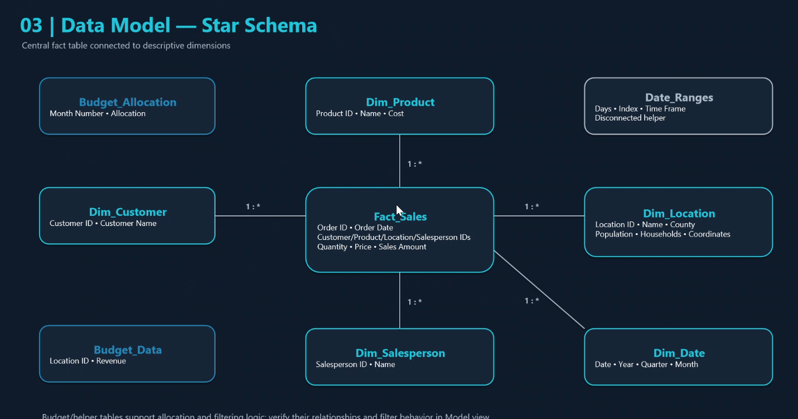
FACT TABLE ARCHITECTURE
Star Schema Data Model
Central fact table
Fact_Sales holds orders, quantity, price and sales amount
Six 1:* dimensions
Product, Customer, Location, Salesperson, Date + IDs
Helper tables
Budget_Data, Budget_Allocation and Date_Ranges drive budget & time logic
Madhu Kunchala | Top Calibo AI Academy · 3

Slide 4
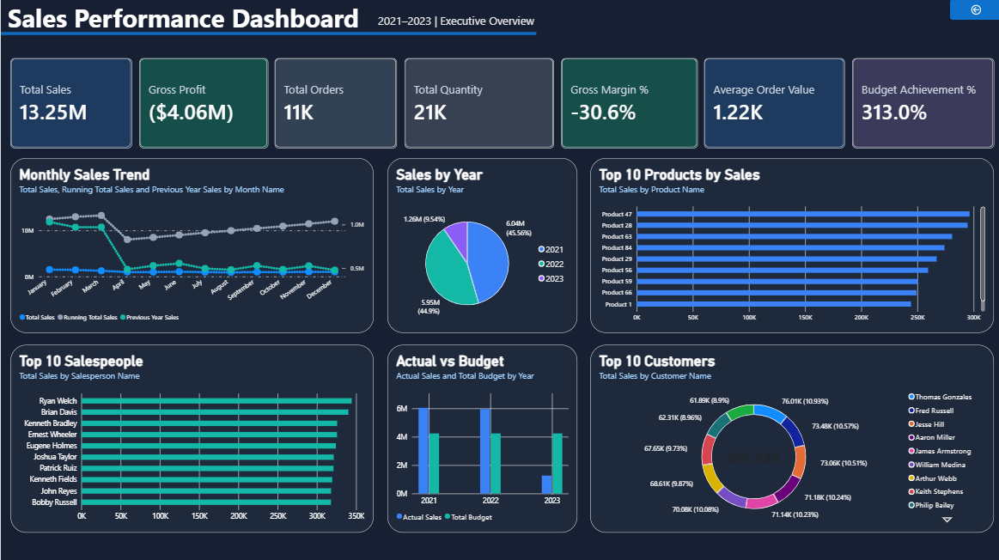
DASHBOARD 01 · EXECUTIVE OVERVIEW
Big picture: strong revenue, negative profit
Insert dashboard screenshot
Executive Overview page
13.25M
Total revenue
-4.06M
Total profit
-30.6%
Overall profit margin
2021
Best year – 6.04M revenue
313%
Overall budget achievement
So what: Revenue base is strong, but profitability is negative – margin recovery is the top priority.
Madhu Kunchala | Top Calibo AI Academy · 4

Slide 5
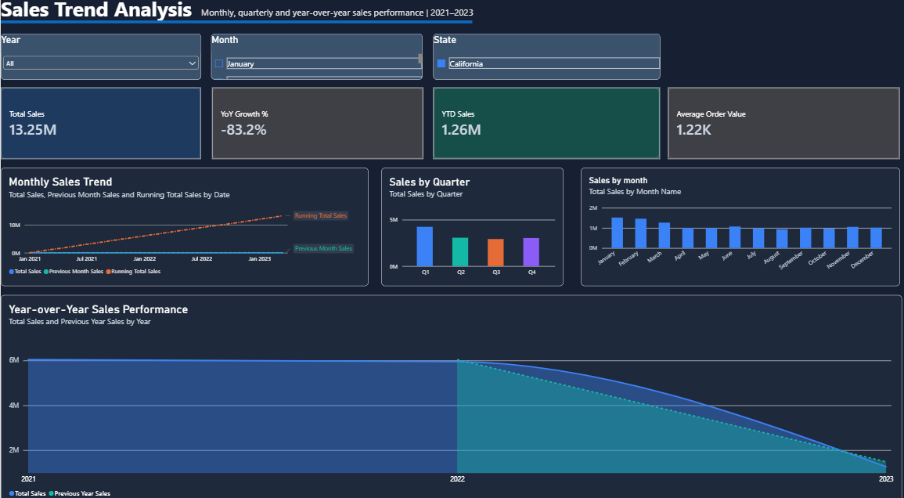
DASHBOARD 02 · SALES TREND ANALYSIS
Sales are not growing year over year
Insert dashboard screenshot
Sales Trend Analysis page
2021 · 6.04M
Highest-sales year
-1.46%
Sales fell 2021 → 2022 (5.95M)
Jan · 1.52M
Peak month (Aug is lowest at 0.93M)
Q1 · 4.24M
Best-performing quarter
-14.8%
Jan–Mar 2023 vs Jan–Mar 2022 (only 3 months of 2023)
So what: Strong January peak and August dip show clear seasonality – plan campaigns and stock around it.
Madhu Kunchala | Top Calibo AI Academy · 5

Slide 6
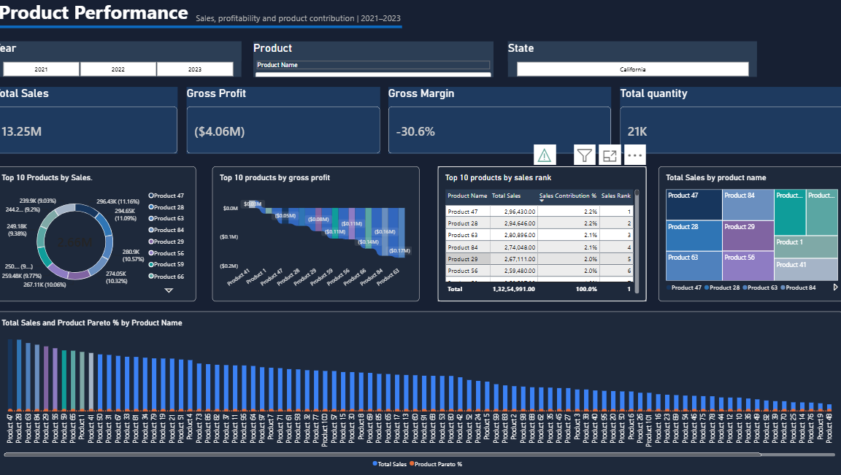
DASHBOARD 03 · PRODUCT PERFORMANCE
High sales do not always mean high profit
Insert dashboard screenshot
Product Performance page
Product 47 · 296K
Highest revenue
Product 41 · 25.4K
Highest profit – prioritise
Product 24 · 289
Most units sold
-61.0%
Product 63 margin on 281K sales
-60.2%
Product 84 margin – also needs repricing
So what: Reprice or cut costs on Products 63 and 84; double down on Product 41.
Madhu Kunchala | Top Calibo AI Academy · 6

Slide 7
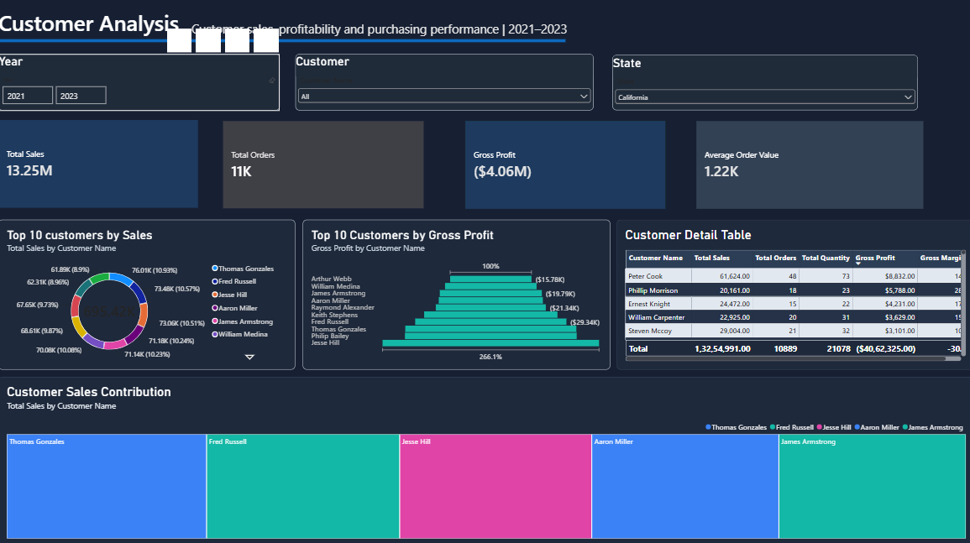
DASHBOARD 04 · CUSTOMER ANALYSIS
Customer Analysis
Insert dashboard screenshot
Customer Analysis page
Aaron Miller · 34.6K
Top customer – also 27 orders
2.4%
Revenue from top 10 customers
Phillip Morrison · 5.8K
Highest-profit customer
-16.2K
Mark Morales profit on 30.9K sales
So what: Low concentration risk – but review discounts and costs for high-sales, loss-making customers.
Madhu Kunchala | Top Calibo AI Academy · 7

Slide 8
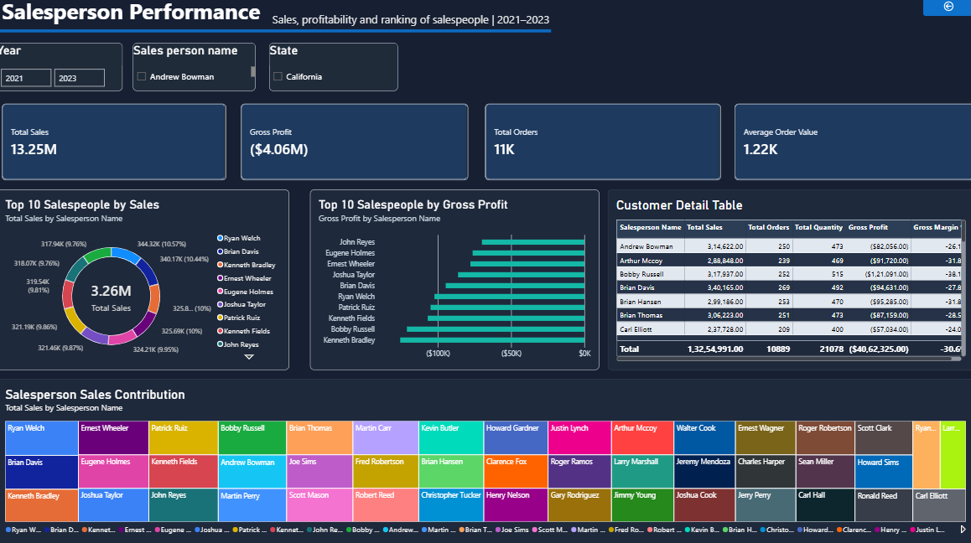
DASHBOARD 05 · SALESPERSON PERFORMANCE
Top seller is not the most profitable
Insert dashboard screenshot
Salesperson Performance page
Ryan Welch · 344K
Top sales, 273 orders
-102K
Ryan Welch profit despite top sales
Sean Miller · -55K
Least negative profit
+21.9%
Carl Hall – best 2021 → 2022 growth
So what: Coach Ryan Welch and Kenneth Bradley on pricing, discount control and costs.
Madhu Kunchala | Top Calibo AI Academy · 8

Slide 9
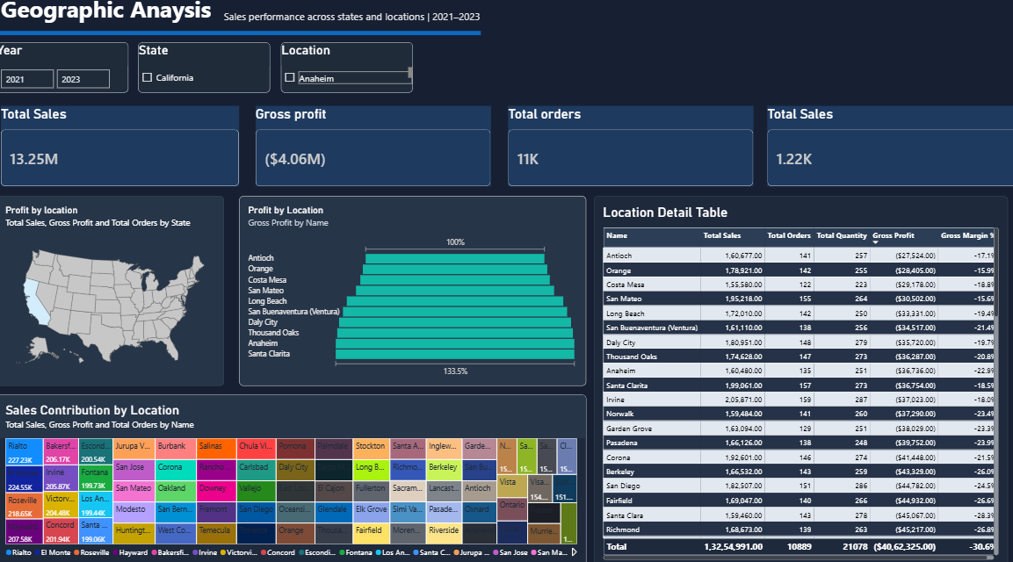
DASHBOARD 06 · GEOGRAPHIC ANALYSIS
Geographic Analysis
Insert dashboard screenshot
Geographic Analysis page
13.25M
California total sales
Rialto · 227K
Best-performing location
San Francisco · 148K
Low sales despite 865K population
~0
Correlation: population vs sales
Fresno
Growth opportunity (high pop., low sales)
So what: Target San Francisco and Fresno – large markets with untapped sales potential.
Madhu Kunchala | Top Calibo AI Academy · 9

Slide 10
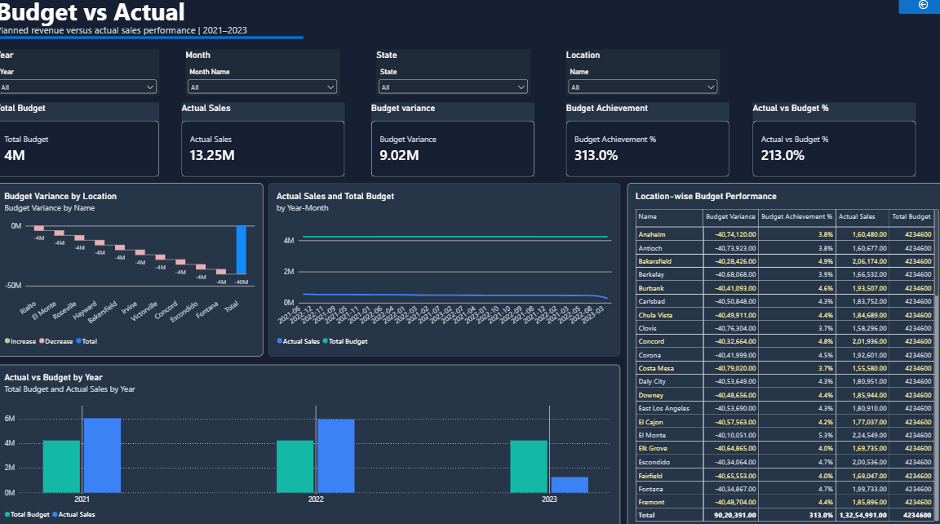
DASHBOARD 07 · BUDGET VS ACTUAL
Budget vs Actual
Insert dashboard screenshot
Budget vs Actual page
313%
Overall budget achievement
74
Locations exceeded budget
23
Locations missed budget
Jan · +1.35M
Largest variance (Feb +1.16M)
A180–A182
Zero sales vs budget – investigate
So what: 313% suggests budgets are set too low or mismatched by year/location – realign allocation.
Madhu Kunchala | Top Calibo AI Academy · 10

Slide 11
STRATEGIC INSIGHTS
What the Data Tells Us
Strengths
Concerns
Recommendations
Strong revenue base – 13.25M total
High-profit products such as Product 41
Top locations like Rialto beat budget
Revenue fell from 2021 to 2022
Overall profit -4.06M, margin -30.6%
Products 63 & 84 and zero-sales locations drag results
Fix pricing and cost on low-margin products
Replicate top products and locations
Investigate weak locations and customers
Track YoY decline drivers closely
Realign budget by year and location
Madhu Kunchala | Top Calibo AI Academy · 11

