Slide 1
KONERU LAKSHMAIAH EDUCATION FOUNDATION
Database Systems Engineering and Distributed Backend Development (25CS1302E)
LOST AND FOUND
CAMPUS TRACKER
A smart, location-aware recovery network for the campus community
REVIEW 2 • Sec No-10 • Team No-16
M. Harshika | 2520090047
Ch. Madhulika | 2520090056
B. Neha | 2520090013

Slide 2
WHY WE NEED THIS SYSTEM
Problem Statement
College campuses generate a constant stream of lost and found belongings — ID cards, electronics, bags, water bottles — but recovery still depends on outdated, fragmented methods.
Result: delayed recovery, lost trust, and repeated losses at the same hotspots across campus.
1
Scattered channels
2
No location context
Notice boards, WhatsApp groups, and word-of-mouth are unorganized and easily missed.
There is no record of where an item was actually lost or found on campus.
3
No verification
4
Slow, manual matching
Anyone can claim an item — there's no way to confirm true ownership.
Students must manually cross-check every posting themselves, item by item.
Lost and Found Campus Tracker | Team 16, Sec 10
2

Slide 3
WHAT THE SYSTEM AIMS TO ACHIEVE
Objectives
Build a centralized platform to report and track lost and found items
Enable location-aware reporting and hotspot visualization on a campus map
1
2
Automatically generate potential matches between lost and found reports
Provide secure ownership verification before an item is released
3
4
Track every report through a clear recovery lifecycle
Give administrators tools to review, resolve, and de-duplicate reports
5
6
Lost and Found Campus Tracker | Team 16, Sec 10
3

Slide 4
HOW THE PLATFORM WORKS
Proposed System
The Lost and Found Campus Tracker gives every reported item a recovery trail — from the moment it's reported to the moment it's safely returned.
1
2
3
4
5
Reported
Possible Match
Verification Pending
Verified
Recovered
Item logged with category, description, location, date/time & image
System compares attributes and flags likely matches with a confidence score
Claimant provides private identifying details known only to the owner
Ownership confirmed by the reporter or an admin
Item returned and the report is closed
Lost and Found Campus Tracker | Team 16, Sec 10
4

Slide 5
THREE-TIER DESIGN
System Architecture
Presentation Layer
Application Layer
Data Layer
HTML5, CSS3, JavaScript, Bootstrap
Java (Spring Boot)
MySQL via Spring Data JPA / Hibernate
Home / Report forms
REST API & controllers
Users, items & reports
→
→
Dashboard & map view
Matching algorithm
Match records
Login & registration
Notification service
Location history
External Services
Google Maps API — campus location & hotspot mapping
Email Notification Service — possible-match alerts
Lost and Found Campus Tracker | Team 16, Sec 10
5

Slide 6
CORE BUILDING BLOCKS
Modules / Functionalities
1
2
3
4
User Auth & Profiles
Report Lost / Found Item
Matching Engine
Location & Map Module
Registration, login and role-based access for students, staff & admins
Capture category, description, location, date/time and photo
Rule-based comparison of attributes to surface likely matches with a score
Google Maps–based hotspot view of frequently reported areas
5
6
7
8
Verification & Recovery
Notifications
Admin Panel
Reporting & Insights
Private-detail ownership checks and lifecycle status tracking
Automated email alerts when a strong match is found
Review flagged reports, resolve disputes, remove duplicates
Trends on recurring loss locations and item categories
Lost and Found Campus Tracker | Team 16, Sec 10
6

Slide 7
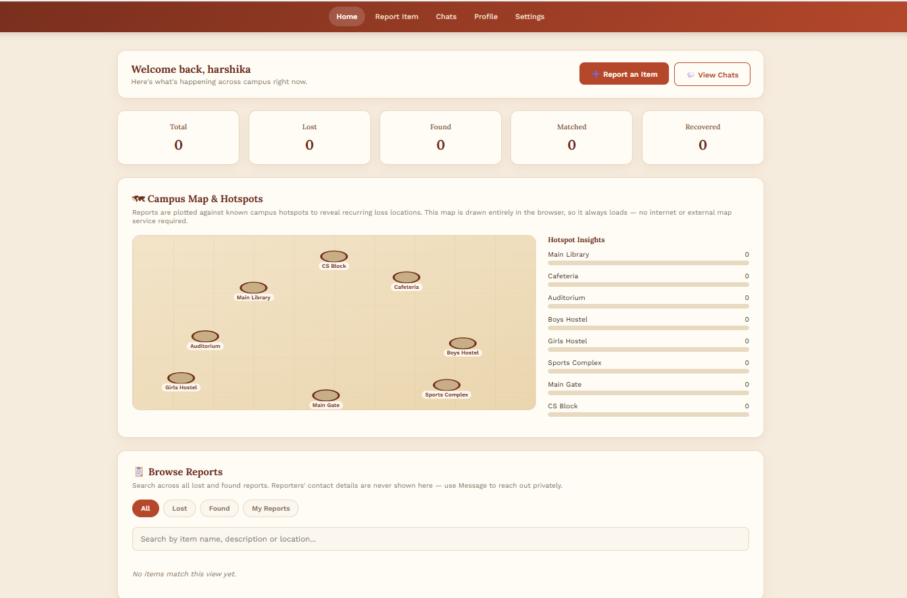
BOOTSTRAP-BASED UI
Frontend Design — Home Page
Design Highlights
Clear navigation to Report Lost, Report Found, and Search
Quick campus-map preview highlighting recent reports
Recently reported items shown as scannable cards
🖼
Consistent header/footer used across every page
Insert Home Page screenshot here
Lost and Found Campus Tracker | Team 16, Sec 10
7

Slide 8
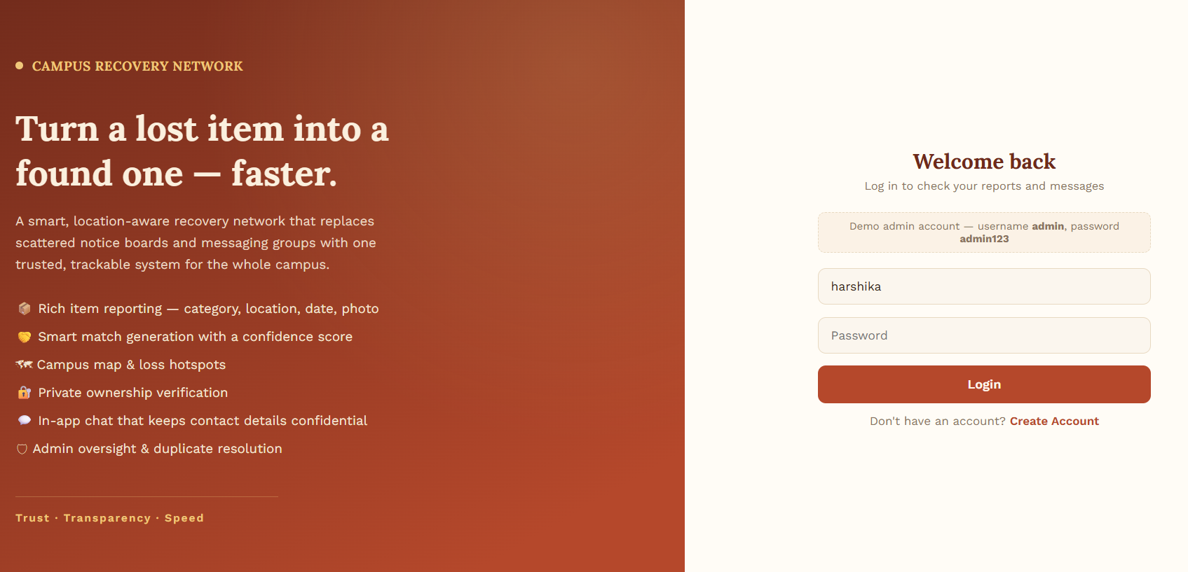
ROLE-BASED ACCESS
Frontend Design — Login / Registration
Design Highlights
Separate sign-up for students and staff
Form validation for email, phone and password strength
Session handling for secure, role-based access
🖼
Clean, distraction-free layout for fast entry
Insert Login / Registration screenshot here
Lost and Found Campus Tracker | Team 16, Sec 10
8

Slide 9
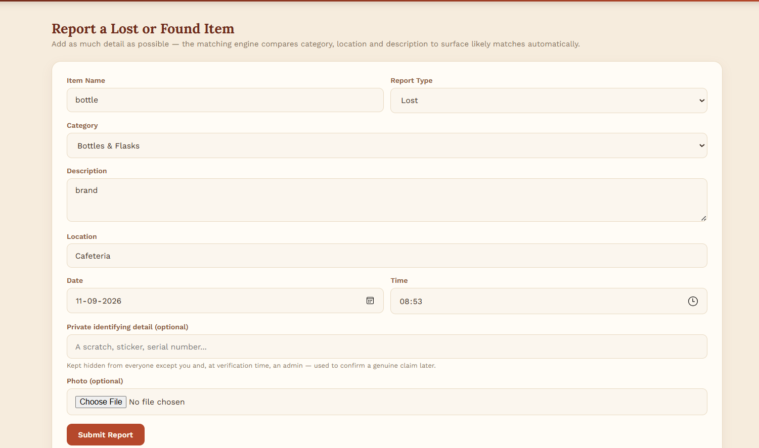
STRUCTURED DATA CAPTURE
Frontend Design — Report Forms
Design Highlights
Fields for category, description, location, date & time
Image upload for visual identification
Optional private detail field for future verification
🖼
Inline validation before submission
Insert Report Form screenshot here
Lost and Found Campus Tracker | Team 16, Sec 10
9

Slide 10
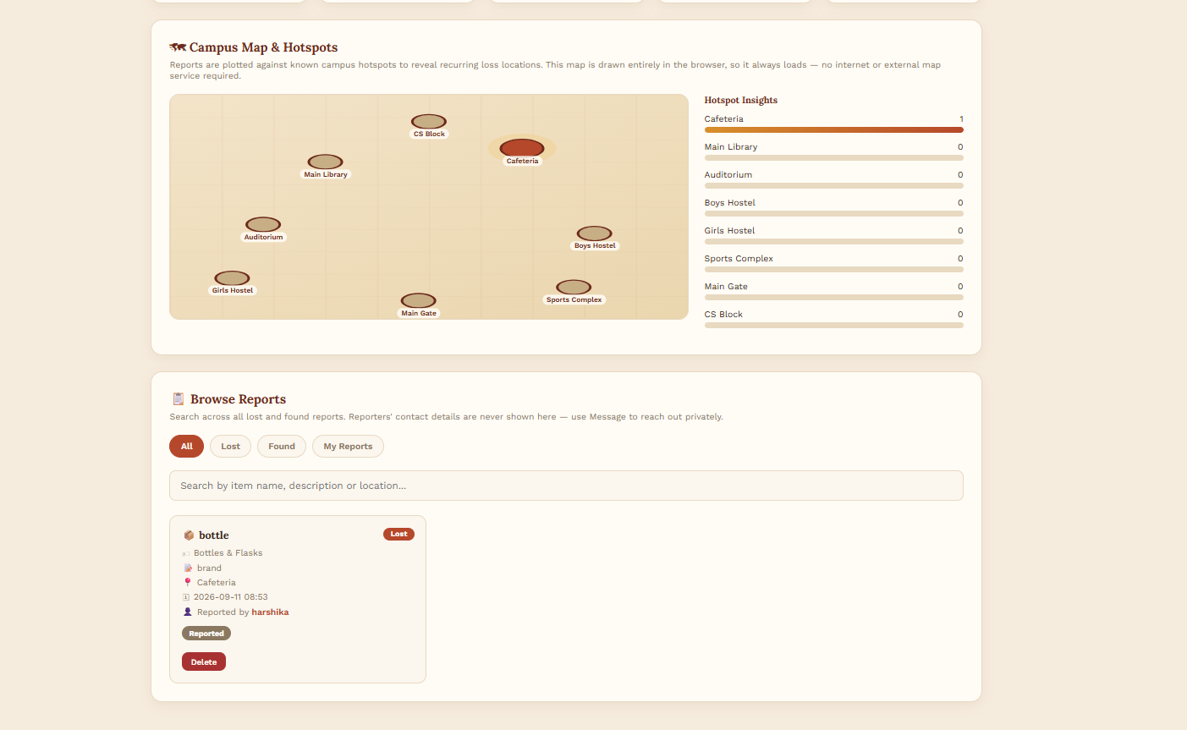
TRACK EVERY REPORT
Frontend Design — Dashboard
Design Highlights
My Reports view with live lifecycle status
Possible-match alerts surfaced at the top
Filter by category, location or status
🖼
Admin view adds moderation & duplicate controls
Insert Dashboard screenshot here
Lost and Found Campus Tracker | Team 16, Sec 10
10

Slide 11
CORE ENTITIES & RELATIONSHIPS
Database Design — ER Diagram
ITEM_REPORT
MATCH
NOTIFICATION
USER
PK report_id
PK match_id
1 : N
PK notif_id
PK user_id
1 : N
FK user_id
N : 1
FK lost_report_id
FK user_id
name
type (lost/found)
FK found_report_id
FK match_id
email
category
confidence_score
sent_at
role
location
match_date
phone
date_time
status
image_url
VERIFICATION
LOCATION_LOG
PK verify_id
PK loc_id
FK match_id
FK report_id
private_detail_hash
latitude / longitude
verified_by
Lost and Found Campus Tracker | Team 16, Sec 10
11

Slide 12
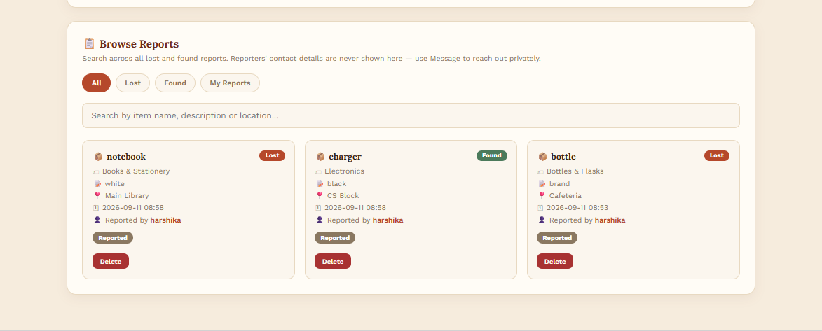
MYSQL VIA SPRING DATA JPA
Database Design — Schema & Sample Records
ITEM_REPORT — Key Columns
Column | Type | Notes
report_id | BIGINT (PK) | Auto-increment
user_id | BIGINT (FK) | References USER
type | VARCHAR(10) | 'lost' or 'found'
category | VARCHAR(50) | e.g. Electronics, ID Card
location | VARCHAR(120) | Approx. location text
status | VARCHAR(30) | Lifecycle stage
Column
Type
Notes
🖼
Insert actual DB table / phpMyAdmin screenshot here
Sample Records (illustrative)
ID | Type | Category | Status
101 | Lost | ID Card | Verification Pending
102 | Found | Water Bottle | Reported
103 | Lost | Earphones | Recovered
ID
Type
Category
Status
Lost and Found Campus Tracker | Team 16, Sec 10
12

Slide 13
STATUS AS OF THIS REVIEW
Current Progress
✔ Completed
◷ In Progress / Pending
Abstract finalized and submitted
Frontend page implementation (Home, Forms, Dashboard)
Requirements, objectives & scope defined
Backend REST APIs & Spring Boot setup
System architecture designed
Matching algorithm implementation
ER diagram & database schema drafted
Google Maps API integration
Tech stack finalized (Spring Boot, MySQL, Bootstrap)
Email notification service integration
Lost and Found Campus Tracker | Team 16, Sec 10
13

Slide 14
WHAT'S NEXT
Challenges & Future Work
Challenges / Issues Faced
Future Work
Designing a matching algorithm that balances accuracy vs. false positives
1
Complete backend APIs and connect to the MySQL database
2
Build and refine all frontend pages with real data
Keeping ownership verification secure without adding friction
3
Integrate Google Maps for live hotspot visualization
Coordinating schema design across three team members
4
Test the matching engine against realistic sample data
Lost and Found Campus Tracker | Team 16, Sec 10
14

Slide 15
CONCLUSION
Turning campus lost & found
into a connected recovery network
Centralizes lost & found reporting for the entire campus
Uses location data and rule-based matching to speed up recovery
Protects ownership through private-detail verification
Gives administrators visibility, control, and useful insights
Thank You
Team 16 • M. Harshika, Ch. Madhulika, B. Neha

