Slide 1


Department of Information Technology
Mini Project- I
YOJANTHA: AI-Powered Access to Government Schemes
Mini Project-I (22ITC07) | B.E. IT – IV Semester
Guided By: Dr. Prathima Tirumalareddy
Presented By: Damodara Lakshmi Madhulika (160123737144) |
Dokuparthi Shravista (160123737145)

Slide 2

The Problem
Our Motivation
Fragmented Information
Millions of eligible citizens miss out on government benefits simply due to lack of awareness and accessibility. YOJANTHA bridges this gap by offering a simple, intelligent, and personalized platform that brings the right schemes to the right people.
Government schemes are scattered across dozens of unconnected portals.
Complex Eligibility
Criteria are written in bureaucratic language, difficult for citizens to parse.
The goal: Make government welfare truly accessible to every citizen, powered by AI.
No Personalization
Generic portals offer zero filtering based on individual user profiles.
No Interactive Help
Citizens have no guided assistance when navigating application processes.

Slide 3
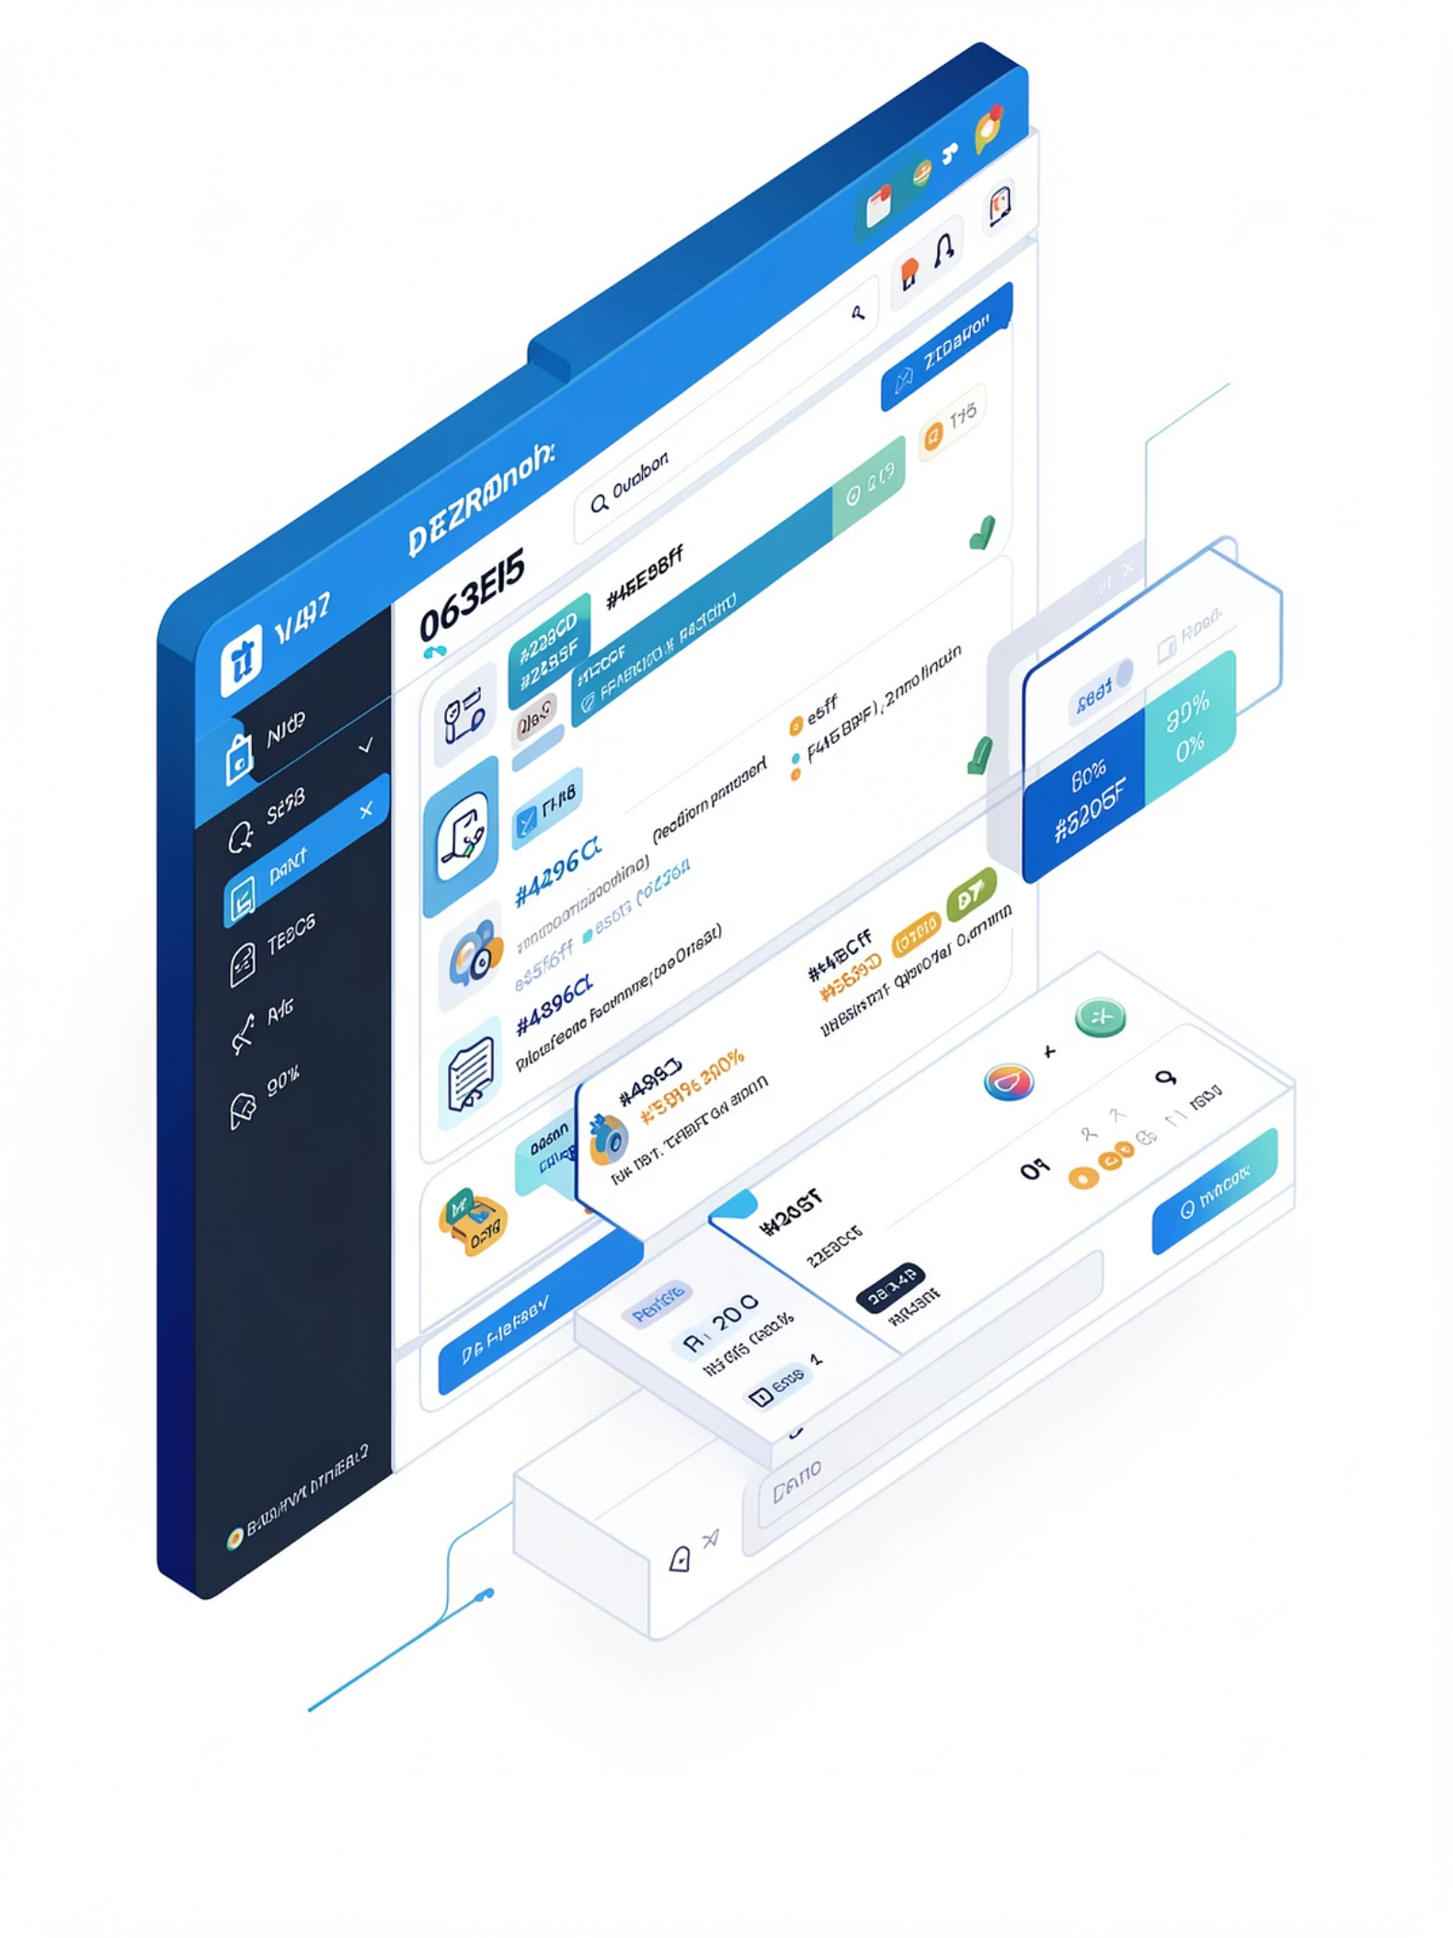
YOJANTHA: The Solution
Centralized Platform
All government schemes in one unified, easy-to-navigate portal.
Profile-Based Personalization
Schemes filtered and ranked based on the user's age, gender, state, and income.
Gemini-Powered AI Chatbot
Natural language assistance for eligibility queries and application guidance.
Semantic Search
Vector-embedding-based search for context-aware, intent-driven results.

Slide 4
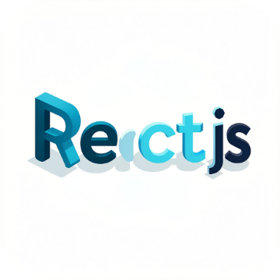

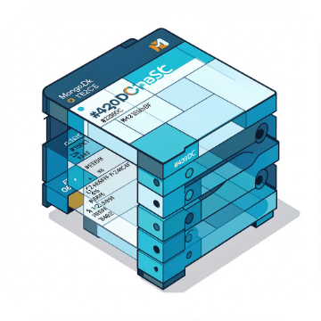

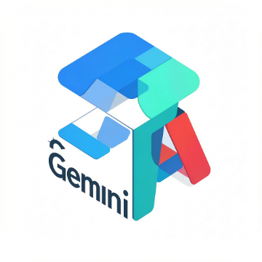
Tech Stack
MERN Stack + Google Gemini AI — a modern, scalable, full-stack architecture
Frontend
Backend
Database
Authentication
React.js — dynamic, component-based Single Page Application
Node.js + Express.js — RESTful API with MVC architecture
MongoDB — flexible NoSQL schema for schemes and user data
JWT + bcrypt — secure token-based login and password hashing
AI Integration
Google Gemini API — powers chatbot, recommendations, and semantic search

Slide 5

System Architecture
Four layers work in concert to deliver a seamless, AI-enhanced user experience.
User
React UI
REST API
MongoDB ↔ Gemini
Every user interaction flows from the React frontend through a secure REST API, queries MongoDB for scheme data, and routes through the Gemini AI layer to deliver personalized, intelligent responses.

Slide 6
Key Features
User Authentication & Profile
AI Chatbot Assistance
Personalized Recommendations
Conversational AI to answer eligibility questions and guide users through applications.
Secure JWT-based login with detailed profile management for personalized experiences.
Schemes ranked by relevance to each user's unique demographic and socioeconomic profile.
Semantic Search
Scheme Tracking
Vector embeddings enable intent-driven search, far beyond simple keyword matching.
Users can mark schemes as Interested or Applied, tracking their journey end-to-end.

Slide 7
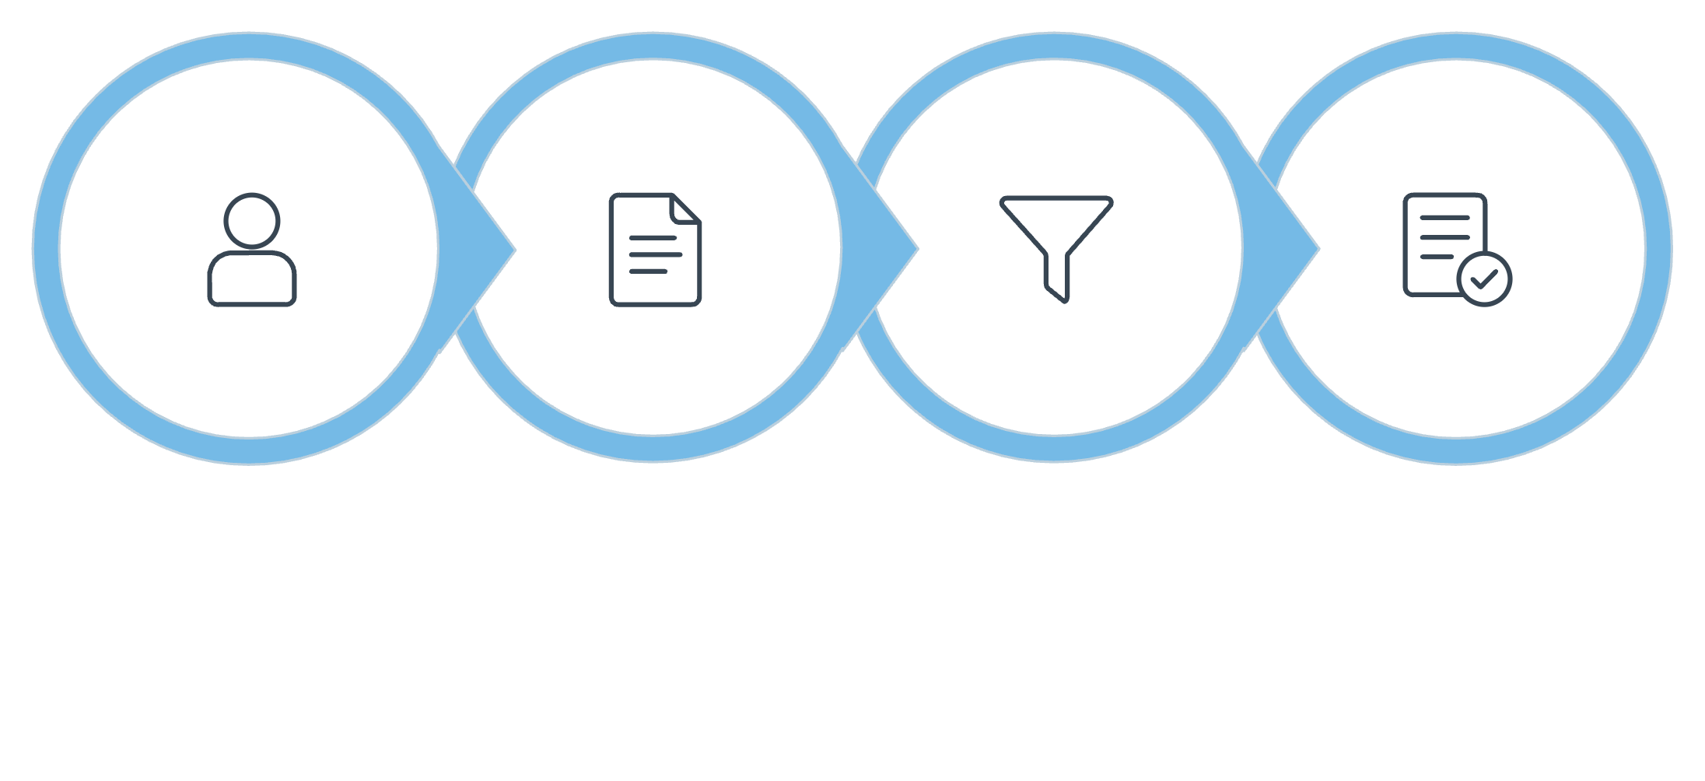

AI CORE
Personalized Recommendation Engine
The engine extracts key user attributes — age, gender, state, income category — and constructs a structured prompt for Google Gemini AI. The model filters the scheme database, ranks results by relevance, and returns personalized matches with clear reasoning.
Extract Profile
Build Prompt
Filter & Rank
Show Results
Result: Users see only the schemes they are actually eligible for, with plain-language explanations of why each scheme applies to them.

Slide 8

GEMINI-POWERED
AI Chatbot
The YOJANTHA chatbot handles natural language queries from citizens — answering questions about eligibility criteria, application deadlines, and required documents in plain, accessible language.
System Prompt Control
Context Retention
Custom system prompts keep responses accurate and scoped to government schemes.
Maintains conversation context across multiple turns for coherent assistance.

Slide 9
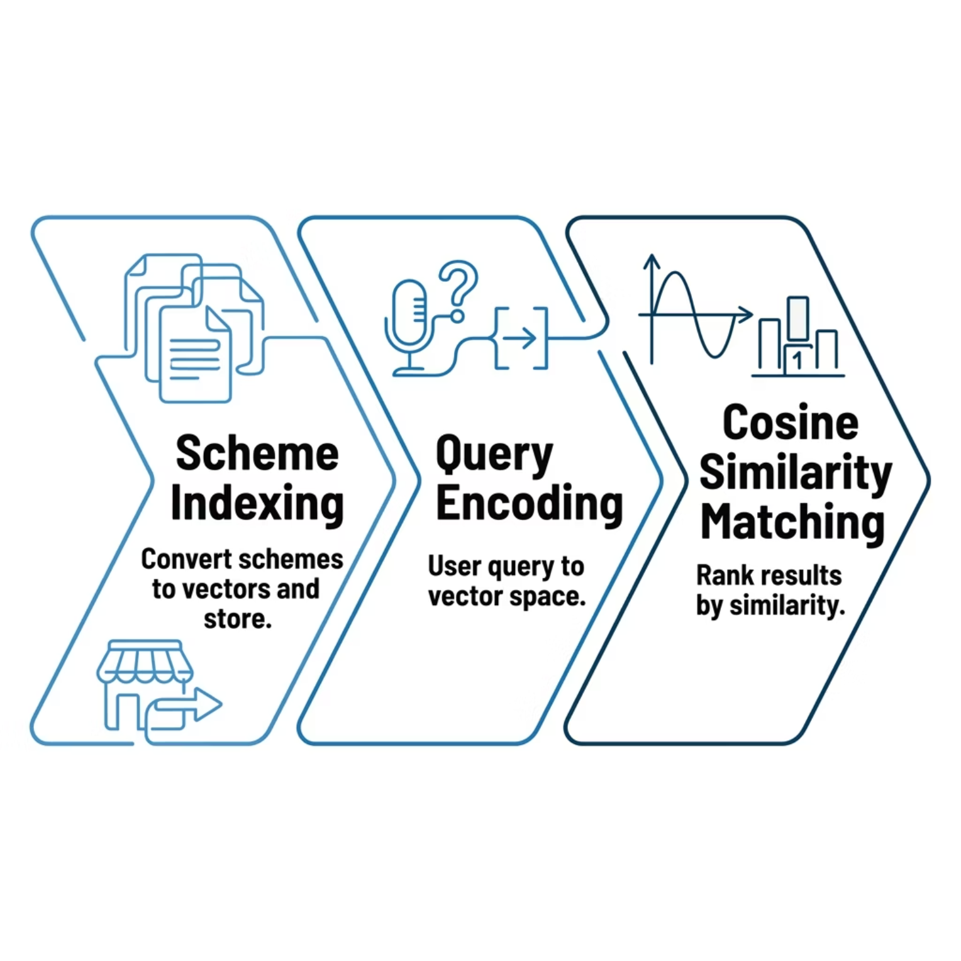


Semantic Search via Vector Embeddings
Going far beyond keyword matching — understanding user intent to surface truly relevant schemes.
Why Semantic Search?
Traditional keyword search fails when users phrase queries differently from how schemes are described. Vector embeddings capture semantic meaning, not just lexical overlap.
Example: A query for "help for farmers" correctly surfaces "PM-KISAN" even if those exact words don't appear in the query.

Slide 10
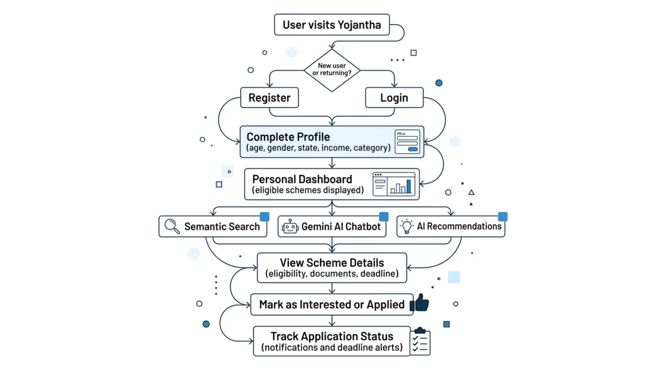

User Journey: Accessing Yojantha
A seamless, AI-guided path to government schemes
From initial interaction to application tracking, Yojantha provides intuitive navigation and comprehensive support at every step.

Slide 11
Challenges & Solutions
Overcoming technical hurdles to deliver a robust and reliable platform.
Gemini API Rate Limits
Diverse Data Formats
Implemented caching for frequent requests and introduced exponential backoff with retry logic to manage API calls efficiently and prevent service interruptions.
Developed NLP-driven data ingestion pipelines to extract, normalize, and standardize scheme information from unstructured government documents into a unified schema.
User Data Privacy
Vector Embedding Scalability
Ensured end-to-end encryption, anonymization techniques for sensitive fields, robust access controls, and strict adherence to privacy best practices.
Optimized embedding storage and retrieval using MongoDB's indexing capabilities and explored approximate nearest neighbor (ANN) search for efficient semantic matching at scale.

Slide 12

Impact & Outcomes
Tangible results driving welfare accessibility and efficiency
3400+
75%
60%
Schemes Covered
Reduction in Application Time
Awareness Boost
A comprehensive database ensuring no eligible citizen misses out on available opportunities. (Estimated Target)
Streamlining complex application processes, making them faster and significantly less burdensome. (Estimated Target)
Significantly bridging the information gap, connecting more citizens with vital government schemes. (Estimated Target)

Slide 13
YOJANTHA: Bridging Gaps, Empowering Futures
YOJANTHA represents a significant step toward a more accessible and equitable welfare system, leveraging cutting-edge AI to serve every citizen.
Impactful Accessibility
AI-Driven Innovation
Future-Proof Empowerment
Centralized, personalized access to all government schemes, eliminating information fragmentation.
Gemini AI powers intuitive recommendations, natural language chatbot assistance, and precise semantic search.
A scalable platform poised to connect millions more to essential benefits, fostering true social equity.
YOJANTHA is more than just a platform; it's a commitment to ensuring that no citizen is left behind due to lack of awareness or complex processes. We envision a future where every eligible individual can easily discover and apply for the support they deserve, powered by intelligence and empathy.
Future Scope
Multilingual support to make the platform accessible across more languages
Mobile app development for easier access on smartphones and tablets
Integration with DigiLocker to simplify document verification and submission
State-level scheme APIs to expand coverage with localized welfare programs

