Slide 1
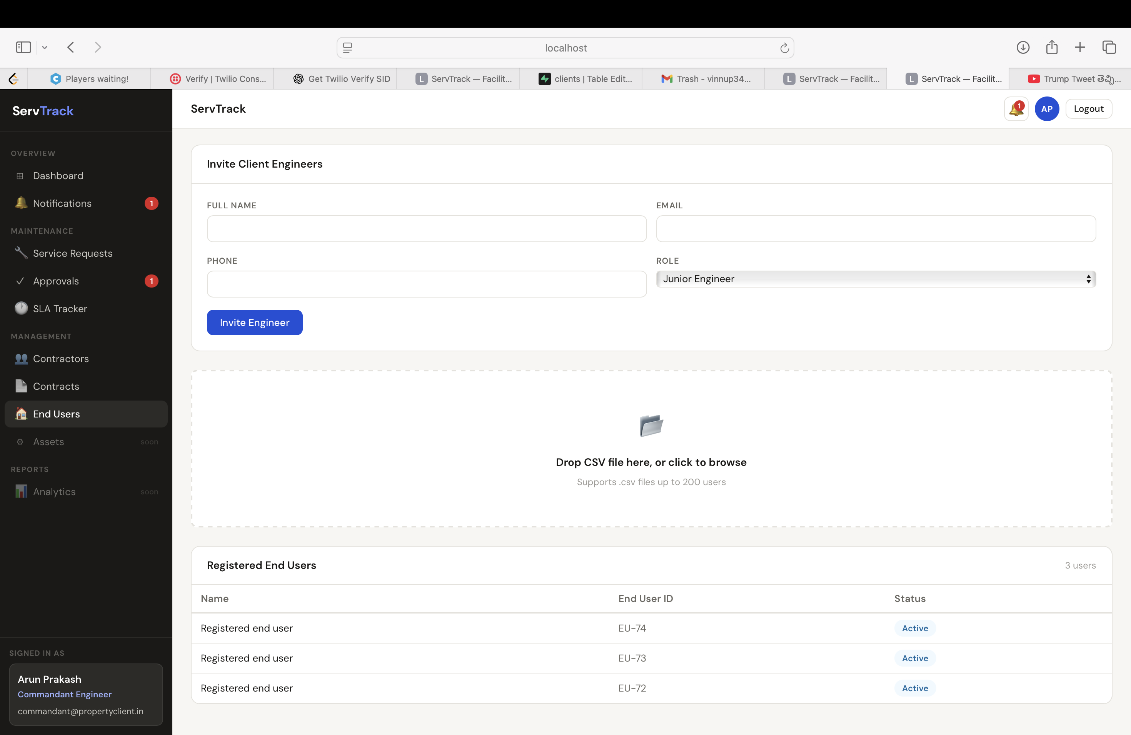
ServTrack
Phase 1 demo
A role-routed maintenance workflow for facility requests, contractor execution, supervisor QC, and requester approval.
Built for the live demo: clear accountability, OTP-only end-user access, and encrypted end-user PII.
Implemented scope
ServTrack Phase 1 demo | 01

Slide 2
OPERATING MODEL
The product system is the work order
Phase 1 makes each handoff explicit so requests do not disappear between admin, contractor, field, QC, and requester approval.
End User
Contractor
Raises a request and approves completed work when they requested it.
Work Order
Receives approved work and assigns supervisor plus workman.
status + assignment + history
Client Engineers
Field Team
Approve, reject, assign contractors, and manage users by subrole.
tenant scoped
Workman executes; supervisor validates QC before requester approval.
ServTrack Phase 1 demo | 02

Slide 3
ACCESS MODEL
Role clarity for the demo audience
Role
Primary responsibility
Phase 1 capability
Super Admin
Platform setup
Create clients and seed primary roles
Commandant Engineer
Client admin
Manage end users, engineers, contractors, contracts
Junior / Assistant Engineer
Approval queue
Approve or reject requests in the time-based stage
Contractor
Execution owner
Assign supervisor and workman to approved requests
Supervisor
Quality control
Approve QC or send work back
Workman
Field execution
Start work and submit completion
End User
Requester
OTP login, raise requests, approve own completed work
ServTrack Phase 1 demo | 03

Slide 4
WORKFLOW
Service request flow now follows the real handoffs
1
2
3
4
5
6
7
End user creates
Engineer approves
Contractor assigns team
Workman starts
Workman submits
Supervisor passes QC
Requester approves
open
assigned
assigned
in progress
qc
pending
closed
Verified flow
For end-user-raised requests, the final close action belongs to the requester after supervisor QC. Client users are blocked from closing that pending approval.
ServTrack Phase 1 demo | 04

Slide 5
REQUESTER APPROVAL
The approval owner changes based on who raised the request
Client approves
Client-raised
open
assigned
in progress
qc
pending
closed
End-user-raised
open
assigned
in progress
qc
pending
closed
End user approves
Supervisor QC does not close the request; it moves work to pending approval.
This avoids the confusing pattern where the client approves work the requester never accepted.
ServTrack Phase 1 demo | 05

Slide 6
DATA MODEL
Tenant scoping and normalized relationships
clients
users
contractors
Own the facility account
Role + client/contractor scope
Service company profile
Fix included
Contracts now carry client_id. A contractor reused by two clients no longer leaks all contracts into one client's contracts page.
work_orders
client_contractor_links
contracts
Indexes added for client + contractor and client + status lookup.
client_id + assignments + raised_by_id
Active client-contractor access
client_id + contractor_id
ServTrack Phase 1 demo | 06

Slide 7
Security implementation
End-user PII is encrypted at field level
Plain input
Encrypt
Search safely
Store
name, email, phone, address
AES-256-GCM per field with versioned ciphertext
HMAC-SHA256 email/phone lookup hashes
Encrypted columns + lookup hashes, never plaintext PII
What is protected
Why hashes exist
End-user name, email, phone, and address are encrypted. OTPs and passwords are hashed, not encrypted.
Encrypted values cannot be searched directly. HMAC lookup hashes let OTP login find email/phone without storing plain PII.
ServTrack Phase 1 demo | 07

Slide 8
ACCESS FLOW
End users use OTP instead of passwords
1. Admin adds end user
2. User requests OTP
3. OTP verifies identity
Commandant Engineer uploads or creates end-user records. PII is encrypted before storage.
The app checks registered email or phone by lookup hash and gives a helpful message if not registered.
Email/local development OTP works today; Twilio Verify hooks are ready for phone OTP setup.
Demo note
If a phone number is not allowed by the Twilio trial account, the app no longer throws a 503 in development. It returns a friendly fallback path.
ServTrack Phase 1 demo | 08

Slide 9
PRESENTER FLOW
Live demo storyboard
A
Home + role login
Show the new home page and login as Commandant Engineer.
Screenshot placeholder: home / login
B
Create request
Log in as an end user through OTP and raise a service request.
C
Approve + assign
Junior Engineer approves and assigns a contractor; modal closes after success.
D
Execute + QC
Screenshot placeholder: work order modal
Contractor assigns team, workman starts/completes, supervisor passes QC.
E
Requester approval
End user sees pending approval and closes the request.
Keep the demo focused: prove the flow, then answer security questions using the encryption slide.
ServTrack Phase 1 demo | 09

Slide 10
CLOSE
Phase 1 readiness and practical next steps
Ready to show
Fixed for demo
Next hardening
Role-based dashboards, client-scoped contracts, end-user OTP access, work-order lifecycle, supervisor QC, requester approval, and encrypted end-user PII.
Dashboard loading no longer flashes zero values. Existing contractor contracts are tenant-scoped. Contractor team assignment moves work into the right supervisor/workman queues.
Configure production Twilio sender, move startup schema changes into migrations, add audit/export controls, complete analytics/assets, and add deeper automated flow tests.
Suggested demo ending: "Phase 1 proves the operating workflow. Next, we harden delivery channels, reporting, and production migration discipline."
ServTrack Phase 1 demo | 10

