Slide 1

TACTIVE AI-POWERED QA AUTOMATION & SOFTWARE ENGINEERING ASSESSMENT
ExpenseFlow
AI-Powered Expense Approval & Reimbursement System
Built Using Next.js + TypeScript · Spring Boot · PostgreSQL · JWT Authentication · JUnit Testing · AI-Assisted Development
Objective: To design and build a secure role-based expense approval workflow with automated testing and AI-driven development.

Slide 2
Problem Statement & Objective
Problem
Objective
Traditional expense reimbursement processes often involve:
Build a complete digital workflow where:
Employee → Manager → Finance
can manage the complete expense lifecycle.
The system should provide:
Manual approval delays
Lack of visibility into expense status
Difficult tracking of approval history
Limited validation and security controls
Role-based access
Secure authentication
Expense validation
Approval workflow
Payment tracking
Automated testing

Slide 3



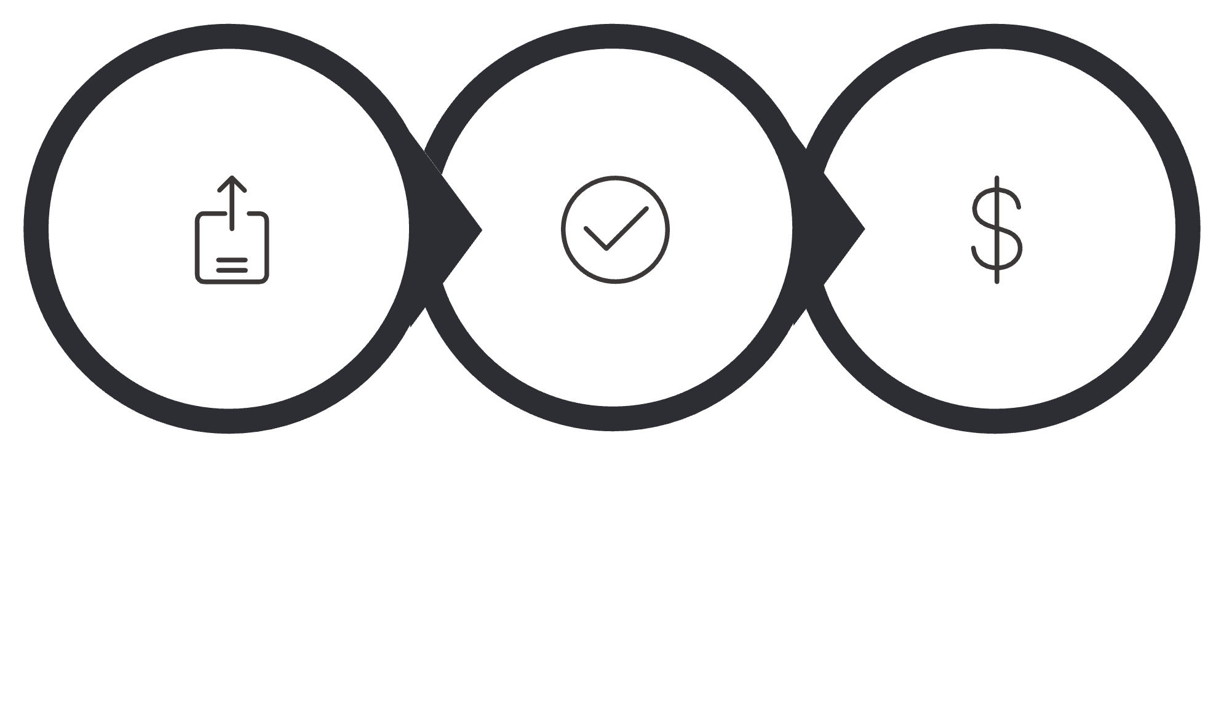
Solution Overview
ExpenseFlow Workflow
Employee
Manager
Finance
Registers and logs in
Creates expense requests
Tracks approval status
Reviews submitted expenses
Approves or rejects requests
Processes approved expenses
Marks reimbursement as completed
Expense Lifecycle
Manager Approved
Submitted
Paid
The workflow maintains clear ownership and status transitions between roles.

Slide 4

System Architecture
High-Level Architecture
User Browser
|
Next.js Frontend
|
REST API Communication
|
Spring Boot Backend
--------------------------------
Controller Layer
Service Layer
Repository Layer
Security Layer
|
PostgreSQL Database
Architecture Approach
Separate frontend and backend architecture
Layered backend design
REST-based communication
Stateless JWT authentication
Database persistence using JPA/Hibernate

Slide 5
Technology Stack
Frontend
Technology
Purpose
Next.js
React application framework
TypeScript
Type-safe development
Tailwind CSS
UI styling
React Context
Authentication state management
Backend
Technology
Purpose
Java
Backend development
Spring Boot
REST API framework
Spring Security
Authentication & authorization
JWT
Secure session handling
Hibernate/JPA
Database operations
Database
PostgreSQL
Used for storing:
Users
Expenses
Approval history

Slide 6
Security & Engineering Decisions
Security Implementation
Access Control
Implemented:
Role
Permissions
✅ JWT-based authentication
✅ Role-based authorization
✅ Password encryption
✅ Input validation
✅ Centralized exception handling
Employee
Create and view expenses
Manager
Approve or reject expenses
Finance
Process payments
Engineering Decisions
Stateless authentication improves scalability
Layered architecture improves maintainability
Validation prevents invalid business operations

Slide 7
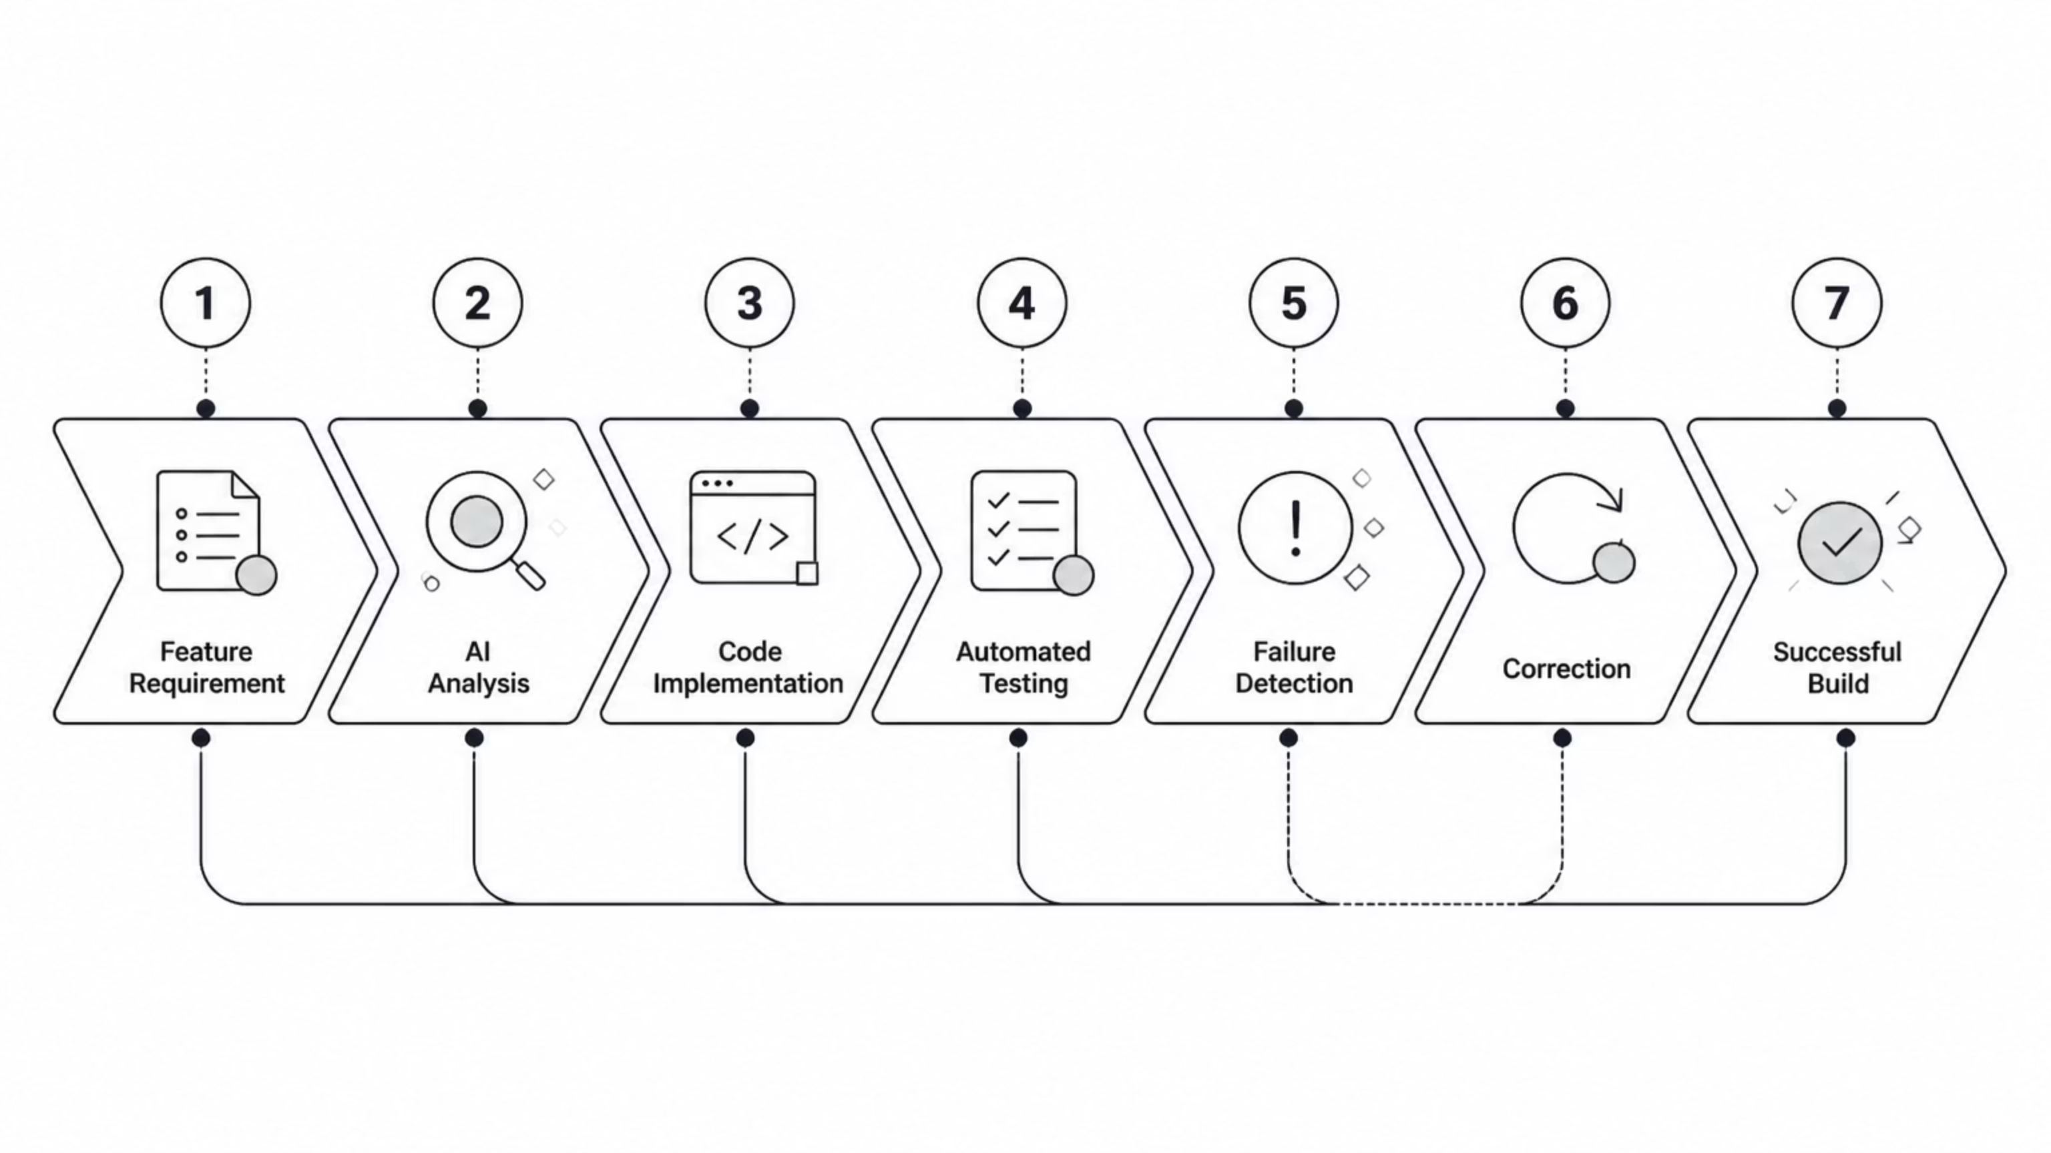
AI-Assisted Engineering Workflow
AI Tools Used
Antigravity
Cursor
ChatGPT
Used for:
Used for:
Used for:
Repository analysis
Feature implementation
Test generation
Debugging
Code review
Development assistance
Code improvements
Architecture planning
Documentation support
Prompt refinement
AI Change Loop

Slide 8
Testing & Quality Assurance
Automated Testing Strategy
Deliberate Failure Testing
Testing Framework: JUnit + Spring Boot Test
Covered Areas:
A business logic defect was intentionally introduced:
Expected: MANAGER_APPROVED
Actual: PAID
Test Result: BUILD FAILURE
After correction: 19/19 Tests Passed — BUILD SUCCESS
This validated that the test suite detects real application failures.
✅ User registration
✅ Authentication
✅ Expense creation
✅ Approval workflow
✅ Payment workflow
✅ Validation rules

Slide 9
Demo Flow & Future Improvements
Live Demonstration
Future Enhancements
The demo covers:
Email notifications
Cloud deployment
Expense attachments
CI/CD integration
Analytics dashboard
01
User registration and login
02
Employee expense submission
Conclusion
03
ExpenseFlow demonstrates:
Manager approval workflow
Full-stack development
Secure application design
AI-assisted engineering workflow
Automated quality validation
04
Finance payment processing
05
AI-assisted feature change
06
Automated test validation

