Slide 1
Employee Data Analysis using Excel
STUDENT NAME : MADHUMATHI S
REGISTER NO : 312209306
NAAN MUDHALVAN : asunm1353312209306
DEPARTMENT : Bachelor of Commerce (General)
COLLEGE : ANNA ADARSH COLLEGE FOR WOMEN

Slide 2
PROJECT TITLE
Employee Performance Analysis using Excel

Slide 3


AGENDA
Problem Statement
Project Overview
End Users
Our Solution and Proposition
Dataset Description
Modelling Approach
Results and Discussion
Conclusion
3/21/2024 Annual Review

Slide 4

PROBLEM STATEMENT
In the current market trend the performance level of the employee need to be increase day by day to make competitive towards the corporate world. Though many techanical software are presented in the market places the EXCEL and POWER POINT has some separate frame in the current AI world.
The frequent updation takes more time to access and also to learn the changes presented in the new visions
E-current employee performance evaluation process lacks a comprehensive and data-driven approach, resulting in subjective assessments, inconsistent feedback, and limited insights into individual and team performance. This hinders the organization's ability to:
- Accurately identify top performers and areas for improvement
- Develop targeted training and development programs
- Inform fair and equitable promotion and compensation decisions
- Enhance overall employee engagement and productivity

Slide 5

PROJECT OVERVIEW
Develop Performance Tracking System: Design an excel based system to track key performance indicators and metrics relevant to employees perfoormance.
Create Reporting Templates: Develop templates and dashboards for generating regular performance reports and visualiziation.
Provide Training and Support: Offer training and support to ensure effective use of the performance tracking system.
Enhance Data Analysis: Utilize advanced excel functions to analyze performance data and generate actionable insights.

Slide 6

WHO ARE THE END USERS?
EMPLOYER
EMPLOYEE
ORGANISATION

Slide 7

OUR SOLUTION AND ITS VALUE PROPOSITION
Customizable Performance Dashboards: Visualize key performance indicators (KPIs) and metrics through interactive charts and graphs.​
Automated Reporting Templates: Generate standardized performance reports and summaries with pre-defined templates.​
Advanced Data Analysis: Utilize pivot tables, complex formulas, and conditional formatting to analyze performance data.​
Real-Time Data Entry and Updates: Enable real-time updates and data entry to ensure accurate and up-to-date performance tracking.​
User Guides and Training Materials: Provide comprehensive documentation and training resources for effective use of the system.​

Slide 8
Dataset Description
Employee Information:​
Columns: Employee ID, Name, Department, Position, Hire Date, Manager​
Description: Basic demographic and employment details for each employee.​
Performance Metrics:​
Columns: Employee ID, Review Period, KPI 1 (e.g., Sales Targets), KPI 2 (e.g., Customer Satisfaction Score), KPI 3 (e.g., Project Completion Rate), Overall Rating​
Description: Key performance indicators and overall performance ratings for each review period.​
Performance Reviews:​
Columns: Employee ID, Review Date, Reviewer, Comments, Rating (e.g., 1-5 scale), Development Areas​
Description: Detailed review comments and ratings from performance evaluations, including feedback and areas for improvement.​
Training and Development:​
Columns: Employee ID, Training Program, Completion Date, Skills Acquired, Post-Training Performance Improvement​
Description: Records of training programs attended, skills gained, and subsequent impact on performance​
​

Slide 9

THE "WOW" IN OUR SOLUTION
Dynamic Dashboards: Our solution features interactive dashboards that visually represent key performance metrics, allowing users to quickly grasp complex data through intuitive charts and graphs. This makes data interpretation easier and more engaging.​
Automated Insights: With built-in formulas and pivot tables, the system provides automated insights and trend analysis. This reduces manual data manipulation and speeds up the process of identifying performance patterns and anomalies.​
Real-Time Data Updates: The system allows for real-time data entry and updates, ensuring that performance information is always current. This feature supports timely decision-making and keeps all stakeholders informed with the latest data.​
Customizable Templates: Users can easily customize reporting templates to fit specific organizational needs, allowing for personalized performance reports and evaluations that align with company standards.

Slide 10
MODELLING
1. Data Structuring:​
Employee Info: Employee ID, Name, Department, Position.​
Performance Metrics: Employee ID, Review Period, KPIs, Overall Rating.​
Performance Reviews: Employee ID, Review Date, Reviewer, Rating, Comments.​
Training: Employee ID, Training Program, Skills Acquired, Performance Improvement.​
Department Summary: Department, Review Period, Average KPIs, Average Rating.​
Trend Analysis: Employee ID, KPI Trends, Performance Over Time.​
2. Modelling Techniques:​
Data Validation: Ensure accurate data entry with dropdown lists.​
Formulas: Use AVERAGE, SUM, COUNTIF, IF for calculations.​
Pivot Tables: Summarize and analyze data dynamically.​
Conditional Formatting: Highlight key metrics for easy identification.​
Charts/Graphs: Visualize data trends and comparisons.​
Dashboards: Create interactive views of key metrics.​
Automated Reports: Generate periodic reports with pre-defined templates ​

Slide 11
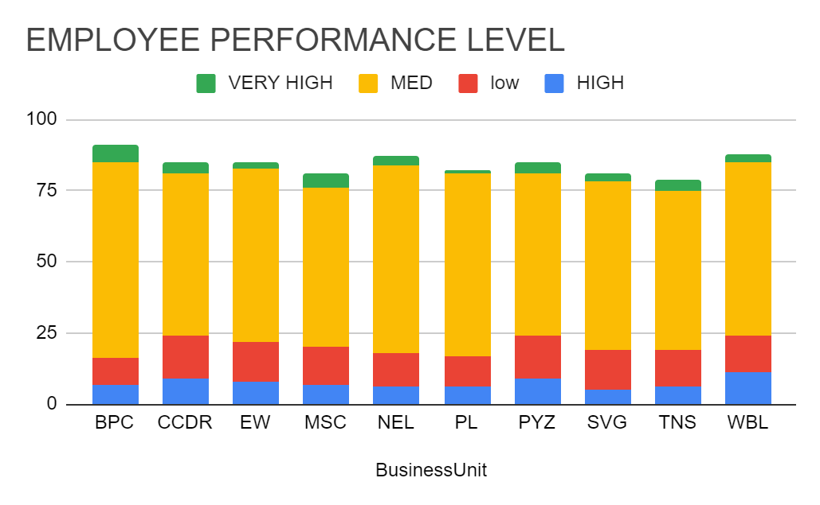
RESULTS
COUNTA of FirstName | PERFORMANCE LEVEL
BusinessUnit | HIGH | low | MED | VERY HIGH | Grand Total
BPC | 7 | 9 | 69 | 6 | 91
CCDR | 9 | 15 | 57 | 4 | 85
EW | 8 | 14 | 61 | 2 | 85
MSC | 7 | 13 | 56 | 5 | 81
NEL | 6 | 12 | 66 | 3 | 87
PL | 6 | 11 | 64 | 1 | 82
PYZ | 9 | 15 | 57 | 4 | 85
SVG | 5 | 14 | 59 | 3 | 81
TNS | 6 | 13 | 56 | 4 | 79
WBL | 11 | 13 | 61 | 3 | 88
Grand Total | 74 | 129 | 606 | 35 | 844

Slide 12
Conclusion
Enhanced Efficiency: Streamlines performance tracking and data analysis, reducing manual effort and improving productivity.​
Data-Driven Decisions: Facilitates informed decision-making with accurate, real-time insights into employee performance.​
Customizability: Adapts to organizational needs with customizable metrics and reporting templates.​
Cost-Effective: Utilizes existing Excel tools, offering a powerful solution without the need for expensive software.​

