Slide 1


K.RAMAKRISHNAN COLLEGE OF ENGINEERING
(AUTONOMOUS)
CUSTOMER CHURN PREDICTION
Presented by,
Name : MADHUMITA SP
Register No. : 8115U24AM033
Roll No. : AM2433
Year : II AIML
Date of Review : 08/05/2026

Slide 2
PRESENTATION OVERVIEW
Project Introduction
Objective
Problem Statement
Software and Hardware Used
Existing and Proposed System
Modules Used
Architecture Diagram
Output Screenshots
Conclusion and Future Scope
References

Slide 3
Project Introduction
The Customer Churn Prediction System is a machine learning-based web application developed using Python and Streamlit to predict whether a customer is likely to leave a business or continue using its services. Customer churn prediction helps organizations identify customers at risk and take preventive measures to improve customer retention.
This system uses various machine learning algorithms such as Logistic Regression, Decision Tree, Random Forest, K-Nearest Neighbors (KNN), and Support Vector Machine (SVM) to analyze customer-related data and predict churn behavior.
The project is useful for businesses such as telecom companies, e-commerce platforms, banks, insurance companies, and subscription-based services.

Slide 4
OBJECTIVE
The main objectives of the Customer Churn Prediction System are:
To predict customer churn using machine learning techniques.
To analyze customer behavior patterns.
To compare different machine learning algorithms.
To improve customer retention strategies.
To provide an easy-to-use web interface using Streamlit.
To reduce manual analysis and improve prediction accuracy.
To generate prediction reports for business analysis.

Slide 5
PROBLEM STATEMENT
Many companies face customer loss due to poor customer engagement, low satisfaction,
or lack of retention strategies. Traditional methods of identifying churn customers are
time-consuming and less accurate.
Businesses need an automated system that can:
Analyze customer data efficiently.
Predict customer churn accurately.
Identify high-risk customers.
Help management take preventive actions.
Therefore, the Customer Churn Prediction System is developed to automate customer
churn analysis using machine learning algorithms and provide accurate prediction results.
.

Slide 6
SOFTWARE AND HARDWARE USED
SOFTWARE:
Python - Programming Language
Streamlit - Web Application Framework
Vs Code – Development Tool
Pandas & NumPy - Data Processing
CSV Dataset - Data Storage
Scikit learn - Machine Learning
HARDWARE:
OS
Storage
Processor
RAM
.

Slide 7
EXISTING AND PROPOSED SYSTEM
Existing System:
Traditional customer analysis systems mainly depend on manual reporting and historical observation.
Proposed System:
The proposed system uses machine learning algorithms to predict customer churn automatically using customer data.
Fast and accurate churn prediction.
Multiple machine learning model comparison.
User-friendly Streamlit interface.
.

Slide 8
Modules Used
Data Generation Module
Data Upload Module
Data Validation Module
Data Splitting Module
Machine Learning Module
Model Training Module
Prediction Module
Feature Importance Module
Model Comparison Module
Download Report Module
.

Slide 9
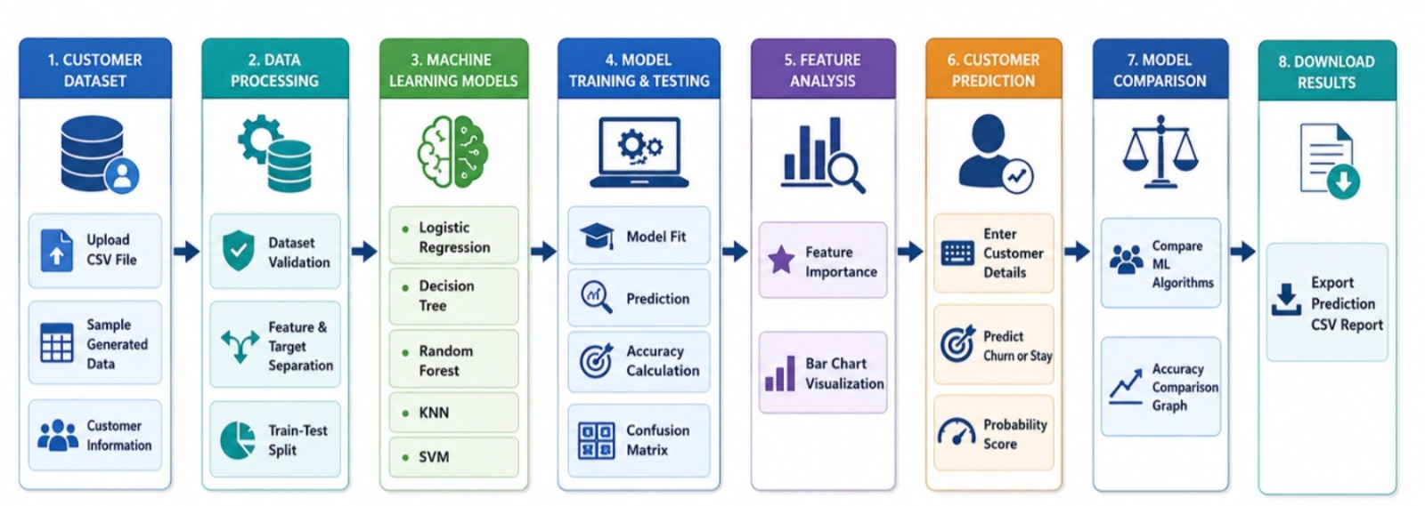
System Architecture
.

Slide 10
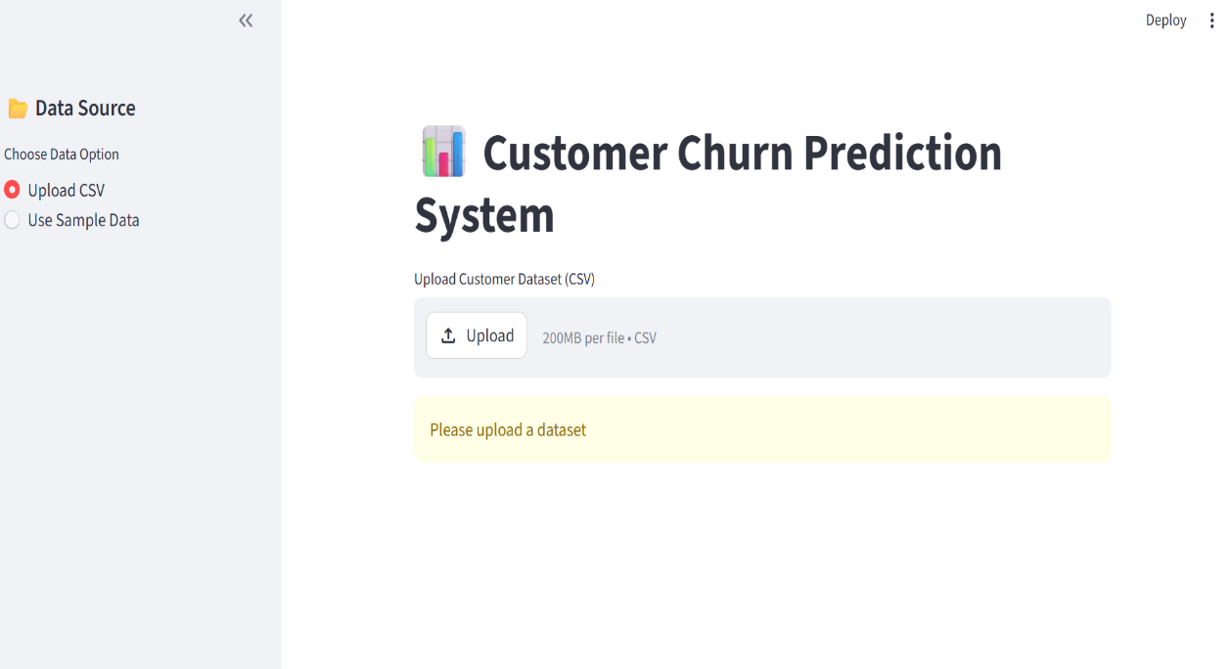
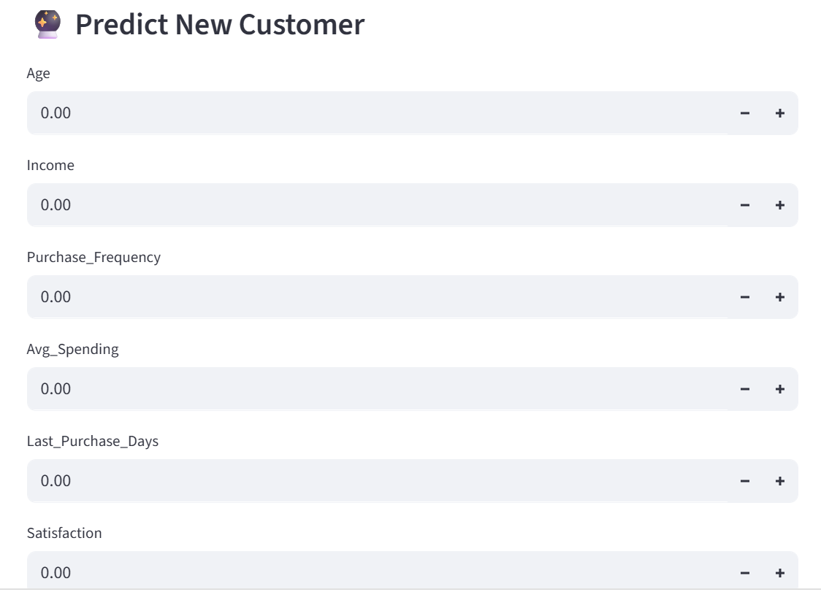
OUTPUT
.

Slide 11
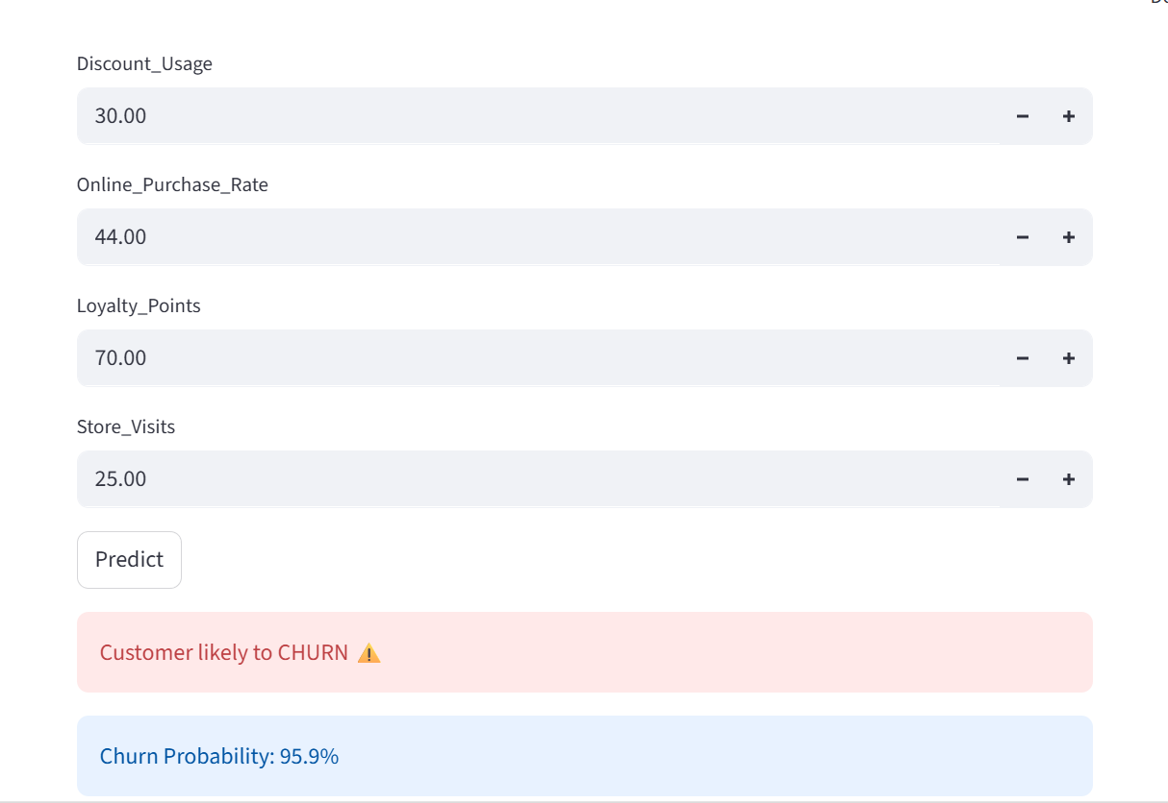
OUTPUT
.

Slide 12
CONCLUSION AND FUTURE SCOPE
Conclusion:
The Customer Churn Prediction System successfully predicts customer churn using machine learning algorithms. The system automates customer behavior analysis and helps organizations identify customers likely to leave.
Future Scope:
Real time customer churn alerts
Deployment on cloud platforms
Mobile application support
Advanced dashboards and analytics
.

Slide 13
REFERENCES
Python Official Documentation
Streamlit Documentation
Scikit-learn Documentation
Pandas Documentation
Machine Learning Research Papers
Kaggle Customer Churn Datasets
Online Tutorials and Technical Articles
.

Slide 14


