Slide 1
Case Study: Analyzing Fitness and Digital Behavior Trends
By
Madhumita Shankar

Slide 2

Who?
(Audience or Stakeholders)
Gym members, gym management teams, and app developers.
Fitness enthusiasts and digitally engaged users who use apps for tracking workouts.
What?
(Purpose or Goal)
Analyze the relationship between gym members’ fitness behaviours and their digital engagement habits.
Segment users based on fitness levels and digital engagement to provide tailored recommendations.
Why?
(Importance)
Analyze the relationship between gym members’ fitness behaviours and their digital engagement habits.
Segment users based on fitness levels and digital engagement to provide tailored recommendations.

Slide 3
Data Source
Gym Members Exercise Tracking Dataset:
Contains information about gym members’ demographics, health metrics, workout habits, and hydration levels.
User Behavior Dataset:
Contains details about members’ mobile device usage and digital habits.

Slide 4
Analytic Approach – Step by step
Step 1:
Exploratory Data Analysis and Data Cleaning
Checked for Missing Values
Validated Data Types
Handled Data Inconsistencies
Step 2: Merging of dataset
No Primary Field for Merging:
The datasets lacked a common unique identifier (like User ID) for a direct one-to-one merge.
Issues with Standard Joins:
Using inner or outer joins caused repeated data in some columns.
Aggregating data (e.g., mean) resulted in significant data loss.

Slide 5
Solution: Grouping and Sequential Merging
Created Age Groups:
Grouped users into intervals of 3 years (e.g., 18-20, 21-23).
Added a new column Age Group in both datasets.
Added Occurrence Column:
Introduced a column Occurrence in each dataset:
If a group (e.g., 18-20 Female) appeared for the first time, its occurrence value was 1.
For subsequent occurrences, the value increased sequentially (2, 3, etc.).
Performed Sequential Merge:
Merged the datasets based on Age Group, Gender, and Occurrence.
This approach minimized data loss and maintained data integrity.
Outcome
Successfully handled the lack of a primary field for merging.
Created meaningful groupings and preserved as much data as possible during the merge.
Enabled further analysis and segmentation of users based on the cleaned and merged dataset.

Slide 6
Are there patterns in workout types (e.g., strength, cardio, yoga) based on digital usage habits?

Slide 7
Pattern Observed:
Yoga Users
Yoga users exhibit high digital engagement and longer session durations.
Likely due to the nature of yoga requiring guided practices, mindfulness, and structured routines.
Cardio Users
Cardio users display low digital engagement and shorter workout sessions.
This reflects the simplicity of cardio activities like running, walking, or cycling, which may not require heavy app involvement.
Strength Users
Strength users spend the most time on workouts and high digital engagement.
Likely because of the need for detailed tracking of metrics like reps, sets, weights, and progress tracking.

Slide 8
Do users with higher app usage spend less time on workouts or burn fewer calories?

Slide 9
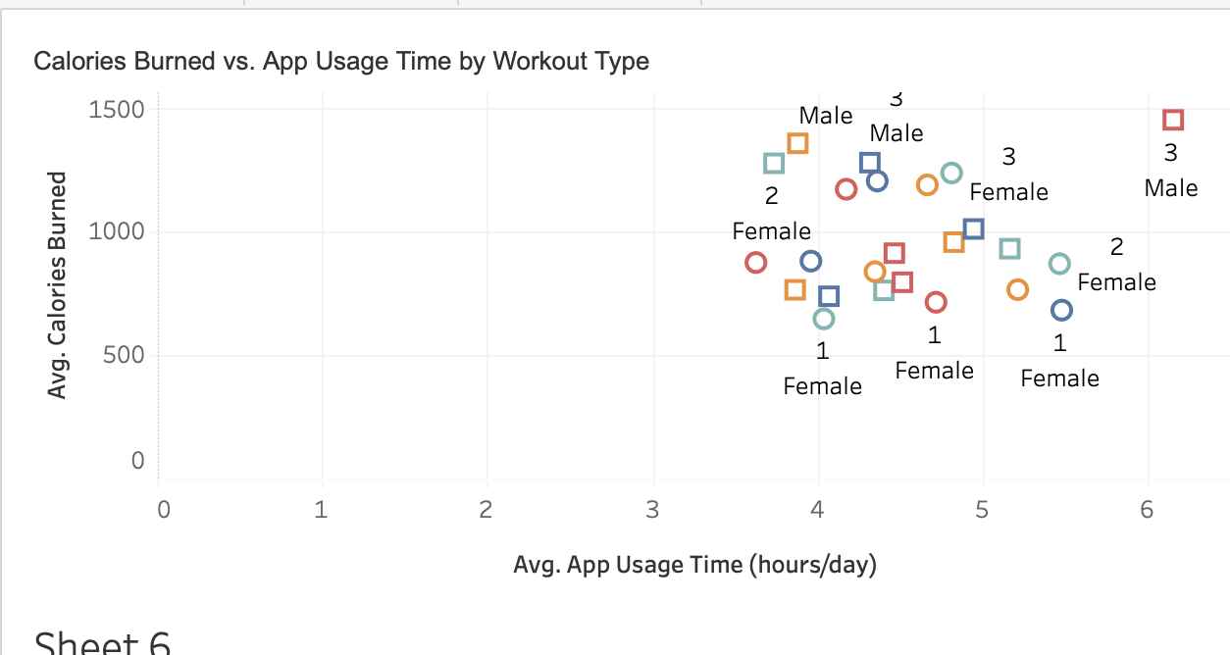
Insights
Higher app usage seems to correlate with intense workout types (e.g., HIIT and Strength), resulting in more calories burned.
Users with low app usage and less intense workout types (e.g., Yoga or Cardio) burn fewer calories.

Slide 10
How does hydration level correlate with app or screen-on time?

Slide 11
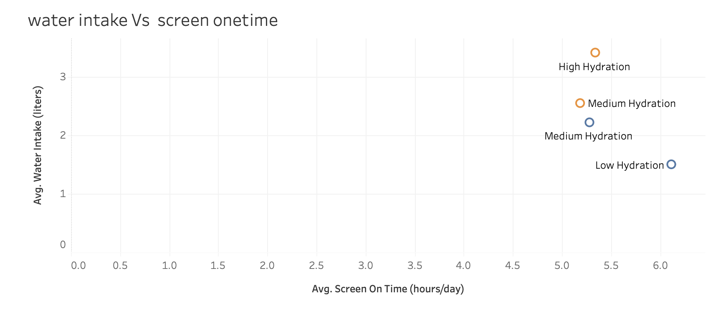
Insights
Higher screen-on time corresponds to lower hydration.
Lower screen-on time corresponds to higher hydration levels.

Slide 12
Can we segment users into groups (e.g., high-engagement, low-fitness) to provide tailored recommendations?

Slide 13
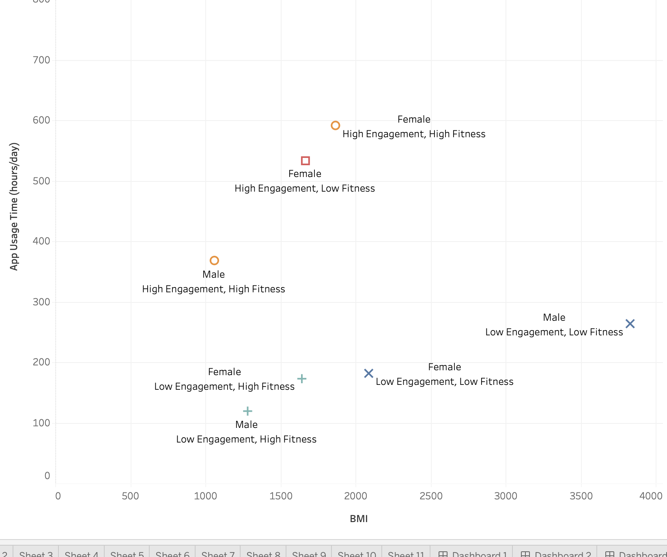
Insight
High Engagement, High Fitness: These users actively utilize fitness apps and maintain good fitness levels.
High Engagement, Low Fitness: These users show engagement with apps but may need better guidance or more effective workout plans.
Low Engagement, High Fitness: These users focus on physical activity without relying heavily on apps.
Low Engagement, Low Fitness: These users require significant intervention to adopt healthier habits.

Slide 14
Recommendation
Modify content for Yoga and Strength users with extended guided workouts.
Provide short, intense workout guidance for HIIT users to minimize screen time.
Develop minimalist tracking features for Cardio users.
Introduce hydration reminders within fitness apps for users with high screen-on or app usage.
Highlight and promote these highly hydrated users as role models in app campaigns.
Based on the engagement and fitness level, introduce advanced tracking features like body composition metrics or performance benchmarks.
Provide personalized workout plans tailored to their goals and BMI.

Slide 15
Thank you

