Slide 1

Analysis of Customer Service Data for Nile
May 2024
Report by :
Madhumita Chakraborty
- By iVison

Slide 2





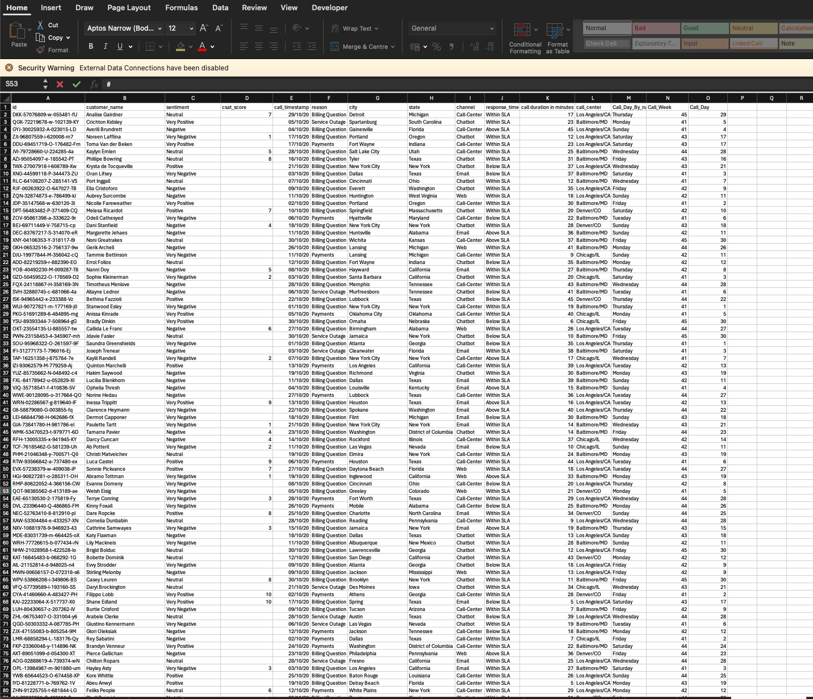
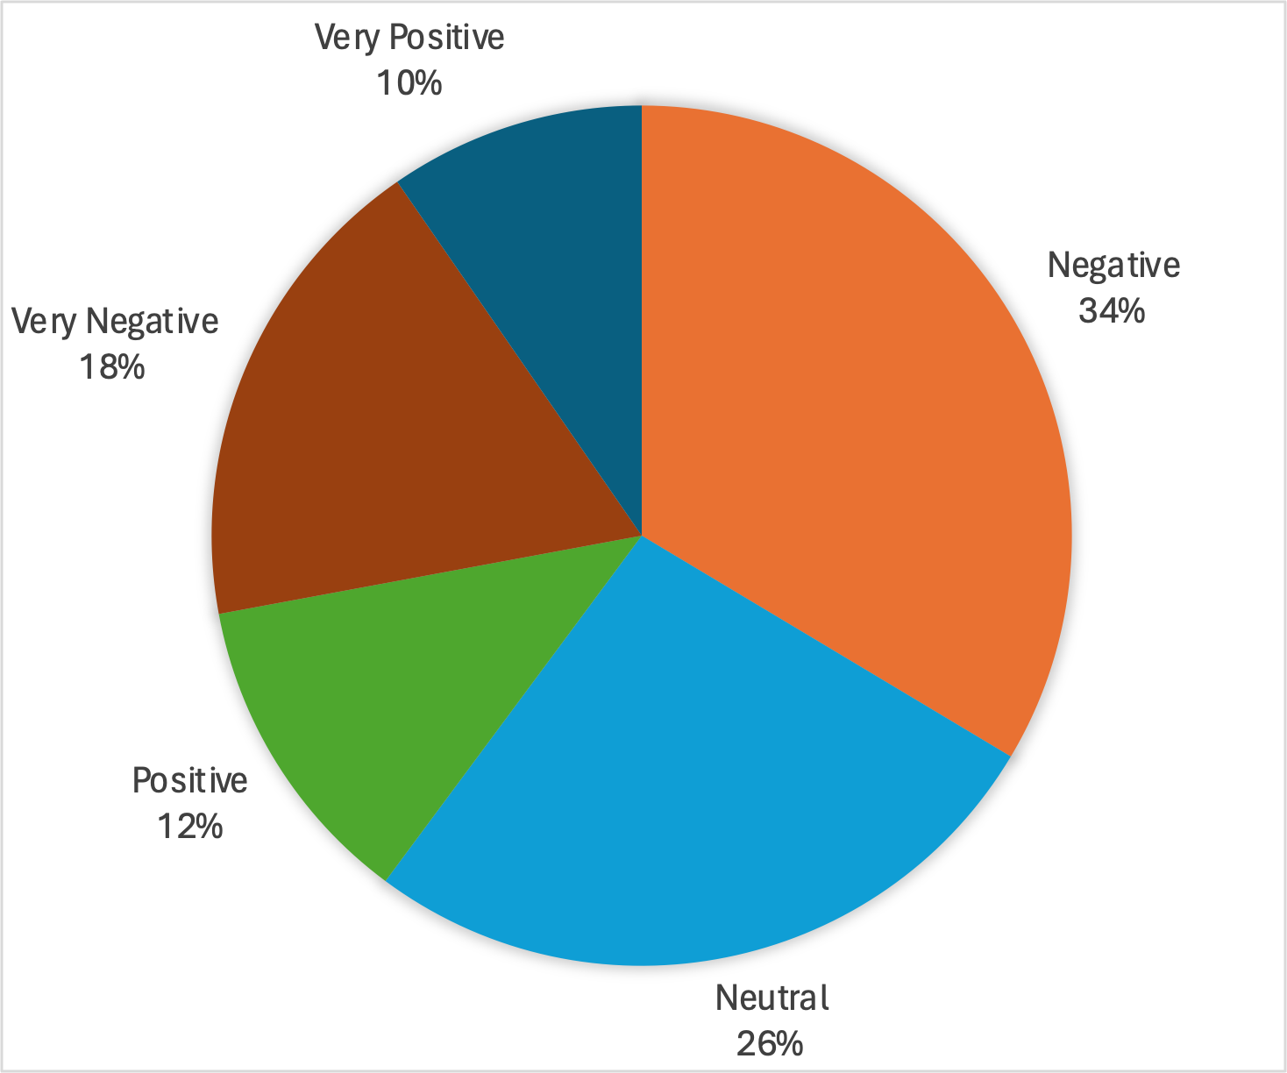
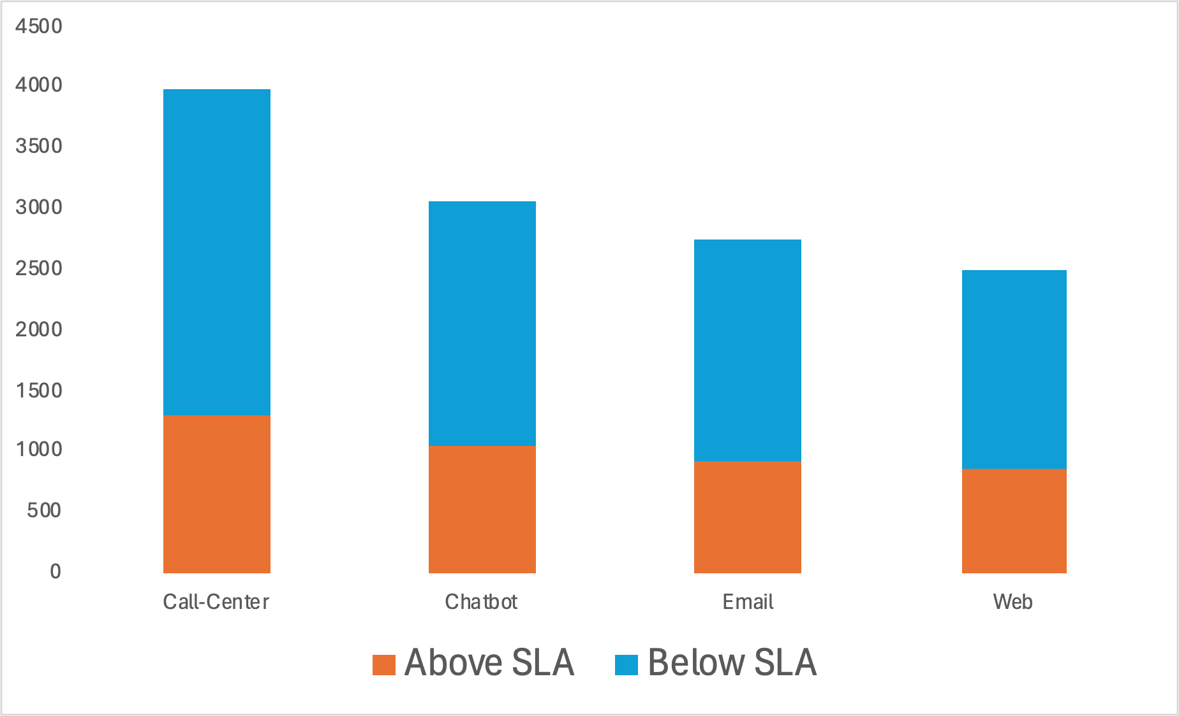
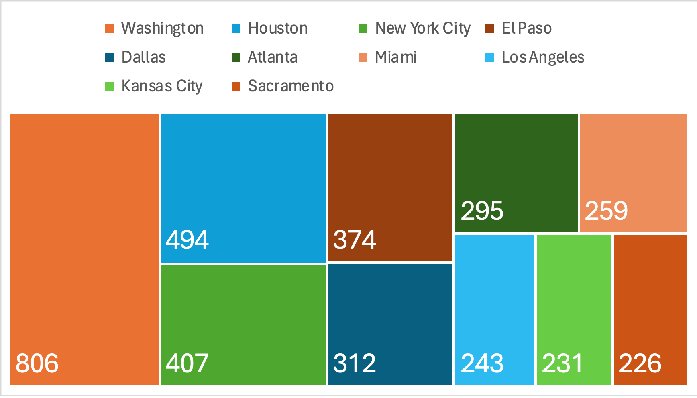
The report was created keeping the objective in mind & leveraging right approach to achieve the expected outcomes
Objective : Leverage data-driven approaches to optimize customer service processes, enhance customer experience, and drive overall business growth.
Inputs
Approach
Outputs
Understanding of objectives
Data understanding
Data analysis – Slicing & Dicing
Output generation
Raw excel data for call center
Objectives and data understanding
Outcome expectations
Dashboard, Charts, Graphs & Trends for analysis – customer sentiment, root cause, service response customer segmentation
Root cause analysis and key observations & suggestions

Slide 3
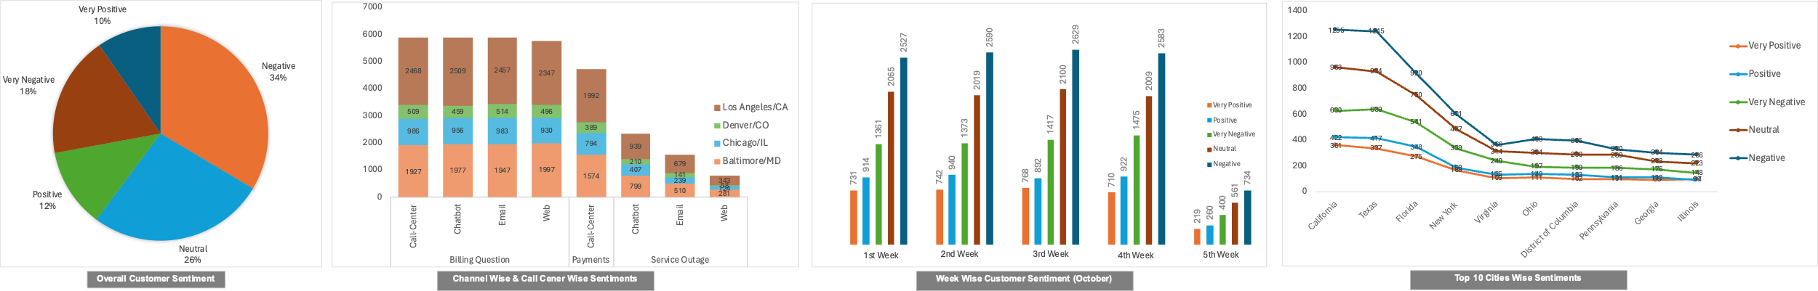
Customer Sentiment Analysis
Key Observations / Recommendations
A large portion (34%) of the overall customer sentiment is negative and needs attention
Majority of the customers concerns are reported in LA & Baltimore and these call centres need more focus
The weekly trend for customer sentiments are similar in the month of October and negative sentiments being the highest
While California remains at top for number of call and sentiments feedback, Georgia and Illinois is much lower

Slide 4
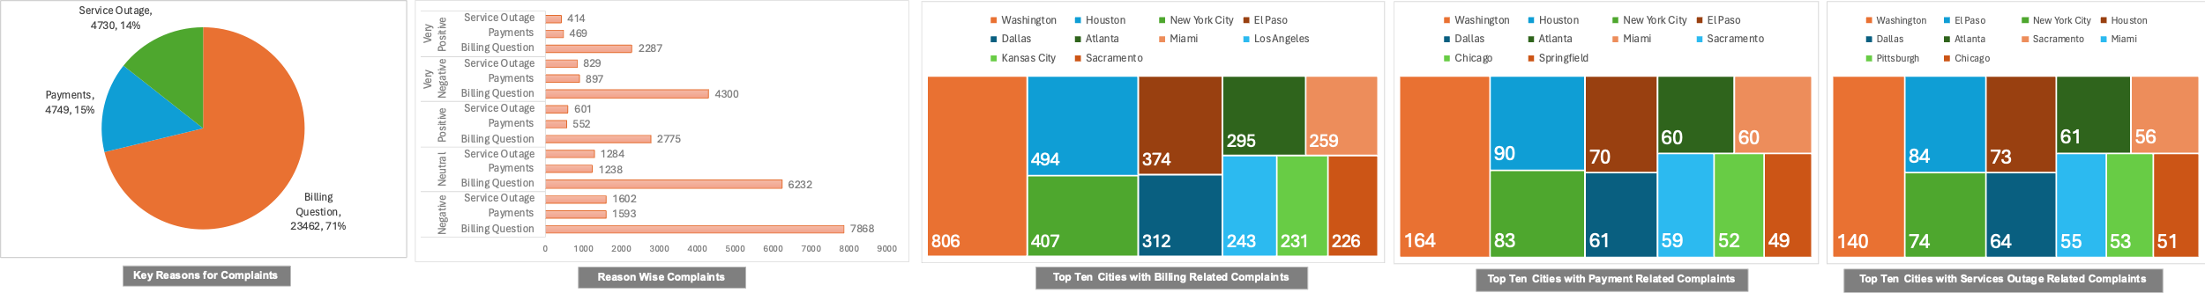
Root Cause Analysis
Key Observations / Recommendations
Billing related questions has maximum (71%) complaints registered
Nile should focus on improving its service related to billing related questions
It can also assign more resource for billing related questions
Majority of the customer care resources can be assigned to cities like LA and Houston and lesser focus can be on Kansas & Miami

Slide 5
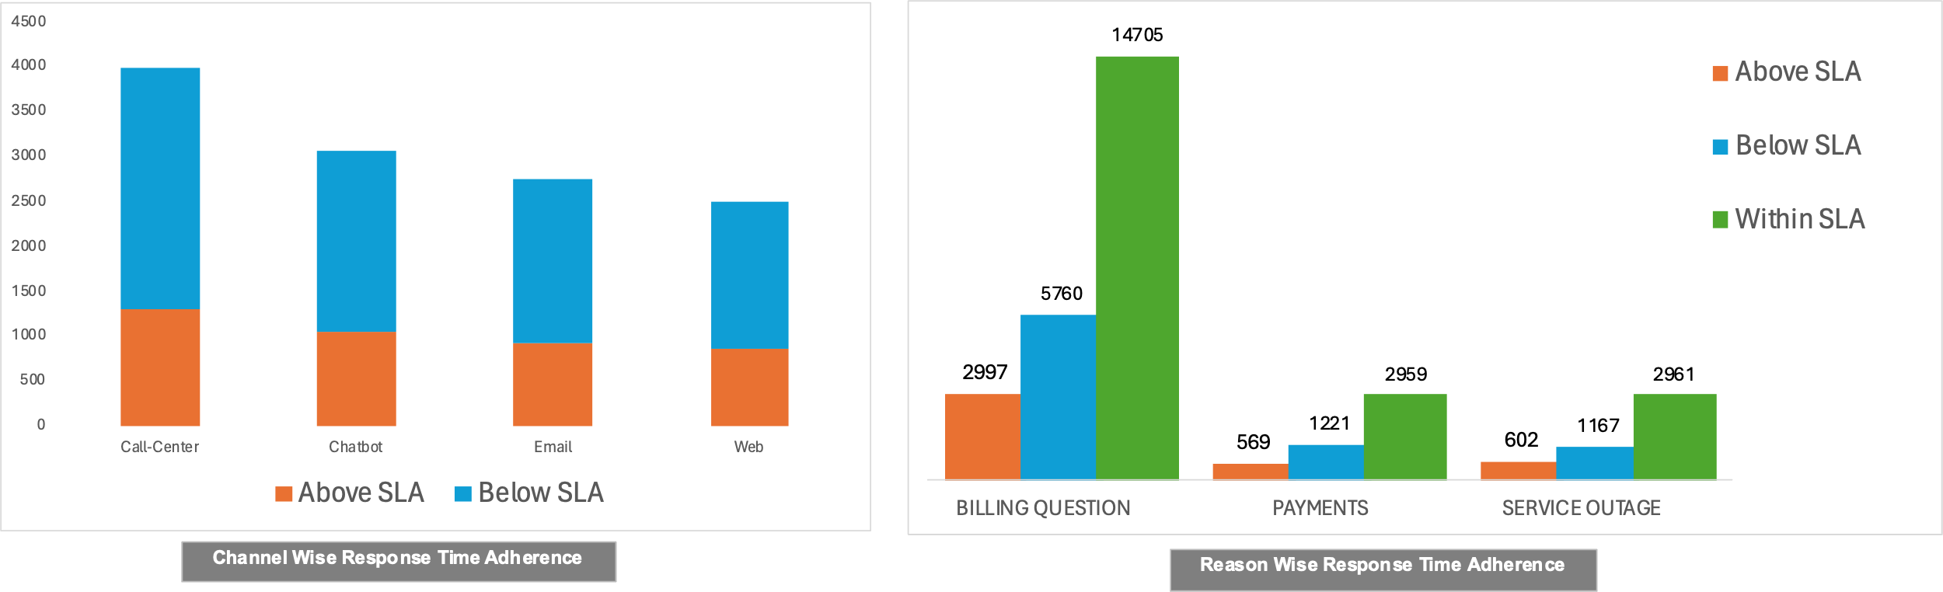
Service Response Time Analysis
Key Observations / Recommendations
More than 60% of the calls are running below SLA
However, the response time are not meeting the SLAs for all channels – Call centre, Chatbot, Email and Web
Billing questions is the primary area which has maximum SLA breaches

Slide 6
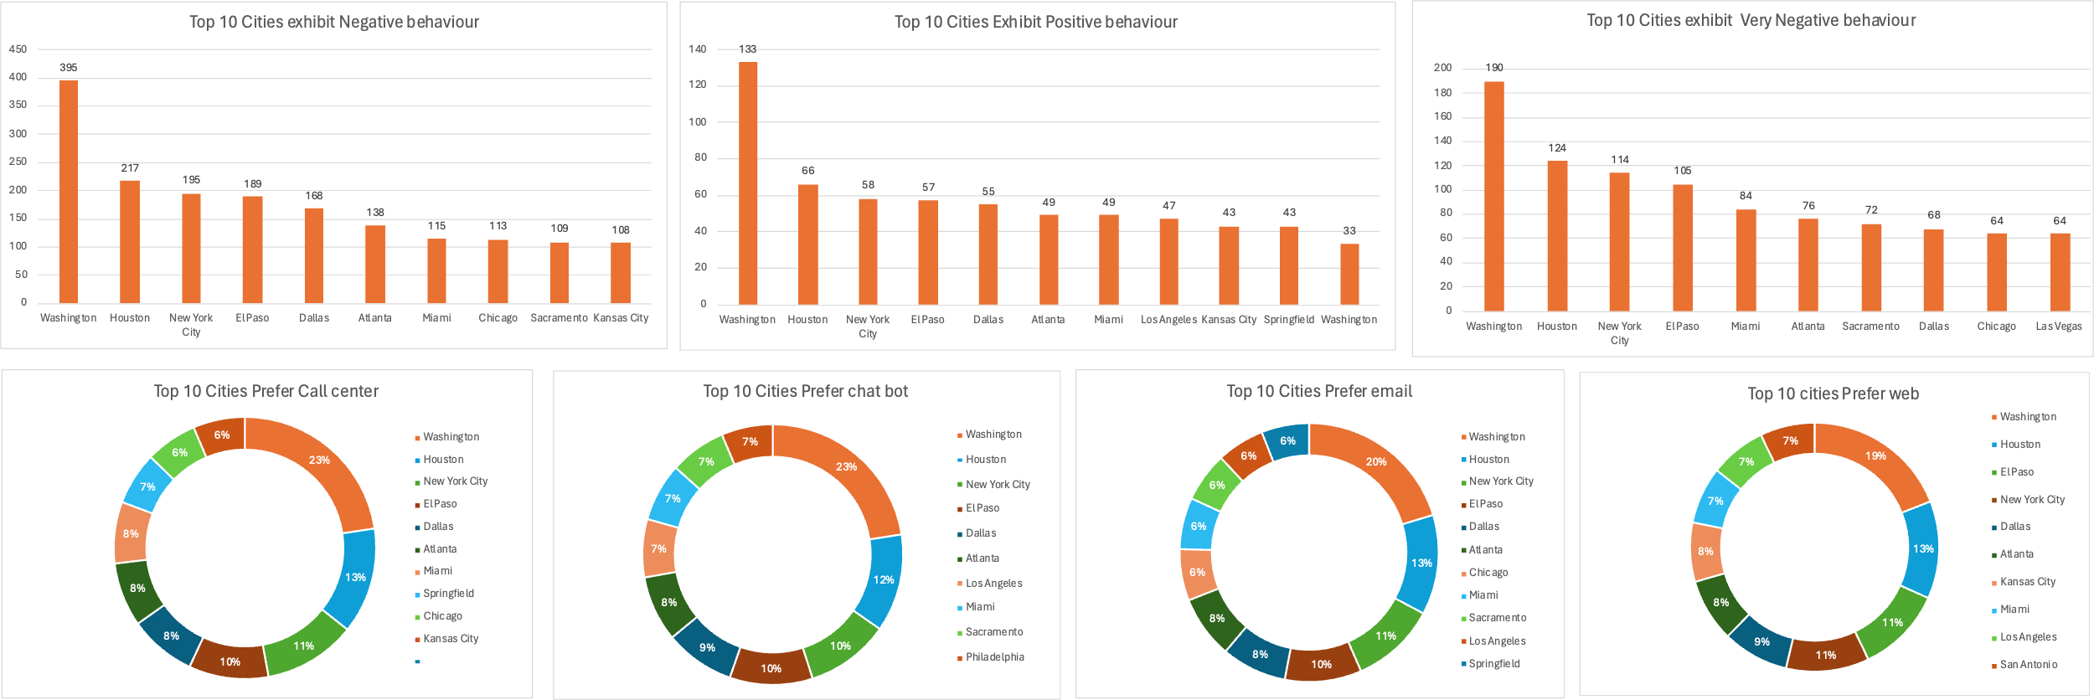
Customer Segmentation
Key Observations / Recommendations
LA & Huston are the primary customers using large percentage of all channels while rest all cities are largely similar
Call centre is a preferred option in all cities
Negative feedback is consistent for all areas with LA being the highest in number.
Customers in Kansas city comparatively happier

Slide 7
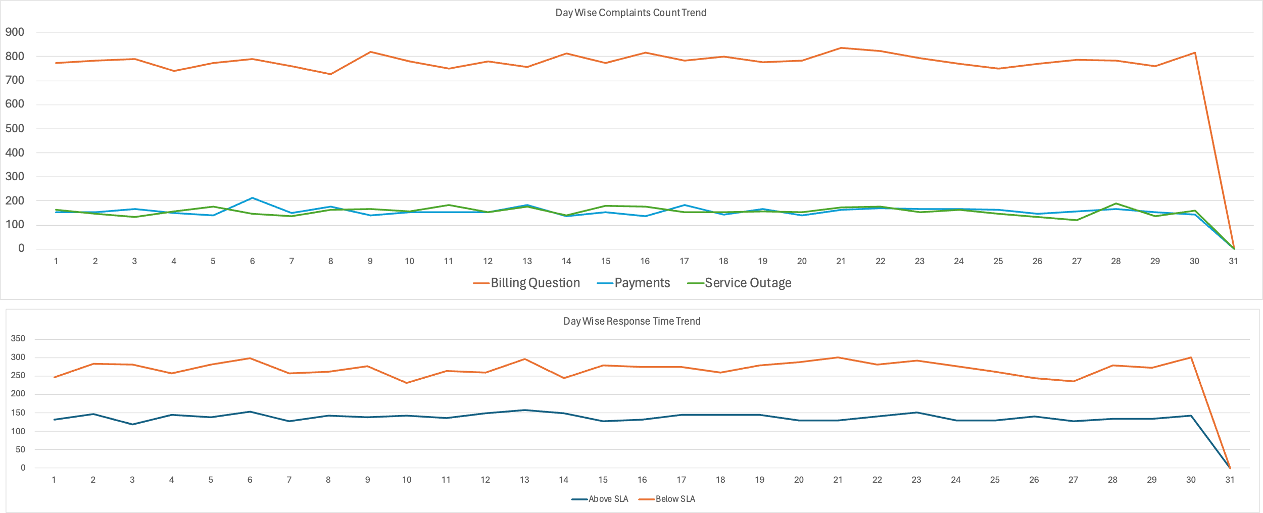
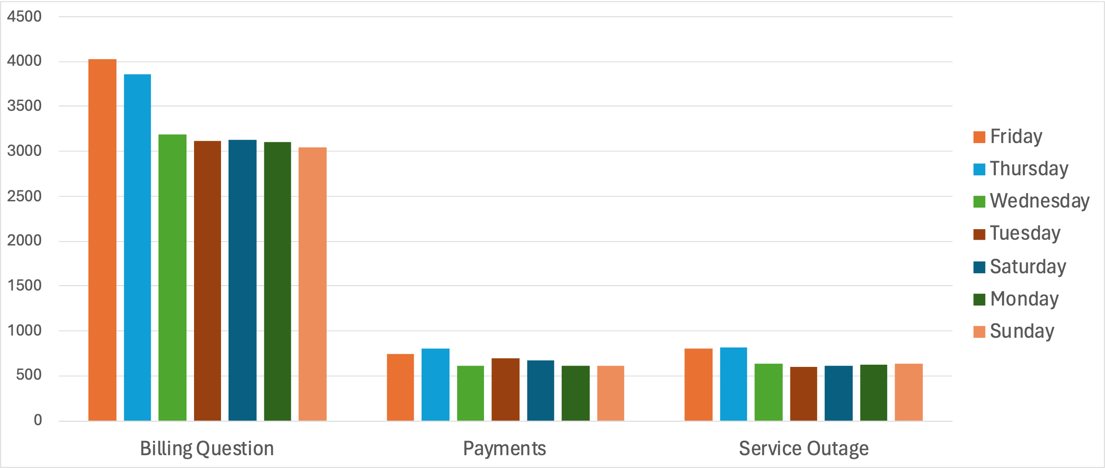
Trends & Patterns
Key Observations / Recommendations
The daily trend for billing questions related call are highest and remains consistent
On daily basis the SLA breach is close to 40% of the calls
Focus of aligning more resources on billing questions and increase the same a notch higher on Mondays & Tuesdays will help Nile in improving efficiency

Slide 8
Overall observations
Billing questions related queries are the highest and needs more focus
LA and Huston should have more augmentation of resource and this can be balanced with Kansas City and Las Vegas
Breach of SLAs are largely because of billing related questions and large calls from LA and Houston
Mondays and Tuesdays are peak days during the week with lesser and similar trend on remaining days
LA and Baltimore call centre needs more augmentation to improve efficiency

Slide 9
THANK YOU

