Slide 1

Vel Tech Rangarajan Dr. Sagunthala R&D Institute of Science and Technology
School of Computing
Department of Computer Science and Engineering
10211CS224 / FULL STACK APPLICATION DEVELOPMENT (JAVA)
END SEMESTER PROJECT REVIEW
Date: 06-05-2026
DEPARTMENT EVENT REGISTRATION AND TICKETING PLATFORM
SDG 9: Industry, Innovation and Infrastructure
Presented By:
J. MADHUMITH CHOWDARY– VTU25576– Reg.No.23UECS0229
Courses Handling Faculty:
Dr. Hafizur Rahman -Assistant Professor

Slide 2
INTRODUCTION
1
Web-based event ticket booking platform with modern user interface
Displays complete event details like title, date, time, venue, and price
Allows users to easily reserve tickets through a simple booking form
Shows real-time ticket availability (e.g., available seats count)
Collects user details such as name, email, and department
Provides instant booking confirmation with digital receipt
Generates QR code for secure and easy event entry verification
Ensures smooth, fast, and user-friendly booking experience
Reduces manual work and minimizes booking errors
Suitable for colleges and institutional event management
2
3
4
5
6
7
8
9

Slide 3
PROBLEM STATEMENT
1
Event booking systems are often manual or not user-friendly
Users do not get clear event details like price, venue, and availability in one place
No real-time ticket availability leads to confusion and overbooking
Traditional systems do not provide instant booking confirmation
Lack of digital receipts and secure verification methods
Difficulty in collecting and managing user details efficiently
No centralized system for booking, tracking, and confirmation
Users face delays and complexity during ticket reservation
Increases chances of errors in booking and data handling
Need for a modern, automated, and reliable event booking platform
2
3
4
5
6
7
8
9

Slide 4
OBJECTIVE(S)
1
To design and develop a web-based event ticket booking system with real-time availability and easy user interface
To provide secure booking with instant confirmation, digital receipt, and QR code verification
2
3
4
5
6
7
8
9

Slide 5
PROPOSED SYSTEM
Web-based platform for displaying event details and managing ticket bookings
Simple and user-friendly interface for entering booking details
Online ticket booking with instant confirmation
Real-time ticket availability display (available seats shown clearly)
Generates digital receipt after successful booking
Provides QR code for secure and easy event verification
Efficient storage and handling of user booking details
Reduces manual work and ensures accurate booking process
1
2
3
4
5
6
7
8
9

Slide 6
PROPOSED SYSTEM ARCHITECTURE
Input
The input includes user registration details such as name, email, department, password, and login credentials.
Users can browse events, select tickets, add events to wishlist, and submit feedback or ratings.
Admin input includes event creation details such as event title, venue, event date, category, ticket price, seat availability, and notification messages.
The system also accepts payment details, booking requests, and certificate generation requests.
Processing
The system validates user login credentials and securely manages authentication using OTP/email verification.
It processes event searching, ticket booking, seat allocation, wishlist management, and payment transactions.
The application generates booking confirmations, digital receipts, QR-based e-tickets, and participation certificates.
Notification services handle booking confirmations, reminders, and event updates.
The admin module processes event management, participant tracking, report generation, feedback analysis, and booking statistics.
Database
The database stores user information, admin details, event records, booking history, payment details, wishlist data, ratings, and feedback.
It maintains secure storage and fast retrieval of data for smooth event management operations.
The database also manages ticket availability, transaction records, and notification history.
Proper validation and backup mechanisms ensure reliability and data security.
Output
The output includes booking confirmation messages, e-tickets, receipts, certificates, payment status, and notification alerts displayed to users.
Users can view booking history, upcoming events, wishlist items, and feedback status.
Admin receives reports related to bookings, participant details, revenue, feedback analytics, and overall event performance.
The system provides real-time updates on ticket availability and event schedules.
1
2
3
4
5
6
7
8
9

Slide 7
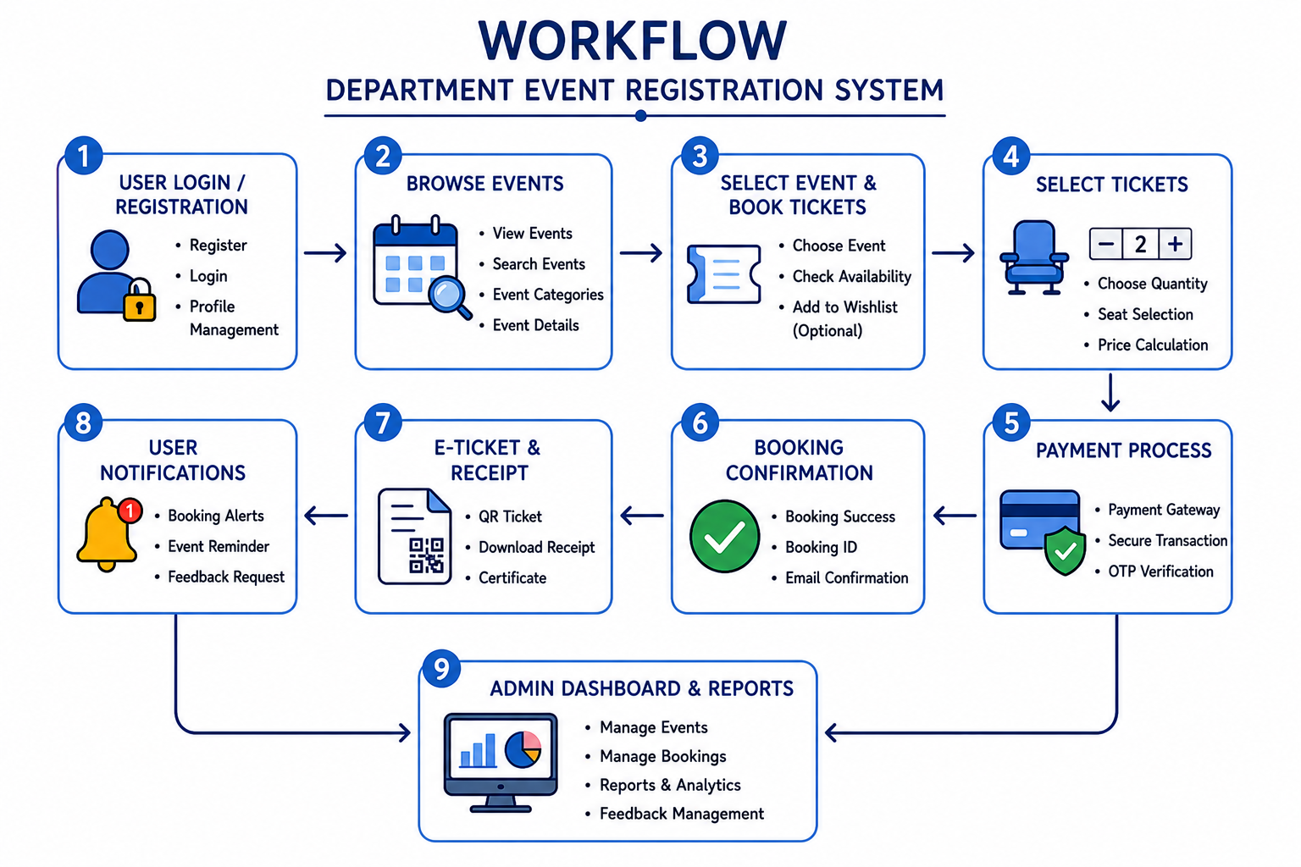
WORKFLOW
1
2
3
4
5
6
7
8
9

Slide 8
TECHNOLOGIES USED
➤ Frontend:
HTML5
CSS3
JavaScript
React.js
Bootstrap / Tailwind CSS
AJAX / Fetch API
➤ Backend:
Node.js
Express.js
➤ Database:
MongoDB / MySQL
➤ Third-Party APIs:
PHPMailer / Nodemailer (Email Notifications & Verification)
JSON (Data Exchange)
➤ Platform:
Web Application (Cross-platform)
➤ Authentication & Security:
JWT Authentication
OTP Verification
Email Authentication
➤ Tools:
VS Code
Git & GitHub
Postman
Chrome Browser
npm / Node Package Manager
➤ Operating System:
Windows / Linux / macOS
➤ Additional Features:
Event Ticket Booking System
Calendar View Integration
Notification System
User Reviews & Ratings
Wishlist / Favorites
Responsive UI Design
1
2
3
4
5
6
7
8
9

Slide 9
MODULE DESCRIPTION
Module 1: User Authentication Module
This module allows users (students/faculty) to register, log in, and manage their accounts securely. It validates user credentials and provides secure access to the Department Event Registration System.
Module 2: Event Management Module
This module is used to create, update, delete, and display department event details. Administrators can manage information such as:
Event name
Date & time
Venue
Description
Ticket availability
Registration deadlines
Module 3: Ticket Booking Module
This module enables users to register and book tickets for department events online. Users can:
Select events
Enter participant details
Confirm bookings
Receive booking confirmation notifications
It also manages ticket availability and prevents overbooking.
Module 4: Database Management Module
Stores and manages:
User data
Event details
Booking records
Reviews & ratings
Notification history
Ensures data integrity, consistency, and quick retrieval of information.
1
2
3
4
5
6
7
8
9

Slide 10
MODULE DESCRIPTION
Module 5: Reviews & Ratings Module
Allows participants to provide feedback after attending events. Users can:
Give star ratings
Write comments/reviews
View feedback from other participants
Helps improve future department events.
Module 6: Calendar & Schedule Module
Displays events in a calendar-based interface for better visualization. Helps users:
Track upcoming events
View event schedules
Plan registrations effectively
Module 7: Reporting & Analytics Module
Generates reports such as:
Total registrations
Revenue summary
Participant statistics
Popular events
Helps administrators analyze data for better event management decisions.
Module 8: Admin Dashboard Module
Provides administrators with centralized control over the system. Admins can:
Manage users and events
Monitor registrations
View analytics and reports
Send notifications
Update event information efficiently
1
2
3
4
5
6
7
8
9

Slide 11
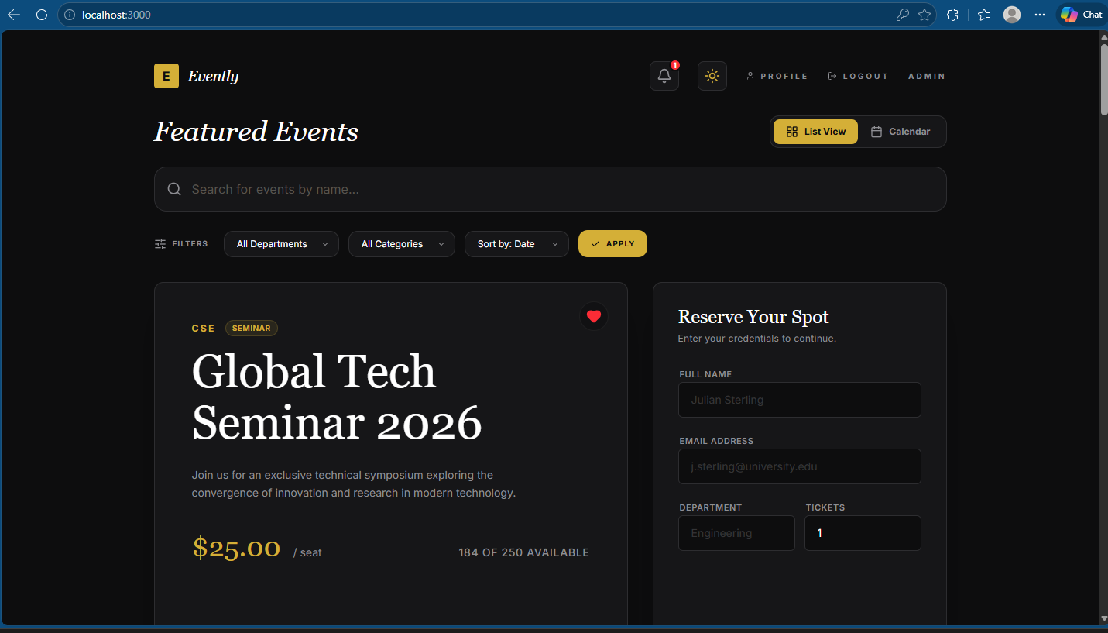
IMPLEMENTATION SCREENSHOTS
1
2
3
4
5
6
7
8(A)
The image shows the homepage of the Department Event Management and ticketing platform with a modern and user-friendly interface.
It provides navigation options such as Home, Events, Admin Login, Login, Sign Up, and buttons for exploring events and student login.
9

Slide 12
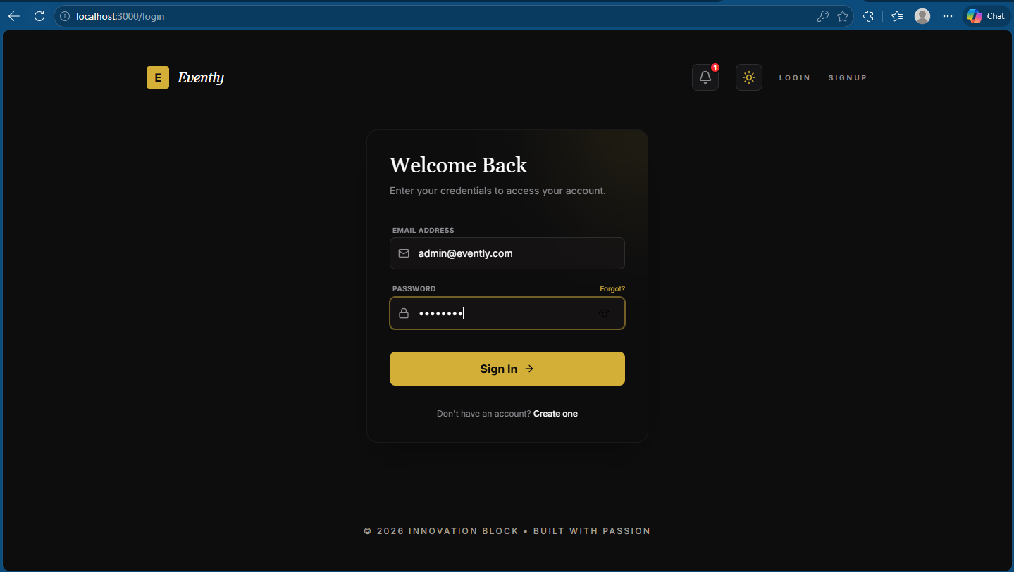
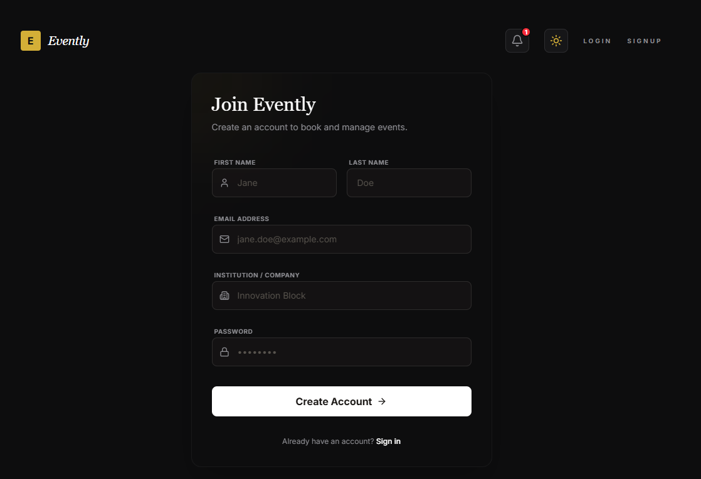
IMPLEMENTATION SCREENSHOTS
Admin Login Page
User signup Page
1
2
3
4
5
6
7
8(B)
9
Admin login page that allows administrators to securely access the system using email and password credentials.
User signup page that enables registered users to sign in and access event booking features.

Slide 13
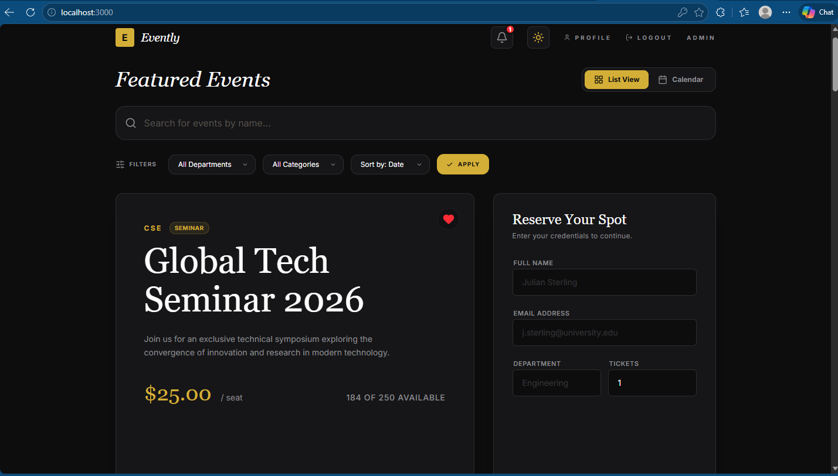
IMPLEMENTATION SCREENSHOTS
1
2
3
4
5
6
7
8(C)
9
This page shows the user dashboard after login, where users can browse events, apply filters, and search for specific college events easily.
It also provides options like book tickets, view schedules, and check bookings, along with event details, availability, and pricing.

Slide 14
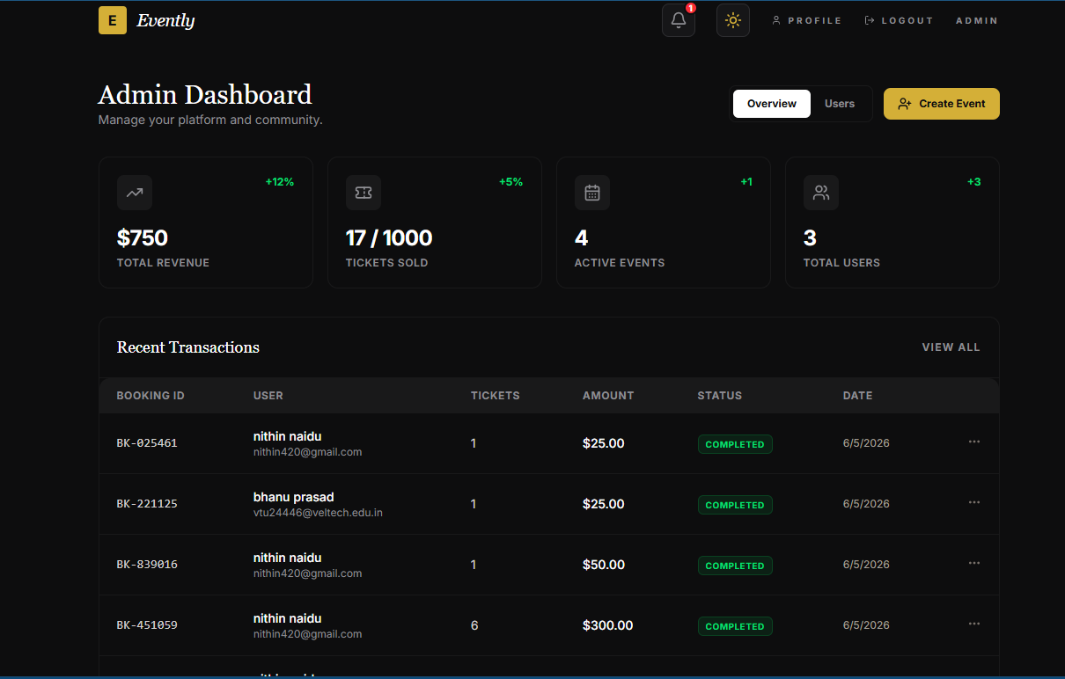
IMPLEMENTATION SCREENSHOTS
1
2
3
4
5
6
7
8(C)
9
The image displays the Admin Dashboard of the Campus Event Management System used for managing events, bookings, and student participation. It shows analytics such as total revenue, tickets sold, QR check-ins, department engagement, and graphical reports for event management.

Slide 15
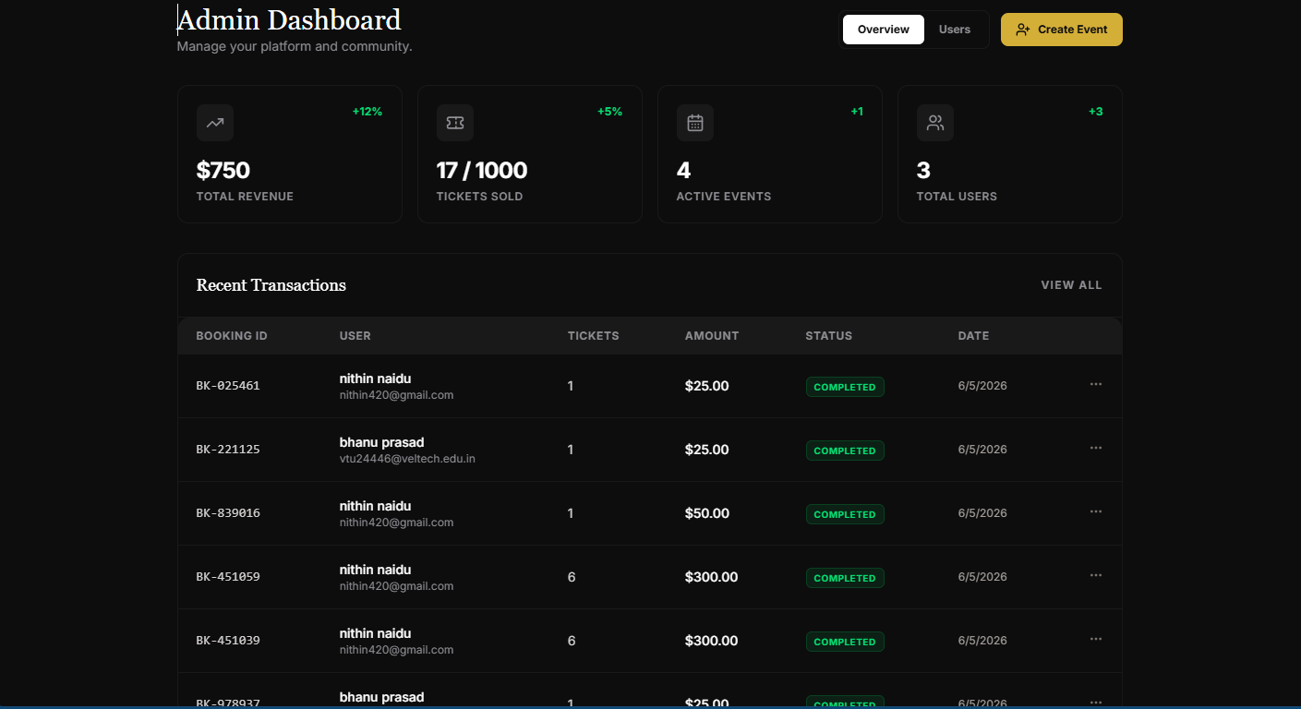
IMPLEMENTATION SCREENSHOTS
1
2
3
4
5
6
7
8(C)
9
The image shows the event management section of the Department event registration platform admin panel. It displays active events with details such as event name, date, venue, capacity, and ticket price, along with options to edit, delete, and manage feedback. The interface also includes QR attendance scanning, email broadcasting, and user management features for efficient administration.

Slide 16
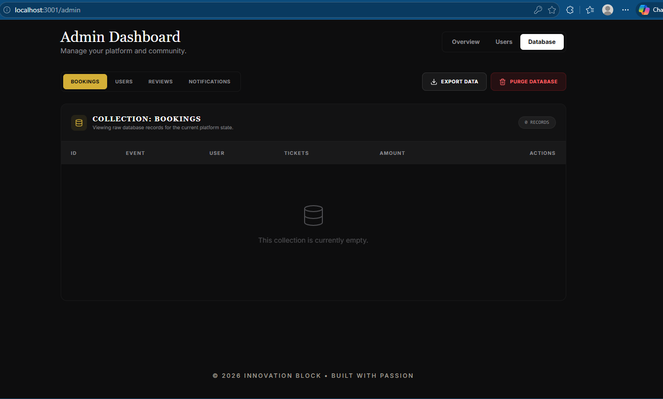
IMPLEMENTATION SCREENSHOTS
1
2
3
4
5
6
7
8(C)
9
This image shows the database table (bookings) displaying stored booking records with fields like user ID, event ID, tickets booked, and payment details.
It provides options to view, edit, delete, and manage booking data, ensuring efficient backend data handling.

Slide 17
ADVANTAGES & LIMITATIONS
> ADVANTAGES
Provides an online platform for easy event registration and ticket booking.
Reduces manual paperwork and administrative workload. Improves accuracy in managing event and participant details.
Enables secure user authentication and data management. Provides quick access to event information and booking status.
Supports automated email notifications, receipts, and certificate generation.
Helps administrators efficiently manage events, users, and reports.
Offers a responsive and user-friendly interface for better user experience.
Stores all data in a centralized database for easy retrieval and maintenance.
Enhances communication between organizers and participants through notifications and feedback systems.
1
2
3
4
5
6
7
8
9

Slide 18
ADVANTAGES & LIMITATIONS
LIMITATIONS
The system requires a stable internet connection for proper access and operation.
Limited scalability for handling a very large number of concurrent users.
Payment gateway integration may be limited or unavailable in the current version.
Data security depends on proper server configuration and maintenance.
The project is mainly designed for campus-level event management only.
System performance may decrease if the database grows significantly without optimization.
Mobile application support is not included in the current implementation.
Advanced analytics and AI-based recommendations are not available.
The application may require regular updates and maintenance for security improvements.
Users with limited technical knowledge may require initial guidance to use some features.
1
2
3
4
5
6
7
8
9

Slide 19
Thank you

