Slide 1

Vel Tech Rangarajan Dr. Sagunthala R&D Institute of Science and Technology
School of Computing
Department of Computer Science and Engineering
10211CS224 / FULL STACK APPLICATION DEVELOPMENT (JAVA)
PROJECT REVIEW : MILESTONE PROJECT – 2
Date: 17-04-2026
Department Event Registration And Ticketing Platform
SDG: SDG 9 – INDUSTRY, INNOVATION AND INFRASTRUCTURE
Presented By:
J. MADHUMITH CHOWDARY – VTU25576 –23UECS0229
Courses Handling Faculty: Dr. HAFIZUR RAHMAN

Slide 2
INTRODUCTION
Web-based event ticket booking platform with modern user interface
Displays complete event details like title, date, time, venue, and price
Allows users to easily reserve tickets through a simple booking form
Shows real-time ticket availability (e.g., available seats count)
Collects user details such as name, email, and department
Provides instant booking confirmation with digital receipt
Generates QR code for secure and easy event entry verification
Ensures smooth, fast, and user-friendly booking experience
Reduces manual work and minimizes booking errors
Suitable for colleges and institutional event management
1
2
3
4
5
6
7
8
9

Slide 3
PROBLEM STATEMENT
1
Event booking systems are often manual or not user-friendly
Users do not get clear event details like price, venue, and availability in one place
No real-time ticket availability leads to confusion and overbooking
Traditional systems do not provide instant booking confirmation
Lack of digital receipts and secure verification methods
Difficulty in collecting and managing user details efficiently
No centralized system for booking, tracking, and confirmation
Users face delays and complexity during ticket reservation
Increases chances of errors in booking and data handling
Need for a modern, automated, and reliable event booking platform
2
3
4
5
6
7
8
9

Slide 4
OBJECTIVE(S)
To design and develop a web-based event ticket booking system with real-time availability and easy user interface
To provide secure booking with instant confirmation, digital receipt, and QR code verification
1
2
3
4
5
6
7
8
9

Slide 5
PROPOSED SYSTEM
Web-based platform for displaying event details and managing ticket bookings
Simple and user-friendly interface for entering booking details
Online ticket booking with instant confirmation
Real-time ticket availability display (available seats shown clearly)
Generates digital receipt after successful booking
Provides QR code for secure and easy event verification
Efficient storage and handling of user booking details
Reduces manual work and ensures accurate booking process
1
2
3
4
5
6
7
8
9

Slide 6
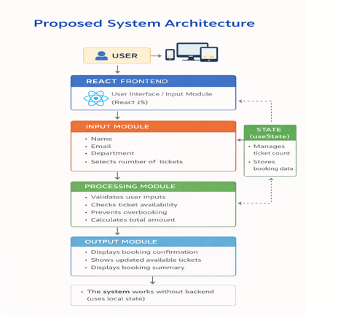
PROPOSED SYSTEM ARCHITECTURE
1
2
3
4
5
6
7
8
9

Slide 7
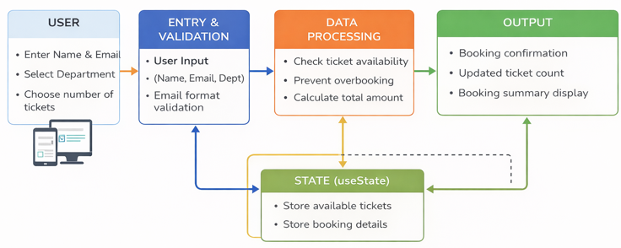
WORKFLOW
1
2
3
4
5
6
7
8
9

Slide 8
TECHNOLOGIES USED
TECHNOLOGIES USED
- Frontend: React JS
- Languages: JavaScript, HTML, CSS
- State Management: useState (React Hook)
- Build Tool: Vite
- Tools: VS Code, Web Browser (Chrome)
- Environment: Node.js & npm
- Operating System: Windows
1
2
3
4
5
6
7
8
9

Slide 9
MODULE DESCRIPTION
1
Module 1: Event Details Module
- Displays event name, department, date, time, venue
- Shows ticket price and available tickets
Module 2: Ticket Booking Module
- Allows user to enter name, email, department
- User selects number of tickets
Module 3: Validation Module
- Validates all input fields
- Checks email format
- Ensures ticket count is valid
Module 4: Booking Processing Module
- Checks ticket availability
- Prevents overbooking
- Calculates total amount
Module 5: Output Module
- Displays booking confirmation
- Shows updated ticket count
- Displays booking summary
2
3
4
5
6
7
8
9

Slide 10
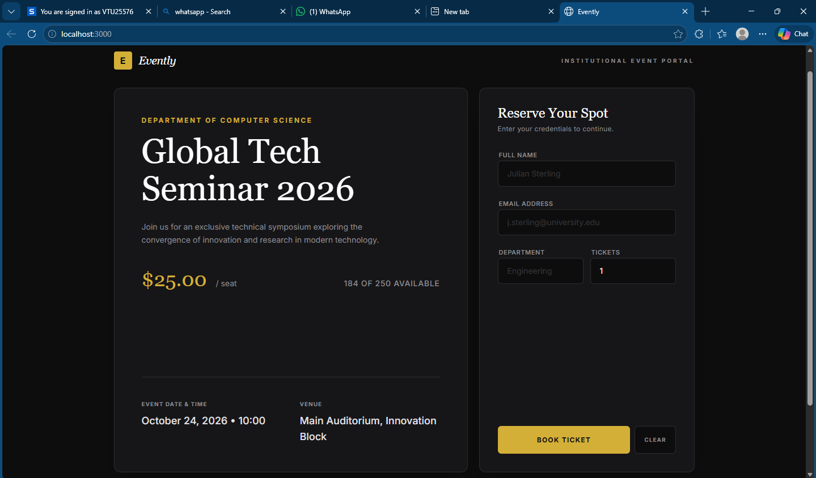
IMPLEMENTATION SCREENSHOTS
1
2
3
4
5
6
7
8
9

Slide 11
IMPLEMENTATION SCREENSHOTS
Event Booking Page:
- Displays event details such as event name, department, date, time, and venue
- Shows available number of tickets dynamically
- Displays ticket price information
- Provides a user-friendly booking form
- User can enter:
- Full Name
- Email ID
- Department
- Number of tickets
- Includes input validation for all fields
- Prevents invalid or empty submissions
- Allows users to confirm registration easily
1
2
3
4
5
6
7
8(A)
9

Slide 12
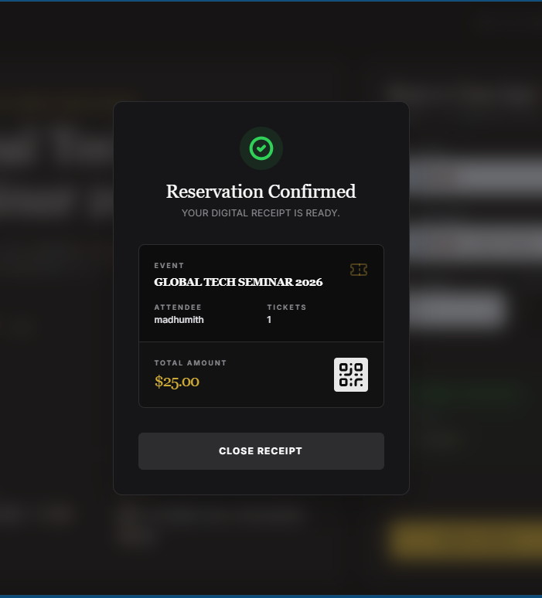
IMPLEMENTATION SCREENSHOTS
1
2
3
4
5
6
7
8(B)
9

Slide 13
IMPLEMENTATION SCREENSHOTS
1
Booking Confirmation Page:
- Displays confirmation message after successful booking
- Shows registration reference ID
- Displays user details:
- Name
- Department
- Shows booking details:
- Number of tickets booked
- Total amount paid
- Updates available ticket count in real-time
- Provides option to start a new booking session
2
3
4
5
6
7
8(C)
9

Slide 14
ADVANTAGES & LIMITATIONS
1
Advantages:
Easy to use and automated system
Reduces manual work
Secure and reliable
Real-time ticket booking
Limitations:
Requires internet connection
Basic UI (can be improved)
2
3
4
5
6
7
8
9

Slide 15
Thank you

