Slide 1
SUMMER INTERNSHIP REVIEW | IT3711
1
Search
Design and Development of a Web-Based Railway Ticket Reservation System
2
Book
A full-stack web application for online train booking
3
Pay
R. MADHUMITHA (810023205064)
B.Tech. Information Technology, Semester VII
University College of Engineering (BIT Campus), Anna University, Tiruchirappalli
Internship at Fantasy Solution, Trichy | 30 days
4
Ticket
Notes:
Good morning. I am R. Madhumitha, register number 810023205064, B.Tech Information Technology, seventh semester. My internship project is a Web-Based Railway Ticket Reservation System, done at Fantasy Solution, Trichy as part of the course IT3711. In simple words: a website where a passenger can search a train, pick a seat, pay, and get a digital ticket with a PNR number.

Slide 2
Internship at a Glance
DURATION
ORGANISATION
30 days
Fantasy Solution
Daily work report: Day 1 to Day 30
Melapudur, Trichy
DOMAIN
COURSE
Web Development
IT3711
Front-end, back-end and database
Summer Internship, 7th semester
Project: Web-Based Railway Ticket Reservation System for passengers and administrators
Notes:
The internship was 30 days at Fantasy Solution, a software company in Melapudur, Trichy. The first part was learning web development step by step. Then I applied it to build the Railway Ticket Reservation System. The course code is IT3711, seventh semester.

Slide 3
Objectives
Build a user-friendly, responsive web-based railway ticket reservation system
1
Let passengers search trains, check seats, book and cancel tickets online
2
Provide secure login with role-based access, plus digital ticket and PNR generation
3
Keep all data in a central database, with an admin module to manage trains and bookings
4
Gain practical skills in front-end, back-end, database integration and testing
5
Notes:
These are the main objectives from my report. The first four are about the system: an easy website, online search and booking, secure login with a digital ticket, and a database with an admin module. The last one is my own learning goal: practical experience in front-end, back-end, database and testing.

Slide 4
30 Days of Learning
DAYS 1-7
DAYS 8-16
DAYS 17-24
DAYS 25-30
Foundations
Design and UX
JavaScript
Web Practice
Web basics, dev setup
HTML structure
CSS, box model
Responsive design
Typography, colour
Images, navigation
UX and UI design
Accessibility
Bootstrap, Foundation
Interaction, speed
JS syntax, functions
DOM, event handling
User-centred design
Mobile-first layouts
Usability testing
E-commerce design
SEO, analytics
HTTPS, XSS security
CMS overview
Database, CRUD
Applied next: these web basics were used to build the railway reservation system.
Notes:
Before building the project I spent the 30 days learning web development in four stages. Days 1 to 7: HTML, CSS and responsive design. Days 8 to 16: images, navigation, UX and UI, accessibility, Bootstrap and optimisation. Days 17 to 24: JavaScript, DOM, user-centred design and usability. Days 25 to 30: e-commerce design, SEO, analytics, security, CMS and database connectivity. This base helped me build the booking system.

Slide 5
Problem and Proposed Solution
The problem
The solution
Complex navigation and long processing time
Counter booking needs a visit and queues
Limited accessibility for passengers
Hard to track bookings, PNR and cancellations
Errors and delays when schedules or seats are updated
One web platform: register, search, book, pay, cancel
Seat selection from live database availability
Automatic PNR and digital ticket after payment
Admin module for trains, schedules, users, bookings
Responsive interface for different devices
Two roles: passengers book and manage tickets; admins manage trains, schedules, users and bookings.
Notes:
The existing way of booking has problems: complex navigation, longer processing time, limited accessibility, and counter booking where people stand in queues. Managing booking and PNR information is also difficult. My solution puts everything on one website: register, search, select seats, pay, get a ticket with PNR, and cancel. An admin module manages trains, schedules and bookings, and a central database keeps data consistent.

Slide 6
System Architecture
1
2
3
4
Passenger
Web Interface
Server
Database
Web browser
HTML, CSS, JavaScript
Node.js + Express.js
MySQL (mysql2)
Frontend
Backend
Database
Forms for login, search, seat selection, passenger details and payment; responsive layout.
Routes /login, /search, /book, /payment, /cancel; validation, fare calculation and PNR logic.
Tables for users, trains (source, destination, date, seats), bookings and payments.
Example: search form → POST /search → SELECT from trains → matching trains returned to the passenger.
Notes:
The system has three layers. The passenger uses the browser. The web interface is built with HTML, CSS and JavaScript. The server uses Node.js and Express.js, which receives requests such as login, search, book, payment and cancel, applies the logic, and talks to the MySQL database. The database stores users, trains, bookings and payments. The result, like a PNR and digital ticket, comes back to the passenger. Example: when the passenger searches, the search form sends a POST request, the server runs a SELECT query on the trains table and sends the matching trains back.

Slide 7
Technologies Used
Also learned
HTML
CSS
JavaScript
Bootstrap, Foundation
CSS frameworks
Google Analytics
Website statistics
HTTPS and XSS
Web security basics
JDBC
Database CRUD with Java
Page structure, forms
Styling, responsive layout
Interactivity, app logic
Node.js
Express.js
MySQL
Server runtime
Routing: app.post, app.get
Relational data via mysql2
JavaScript runs on both sides: in the browser and on the Node.js server.
Notes:
These are the technologies in the project. HTML for page structure and forms. CSS for styling and responsive layout. JavaScript for interactivity and logic. Node.js is the server runtime and Express.js handles routes. MySQL stores the data, accessed through the mysql2 package. On the right are things I also learned during the internship, such as Bootstrap, Google Analytics, HTTPS and XSS prevention, and JDBC.

Slide 8
Modules and Booking Workflow
1
2
3
4
5
6
Login
Search
Seats
Details
Payment
Ticket
Credentials checked in the database
Source, destination, date give matching trains
Free seats shown; none means modify search
Passenger data validated, fare calculated
Payment processed; failure allows retry
Unique PNR generated, booking stored
Cancellation and PNR status
Admin management
Database and testing
Enter PNR or booking ID; status becomes Cancelled, the seat is released and availability is updated.
Add, update and delete trains; manage schedules, users and bookings; view reports.
Central MySQL store for users, trains, seats, bookings and payments. Main functions were tested.
Notes:
This is how a booking flows. One: the user logs in and the credentials are checked. Two: search by source, destination and date. Three: available seats are shown; if none, the search is modified. Four: passenger details are validated and the fare is calculated. Five: payment is processed, and if it fails the user can retry. Six: a unique PNR is generated, the booking is stored and the e-ticket is shown. Below are the other modules: cancellation and PNR status, the admin module, and the database with testing.

Slide 9
Implementation
HTML forms send POST requests to the server
Node.js + Express | MySQL
1
app.post('/search', (req, res) => {
const { source, destination, date }
= req.body;
const sql = `SELECT * FROM trains
WHERE source = ?
AND destination = ?
AND journey_date = ?`;
db.query(sql, [source, destination, date],
(err, result) => {
if (err) return res.status(500)
.send("Database Error");
res.json(result);
});
});
CREATE TABLE trains (
train_id INT PRIMARY KEY AUTO_INCREMENT,
train_name VARCHAR(100), source VARCHAR(50),
destination VARCHAR(50), journey_date DATE,
available_seats INT );
Express routes: /login, /search, /book, /payment, /cancel
2
Parameterised SQL (?) through mysql2, so input is never joined into the query
3
Booking saved as Confirmed, cancellation sets Cancelled; PNR = "PNR" + 6 digits
4
Notes:
This is a real part of my code. The search route receives source, destination and date from the form, runs a SELECT query on the trains table, and returns the matching trains as JSON. The question marks are placeholders, so user input is never joined into the SQL text. This protects against SQL injection. Booking, payment and cancellation routes follow the same pattern. A booking is saved with status Confirmed and cancellation changes it to Cancelled. The PNR is the letters PNR plus a six-digit number.

Slide 10
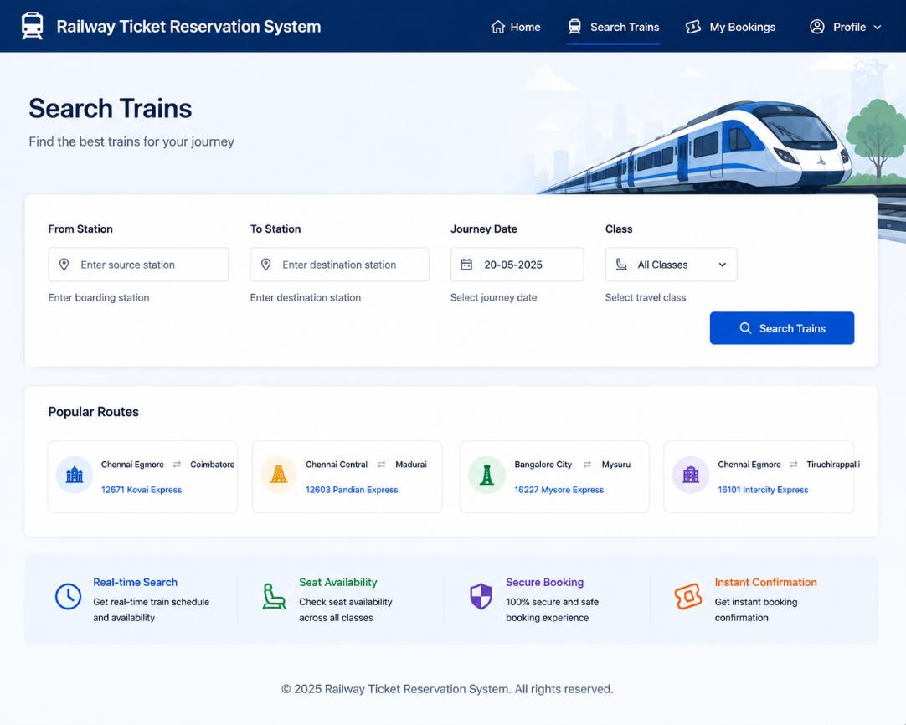
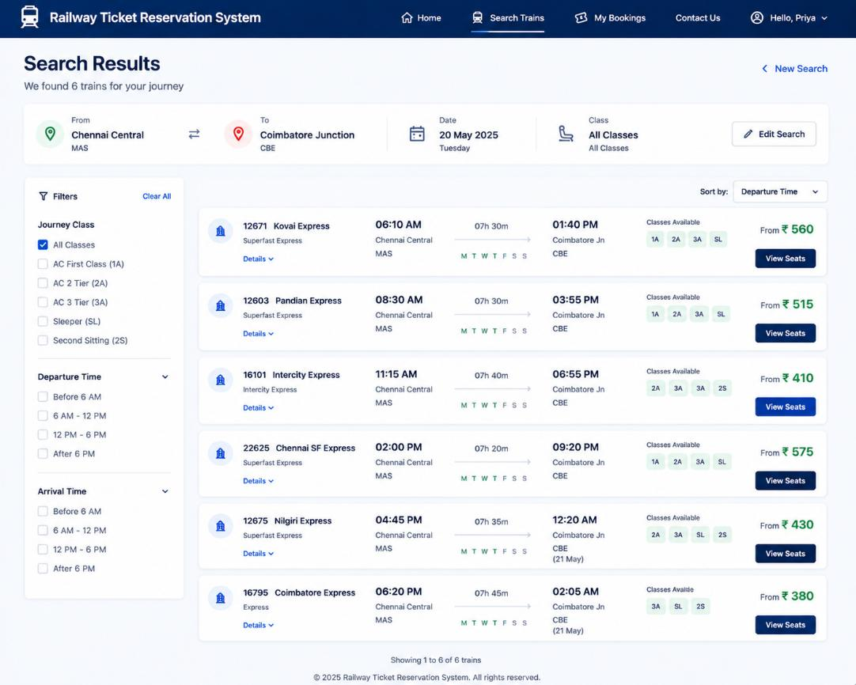
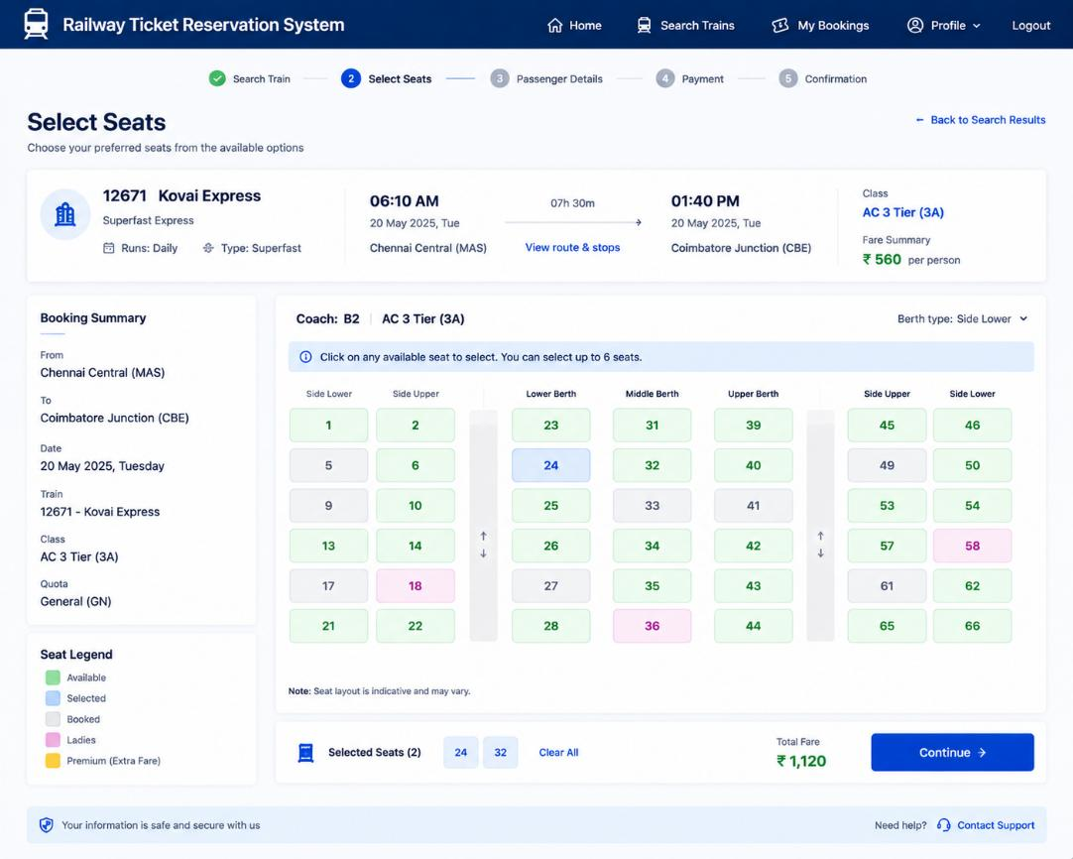
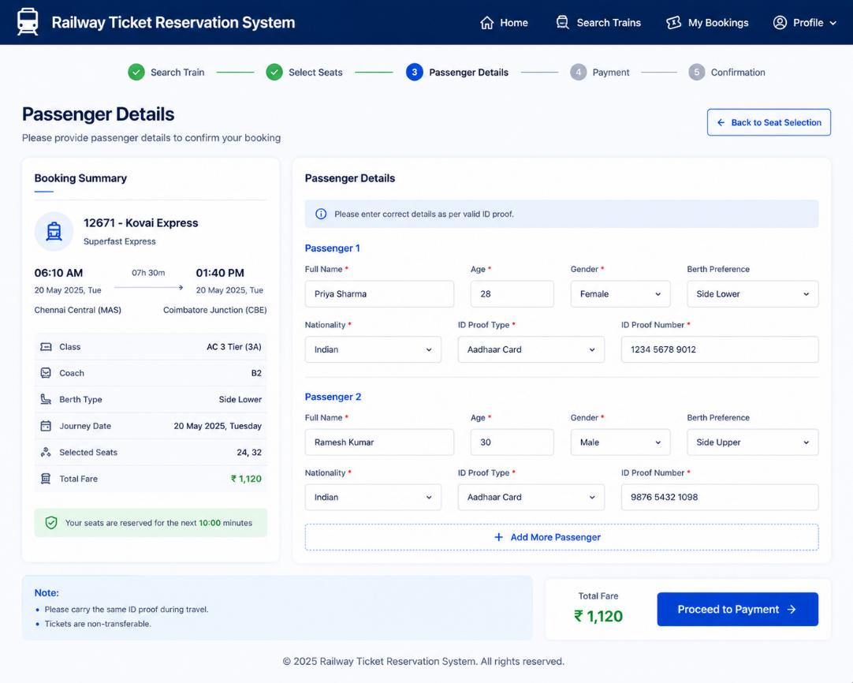
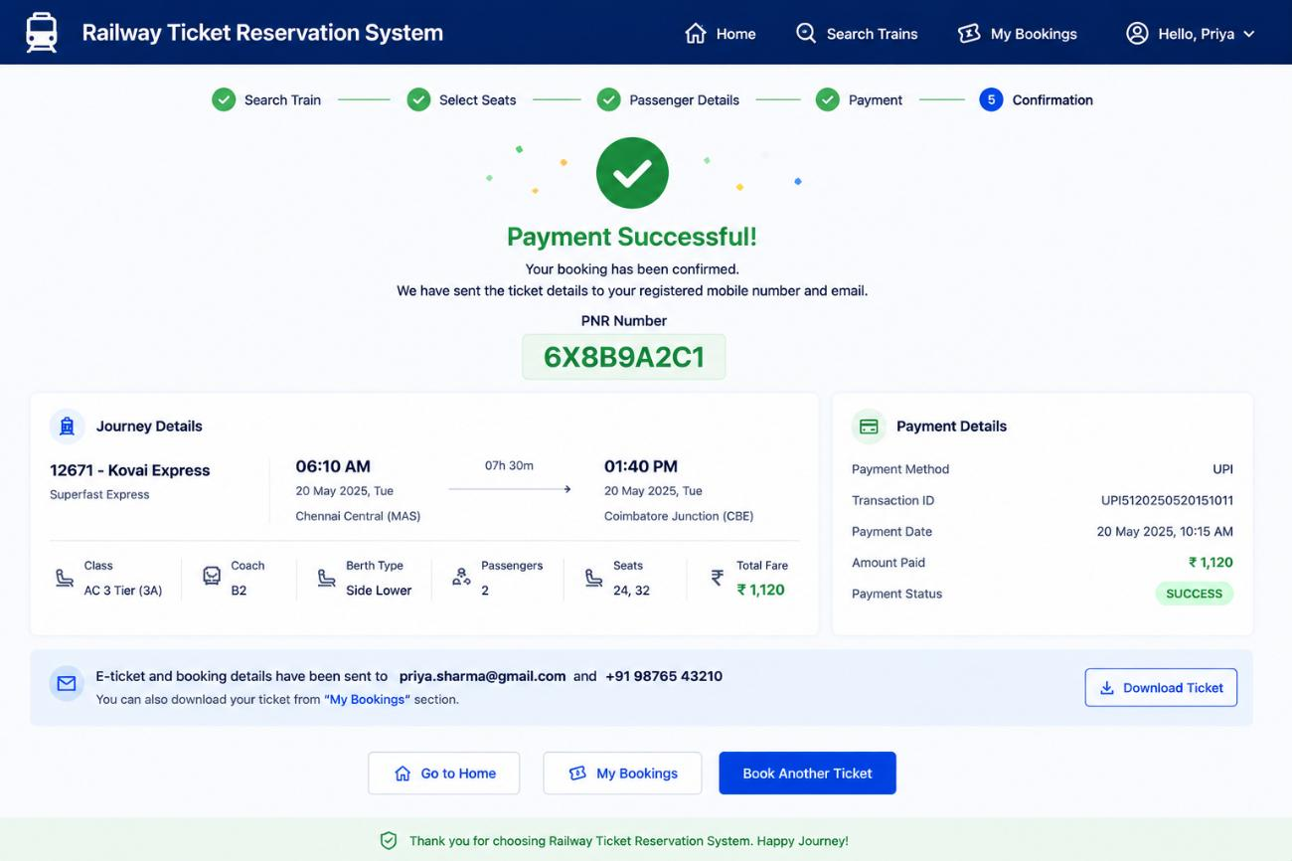
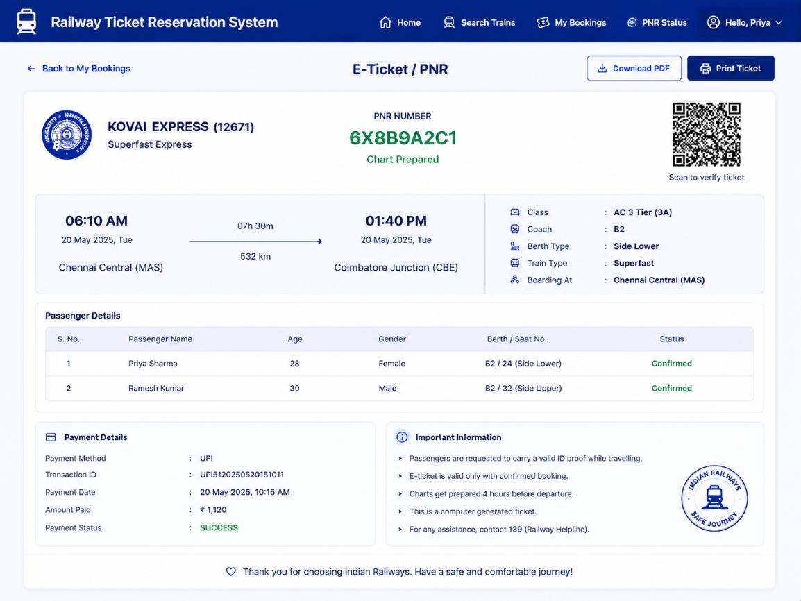
Sample Output Screens
Train search
Search results
Seat selection
Passenger details
Payment success and PNR
Digital e-ticket
Notes:
These are output screens from my report. Top row: the train search page, the search results with filters, and seat selection with a coach layout and fare. Bottom row: passenger details, the payment success page with PNR, and the digital e-ticket. The report also has the registration, login, payment method and booking history screens.

Slide 11
Results, Testing and Learning
What was achieved
Limitations and fixes
Complete flow built: register, login, search, seats, payment, PNR, e-ticket, history
Tested: login, search, seat selection, booking, payment, ticket, cancellation
Result is qualitative: less manual effort and fewer booking errors; no benchmark figures recorded
Plain-text password check: hash with bcrypt
Payment is simulated: use a real gateway
PNR from Math.random: add uniqueness check
No seat locking: use DB transactions
From my own review of the code in the report
Skills gained: HTML, CSS, JavaScript, Node.js, Express, MySQL, authentication, testing and debugging.
Notes:
Per my report, the main functions were tested: login, train search, seat selection, booking, payment, ticket generation and cancellation. The results are qualitative: less manual effort, fewer booking errors, faster reservation. I did not record numerical benchmarks, so I do not claim any numbers. On the right are limitations I noticed when reviewing my own code, and how I would fix them. Passwords are compared as plain text, so I would hash them with bcrypt. Payment is simulated, so a real gateway is needed. The PNR uses a random number, so a uniqueness check is needed. And booking should use a database transaction to stop two people taking the same seat.

Slide 12
Conclusion and Future Scope
Conclusion
Future scope
Booking, payment, cancellation and e-ticket in one platform
Admin module and central MySQL database
Hands-on experience across the full web stack
Live train schedules and status
Real payment gateway, OTP login
Email and SMS notifications
Mobile app, multilingual support
Cloud deployment, admin analytics
Thank you. Questions welcome.
References: MDN Web Docs; Node.js, Express.js and MySQL official documentation; J. Duckett, HTML and CSS: Design and Build Websites (Wiley); E. Brown, Web Development with Node and Express (O'Reilly).
Notes:
To conclude: I built a web-based railway reservation system that brings search, seat selection, booking, payment, cancellation, PNR and digital ticket into one platform, with an admin module and a central database. The internship gave me practical experience across the full web stack. In future I would add real-time train data, a real payment gateway, email and SMS alerts, OTP login, a mobile app and cloud deployment. Thank you. I am happy to take questions.

