Slide 1
KEYLOGGER
CYBER SECURITY PROJECT
Presented By:
K V. Madhumitha - Jeppiaar Institute of Technology- B.Tech/Information Technology

Slide 2
OUTLINE
Problem Statement (Should not include solution)
Proposed System/Solution
System Development Approach (Technology Used)
Algorithm & Deployment
Result (Output Image)
Conclusion
Future Scope
References

Slide 3
Problem Statement
The primary goal of a keylogger in cybersecurity attacks is to compromise the security and privacy of individuals or organizations by secretly capturing sensitive information entered via keyboards. This poses significant risks to personal privacy, financial security, and data integrity.
The problem is compounded by the fact that keyloggers can operate stealthily, often evading detection by traditional antivirus software and other security measures. Additionally, keyloggers can be deployed through various vectors including phishing emails, malicious websites, compromised software downloads, and physical access to devices.

Slide 4
Proposed Solution
Our proposed system entails the development of a keylogger using Python's Tkinter library for the GUI, alongside the pynput library for capturing keyboard inputs. The keylogger records keystrokes and saves them in both text and JSON formats for comprehensive analysis.

Slide 5
System Approach
The "System Approach" section outlines the overall strategy and methodology for developing and implementing the rental bike prediction system. Here's a suggested structure for this section:
System requirements
Library required to build the model

Slide 6
Algorithm & Deployment
Algorithm :
Keylogger applications designed by implementing the Exact String Matching algorithm can record all user activities related to the keyboard, and the results are stored automatically in a dedicated database that can only be accessed by the keylogger owner, the next development of the keylogger application can record the activity on the virtual keyboard or remote activity on the user's computer.
Deployment :
a. The program will wait for all the system processes to initialize.
b. The keylogger daemon is initialized and the process will be gauged in scale of time.
c. A log file is created for the current session to log all the keystrokes and maintain a record.
d. If no event occurs, keylogger continues listening to the strokes.
e. If an event occurs, the keylogger classifies the type of keystroke that has occurred- special key which are commands or normal text input.
f. If a special key that gives a command has been entered then it is compared with a value in a dictionary and recorded in the log file.
g. If a normal text i.e. anything in the range of ASCII characters has been inputted, the ASCII code is converted to its respective character and this is exported to the log file.
h. The inputs along with their timestamps are recorded in the log file.

Slide 7
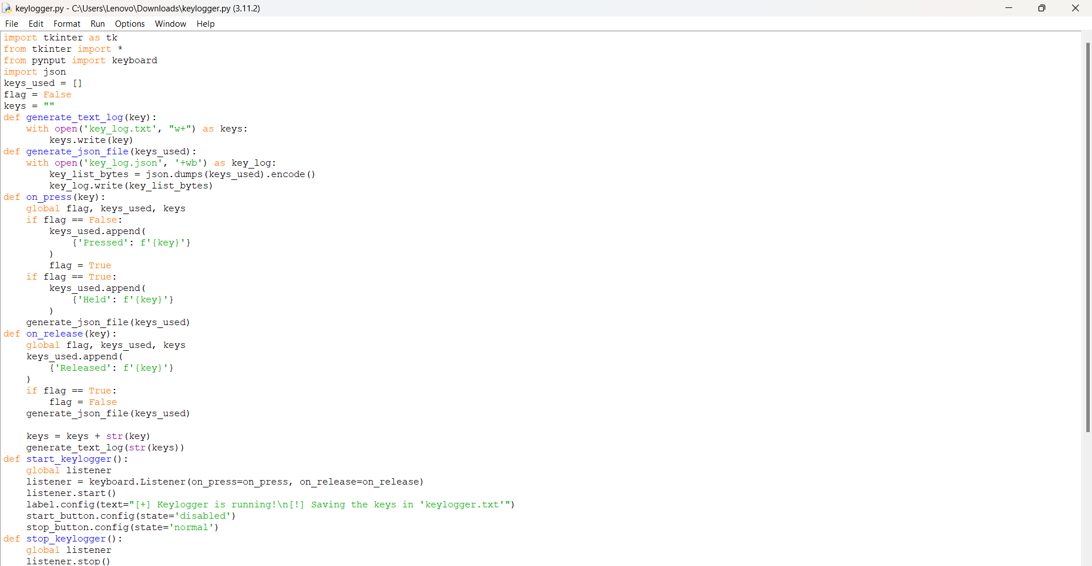
Source code

Slide 8
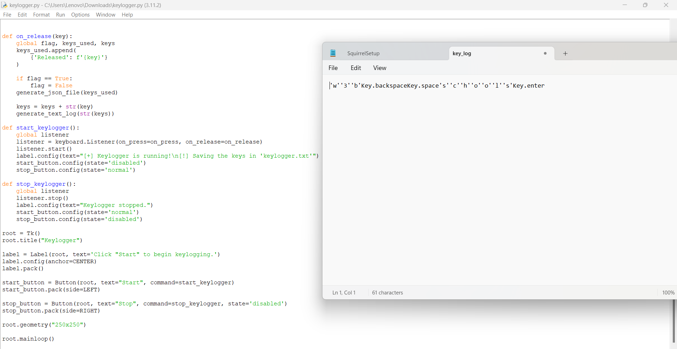
Result

Slide 9
Conclusion
keyloggers represent a significant cybersecurity threat, capable of covertly capturing sensitive information such as passwords, credit card numbers, and other personal data entered by users on compromised systems. The proliferation of keyloggers underscores the importance of robust security measures and user awareness in mitigating the risks associated with these malicious tools.

Slide 10
Future scope
Enhancing Security Measures: Implement encryption techniques to secure logged data.
User Authentication: Integrate user authentication mechanisms to prevent unauthorized access.
Advanced Logging: Implement advanced logging features, such as timestamping and window tracking.

Slide 11
THANK YOU

