Slide 1



AI-Driven NPU-Enabled Battery Management for Electric Vehicles: Predictive Cell Voltage and Optimization Planning
\

Slide 2
team MEMBERS
MADHUMITHA.L
LEKHASHREE.S
MONIKA.I

Slide 3
Abstract
EV batteries contain many lithium-ion cells with uneven degradation
Traditional BMS cannot track individual cell behavior accurately
Uses GRU model to predict future cell voltage
Uses K-Means clustering to identify weak and healthy cells
Implemented on NPU for fast, low-power processing
Enables real-time monitoring and early fault detection
Improves battery life, safety, and overall EV performance

Slide 4
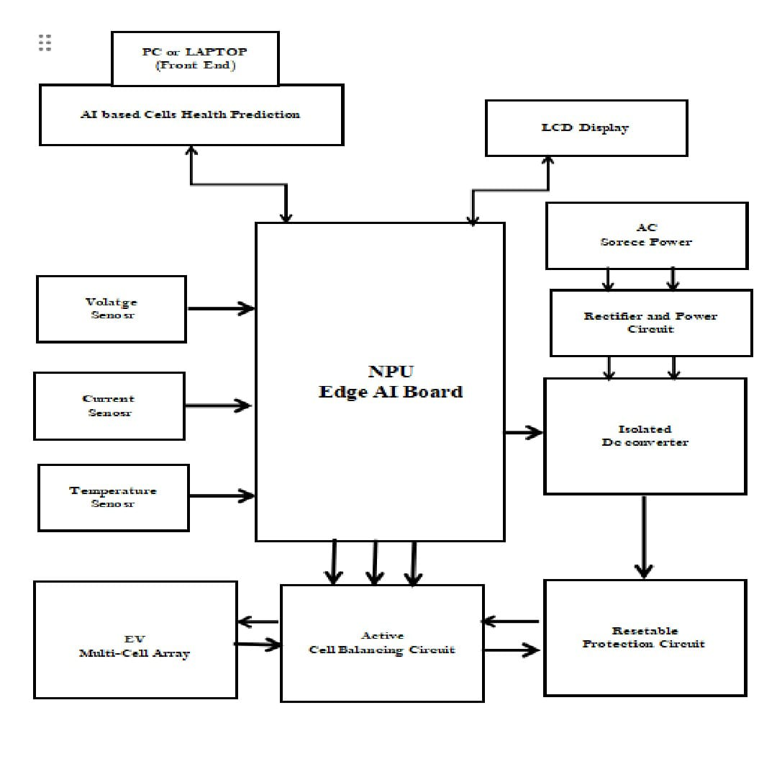
Block diagram

Slide 5
Existing system
Conventional battery management systems monitor average pack voltage and current. Alerts are generated only when predefined voltage or temperature limits are exceeded.
Individual cell behavior or early imbalance cannot be predicted. Weak or degrading cells are detected only after significant performance drop.
Only basic passive cell balancing is applied. No active optimization is performed to maintain uniform cell voltage.
Processing is slow and limited to simple threshold-based decisions. Real-time monitoring and analysis of all cells is not possible.
No AI or advanced computing is used for prediction. The system cannot forecast future cell behavior or prevent issues proactively

Slide 6
Proposed syetem
The system uses an NPU-enabled processor for high-speed computation.GRU-based models predict individual cell voltages in real time.
K-Means clustering categorizes cells based on their operating condition.Weak or unstable cells are identified before they affect overall performance.
Active cell balancing is applied based on prediction and optimization.Voltage is maintained uniformly across the battery pack during operation.
Real-time monitoring and analysis allow proactive control actions.The system adjusts current and charging strategies dynamically.
AI-driven prediction and optimization improve battery reliability.Overall lifespan is extended, and performance is enhanced without cloud dependency

Slide 7
Hardware Requirements and Software Requirements
NPU-Enabled Edge AI Processor Board
Microcontroller Unit (MCU)
Multi-Cell Battery Voltage Monitoring IC
Battery Temperature Sensors
Current Sensor Module
Active / Passive Cell Balancing Circuit
Isolated DC-DC Converter
UART Interface Modules
LCD Display Module
Thermal Cut-Off Relay Module
Resettable Protection Circuit
Power Supply / Battery Cell
Programming Language: • Embedded C • python
Integrated Development Environment (IDE): • Thonny IDE • Visual Studio

Slide 8
Power Supply Section and Power Supply Section
AC mains converted using transformer
Rectifier converts AC → DC
Filter removes noise
Regulator provides:
  5V for relays/LCD
  3.3V for ESP32
Uses 18650 lithium-ion batteries
Charges during normal operation
Supplies power during failure

Slide 9
working
AC power is converted to DC
System powers ESP32 and charges battery
ESP32 monitors sensors
Relays control loads
LCD displays system status

Slide 10
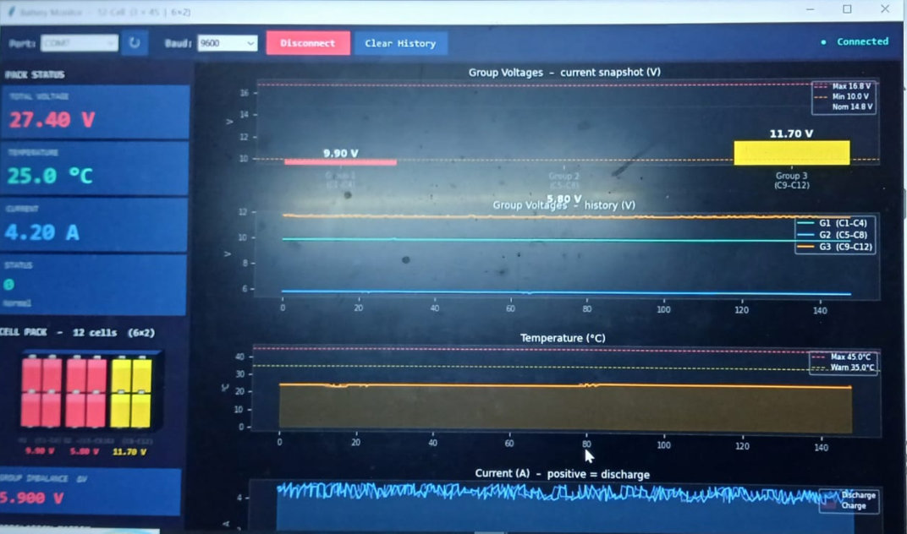
Output of the project

Slide 11
advantage
Automatic operation
Battery backup support
Energy monitoring
Low cost
Easy to expand
Limitations
Limited battery capacity
Manual wiring complexity
Needs proper insulation for safety

Slide 12
Future Improvements
Mobile app control (IoT)
Solar charging integration
Advanced monitoring dashboard
Compact PCB design

Slide 13
Conclusion
System provides:
  Reliable backup
  Smart control
  Monitoring capability
Useful for real-world automation applications

Slide 14
Thank you

