Slide 1


RESOLVE HUB
Smart Municipal Issue Reporting Platform
Resolve Hub is a full-stack, responsive web application designed to bridge this gap. It provides a centralized, transparent platform where community members can easily report issues and local authorities can efficiently manage and resolve them.

Slide 2


Project Summary & Tech Stack
Project Name: Resolve Hub
Objective: A seamless, real-time tracking system for civic maintenance.
TECH STACK
  Frontend: React (Vite), Tailwind CSS, Recharts
  Backend: Java, Spring Boot, REST APIs
  Database: MySQL (via XAMPP)

Slide 3
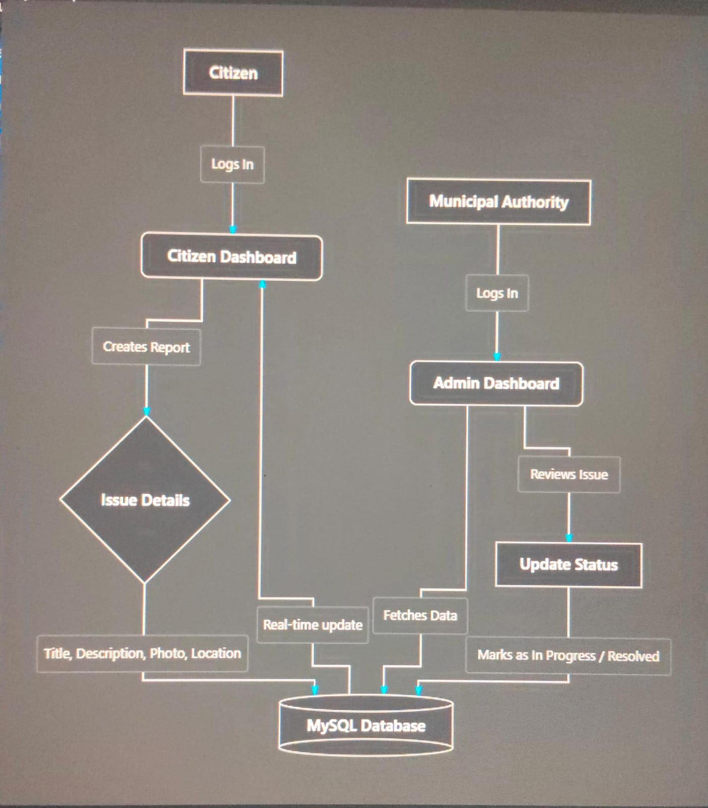
FLOW CHART

Slide 4
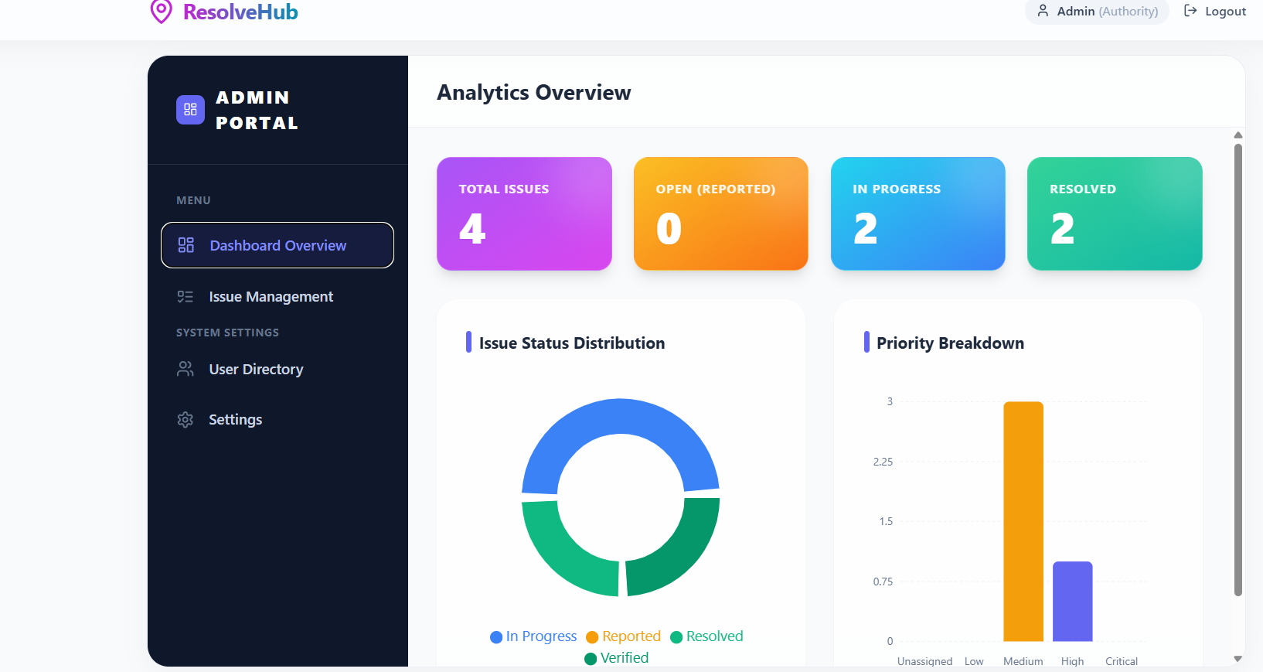
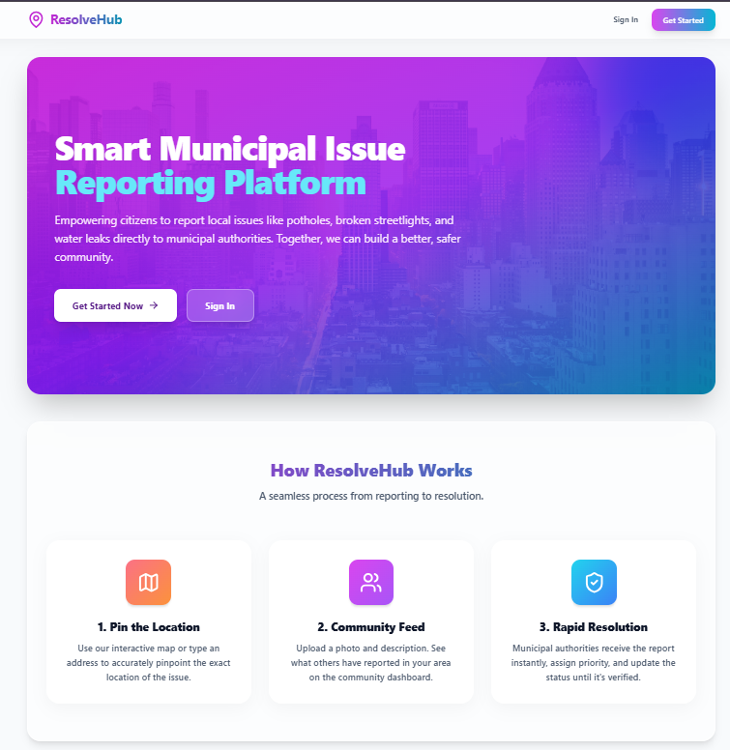
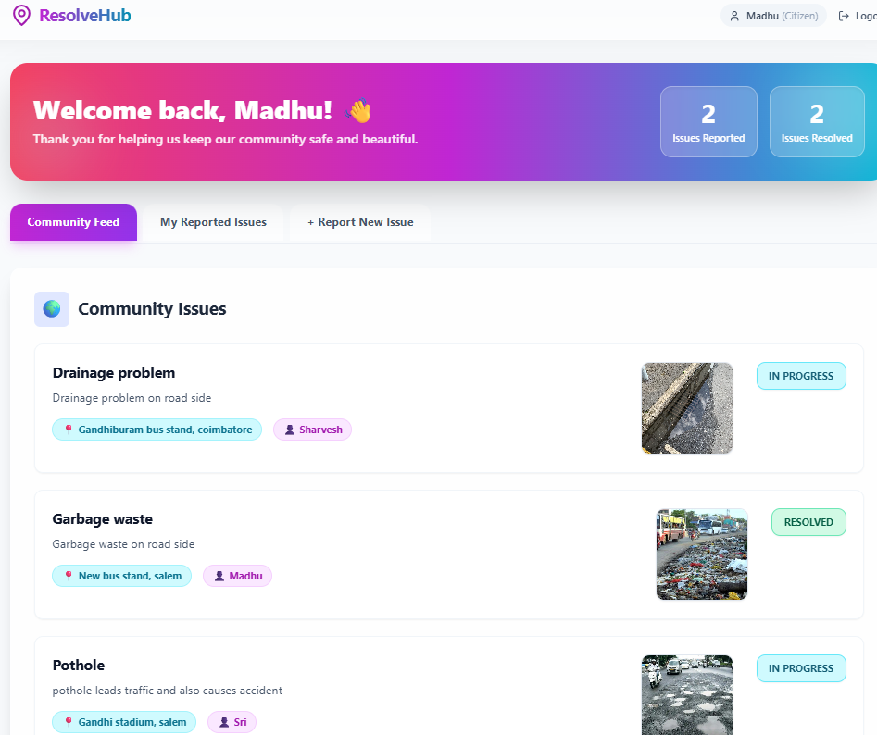
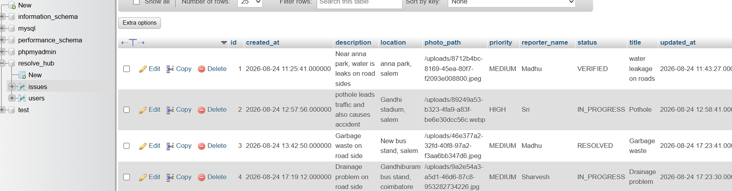
O U T P U T I M A G E S

Slide 5

PROS CONS
Dependent on physical responsiveness of authorities
High Transparency & Real-time tracking
Requires internet access and smart devices
Efficient workflow for municipal authorities

Slide 6

CONCLUSION
Resolve Hub connects citizens and municipal authorities on one platform.
It makes issue reporting simple, transparent, and trackable.
Authorities can efficiently prioritize and manage reported problems.
Our goal is to build smarter communities with faster issue resolution.

