Slide 1
Employee Data Analysis using Excel
STUDENT NAME : MADHUMITHA.V
REGISTER NO : 312204589,E6AAE4940FA8437B96647E9DFD674D9F
DEPARTMENT : COMMERCE
COLLEGE : K.C.S KASI NADAR COLLEGE OF ARTS & SCIENCE

Slide 2
PROJECT TITLE
Employee Project Management

Slide 3


AGENDA
Problem Statement
Project Overview
End Users
Our Solution and Proposition
Dataset Description
Modelling Approach
Results and Discussion
Conclusion
3/21/2024 Annual Review

Slide 4

PROBLEM STATEMENT
The problem definition for designing the system is to maintain data of employee to make easy controlling employees to divide job and access control of employees to use technology to accurate and timely processing
THE PROBLEM IS TO IDENTIFY
project wise analysis
Task wise analysis
Employee wise analysis

Slide 5

PROJECT OVERVIEW The employee project management initiative focuses on streamlining and optimizing our team’s efforts to enhance productivity and achieve project goals efficiently. This project involves defining clear objectives, assigning specific roles and responsibilities, and establishing a structured timeline with key milestones. Tables Conditional Formatting Pivot Chart -Line Chart ,Pie Chart, Bar Chart Slicers

Slide 6

WHO ARE THE END USERS? End users are the individuals or groups who will ultimately use impacted the final product or outcome of a project. They are the recipients of the project's deliverables and often provide feedback that influences the development process. Identifying end users involves understanding who will benefit from or interact with the project results, such as: Project manager Team members HR and admin staff Clients

Slide 7

OUR SOLUTION AND IT’S VALUE PREPOSITION Task and project tracking Resource a collection Collaboration tools Performance analytics Integration capabilities

Slide 8
DATASET DISCRIPTION Employee project management involves overseeing and coordinating the various aspects of a project, ensuring that tasks are completed on time and within budget. DATA OVERVIEW Data is collection of information gathered by observation measurement or analysis .There may consist of fact number names even description of things DATA FIELD Data base name Data type Data field and columns Task name

Slide 9
MODELLING
Employee project management for modeling involves organizing and overseeing projects related to creating or refining models, which could be in fields such as business, engineering, or data science. Here are key aspects to consider:
Data cleaning
Creating table
Creating pivot chart
Inserting pivot chart in dashboard
Creating dashboard
Inserting formulas in dashboard to make interaction
Creating interactive dashboard by putting all together elements
9

Slide 10

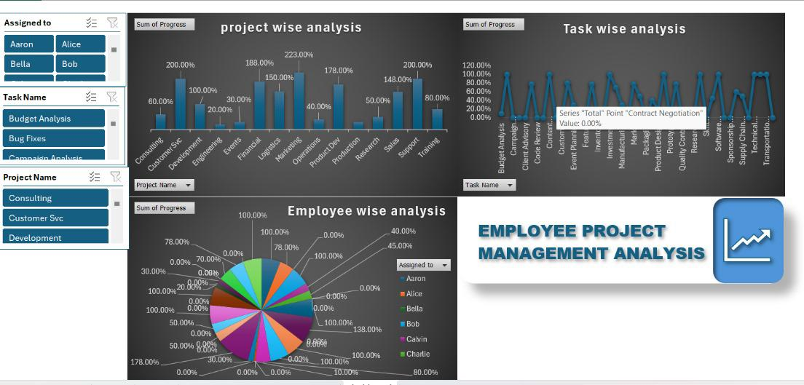
RESULTS
10

Slide 11
Conclusion In conclusion, effective employee project management is crucial for achieving organizational goals and enhancing productivity. By clearly defining project objectives, roles, and responsibilities, and ensuring consistent communication and feedback, organizations can foster a collaborative environment that drives success. Implementing structured processes, utilizing project management tools, and supporting employees through training and development also contribute to smoother project execution and better outcomes. Ultimately, a well-managed project not only meets its goals but also promotes growth and efficiency within the team.

