Slide 1
Employee Data Analysis using Excel
STUDENT NAME: MADHUMITHA R
REGISTER NO:312209844
NM ID:B8114BD0907E9CE924E4BBDCDB15C6E3
DEPARTMENT:B.COM(ACCOUNTING AND FINANCE)
COLLEGE: VALLIAMMAL COLLEGE FOR WOMEN

Slide 2
PROJECT TITLE
Employee Performance Analysis using Excel

Slide 3


AGENDA
Problem Statement
Project Overview
End Users
Our Solution and Proposition
Dataset Description
Modelling Approach
Results and Discussion
Conclusion
3/21/2024 Annual Review

Slide 4

PROBLEM STATEMENT
Develop an Excel-based system to accurately track and analyze employee performance metrics, including sales targets, customer satisfaction ratings, and productivity levels.

Slide 5

PROJECT OVERVIEW
The dashboard will display key performance indicators, automate reporting, and enable filtering and analysis to support performance improvement initiatives."

Slide 6


WHO ARE THE END USERS?
Managers
Time Managers
Team leads
Department leads

Slide 7

OUR SOLUTION AND ITS VALUE PROPOSITION
Unlock data-driven insights to boost employee performance and drive business growth with our 'Performance Insights' Excel dashboard.

Slide 8
Dataset Description
Key data points include employee information, performance scores, goals, and development plans, as well as metrics on sales, customer satisfaction, and productivity, updated monthly, quarterly, and annually.

Slide 9

THE "WOW" IN OUR SOLUTION
Interactive dashboards and heat maps reveal top performers, areas for improvement, and hidden trends in real-time, enabling data-driven decisions with confidence.
3/21/2024 Annual Review
9

Slide 10
MODELLING
Pivot tables
Charts (e.g., column, line, scatter)
Conditional formatting- Formulas
Data validation
Trend analysis tools (e.g., moving averages, regression)
10

Slide 11
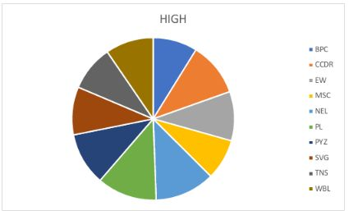
RESULTS
11

Slide 12
conclusion
Unlock the full potential of your workforce with data-driven insights from our Employee Performance Analysis Excel solution, empowering informed decisions and strategic growth. Transform performance data into actionable intelligence to drive business success and employee development.

