Slide 1
SHOPIFY
Madhumitha.S 19PW13,
Muhammed Razeen Amanullah 19PW17

Slide 2
OUTLINE OF THE VIDEO
ABSTRACT of the package
Analysis of tables and ER diagram
Demonstration of website integrated with backend
Languages used
Procedures,Triggers and Joins analysis

Slide 3
ABSTRACT of the package
SHOPIFY is a olx like web portal in which its customers can advertise and purchase products from various categories implemented.It aims at a user friendly interface in which its users can message peer users to negotiate price of products or know deep about the product that is of their interest.Our aim is to empower every person to independently connect with buyers and sellers online.

Slide 4
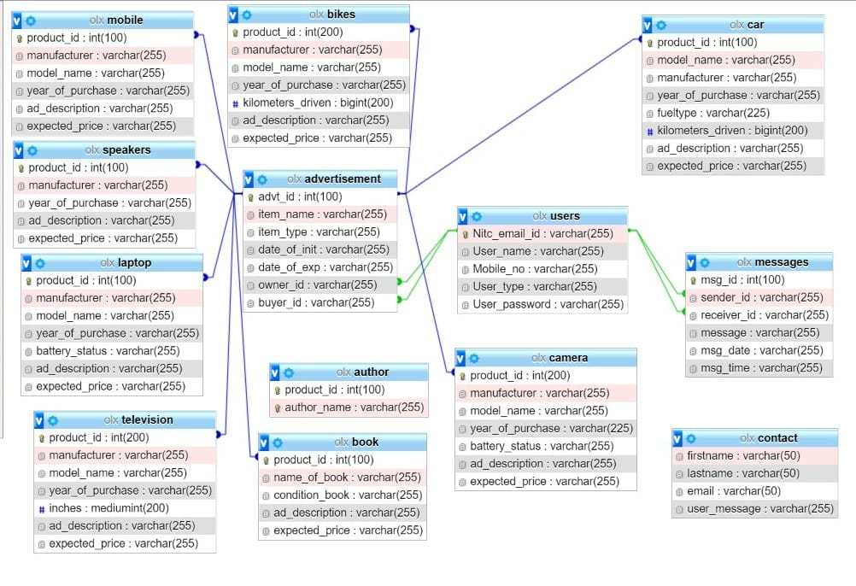

Slide 5
Languages used
For Database : MYSQL,PL/SQL
For Connectivity,Frontend
PHP,HTML,CSS,JS,BOOTSTRAP,AJAX,JQUERY)

