Slide 1
Predicting Cardiovascular Risk using Electronic Health Records
UE24CS352A Machine Learning - Mini-Project
Madhumitha Dhondi, Anjali Arun

Slide 2
Problem and plan
CVD is the leading cause of death worldwide - early identification of at-risk patients matters
Question 1: which models predict cardiovascular risk best from routine clinical data?
Question 2: do the conclusions hold on two very different datasets?
Following Nguyen (Stanford CS229); the original STRIDE EHR data is private, so we use two public datasets
Study A: Kaggle (prevalent CVD). Study B: Framingham (10-year incident CHD)

Slide 3
Two studies, one pipeline
Study A - Kaggle: 70,000 records -> 67,941 clean; 13 features; 50% positive (balanced)
Study B - Framingham: 4,238 records; 15 features; 15% positive (imbalanced); 582 rows with missing values
Same five models, same split, same CV, same metrics on both
Framingham exploration and first baselines done earlier; the benchmark reuses the exact same split

Slide 4
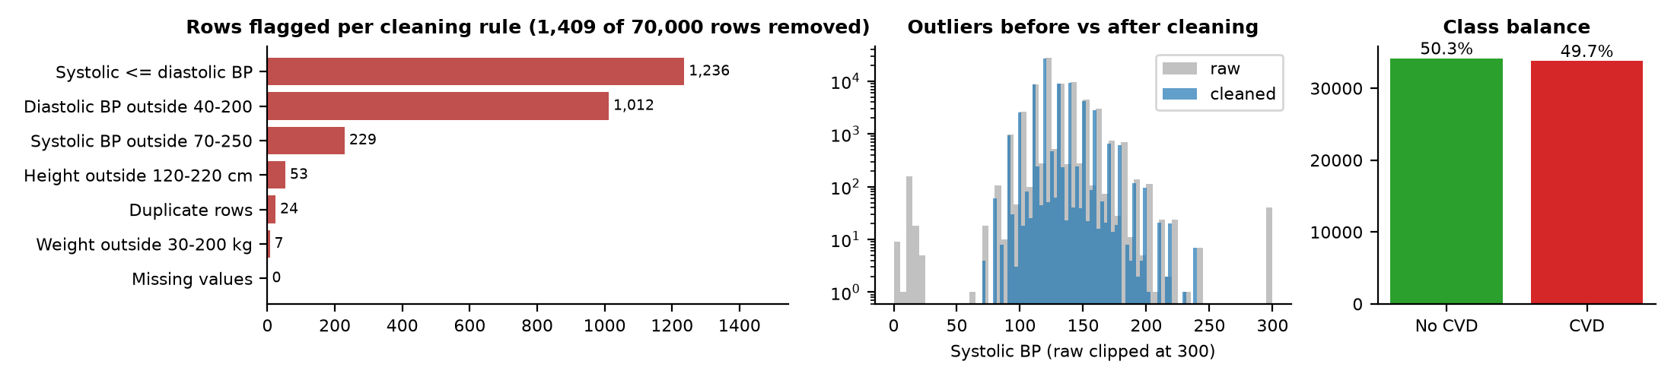
Data quality - Study A (Kaggle)
Implausible blood pressure / height / weight rows removed; no missing values

Slide 5
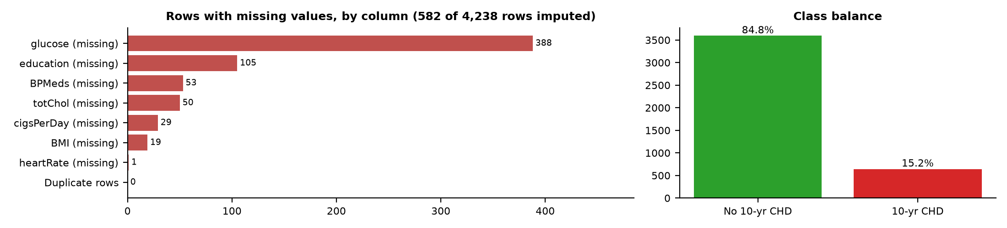
Data quality - Study B (Framingham)
Missing values imputed with the training-fold median (inside the pipeline, no leakage)

Slide 6
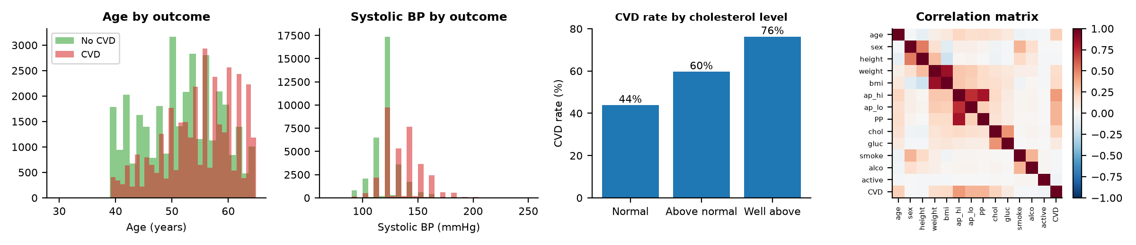
Exploratory analysis - Study A

Slide 7
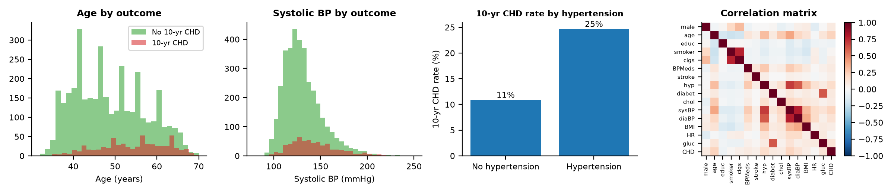
Exploratory analysis - Study B

Slide 8
Approach and protocol
Logistic regression: Ridge, Lasso, Elastic Net (standardised features)
Random Forest: bagged, decorrelated trees
XGBoost: sequential regularised trees, each correcting the previous errors
Stratified 80/20 split (seed 42); 10-fold CV grid search on AUROC, training data only
Imputation and scaling inside each fold; class weighting for the 15% positive class (Study B)
Metrics: AUROC, avg precision, sensitivity/specificity, confusion matrix, calibration, subgroup AUROC

Slide 9
Implementation
src/benchmark/datasets.py - loading, cleaning and settings per dataset
src/benchmark/train.py - tuning and evaluation; visualize.py - all figures
src/benchmark/make_report.py / make_slides.py - build this write-up and deck from results
src/*.py - Framingham exploration and first baselines; results/ - outputs for both studies
Python: pandas, scikit-learn, XGBoost, matplotlib

Slide 10
Results: test AUROC
Model | A: CV AUROC | A: Test AUROC | B: CV AUROC | B: Test AUROC
LogReg (Ridge) | 0.793 | 0.783 | 0.733 | 0.700
LogReg (Lasso) | 0.793 | 0.784 | 0.733 | 0.699
LogReg (ElasticNet) | 0.793 | 0.784 | 0.734 | 0.699
Random Forest | 0.801 | 0.793 | 0.718 | 0.684
XGBoost (GBM) | 0.802 | 0.796 | 0.707 | 0.676

Slide 11
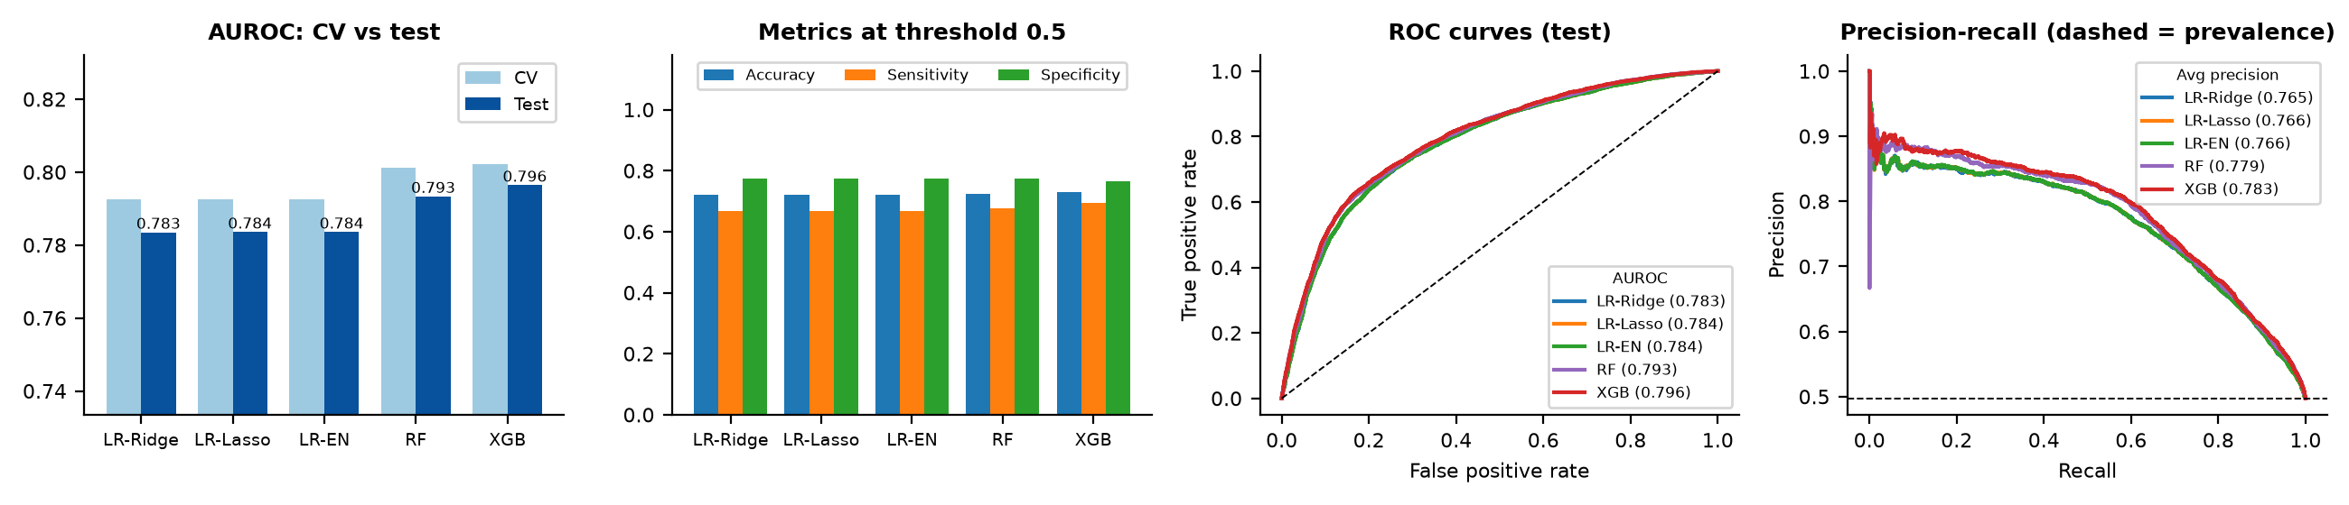
Model comparison - Study A

Slide 12
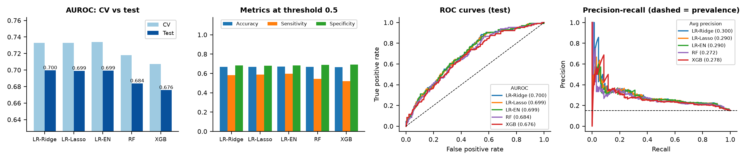
Model comparison - Study B
848 test patients: differences of a few hundredths in AUROC are within noise

Slide 13
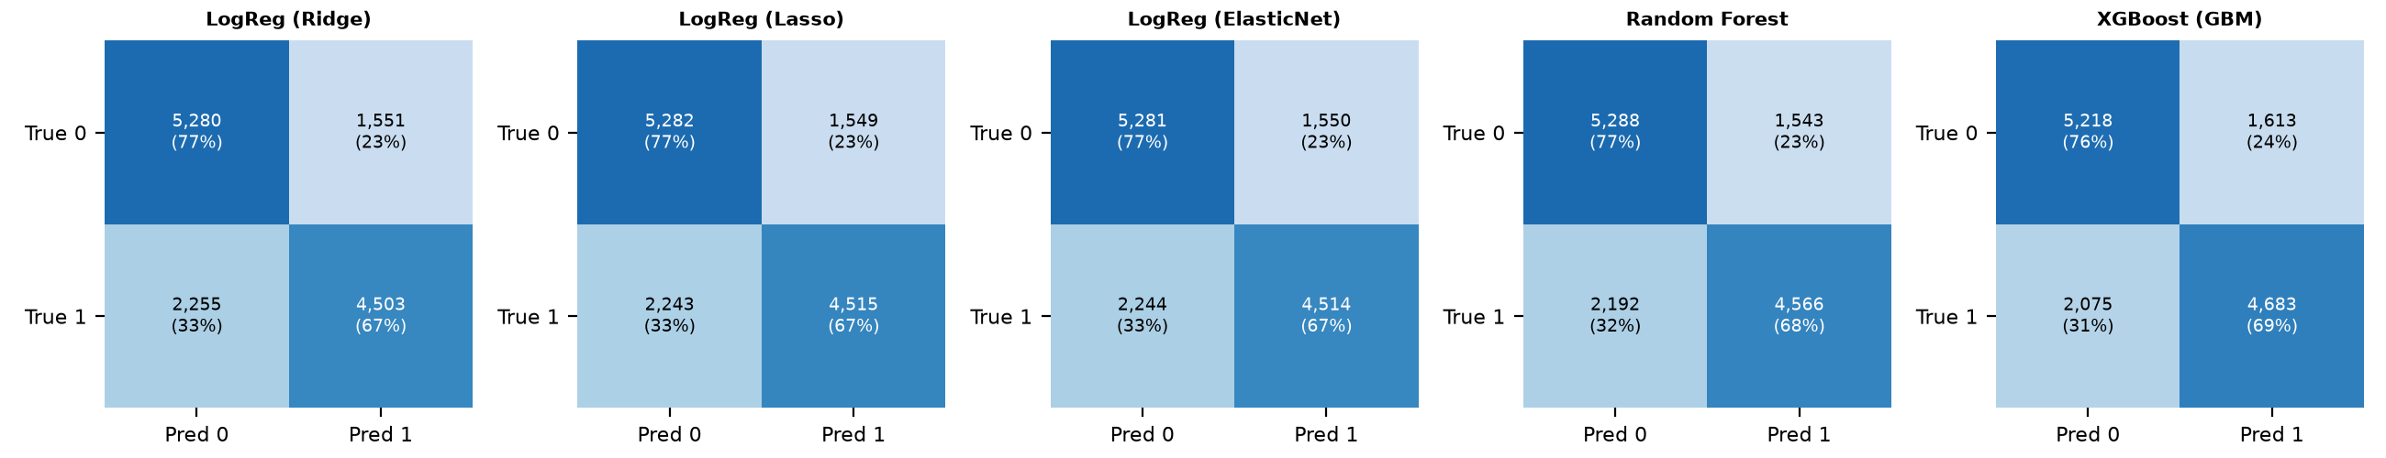
Confusion matrices - Study A
Threshold 0.5; percentages are row-normalised

Slide 14
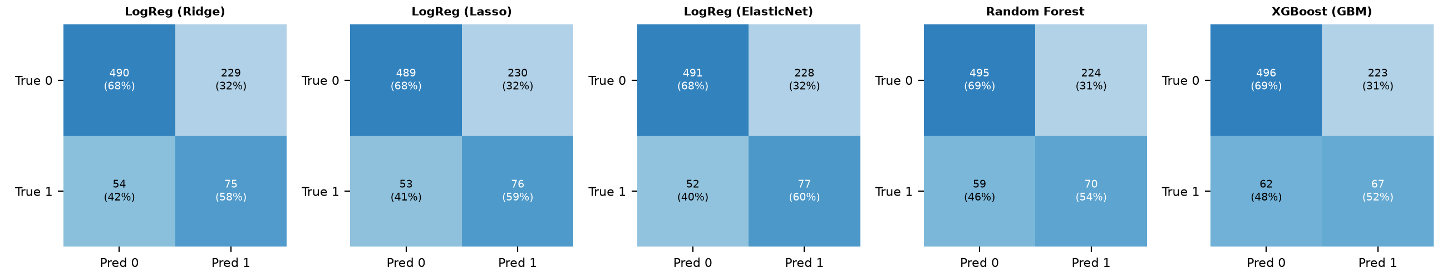
Confusion matrices - Study B
Class weighting trades specificity for sensitivity

Slide 15
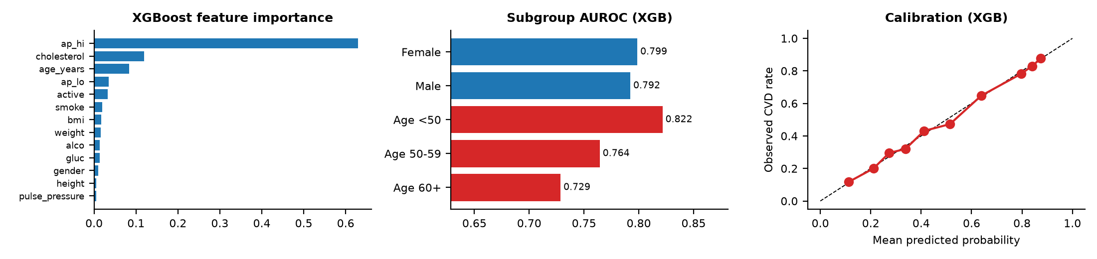
Importance, subgroups, calibration - Study A

Slide 16
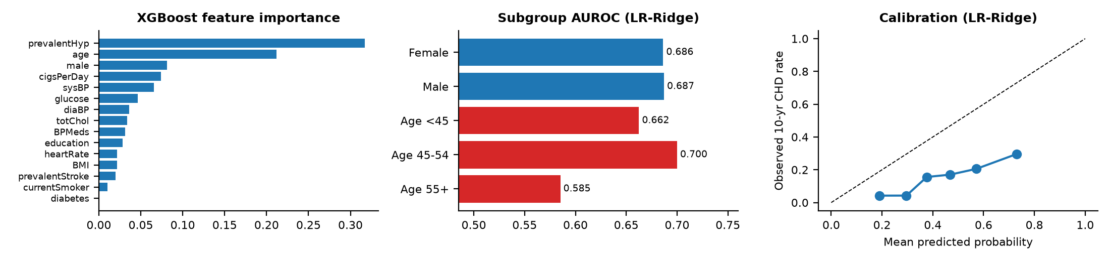
Importance, subgroups, calibration - Study B
Class weighting inflates probabilities (mean 0.44 vs observed 0.15)

Slide 17
Conclusions
Study A best: XGBoost (GBM), test AUROC 0.796. Study B best: LogReg (Ridge), test AUROC 0.700
Spread across the five models: 0.013 (A) and 0.024 (B), vs a 0.097 gap between the datasets - the data matters more than the model
AUROC is lower for 10-year incident risk on a small cohort (Study B) than for prevalent disease (Study A)
Performance is not uniform across age groups - audit before clinical use
Class weighting keeps the ranking (AUROC) but distorts probabilities - recalibrate before use

Slide 18
Limitations and future work
Study A: prevalent (not incident) disease, noisy self-reported fields, no ethnicity column
Study B: small single cohort, one random split
Next: repeated CV and confidence intervals, probability calibration
Next: survival-style modelling of incident risk; fairness-aware training

