Slide 1
Employee Data Analysis using Excel
STUDENT NAME: Madhumitha R
REGISTER NO: 312216381
DEPARTMENT: Bcom Computer Applications
COLLEGE: Shri shankarlal sundarbai shasun jain college for women.

Slide 2
PROJECT TITLE:
Employee Performance Analysis using Excel

Slide 3


AGENDA
Project Overview
End Users
Our Solution and Proposition
Dataset Description
Modelling Approach
Results and Discussion
Conclusion
3/21/2024 Annual Review

Slide 4


PROBLEM STATEMENT
Employee performance is a condition and an assumption for the performance and success of a company on the market. In order to ensure competitive ability, the quality of human resources, their management, and related measurement and performance assessment are at the forefront of company interest. Employee assessment affects the performance, development and motivation of people and also provides the necessary information about the employees. It allows the organization to monitor employee performance and compare their work with other collaborators. Many companies have the problem of setting up evaluation system so that it carried itself elements of responsibility and objectivity. The result of conceptual work in this area is the ultimate use of tools whose deployment, if possible, motivates employees to perform better. The aim of the paper is to refer to problems that arise in companies in evaluating the performance of employees.

Slide 5

PROJECT OVERVIEW
Department wise performances.
Top 3 Important Factors effecting employee performance.
A trained model which can predict the employee performance based on factors as inputs.
Recommendations to improve the employee performance based on insights from analysis..

Slide 6
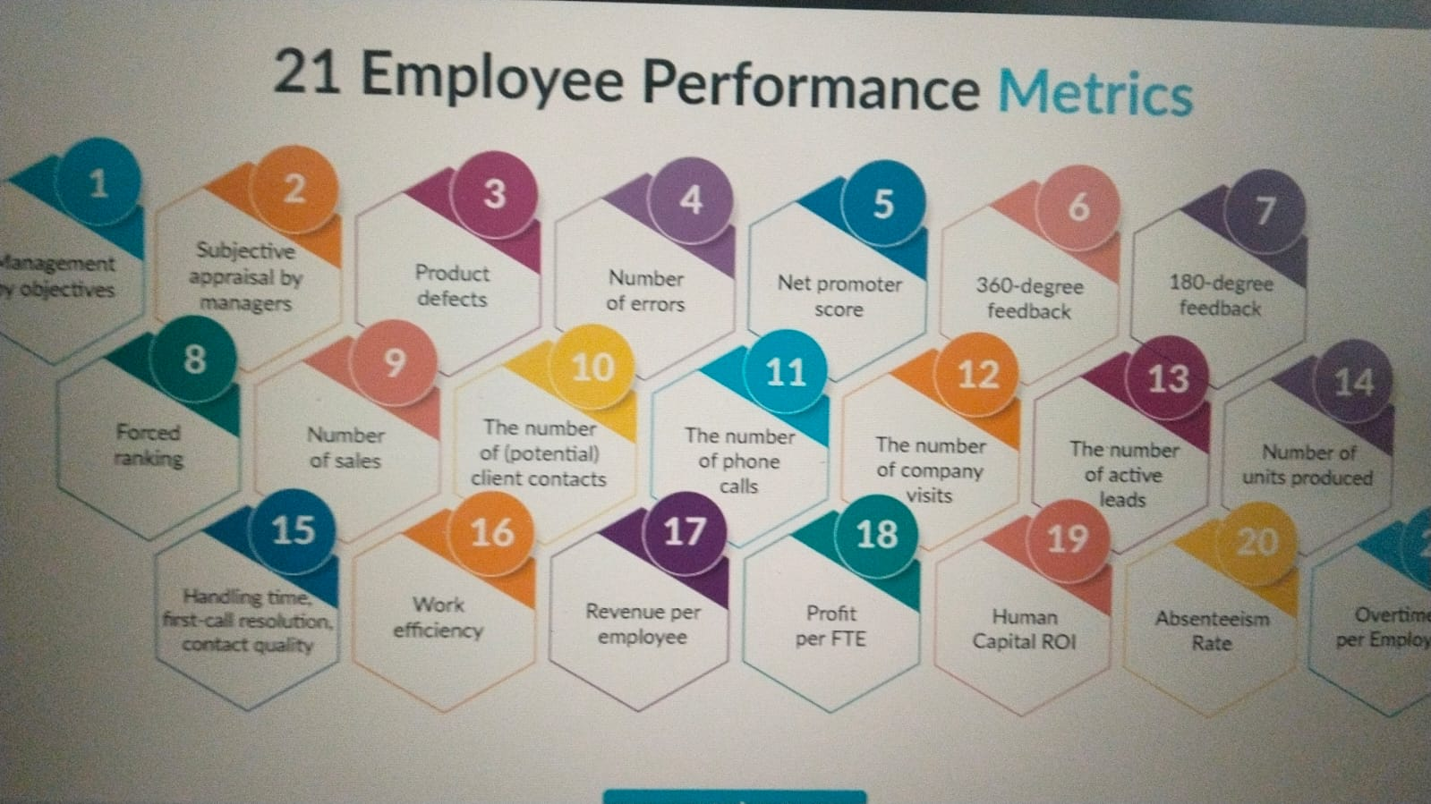

WHO ARE THE END USERS?

Slide 7

OUR SOLUTION AND ITS VALUE PROPOSITION: Conditional formatting- Missing Filter- Remove Formula- Performance Pivot- Summary Graph- Data visualization.

Slide 8
Dataset Description Employee Dataset – Kaggle 26- Features 9- Features Emp id- Number Name- Text Employee type Performance level Gender- Male female Employee rating- Number

Slide 9

THE "WOW" IN OUR SOLUTION *Performance Level=IFS(Z8>=5,”VERY HIGH”,Z8>=4,”HIGH”,Z8>=3,”MED”,true, “LOW”)
3/21/2024 Annual Review
<number>

Slide 10
MODELLING
Performance management models are the frameworks that guide how organizations set and align goals, evaluate employee performance, and promote continuous development. Choosing the right model is crucial for boosting employee performance, alignment, employee engagement, productivity, and overall organizational success.
These models provide a structured approach to performance management, encompassing five key elements:
1. Planning: Setting clear goals aligned with organizational objectives.
2. Monitoring: Tracking progress and collecting data throughout the cycle.
3. Developing: Providing ongoing employee feedback and growth opportunities.
4. Rating: Evaluating performance based on established criteria.
5. Rewarding: Recognizing and rewarding achievements.
<number>

Slide 11
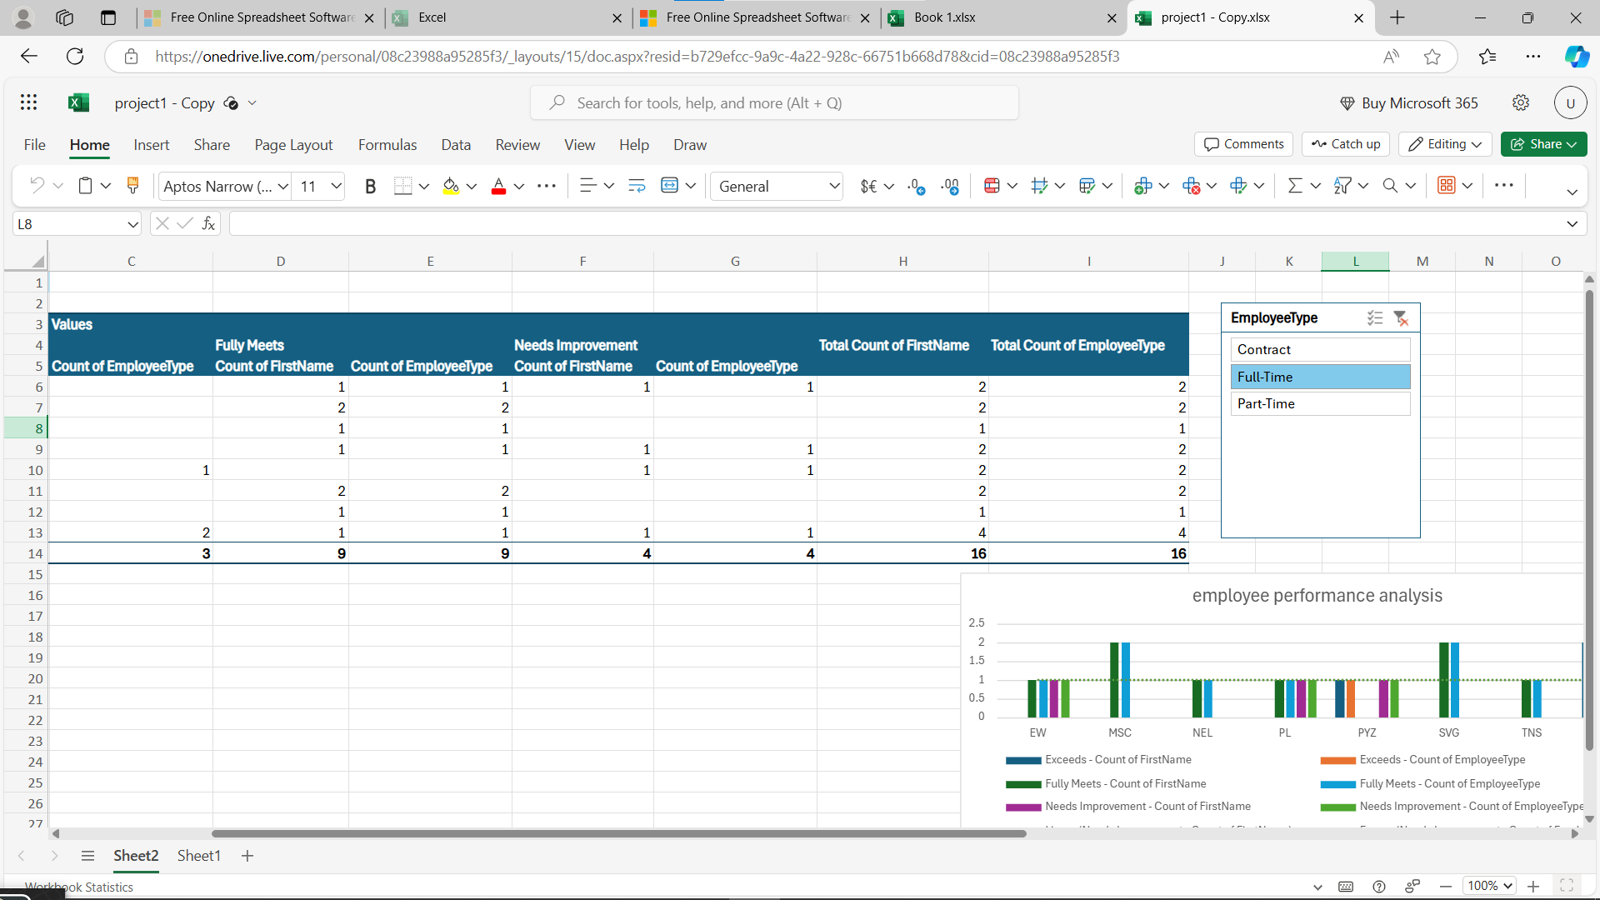
Results:
<number>

Slide 12
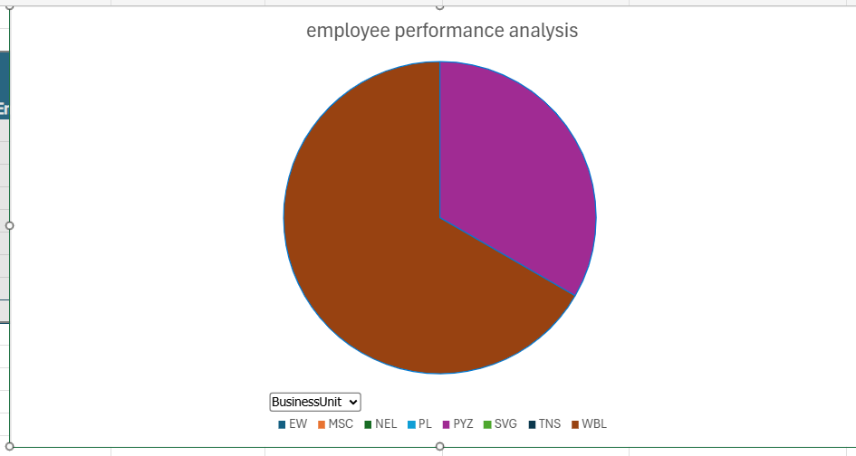
Results:

Slide 13
Conclusion: In summary, three clear trends that affect performance management systems have emerged. First, individual values and needs are diverse and changing, and the heterogeneity of the workforce is increasing. Second, technology is embedded into almost every aspect of work, including performance management. Third, global expansion is increasing the diversity of employees and the cultural contexts in which they work. For performance management systems to be aligned with organizational goals and individual needs, they must consider all three trends.

