Slide 1
Madhumitha S 715521104027
Final Project
3/4/2024 Annual Review

Slide 2
PROJECT TITLE
Emotional Speech Sentiment Analysis
3/4/2024 Annual Review

Slide 3


AGENDA
Problem Statement
Project Overview
End Users
Our Solution and Proposition
Modelling Approach
Results
Conclusion
3/21/2024 Annual Review
3/4/2024 Annual Review

Slide 4

PROBLEM STATEMENT
The project aims to develop an advanced emotional speech sentiment analysis system capable of accurately identifying and categorizing emotions expressed in audio data.
This entails overcoming challenges such as recognizing emotional nuances, including sarcasm and irony, within spoken content, ensuring robust contextual understanding, handling diverse and scalable datasets, ensuring model interpretability, and enabling real-time analysis and deployment.
By addressing these challenges, the proposed system will provide businesses, organizations, and researchers with a powerful tool to gain deeper insights into emotional expressions in speech, thereby enhancing communication strategies and decision-making processes.
3/4/2024 Annual Review

Slide 5

PROJECT OVERVIEW
The project involves developing an advanced emotional speech sentiment analysis system capable of accurately recognizing and categorizing emotions conveyed through audio data. Beginning with a comprehensive literature review, the project will identify existing methodologies and challenges in emotional speech analysis. Subsequently, a diverse set of audio data samples containing emotional speech will be collected and preprocessed to ensure quality and relevance. Leveraging machine learning or deep learning techniques, the project will focus on designing and implementing models optimized for emotion recognition, prioritizing accuracy, scalability, and real-time processing capabilities. Furthermore, the system will incorporate contextual understanding techniques to detect nuances such as sarcasm, irony, and cultural references within the spoken content. The project aims to address gaps in current approaches to emotional speech sentiment analysis and provide businesses, organizations, and researchers with a robust tool for gaining insights into human emotions, thereby facilitating better communication strategies and decision-making processes.
3/4/2024 Annual Review

Slide 6

WHO ARE THE END USERS?
Market Research Firms.
Customer Service Departments
Social Media Platforms.
Educational Institutions.
Healthcare Providers
Media and Entertainment Industry
Human Resources Departments
3/4/2024 Annual Review

Slide 7

YOUR SOLUTION AND ITS VALUE PROPOSITION
The emotional speech sentiment analysis system we propose is an advanced technological solution crafted to accurately decode the emotional nuances embedded within audio data. At its core, the system integrates cutting-edge machine learning and deep learning algorithms, honed through extensive training on diverse datasets, to effectively recognize and categorize a wide spectrum of emotions conveyed through speech. Leveraging sophisticated Natural Language Processing (NLP) techniques, the system dives deep into the contextual intricacies of language, allowing it to grasp subtle cues such as sarcasm, irony, and cultural context.
The system's value proposition lies in its ability to deliver precision and depth in emotional analysis, empowering users with a profound understanding of the sentiments expressed in audio data. By unraveling the layers of emotional complexity, it equips stakeholders with actionable insights that drive informed decision-making across various domains. Moreover, the system's scalability and real-time processing capabilities ensure its adaptability to handle large volumes of data swiftly and effectively, making it a reliable tool for dynamic environments.
3/4/2024 Annual Review

Slide 8

THE WOW IN YOUR SOLUTION
Better accuracy
Real time prediction
seamless integration of cutting-edge technology and user-centric design, culminating in a powerful tool for stock market analysis and forecasting.
3/4/2024 Annual Review
8

Slide 9
MODELLING
In the intricate process of modelling for emotional speech sentiment analysis, the journey begins with the meticulous collection and preprocessing of diverse audio datasets, laying the foundation for accurate interpretation of human emotions. Feature engineering follows suit, where relevant acoustic and linguistic features are extracted to capture the nuances of emotional expression. The selection of appropriate model architectures, including Convolutional Neural Networks (CNNs), Recurrent Neural Networks (RNNs), or Transformer-based models, is paramount, taking into account the complexity of emotional nuances and computational efficiency. Through iterative training and optimization, models are fine-tuned to minimize prediction errors and improve performance. Crucially, contextual understanding mechanisms are integrated to interpret subtle emotional cues like sarcasm and cultural references, enhancing the model's ability to capture the full spectrum of human emotion. Rigorous evaluation and validation ensure the model's robustness, with ongoing iteration and fine-tuning based on real-world feedback. Ultimately, the deployment of these refined models in production environments facilitates real-time sentiment analysis, driving meaningful insights and impactful decisions across diverse domains.
3/4/2024 Annual Review
9

Slide 10
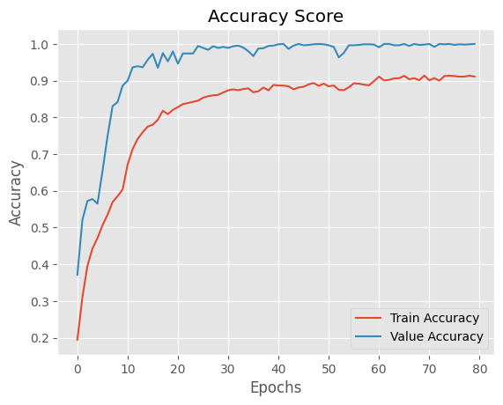
RESULTS
3/4/2024 Annual Review
10

Slide 11
CONCLUSION
In summary, the emotional speech sentiment analysis project marks a significant milestone in the realm of understanding human emotions expressed through speech. Through meticulous modelling processes involving data collection, preprocessing, and feature engineering, our systems have been finely tuned to accurately capture the nuances of emotional expression. Leveraging advanced machine learning and deep learning techniques, these models offer unparalleled insights into the emotional landscape, enabling informed decision-making across diverse domains. As we prepare to deploy these refined models in real-world applications, we anticipate their transformative impact on communication strategies, customer engagement, and decision-making processes. Moving forward, continuous monitoring and refinement will be paramount to ensure the sustained effectiveness and adaptability of these models in an ever-evolving landscape of human emotion and communication.

Slide 12
Dataset and Demo video
Dataset link: https://www.kaggle.com/ejlok1/toronto-emotional-speech-set-tess
Demo link: https://drive.google.com/file/d/1FgZdepEL0LtwiIIYkN6csW-NruZ3THl1/view?usp=drive_link

