Slide 1
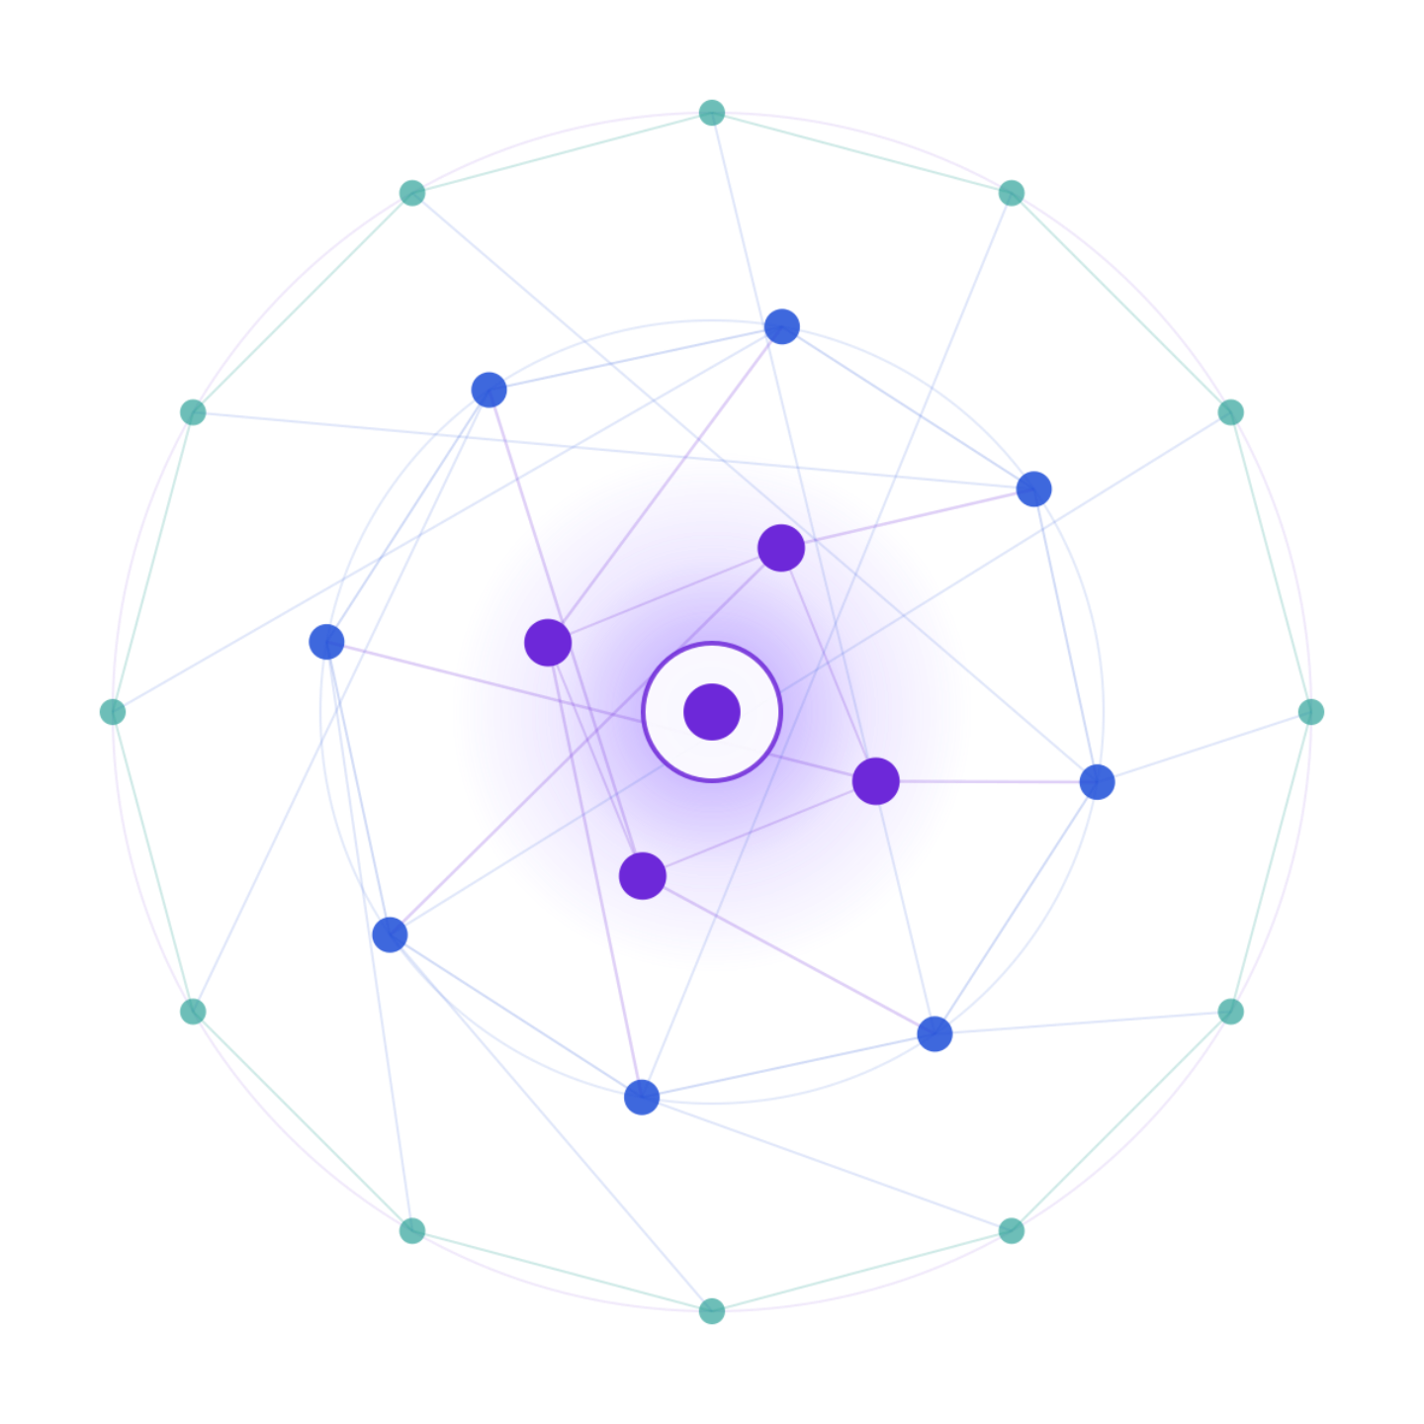
SAMSUNG PRISM
Generative AI
Hackathon
3rd Edition
2026 – 27
Theme ID – 4 (STREAMING LIVE RAG)
Team Name - TensorFlow
College Name - SRM institute of science and technology
Member Name & Email 1- Kasu Sathvika Mary - sk0981@srmist.edu.in
Member Name & Email 2- Madhumitha G - mg9410@srmist.edu.in
Submission Github link - https://github.com/Madhumithagopinath-2121/adaptive-shield-rag
Notes:
Opening slide for the 3rd edition of the PRISM Generative AI Hackathon. Replace the SAMSUNG PRISM pill with the official PRISM logo image if you have the asset. Confirm the academic year label (2026-27) before circulating.

Slide 2
Theme
AdaptiveShield RAG
A retrieval-augmented generation system that adapts to the query, retrieves trusted context, and applies a safety shield before producing an answer.
Ground responses in approved knowledge sources
Reduce unsupported or unsafe outputs
Keep the experience simple for enterprise users

Slide 3
Existing Solutions & Gaps
What exists
Gaps
General-purpose chatbots and LLM assistants
Keyword search and static FAQ systems
Basic RAG pipelines over document stores
Standalone content filters applied after generation
Retrieval can miss the right context
Answers may be confident but unsupported
Safety checks are often disconnected from retrieval
Limited transparency, control, and feedback loops

Slide 4
Our Solutions & Architecture Diagram
Adaptive retrieval
Generation
Classify the request, select the relevant sources, retrieve supporting passages, and assemble grounded context.
Use the approved context to generate a concise answer with traceable evidence.
Feedback loop
Safety shield
Capture user feedback, retrieval quality, and shield decisions for continuous improvement.
Check the request and candidate answer against policy and evidence before release.
Architecture diagram : https://drive.google.com/file/d/1wIxog8E3c5AE0zx6Rghgf6MoBkFX1uu7/view?usp=sharing

Slide 5
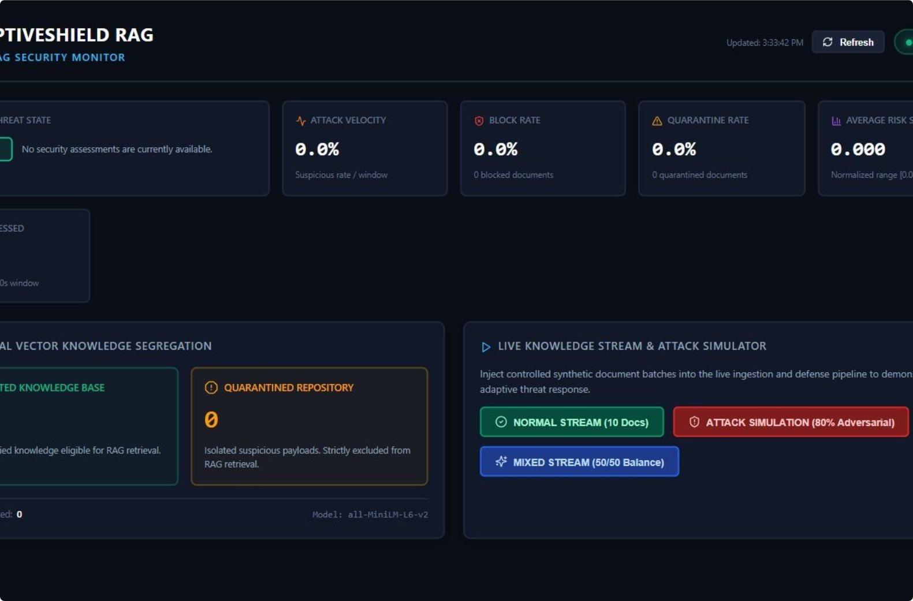
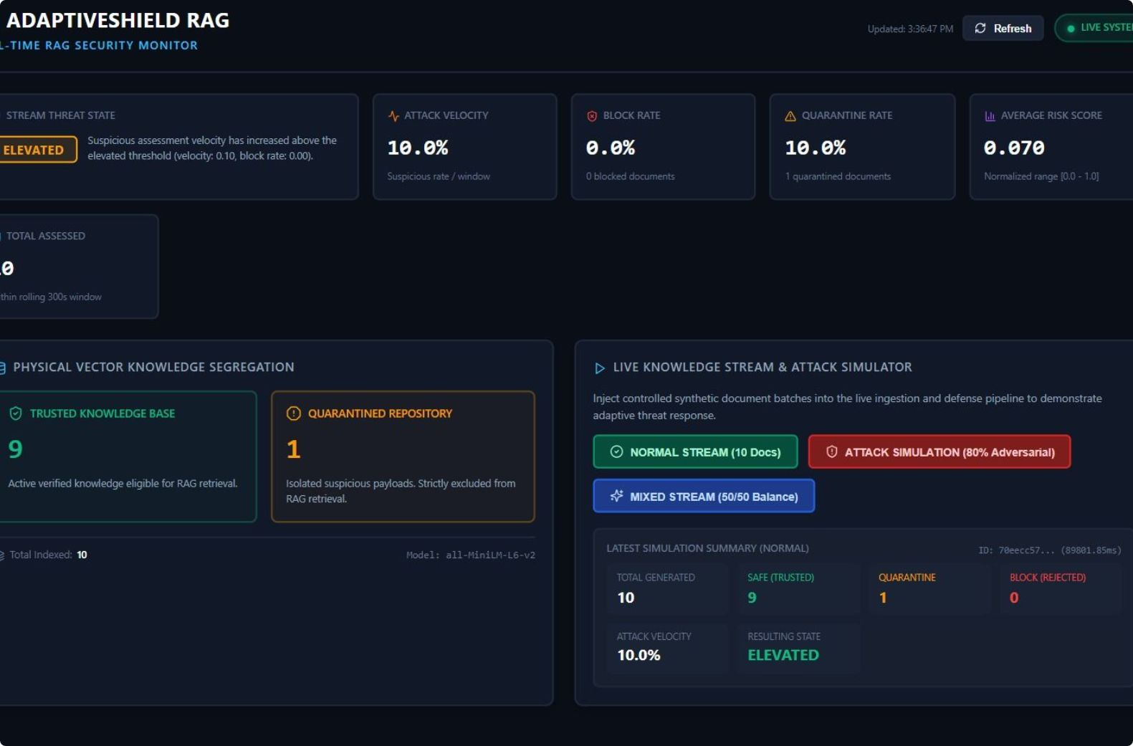
Demo & Product Walkthrough
1. Ask — retrieve trusted sources
2. Review — grounded answer with evidence
From user query → retrieval → shield check → grounded response

Slide 6
Tools and tech stack used
Core pipeline
Product layer
Python application layer
Document ingestion and chunking
Embeddings and vector retrieval
Large language model generation
Prompt and policy guardrails
Interactive demo interface
Source-aware response display
Evaluation and feedback capture
Version-controlled project on GitHub
Modular components for future deployment

Slide 7
Impact & Use case
Expected impact
Use cases
Faster access to reliable internal knowledge
Fewer unsupported answers and safer interactions
More consistent responses across teams
Traceability for review and improvement
Enterprise policy and process assistant
Technical support and troubleshooting
Product and service knowledge search
Employee enablement and onboarding

Slide 8
Innovation highlights, results and limitations
Innovation
Prototype results
Limitations
Retrieval and safety are designed as one adaptive loop
Evidence is treated as a release condition, not decoration
Feedback can improve both search and shielding
End-to-end flow demonstrated from query to grounded answer
Architecture supports modular evaluation and iteration
Responses can be reviewed against retrieved context
Quality depends on source coverage and retrieval
Prototype needs broader evaluation and monitoring
Production deployment requires access controls and scale testing

Slide 9
What’s next
Roadmap
Expand and curate the trusted knowledge base
Improve retrieval, reranking, and evaluation coverage
Strengthen policy checks, access control, and observability
Run pilot testing with representative enterprise workflows
Package the solution for reliable, scalable deployment

Slide 10
Brownie points slide( differentiation)
Why AdaptiveShield RAG stands out
Grounded by design: retrieval and evidence are central to every answer.
Shielded before release: safety and policy checks sit in the response path.
Adaptive rather than static: the workflow can change with query intent and feedback.
Enterprise-ready direction: modular components support auditability, access control, and future scale.

Slide 11
Checklist- Updated on Public GitHub
Working prototype code — public or shared GitHub repo : Y
README with reproducible setup instructions : Y
Demo video, max 5 minutes (YouTube or Drive link) : https://drive.google.com/file/d/1zl1hb-_aREvxo3ctIX0vvJF9llqdNglL/view?usp=sharing
Presentation file (PPT or PDF) : PPT

Slide 12
Thank you
Organised by the Language AI Team and the PRISM Team, Samsung R&D Institute India
Notes:
Closing slide. Add the Google Form URL and a contact email before sharing. Edition 2 organising team for reference: Language AI - Sourabh Tiwari, Gaurav, Sanjeeth Pothireddy, Gorang Maniar; PRISM - Binny Lakra, Prakhar Chandrakar, Vishu Kumar; Kick-off and mentors - Giridhar Jakki, Deepraj Prabhakar Patkar (Language AI), Srimanu Prasad Nagaraju, Ashish Kumar (Tech Strategy).

