Slide 1

Deep2Neuron
CONVOLUTIONAL NEURAL NETWORK (CNN)

Slide 2
CONVOLUTIONAL NEURAL NETWORK
It’s a type of deep learning.
Well suited for image recognition.

Slide 3
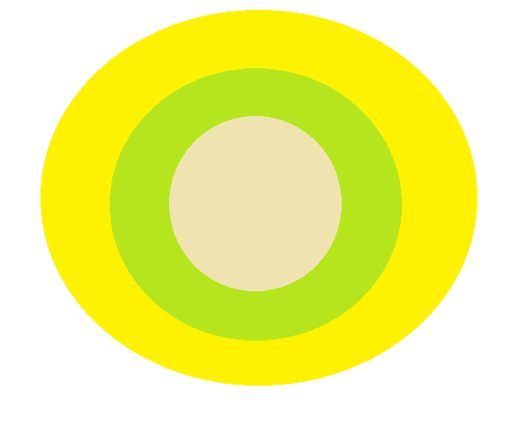
THREE LAYERS
Convolutional layer
Pooling layer
Output layer

Slide 4
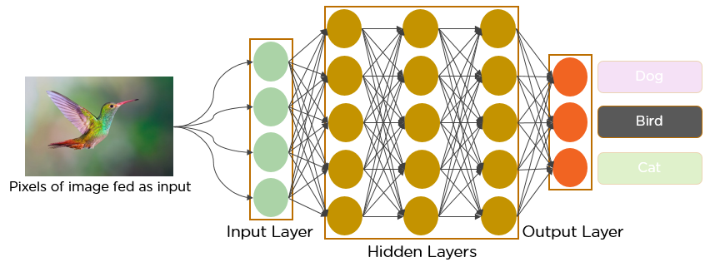

Slide 5
CONVOLUTIONAL LAYER
To extract the features from input image.
By learning image features using a small square of input data, the convolutional layer preserves the relationship between pixels.
It is a mathematical operation which takes two inputs such as image matrix and a kernel or filter.

Slide 6
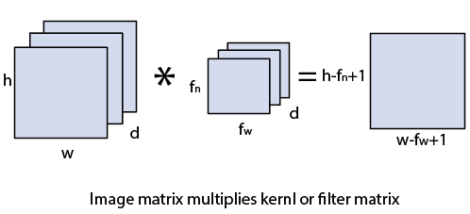
DIMENSIONS
Image matrix is h×w×d
Filter is f_{h}×f_{w}×d
Output is (h-f_{h}+1)×(w-f_{w}+1)×1

Slide 7
The convolution of image matrix multiplies with filter matrix is called "Features Map" and show as an output.
Convolution of an image with different filters can perform an operation such as blur, sharpen, and edge detection by applying filters.

Slide 8
STRIDES
Stride is the number of pixels which are shift over the input matrix.
When the stride is equaled to 1, then we move the filters to 1 pixel at a time and similarly, if the stride is equaled to 2, then we move the filters to 2 pixels at a time.

Slide 9
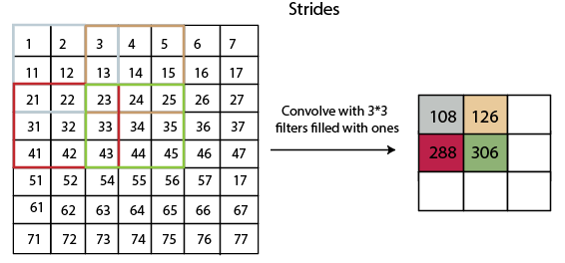

Slide 10
PADDING
Padding plays a crucial role in building the convolutional neural network.
If the image will get shrink and if we will take a neural network with 100's of layers on it, it will give us a small image after filtered in the end.

Slide 11
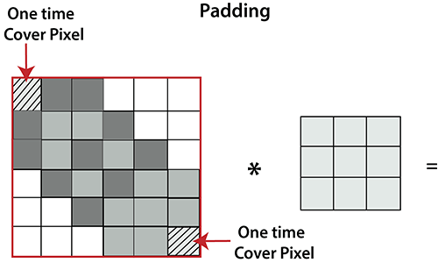
It is clear from the above picture that the pixel in the corner will only get covers one time, but the middle pixel will get covered more than once.

Slide 12
It means that we have more information on that middle pixel, so there are two downsides:
Shrinking outputs
Losing information on the corner of the image.
To overcome this, we have introduced padding to an image. "Padding is an additional layer which can add to the border of an image."

Slide 13
POOLING LAYER
Pooling layer plays an important role in pre-processing of an image.
Pooling layer reduces the number of parameters when the images are too large.
Pooling is "downscaling" of the image obtained from the previous layers.
It can be compared to shrinking an image to reduce its pixel density.
Spatial pooling is also called downsampling or subsampling.

Slide 14
MAX POOLING
Max pooling is a sample-based discretization process.
Its main objective is to downscale an input representation, reducing its dimensionality and allowing for the assumption to be made about features contained in the sub-region binned.
Max pooling is done by applying a max filter to non-overlapping sub-regions of the initial representation.

Slide 15
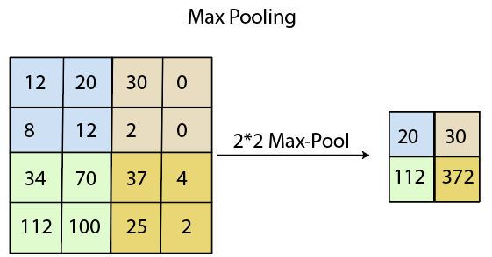
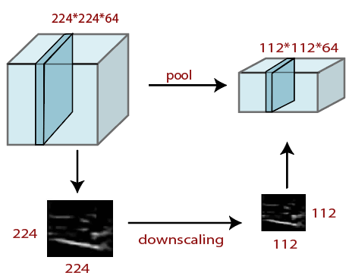

Slide 16
AVERAGE POOLING
Down-scaling will perform through average pooling by dividing the input into rectangular pooling regions and computing the average values of each region.

Slide 17
SUM POOLING
The sub-region for sum pooling or mean pooling are set exactly the same as for max-pooling but instead of using the max function we use sum or mean.

Slide 18
FULLY CONNECTED LAYER
The fully connected layer is a layer in which the input from the other layers will be flattened into a vector and sent.
It will transform the output into the desired number of classes by the network.

Slide 19
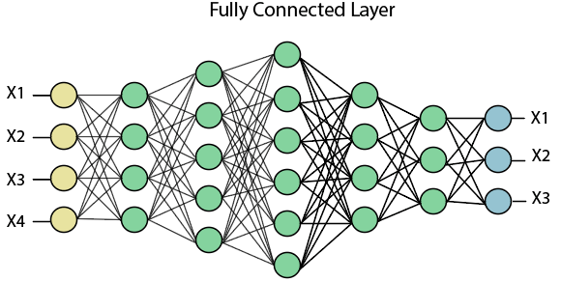
In the above diagram, the feature map matrix will be converted into the vector such as x1, x2, x3... xn with the help of fully connected layers. We will combine features to create a model and apply the activation function such as softmax or sigmoid to classify the outputs as a car, dog, truck, etc.

Slide 20
DIFFERENT TYPES OF CNN MODELS
LeNet
ResNet
MobileNet
AlexNet
VGG
GoogleNet

Slide 21
APPLICATIONS
Decoding facial recognition
Analysing Documents
Collecting Historical and Environmental Elements
Understanding climate
Understanding Gray Areas
Advertising
Other fields like robots , driverless cars, etc.

Slide 22
THANK YOU

