Slide 1
Car
Analysis of severity

Slide 2
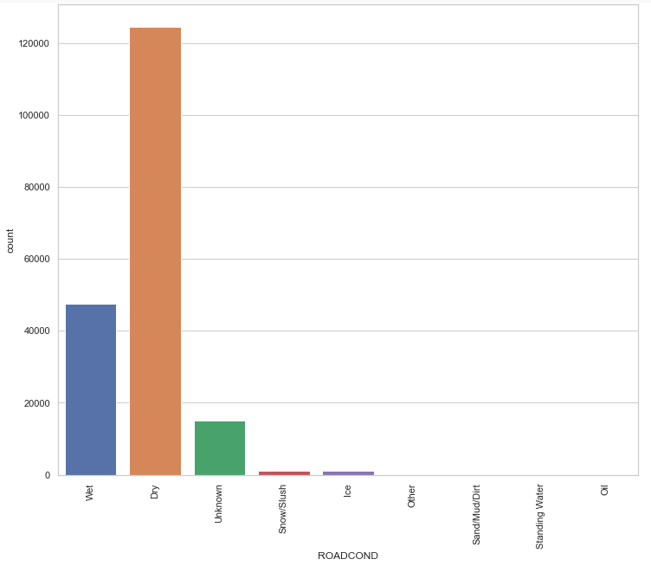
Road condition and accidents

Slide 3
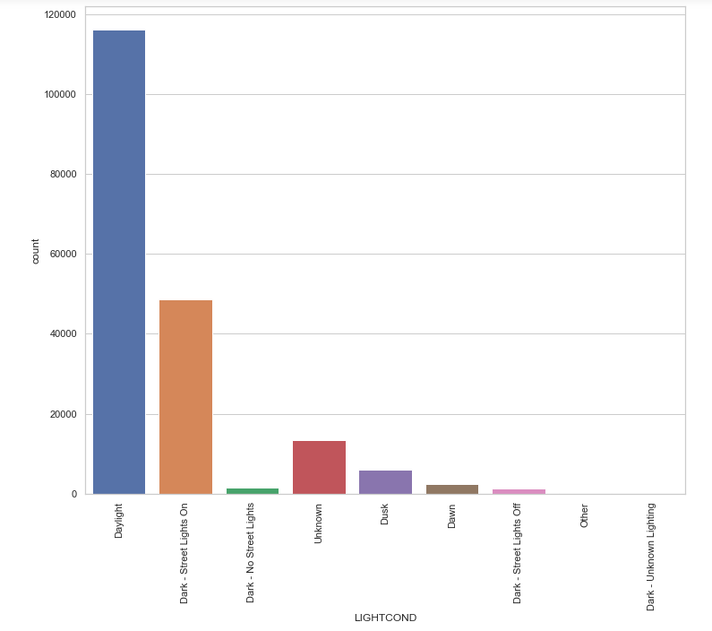
Light conditions and accidents

Slide 4
Evaluation of various models
KNN Jaccard index: 0.48
KNN F1-score: 0.60
DT Jaccard index: 0.50
DT F1-score: 0.58
SVM Jaccard index: 0.50
SVM F1-score: 0.58
LR Jaccard index: 0.50
LR F1-score: 0.58

