Slide 1
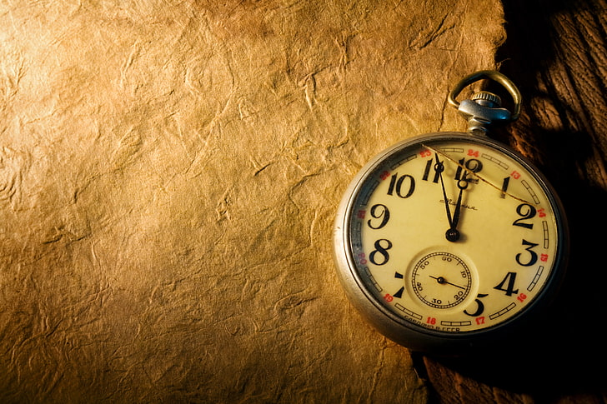
STOPWATCH/CLOCK
Madhunitha Paidipally
MITS Intership
June 2025

Slide 2

Introduction
A Stopwatch/Clock is a time-keeping application that helps users measure elapsed time, display the current time, and perform start, stop, and reset actions.

Slide 3
Objective of the Project
- Create an easy-to-use interface for time tracking
- Provide both clock and stopwatch functionalities
- Accurately measure time in hours, minutes, and seconds

Slide 4
Features
- Real-time Clock display
- Stopwatch functionality
- Start, Stop, Reset buttons
- User-friendly interface
- Accurate time tracking

Slide 5
Tools & Technologies Used
- Frontend: HTML, CSS, JavaScript
- Backend: Not required (for basic version)
- IDE: VS Code
- Optional: React / Python (Tkinter), Android Studio (for app version)

Slide 6
Working of the Application
- Clock: Uses system time to update every second
- Stopwatch:
• Start: Begins time count
• Stop: Pauses timer
• Reset: Sets timer to 00:00:00
- Displays time in HH:MM:SS format

Slide 7
Screenshots / UI Design
Insert UI mockups or screenshots here.
(Use shapes or draw if actual screenshots are not available).

Slide 8
Applications
- Sports events
- Cooking timers
- Fitness tracking
- Time-based productivity tools
- Educational and demo tools

Slide 9
Challenges Faced
- Implementing accurate time intervals
- UI responsiveness
- Reset without bugs
- Managing start/stop states

Slide 10
Conclusion
- Successfully developed a dual-purpose clock and stopwatch
- Improved time handling and UI development skills
- Ready for further enhancements (like lap time, alarm, etc.)

Slide 11
Thank You
Thank you for reviewing my project.

