Slide 1
Etihad – Lead Capture Solution

Slide 2


Slide 3
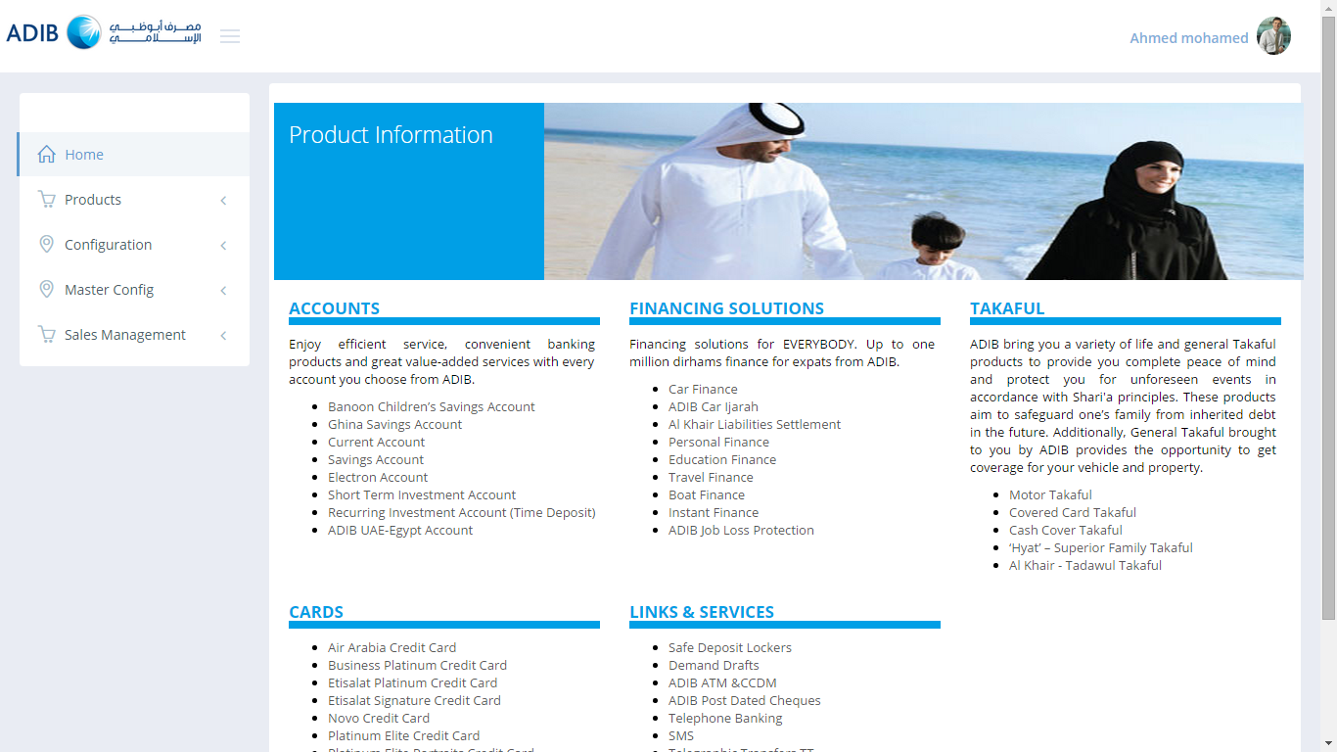
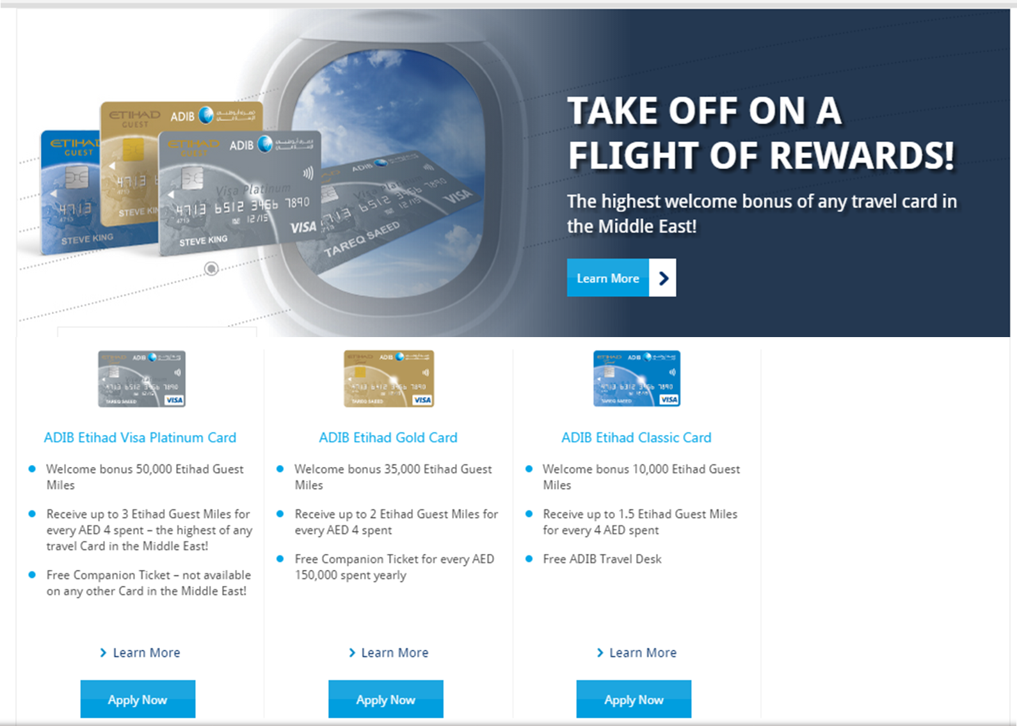
Home
Should go to card application page (with the same card pre-selected in the dropdown)

Slide 4
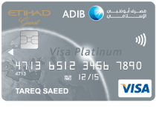
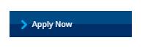
Learn More - Etihad Platinum Card
Page Title: ADIB Etihad Guest Visa Platinum Card
​​​Earn a welcome bonus of 50,000 Etihad Guest Miles – the highest of any travel card in the region! Enhance your lifestyle with ADIB's Etihad Platinum Card.
​ Welcome bonus of 50,000 Etihad Guest Miles – the highest of any travel card in the Middle East!
​​International Non-AED Transactions: Receive 3 Etihad Guest Miles for every AED 4 equivalent spent
Local AED Transactions: Receive 2.​2 Etihad Guest Miles for every AED 4 spent for AED transaction*
Free Companion Ticket – no​t available on any other Card in the Middle East!
Fast track to Etihad Guest Gold Tier
Free VIP Airport Lounge Access
Free Valet parking​​ at select locations
Pay your ADIB Etihad Guest Covered Card Annual fees using 60,510 Etihad Guest Miles
Platinum roadside assistance
Redeem your Etihad Guest Miles for Travel Bookings, Home Furnishing, Electronics and Gifts for family & friends.
Should go to card application page (with the same card pre-selected in the dropdown)
*Specific merchants in the following categories will receive 1 Etihad Guest Mile per AED 4 for UAE transactions: Supermarkets, Government Services (e.g. Fines, Taxes, Bonds), Utilities, Education, Service/Petrol Stations, Real Estate Agents, Public Transport (e.g. Taxis, Metro, Buses), Road Tolls/Salik, Charities/Religious Organisation
Terms & Conditions apply

Slide 5
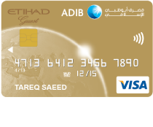
Learn More - Etihad Gold Card
Page Title: ADIB Etihad Guest Visa Gold Card
​​​​​As a welcome bonus, you will receive 35,000 Etihad Guest Miles! Earn 2 Etihad Guest Miles for every AED 4 spent and travel anywhere with Etihad Airways.​
Welcome bonus of 35,000 Etihad Guest Miles – the highest of any travel card in the Middle East!
International Non-AED Transactions: Receive 2 Etihad Guest Miles for every AED 4 equivalent spent
Local AED Transactions: Receive 1.65 Etihad Guest Miles for every AED 4 spent for AED transaction*
Free Comp​anion Ticket – not available on any other Card in the Middle East!
Fast track to Etihad Guest Gold Tier
Free VIP Airport Lounge Access
Pay your ADIB Etihad Guest Covered Card Annual fees using 30,255 Etihad Guest Miles .
Gold roadside assistance
Redeem your Etihad Guest Miles for Travel Bookings, Home Furnishing, Electronics and Gifts for family & friends.
Should go to card application page (with the same card pre-selected in the dropdown)
*Specific merchants in the following categories will receive 0.5 Etihad Guest Miles per AED 4 for UAE transactions: Supermarkets, Government Services (e.g. Fines, Taxes, Bonds), Utilities, Education, Service/Petrol Stations, Real Estate Agents, Public Transport (e.g. Taxis, Metro, Buses), Road Tolls/Salik, Charities/Religious Organisation
Terms & Conditions apply

Slide 6
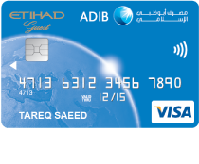
Learn More - Etihad Classic Card
Page Title: ADIB Etihad Guest Visa Classic Card
Receive 10,000 Etihad Miles as a welcome bonus with our Etihad Guest Classic Card! Earn up to ​1.1 Etihad Guest Miles for every AED 4 spent.​
Welcome bonus of 10,000 Etihad Guest Miles – the highest of any travel card in the Middle East!
International Non​​​​-AED Transactions: Receive 1.5 Etihad Guest Miles for every AED 4 equivalent spent
Local AED Transactions: Receive 1.1 Etihad Guest Miles for every AED 4 spent for AED transaction*
Free ADIB Travel Desk
Pay your ADIB Etihad Guest Covered Card Annual fees using 15,128 Etihad Guest Miles
Redeem your Etihad Guest Miles for Travel Bookings, Home Furnishing, Electronics and Gifts for family & friends.
Should go to card application page (with the same card pre-selected in the dropdown)
*Specific merchants in the following categories will receive 0.25 Etihad Guest Miles per AED 4 for UAE transactions: Supermarkets, Government Services (e.g. Fines, Taxes, Bonds), Utilities, Education, Service/Petrol Stations, Real Estate Agents, Public Transport (e.g. Taxis, Metro, Buses), Road Tolls/Salik, Charities/Religious Organisation
Terms & Conditions apply

Slide 7
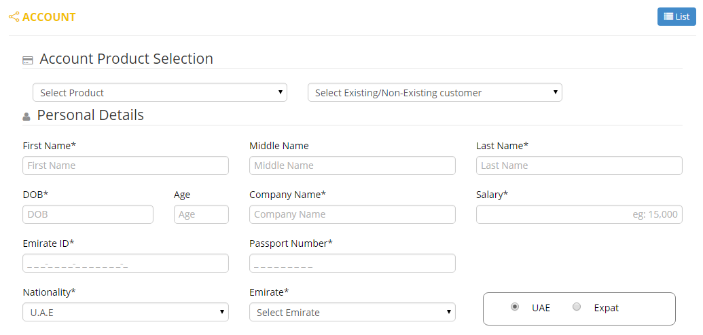
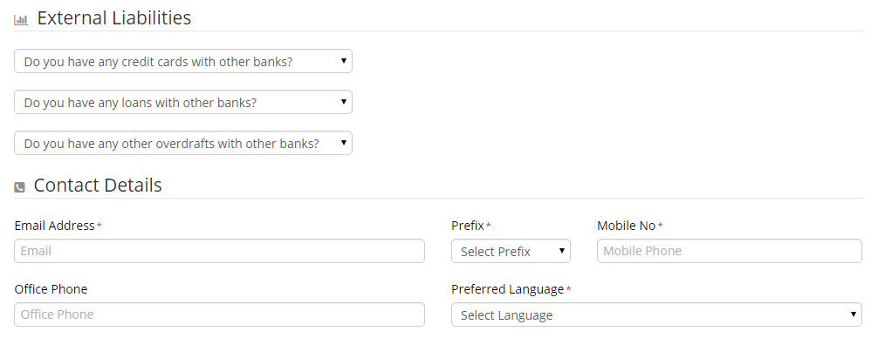
Application Form – ADIB Etihad Cards
Personal Info Screen
Apply Now
Please enter the details below to begin your application :
Cards
Already an ADIB Customer?
Etihad Guest Visa Platinum Card
Etihad Guest Visa Gold Card
Etihad Guest Visa Classic Card
Yes
No

Slide 8
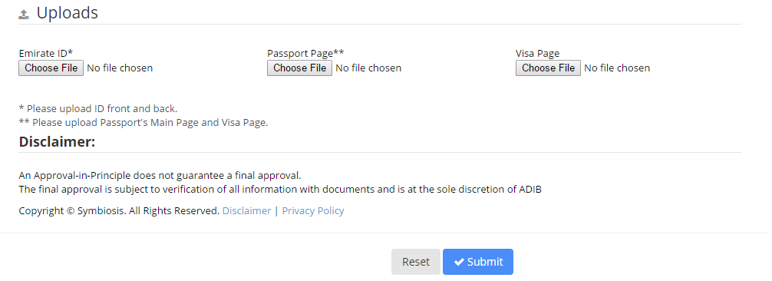
Application Form – ADIB Etihad Cards
Document Upload
Take Picture
<Camera icon>
Take Picture
<Camera icon>
Take Picture
<Camera icon>
This button should open the camera on the tablet
Submitting should lead to a confirmation screen with the following message:
Congratulations
You have successfully completed your ADIB Etihad card application.
We’ll be getting in touch with you with regards to the status of your application shortly.

Slide 9
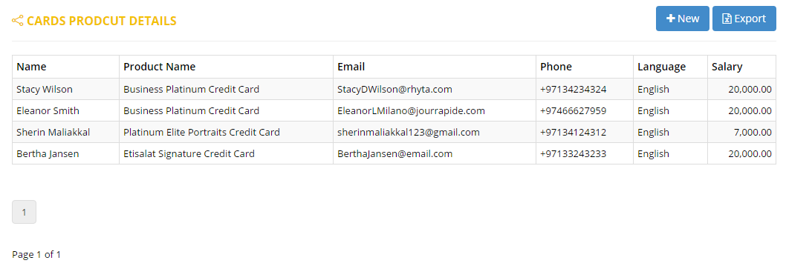
Data Export Sample

Slide 10
Configuration

Slide 11
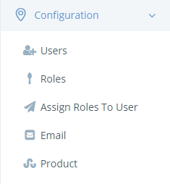
User Roles & Permissions

Slide 12
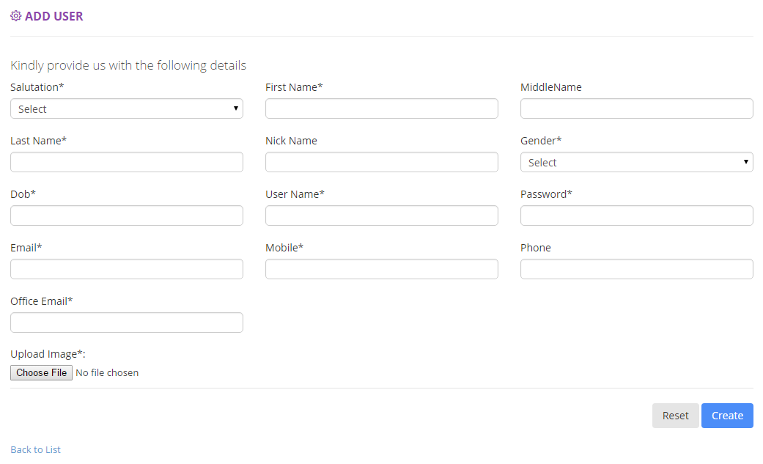
New User

Slide 13
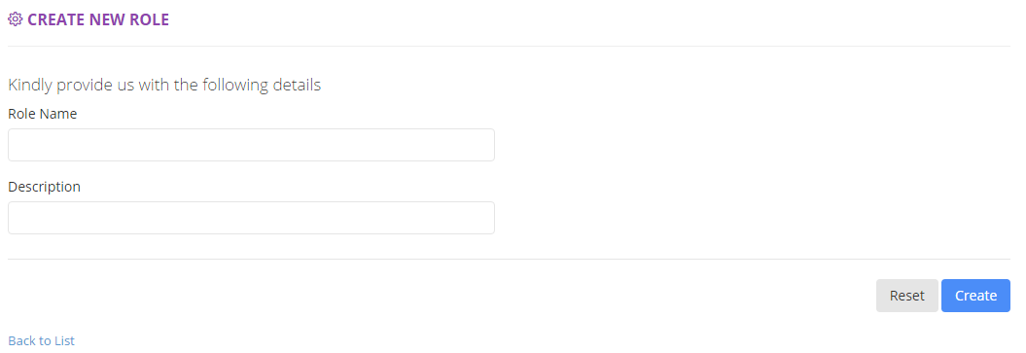
New Role

Slide 14
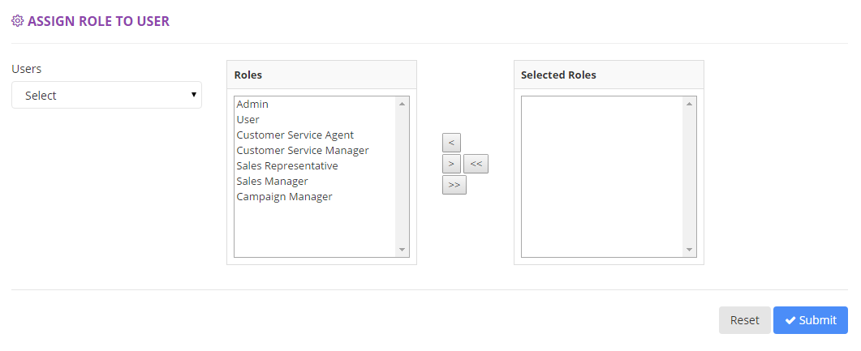
User Role Assignment

Slide 15
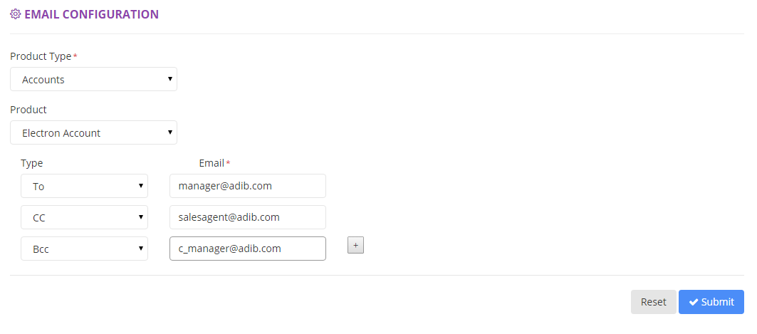
Email configuration
Daily Summary & Data Export to be sent to assigned users.

Slide 16
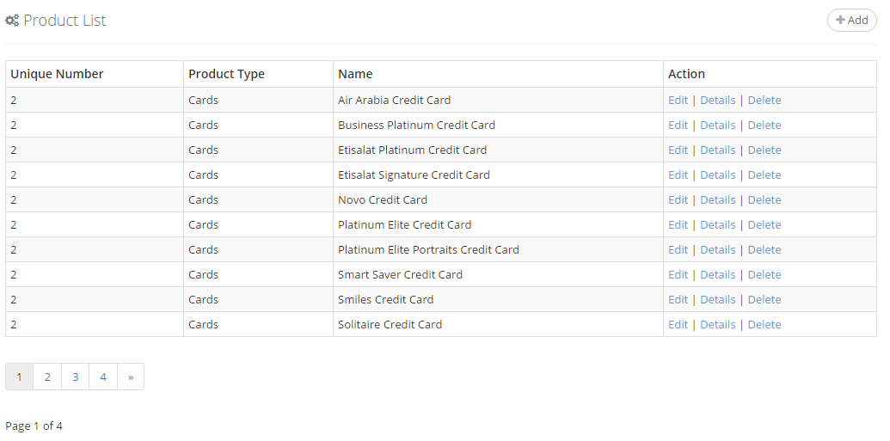
Product Listing

Slide 17
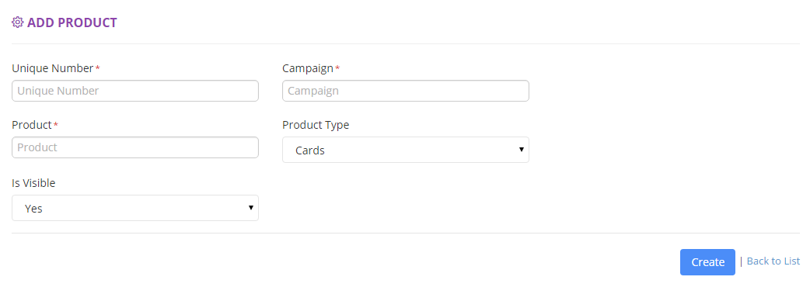
Add New Product

Slide 18
Master Config

Slide 19
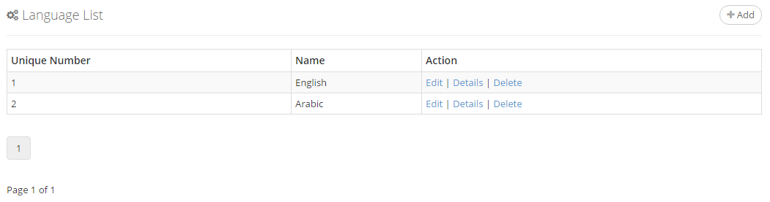

Slide 20
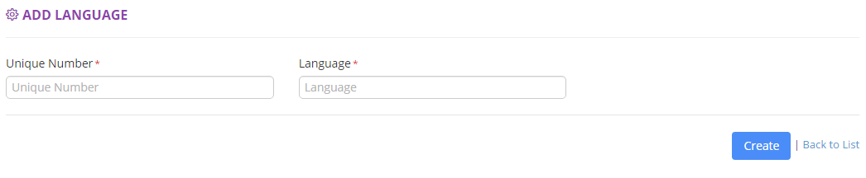

Slide 21
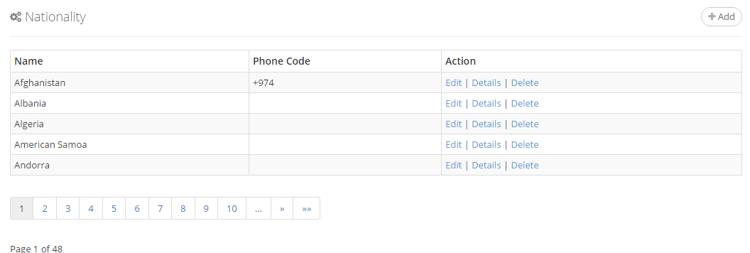

Slide 22
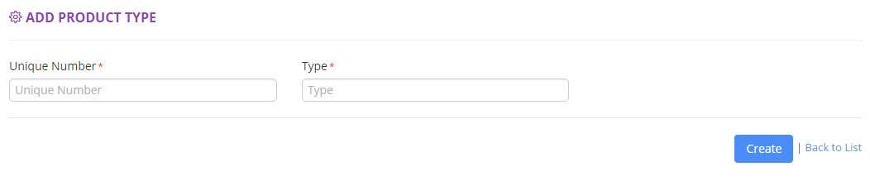

Slide 23
Thank you

