Slide 1
Lead Capture System

Slide 2
Topics
Lead Capture System
Home
Cards
Loan
Configuration
User Configuration
Role Configuration
Assign Role to User

Slide 3
Lead Capture System
Lead Engagement Index – Get quantified engagement insights for any segment or group of leads.
Marketing Insights – Deep insights on campaigns & lead sources driving qualified leads for your business.
Sales Insights – Get clarity on factors that drive your revenue. Lead sources, sales people, product & service offerings and more

Slide 4
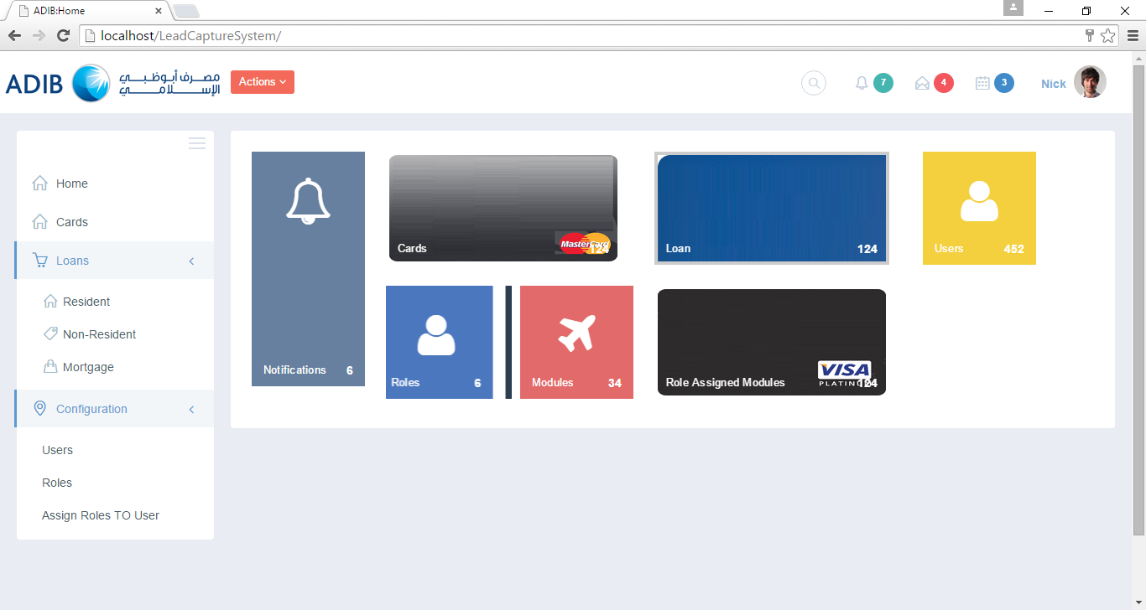
Home Page
Lead capturing is an essential element in online marketing. It may look like a small step in the process but it’s not.
You need data from people who are interested in your products or services so that you can connect with them.
Whether you add them to a nurture campaign or make a sales call, unless you know who they are, you can’t make that connection.

Slide 5
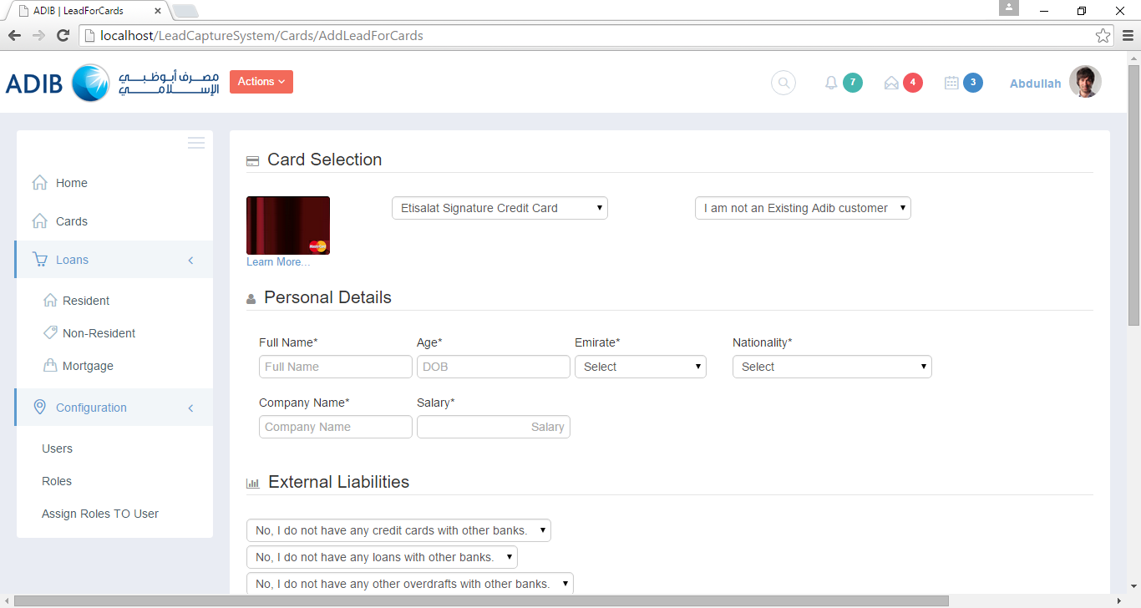
Product-Cards
The most common and effective way of lead capture is by asking basic information to begin with.
So in the beginning of this new relationship all you really need to know is the e-mail address and perhaps the person’s name.
Consider that your seed to the beginning of a great new long-term relationship.
Your lead management system database can always grow as your relationship grows.

Slide 6
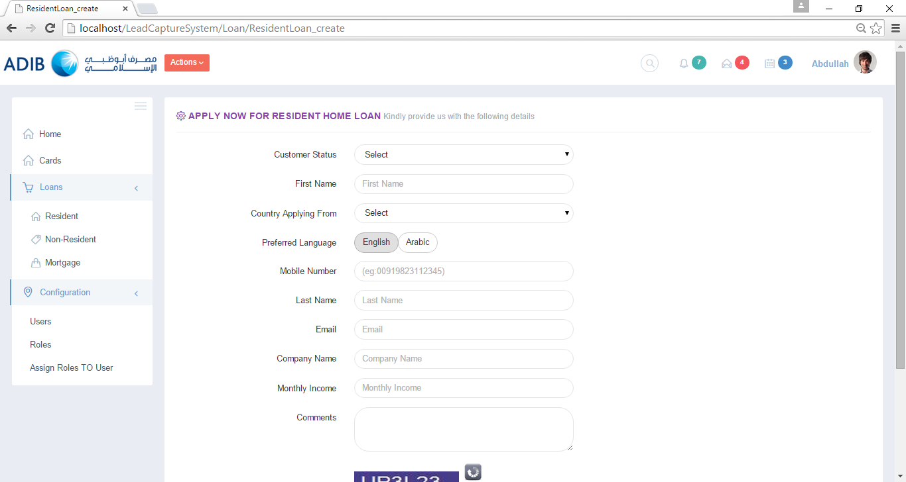
Product-Loans
Capture the information related to their Product.
Here you can fill the details of their monthly income and other basic contact information such as Name, Email and Phone etc.;
We should have different forms for the product like Mortgage Loan, Resident Loan, Non Resident Loan.

Slide 7
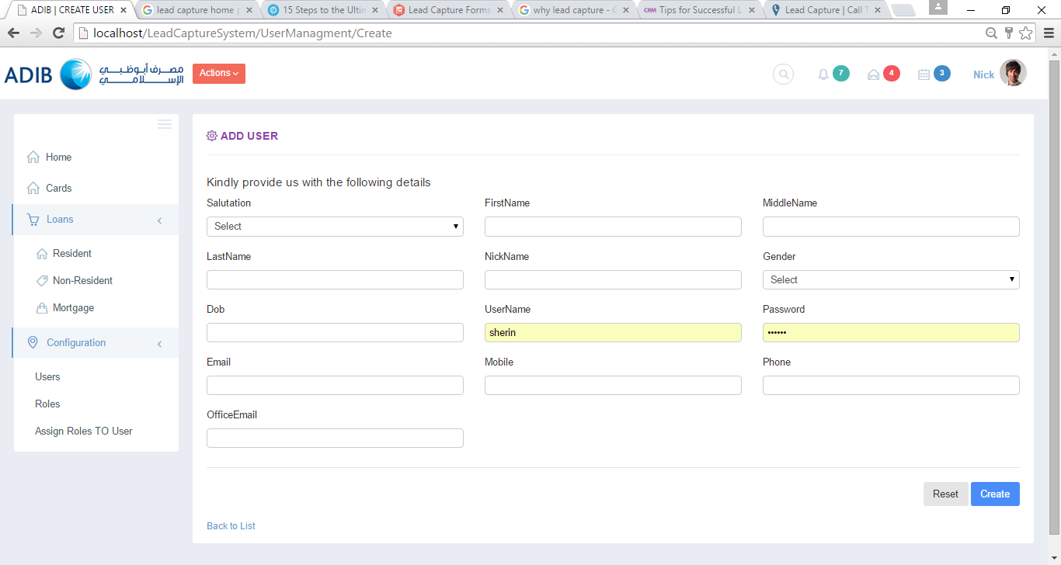
Create User
You should create the user first. Because the signed in/Registered user can do the functions.

Slide 8
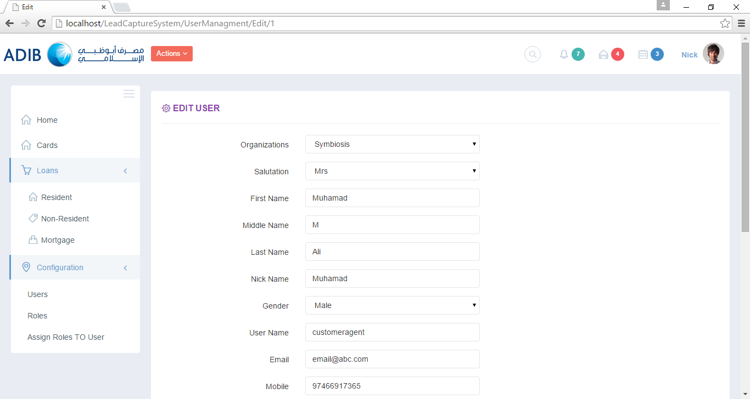
Edit User

Slide 9
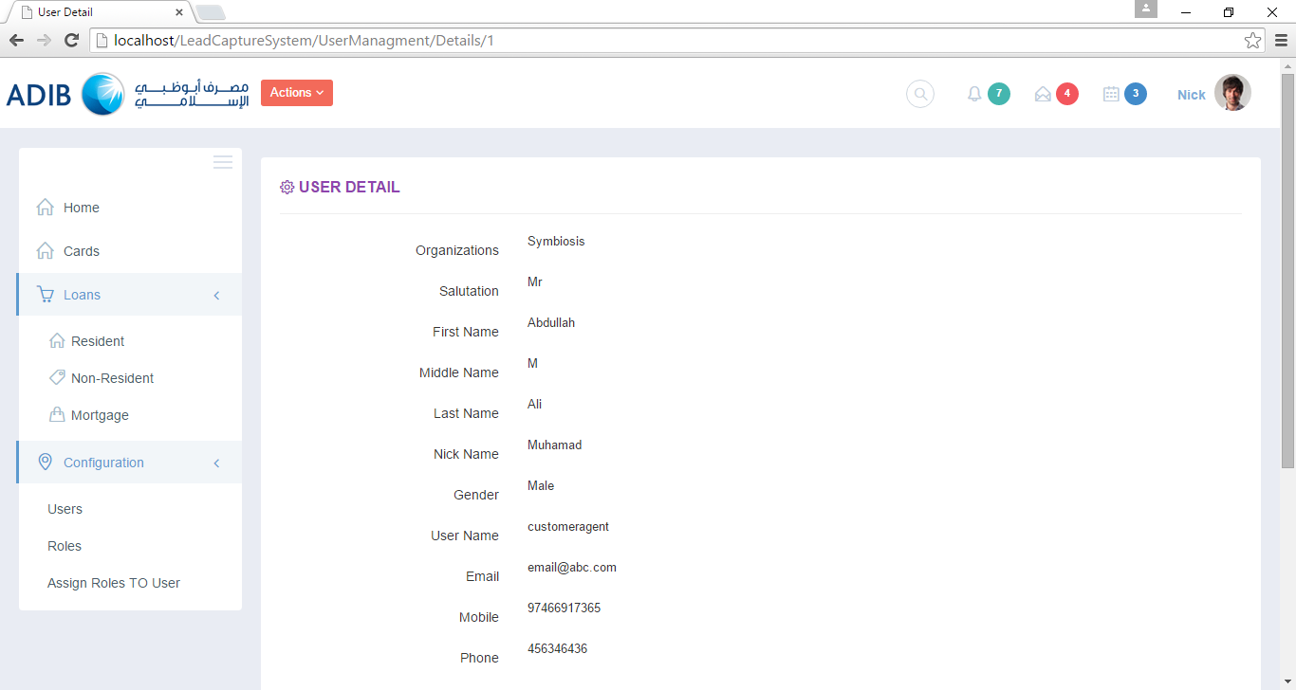
User Details

Slide 10

Remove User

Slide 11
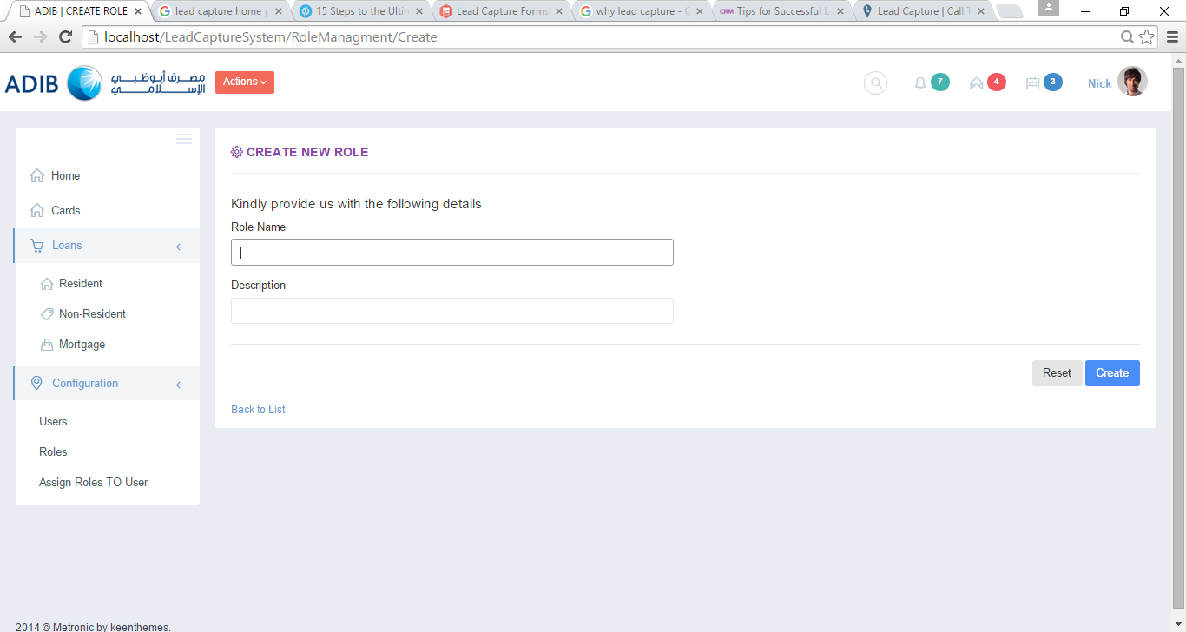
Create Role
You can create user roles in the System to define the objects that users can manage and the management operations that users can perform.

Slide 12
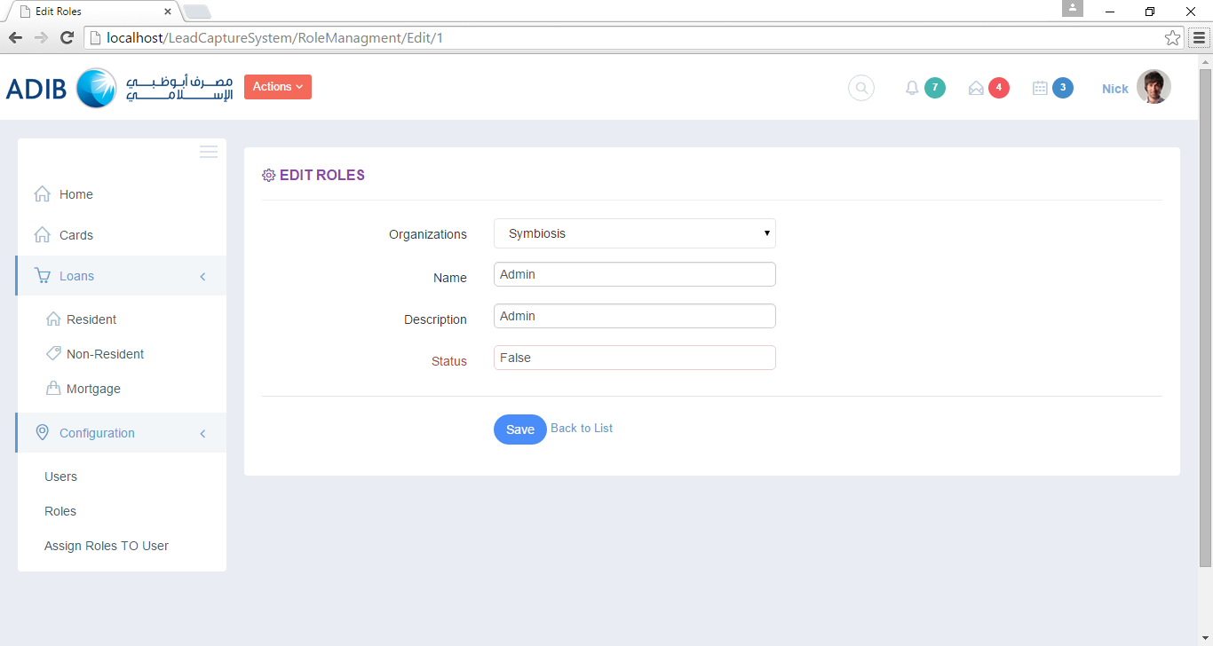
Edit Role

Slide 13
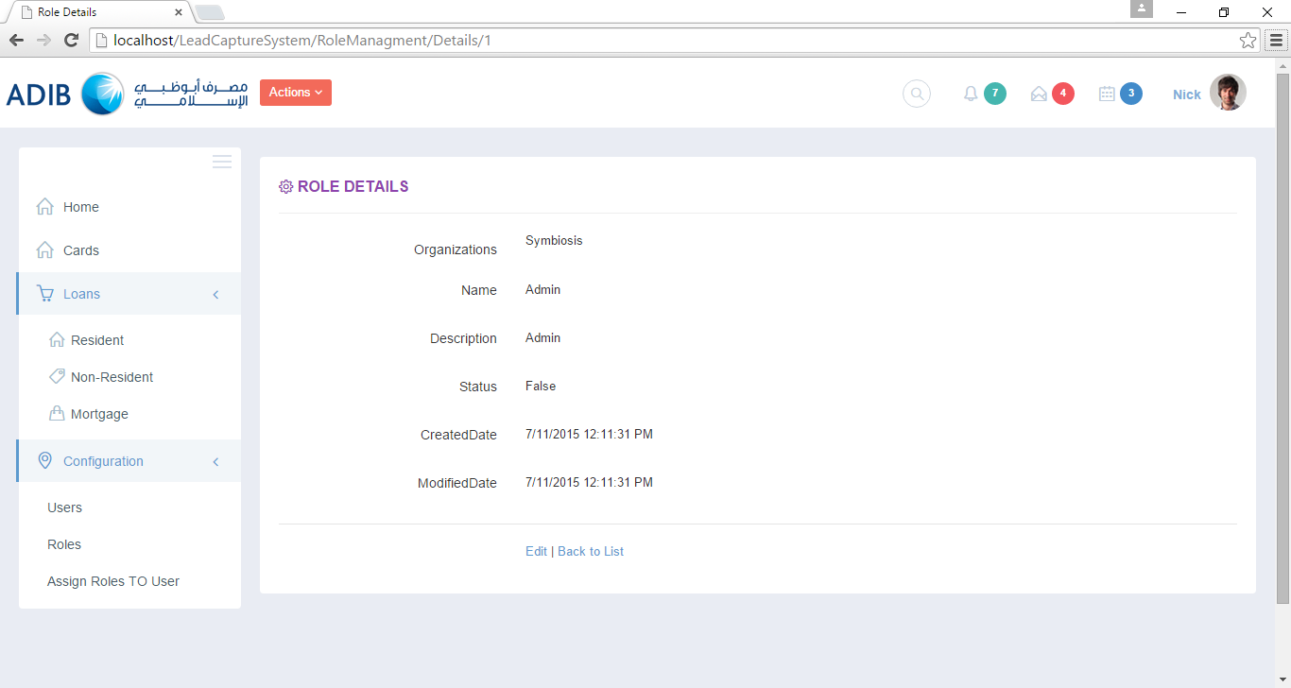
Role Details

Slide 14
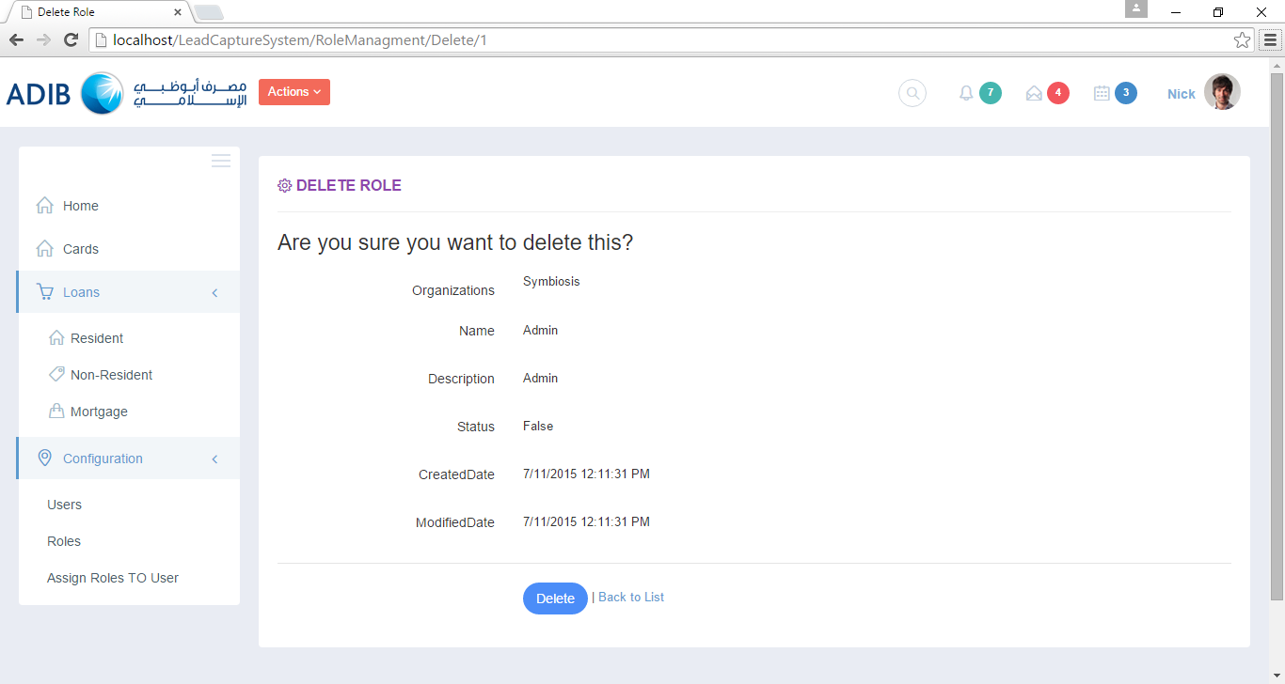
Remove Role

Slide 15
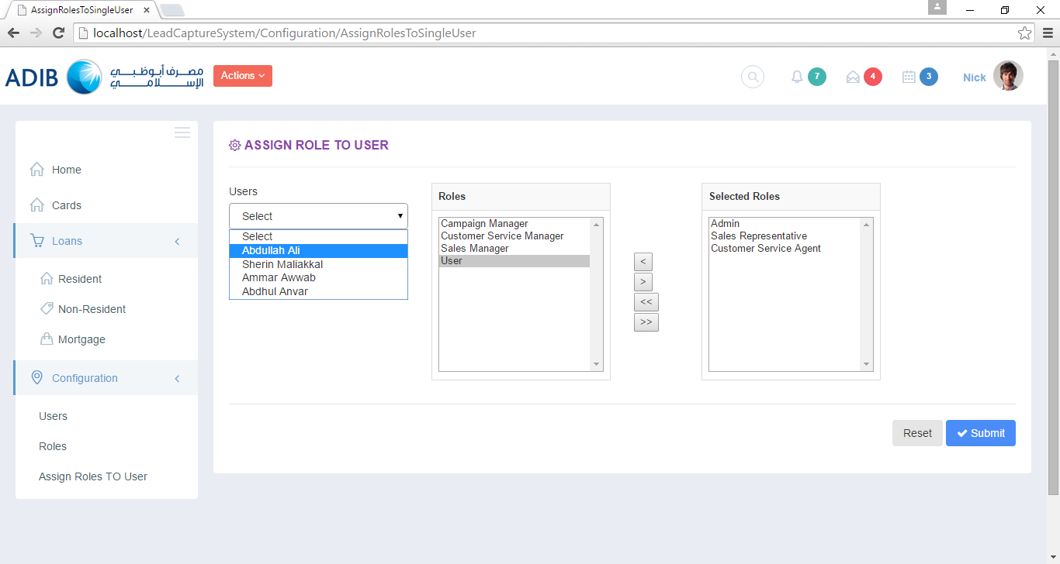
Assign Role To User

Slide 16
Thank You!

