Slide 1

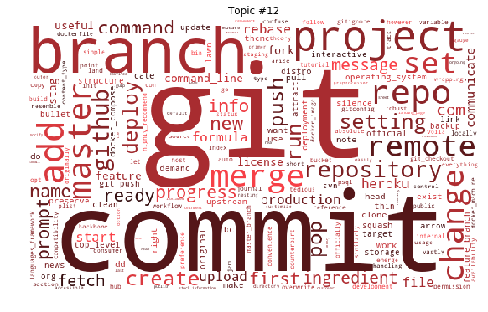
Git

Slide 2


About Git
Created by Linus Torvalds, creator of Linux, in 2005
Came out of Linux development community
Designed to do version control on Linux kernel
Goals of Git:
Speed
Support for non-linear development (thousands of parallel branches)
Fully distributed
Able to handle large projects efficiently
(A "git" is a cranky old man. Linus meant himself.)

Slide 3
Installing/learning Git
Git website: http://git-scm.com/
Free on-line book: http://git-scm.com/book
Reference page for Git: http://gitref.org/index.html
Git tutorial: http://schacon.github.com/git/gittutorial.html
Git for Computer Scientists:
http://eagain.net/articles/git-for-computer-scientists/
At command line: (where verb = config, add, commit, etc.)
– git help verb

Slide 4

Centralized VCS
In Subversion, CVS, Perforce, etc. A central server repository (repo) holds the "official copy" of the code
the server maintains the sole version history of the repo
You make "checkouts" of it to your local copy
you make local modifications
your changes are not versioned
When you're done, you "check in" back to the server
your checkin increments the repo's version

Slide 5
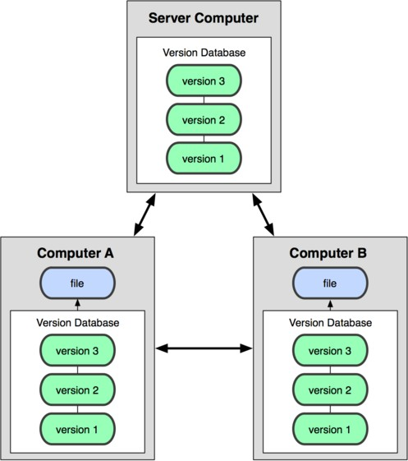
Distributed VCS (Git)
In git, mercurial, etc., you don't "checkout" from a central repo
you "clone" it and "pull" changes from it
Your local repo is a complete copy of everything on the remote server
yours is "just as good" as theirs
Many operations are local:
check in/out from local repo
commit changes to local repo
local repo keeps version history
When you're ready, you can "push" changes back to server

Slide 6
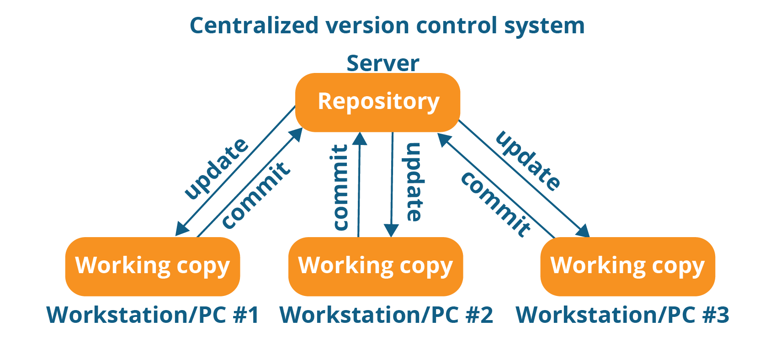
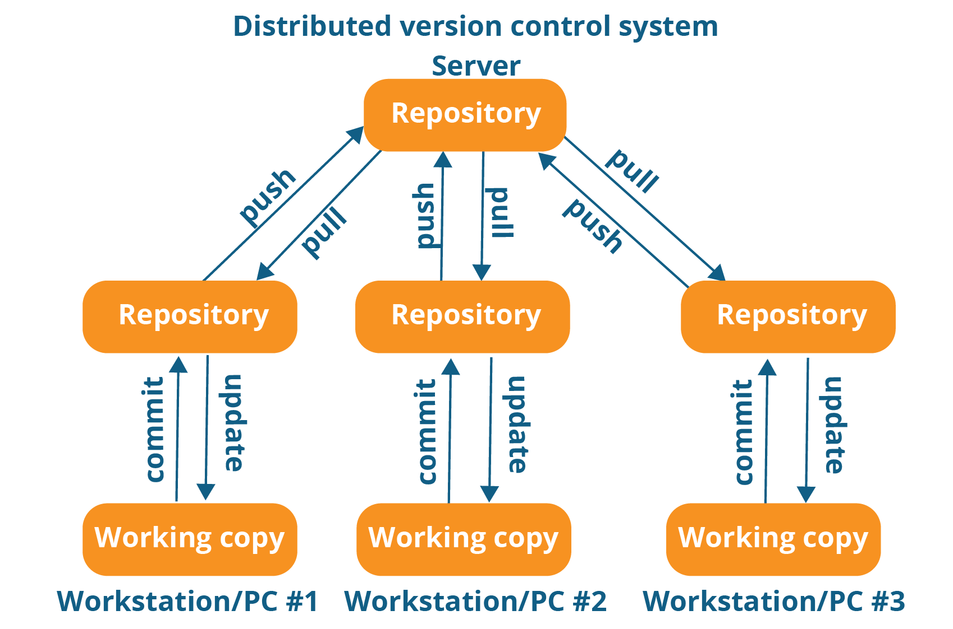
Central vs Distributed

Slide 7
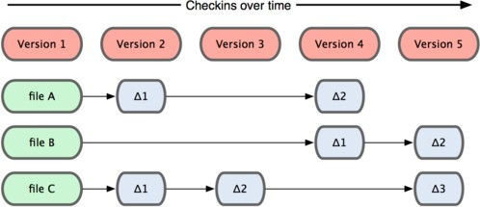
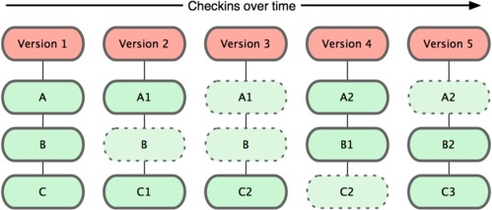
Git snapshots
Centralized VCS like Subversion track version data on each individual file.
Subversion
Git keeps "snapshots" of the entire state of the project.
Each checkin version of the overall code has a copy of each file in it.
Some files change on a given checkin, some do not.
More redundancy, but faster.
Git

Slide 8
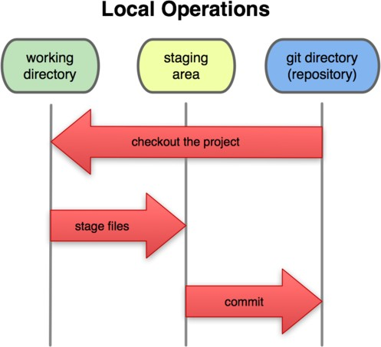
Local git areas
In your local copy on git, files can be:
In your local repo
(committed)
Checked out and modified, but not yet committed
(working copy)
Or, in-between, in a "staging" area
Staged files are ready to be committed.
Unmodified/modified Files
Staged Files
Committed Files
A commit saves a snapshot of all staged state.

Slide 9
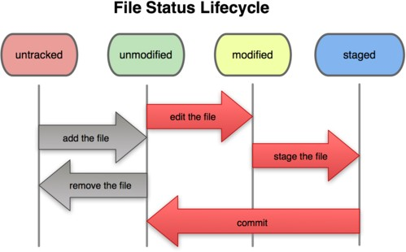
Basic Git workflow
Modify files in your working directory.
Stage files, adding snapshots of them to your staging area.
Commit, which takes the files in the staging area and stores that snapshot permanently to your Git directory.

Slide 10
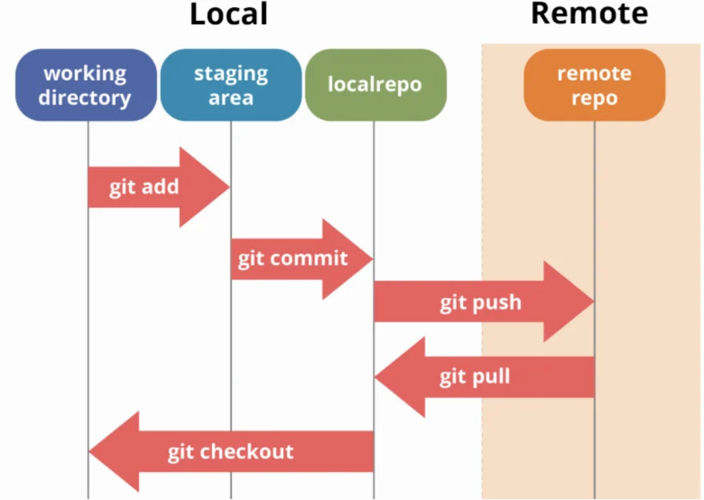
Workflow

Slide 11
Git commit checksums
In Subversion each modification to the central repo increments the version # of the overall repo.
In Git, each user has their own copy of the repo, and commits changes to their local copy of the repo before pushing to the central server.
So Git generates a unique SHA-1 hash (40 character string of hex digits) for every commit.
Refers to commits by this ID rather than a version number.
Often we only see the first 7 characters:
1677b2d Edited first line of readme
258efa7 Added line to readme
0e52da7 Initial commit

Slide 12
Initial Git configuration
Set the name and email for Git to use when you commit:
git config --global user.name "Bugs Bunny"
git config --global user.email bugs@gmail.com
– You can call git config –list to verify these are set.
Set the editor that is used for writing commit messages:
git config --global core.editor nano
(it is vim by default)

Slide 13
Creating a Git repo
Two common scenarios: (only do one of these)
To create a new local Git repo in your current directory:
git init
This will create a .git directory in your current directory.
Then you can commit files in that directory into the repo.
git add filename
git commit –m "commit message"
To clone a remote repo to your current directory:
git clone url localDirectoryName
This will create the given local directory, containing a working copy of the files from the repo, and a .git directory (used to hold the staging area and your actual local repo)

Slide 14
Git commands
command | description
git clone url [dir] | copy a Git repository so you can add to it
git add file | adds file contents to the staging area
git commit | records a snapshot of the staging area
git status | view the status of your files in the working directory and staging area
git diff | shows diff of what is staged and what is modified but unstaged
git help [command] | get help info about a particular command
git pull | fetch from a remote repo and try to merge into the current branch
git push | push your new branches and data to a remote repository
others: init, reset, branch, checkout, merge, log, tag

Slide 15
Add and commit a file
The first time we ask a file to be tracked, and every time before we commit a file, we must add it to the staging area:
git add Hello.java Goodbye.java
Takes a snapshot of these files, adds them to the staging area.
In older VCS, "add" means "start tracking this file." In Git, "add" means "add to staging area" so it will be part of the next commit.
To move staged changes into the repo, we commit:
git commit –m "Fixing bug #22"
To undo changes on a file before you have committed it:
git reset HEAD -- filename
git checkout -- filename
(unstages the file) (undoes your changes)
– All these commands are acting on your local version of repo.

Slide 16
Viewing/undoing changes
To view status of files in working directory and staging area:
git status or git status –s (short version)
To see what is modified but unstaged:
git diff
To see a list of staged changes:
git diff --cached
To see a log of all changes in your local repo:
git log or git log --oneline (shorter version)
1677b2d Edited first line of readme 258efa7 Added line to readme 0e52da7 Initial commit
git log -5 (to show only the 5 most recent updates), etc.

Slide 17
An example workflow
[rea@attu1 superstar]$ emacs rea.txt
[rea@attu1 superstar]$ git status
no changes added to commit
(use "git add" and/or "git commit -a")
[rea@attu1 superstar]$ git status -s
M rea.txt
[rea@attu1 superstar]$ git diff
diff --git a/rea.txt b/rea.txt [rea@attu1 superstar]$ git add rea.txt [rea@attu1 superstar]$ git status
# modified: rea.txt
[rea@attu1 superstar]$ git diff --cached
diff --git a/rea.txt b/rea.txt
[rea@attu1 superstar]$ git commit -m "Created new text file"

Slide 18
Branching and merging
Git uses branching heavily to switch between multiple tasks.
To create a new local branch:
git branch name
To list all local branches: (* = current branch)
git branch
To switch to a given local branch:
git checkout branchname
To merge changes from a branch into the local master:
git checkout master
git merge branchname

Slide 19
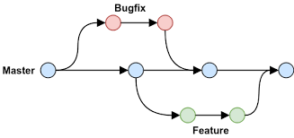
Branching & Rules
Master is always a main branch containing a Production Deployed Code.
It’s advisable to take branch from master when working with new feature or production bug.
Create a branch specifying the Tracking Id of the feature/bug or with feature name (which ever applies)
Commit all the changes from local git repository to remote repository branch.
Test the feature, create test report and feature documentation.
Raise the pull request from Working Branch to Master, attaching all the related artifacts and get it reviewed.
Get the approval to Merge Pull Request.
Deploy the new version.

Slide 20
Merge conflicts
The conflicting file will contain <<< and >>> sections to indicate where Git was unable to resolve a conflict:
<<<<<<< HEAD:index.html
<div id="footer">todo: message here</div>
=======
<div id="footer">
thanks for visiting our site
</div>
>>>>>>> SpecialBranch:index.html
branch 1's version
branch 2's version
Find all such sections, and edit them to the proper state (whichever of the two versions is newer / better / more correct).

Slide 21
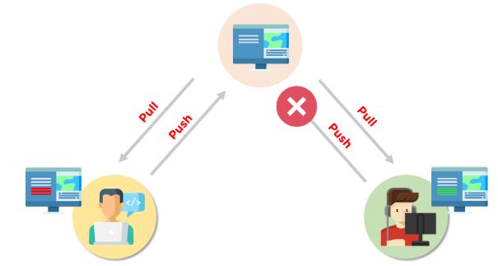
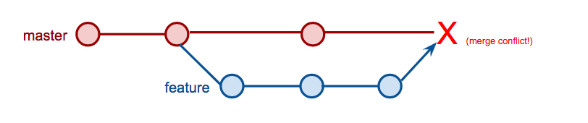
Merge Conflicts

Slide 22
Interaction w/ remote repo
Push your local changes to the remote repo.
Pull from remote repo to get most recent changes.
– (fix conflicts if necessary, add/commit them to your local repo)
To fetch the most recent updates from the remote repo into your local repo, and put them into your working directory:
git pull origin master
To put your changes from your local repo in the remote repo:
git push origin master

Slide 23
GitHub
GitHub.com is a site for online storage of Git repositories.
You can create a remote repo there and push code to it.
Many open source projects use it, such as the Linux kernel.
You can get free space for open source projects, or you can pay for private projects.
Free private repos for educational use: github.com/edu
Question: Do I always have to use GitHub to use Git?
Answer: No! You can use Git locally for your own purposes.
Or you or someone else could set up a server to share files.
Or you could share a repo with users on the same file system, as long everyone has the needed file permissions).

Slide 24



Popular Git Providers

