Slide 1

Basics of Java
Yogesh Patel
Technical Lead
yogesh.patel@nucleusteq.com

Slide 2
Agenda
01
Introduction
02
Data Types – Variable and Literals
03
IDE Setup (Eclipse)
04
Features And Architecture
05
Operator And Expressions
06
Iteration Statements (Loops)
07
Arrays
07
String Handling

Slide 3

Introduction
JDK : Download And Install
JDK: Java Development kit, is a program which provide the necessary tools to develop and execute a Java program.
Link to Download: Latest Java Version available at https://www.oracle.com/java/technologies/downloads/
For now we will be working with Java 17 - https://www.oracle.com/java/technologies/downloads/
Refer to the attached doc to follow the installation process.

Slide 4
Introduction
First Java Program using Notepad
Create and save a file name FirstProgram.java from notepad and write the below content in it.
import java.lang.*;
public class FirstProgram {
public static void main(String[] args) {
System.out.println("Hello World!");
}
}
Compile the file – Go to the folder where the files is saved and run below command. After compilation you will see a .class file, which the equivalent bytecode of you program and understandable to java virtual machine.
javac FirstProgram.java
Run the file – From the same location run the below command to run the program
java FirstProgram

Slide 5
Introduction
Exercise
Write your first Java program using notepad and run it.
Play around with the various keywords in the program and run the program and see what happens and find out the reason for the same. Like -
Remove keyword “static” from main method.
Find out what happens when the filename is different than the class name in the file.

Slide 6
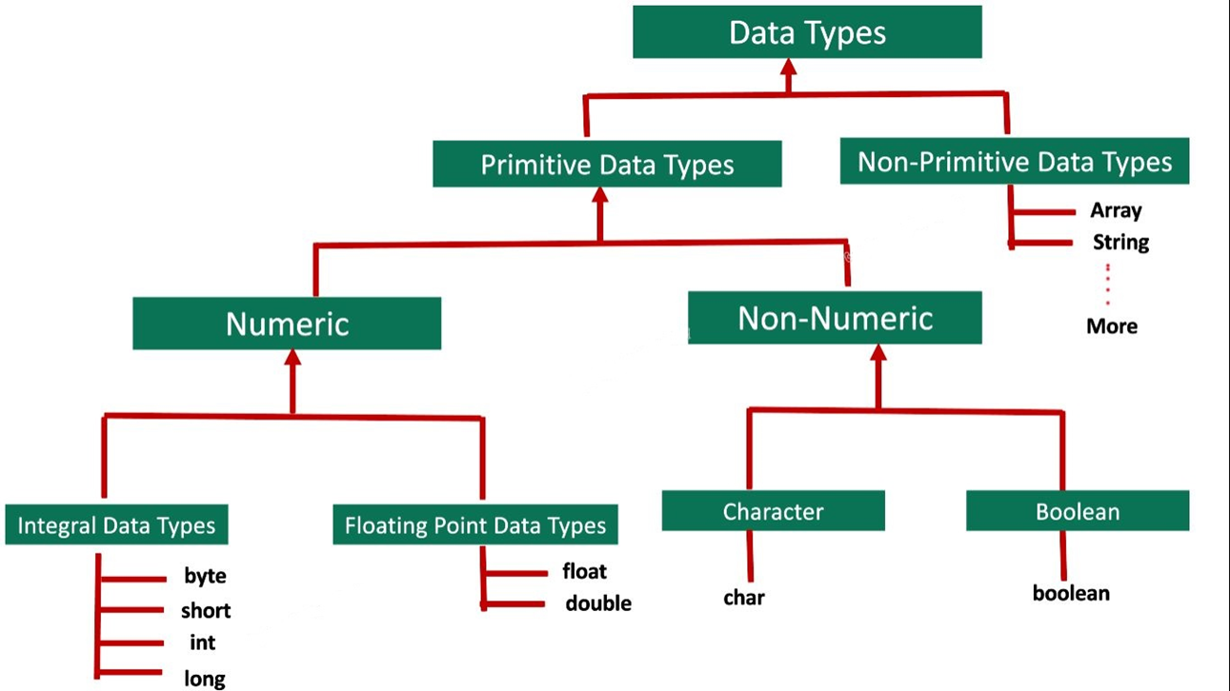
Data Types – Variable and Literals
Data Types
A data type, in programming, is a classification that specifies which type of value a variable has and what type of mathematical, relational or logical operations can be applied to it without causing an error.

Slide 7
Data Types – Variable and Literals
Data Types: Size and Range
Type | Size in byte | Range | Default Value
byte | 1 Byte | -128 to 127 (-2^7 to 2^7-1) | 0
short | 2 Byte | -32,768 to 32,767 (-2^15 to 2^15-1) | 0
int | 4 Byte | -2,147,483,648 to 2,147,483,647 (-2^31 to 2^31-1) | 0
long | 8 Byte | -9,223,372,036,854,775,808 to -9,223,372,036,854,775,807 (-2^15 to 2^15-1) | 0
float | 4 Byte | 1.4e–045 to 3.4e+038 | 0.0f
double | 8 Byte | 4.9e–324 to 1.8e+308 | 0.0d
char | 2 Byte | \u0000 to \FFFF (65536 characters) | \u0000
boolean | Not precisely defined | true, false | false

Slide 8
Data Types – Variable and Literals
Variables
A variable is a container which holds the value during the execution of the Java program.
Every variable is always assigned a data type shows the type and quantity of value it can hold.
So basically whenever a variable is declared it will be assigned a memory based on its data type.
Example:
byte b = 5; // a variable b is being declared and initialized with data type byte, i.e. it will take 1 byte of memory
int i = 4534; // a variable i is being declared and initialized with data type int, i.e. it will take 4 bytes of memory
double d = 1345.45; // a variable d is being declared and initialized with data type double, i.e. it will take 8 bytes of memory
float f = 1345.234f; // a variable f is being declared and initialized with data type float, i.e. it will take 4 bytes of memory

Slide 9
Data Types – Variable and Literals
Variables – Naming Conventions
Case sensitive
Can contain Alphabets, numbers, but no special characters except _ and $
Can start with Alphabets, _ or $
Should not be a keyword
Should not be similar to a class name
No limit on length of name
Should follow camel case style.

Slide 10
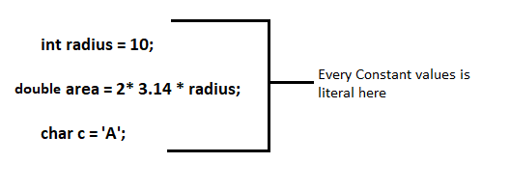
Data Types – Variable and Literals
Literals
Literal are constant values that are used in program.
Literals are of a specific data type
Data Type | Literal Type | Example
Byte | Int | byte a =14;
Short | Int | short s = 104;
Int | Int | int i = 2343;
Long | Int, L or l | Long l = 23L;
Float | Int, F or f | float f = 2.4F;
Double | F, D or d | double d = 5.3D;
Char | ‘’ | char c = ‘A’
boolean | true/false | boolean b = true;

Slide 11
Data Types – Variable and Literals
Exercise
Write Java programs to declare, initialize, modify all the primitive data types.
Write Java programs to find out what happen when we use different type of literals for data types.
Like try to use float literal for integer data type.
Write Java programs to demonstrate the rules of naming conventions of variables.

Slide 12
IDE Setup (Eclipse)
IDE (Integrated Development Environment)
An integrated development environment (IDE) is software for building applications that combines common developer tools into a single graphical user interface (GUI).
An IDE typically consists of (not only limited to):
Source Code Editor – Assist in writing software code with features such as syntax highlighting with visual cues, providing language specific auto-completion, and checking for bugs as code is being written.
Debugger – A program for testing other programs that can graphically display the location of a bug in the original code.
Local Build Automation – Utilities that automate simple, repeatable tasks as part of creating a local build of the software for use by the developer, like compiling computer source code into binary code, packaging binary code, and running automated tests.

Slide 13
IDE Setup (Eclipse)
Eclipse
Where to download from: https://www.eclipse.org/downloads/
After download, install the Software. For now chose Eclipse IDE for Java Developers option
It will automatically detect the path of JDK, because we have already setup the JAVA_HOME in environment variables.

Slide 14
Features And Architecture
Compiler vs Interpreter
Compiler and Interpreter are used for translating our programs into machine and also getting them executed. (you can say in a nutshell they are translators.)
Line by Line translation and execution happen at the same time in interpreter, but in compiler the translation is done first then the execution is performed.
Separate file is generated with compiler but in interpreter no separate file is generated. That’s why compilation is done once, where interpretation is done every time a piece of code is required to be executed.
Compilers more often take a large amount of time for analyzing the source code. In comparison, Interpreters take less time for analyzing the source code.

Slide 15
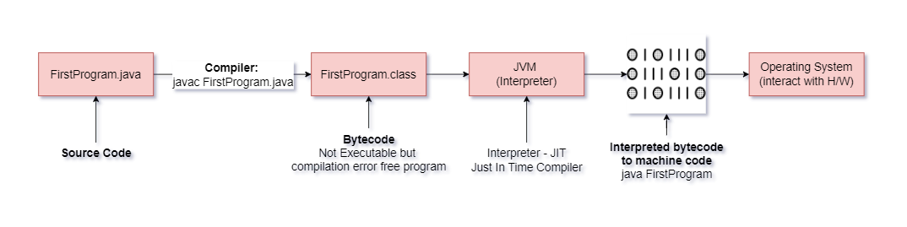
Features And Architecture
Java - Compiler + Interpreter
Java is a hybrid language, i.e. it uses both compiler and interpreter

Slide 16
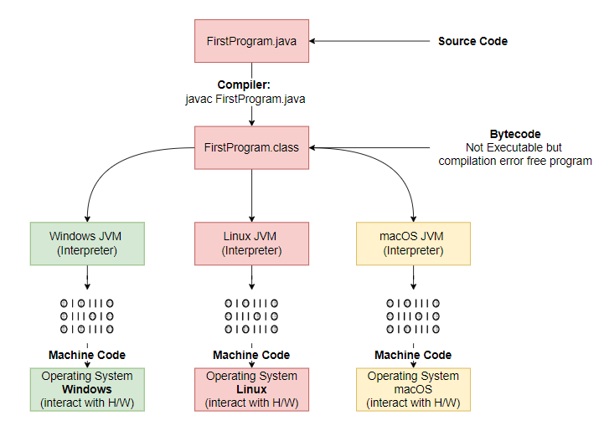
Features And Architecture
Java – How it is Platform Independent
Once a bytecode is generated from any of the operating system, it can be interpreted by any other operating system’s JVM and it can be executed by the other operating system. That’s why java is also called Write Once Run Anywhere (WORA). JVM is reason for Java being a platform independent language

Slide 17
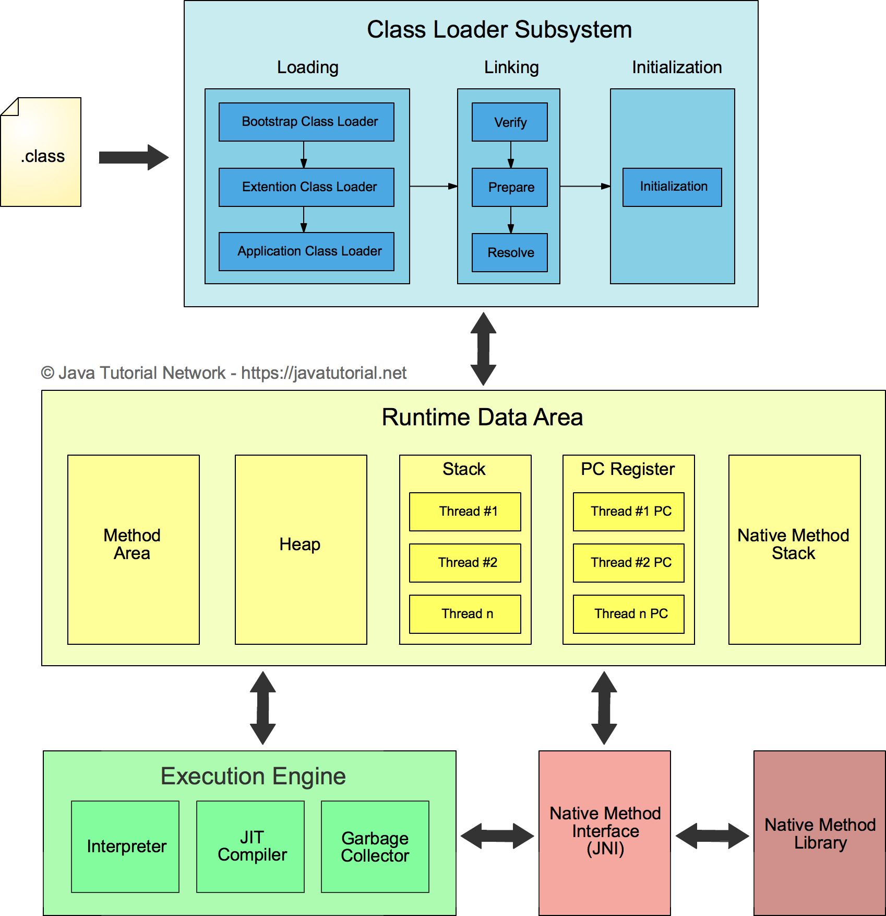
Features And Architecture
JVM (Java Virtual Machine) Architecture
JVM is responsible for executing Java program. It also provide the interpreter for execution of Java programs.

Slide 18
Features And Architecture
Exercise
Read and learn about the below java buzzwords. Why java is -
Simple
Secure
Portable
Robust
Architecture-Neutral
High performance
Distributed
Dynamic

Slide 19
Operator And Expressions
Operators
Operators are special symbols that perform specific operations on one, two, or many operands, and then return a result.
Types of Operators
Assignment
Arithmetic
Increment /Decrement (Unary Operator)
Equality And Relational
Conditional
Bitwise And Bit Shift

Slide 20
Operator And Expressions
Operators – Assignment Operators
One of the most common operators that you'll encounter is the simple assignment operator "=".
It assigns the value on its right to the operand on its left.
int cadence = 0;
int speed = 0;
int gear = 1;

Slide 21
Operator And Expressions
Operators Precedence
As we explore the operators of the Java programming language, it may be helpful for you to know ahead of time which operators have the highest precedence.
The operators in the next slide’s table are listed according to precedence order.
The closer to the top of the table an operator appears, the higher its precedence.
Operators with higher precedence are evaluated before operators with relatively lower precedence.
Operators on the same line have equal precedence.
All binary operators except for the assignment operators are evaluated from left to right.
Assignment operators are evaluated right to left.

Slide 22
Operator And Expressions
Operators Precedence
Operators | Precedence
postfix | expr++ expr--
unary | ++expr --expr +expr -expr ~ !
multiplicative | * / %
Additive | + -
Shift | << >> >>>
Relational | < > <= >= instanceof
Equality | == !=
bitwise AND | &
bitwise exclusive OR | ^
bitwise inclusive OR | |
logical AND | &&
logical OR | ||
Ternary | ? :
Assignment | = += -= *= /= %= &= ^= |= <<= >>= >>>=

Slide 23
Operator And Expressions
Operators – Arithmetic Operators
The Java programming language provides operators that perform addition, subtraction, multiplication, and division.
They are easily recognizable by their counterparts in basic mathematics.
The only symbol that might look new to you is "%", which divides one operand by another and returns the remainder as its result.
Operator | Description | Example
+ | Additive operator (also used for String concatenation) | 1 + 2 = 3
- | Subtraction operator | 3 - 1 = 2
* | Multiplication operator | 2 * 2 = 4
/ | Division operator | 4 / 2 = 2
% | Remainder operator | 10 % 7 = 3

Slide 24
Operator And Expressions
Operators – Data type of Result of Expressions
Expression | Data type of Result
byte <arithmetic operator> byte | int
short <arithmetic operator> short | int
byte <arithmetic operator> short | int
int <arithmetic operator> int | Int
short <arithmetic operator> int | int
char <arithmetic operator> short | int
char <arithmetic operator> int | int
int <arithmetic operator> float | float
long <arithmetic operator> float | float
float <arithmetic operator> double | double
long <arithmetic operator> double | double

Slide 25
Operator And Expressions
Operators – Unary Operators
The unary operators require only one operand; they perform various operations such as incrementing/decrementing a value by one, negating an expression, or inverting the value of a boolean.
Operator | Description | Example
+ | Unary plus operator; indicates positive value (numbers are positive without this, however) | int result = +1; // 1
- | Unary minus operator; negates an expression | result--; // 0
++ | Increment operator; increments a value by 1 | result++; // 1
-- | Decrement operator; decrements a value by 1 | result = -result; // -1
! | Logical complement operator; inverts the value of a boolean | boolean success = false; !success // true

Slide 26
Operator And Expressions
Operators – Unary Operators (Increment/Decrement Operator)
The increment/decrement operators can be applied before (prefix) or after (postfix) the operand.
The code result++; and ++result; will both end in result being incremented by one. The only difference is that the prefix version (++result) evaluates to the incremented value, whereas the postfix version (result++) evaluates to the original value.
If you are just performing a simple increment/decrement, it doesn't really matter which version you choose. But if you use this operator in part of a larger expression, the one that you choose may make a significant difference.

Slide 27
Operator And Expressions
Operators – Equality And Relational
The equality and relational operators determine if one operand is greater than, less than, equal to, or not equal to another operand. The majority of these operators will probably look familiar to you as well. Keep in mind that you must use "==", not "=", when testing if two primitive values are equal.
Operator | Description
== | Equal to
!= | Not equal to
> | Greater than
>= | Greater than or equal to
< | Less than
<= | Less than or equal to

Slide 28
Operator And Expressions
Operators – Conditional Operators
The && and || operators perform Conditional-AND and Conditional-OR operations on two boolean expressions. These operators exhibit "short-circuiting" behavior, which means that the second operand is evaluated only if needed.
Another conditional operator is ?:, which can be thought of as shorthand for an if-then-else statement. This operator is also known as the ternary operator because it uses three operands.
In the following example, this operator should be read as: "If someCondition is true, assign the value of value1 to result. Otherwise, assign the value of value2 to result.“
result = someCondition ? value1 : value2;
Operator | Description
&& | Conditional-AND
|| | Conditional-OR

Slide 29
Operator And Expressions
Operators – Bitwise and Bit Shift Operators
The Java programming language also provides operators that perform bitwise and bit shift operations on integral types. The operators discussed in this section are less commonly used.
Operator | Description
~ | Unary bitwise complement
<< | Signed left shift
>> | Signed right shift
>>> | Unsigned right shift
& | Bitwise AND
^ | Bitwise exclusive OR
| | Bitwise inclusive OR

Slide 30
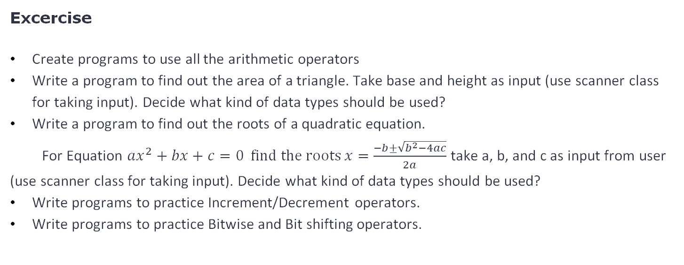
Operator And Expressions

Slide 31
Iteration Statements (Loops)
Loops
Loops in programming allow a set of instructions to be executed repeatedly until a certain condition is fulfilled. Loops are also known as iterating statements or looping statements.
Iteration statements in Java are for, while, and do-while.
Need for Loops in Java: While programming, sometimes, there occurs a situation when we need to execute a block of code several numbers of times. In general, these statements execute in a sequential manner: The first statement in a function executes first, followed by the second, and so on. Loops are used to avoid repetition of such statements.
Every loop has its elements or variables that govern its execution. Generally, a loop has four elements that have different purposes which are:
Initialization Expression(s)
Test Expression(Condition)
Update Expression(s)
Body of the loop

Slide 32

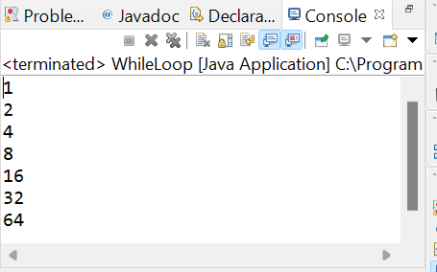
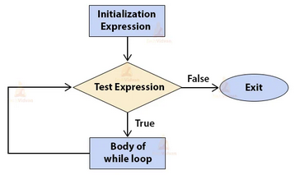
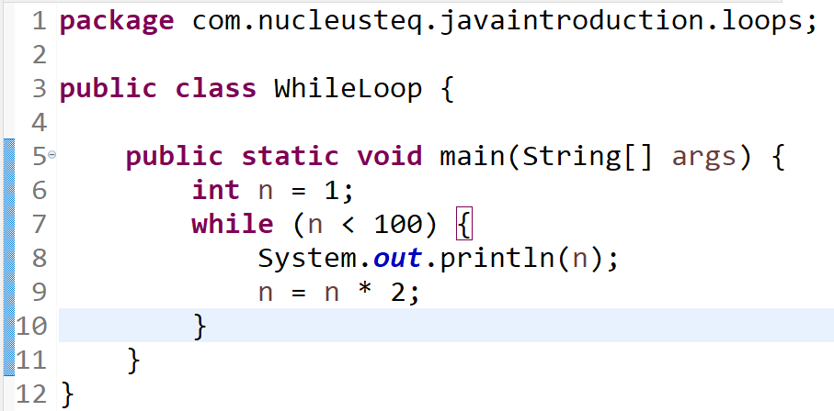
Iteration Statements (Loops)
Loops - “While” Loop
While loop is an entry-controlled loop.
The syntax or general form of while loop is:
The following figure outlines the working of a while loop:

Slide 33
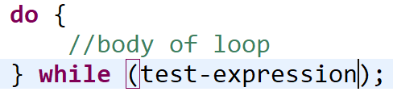
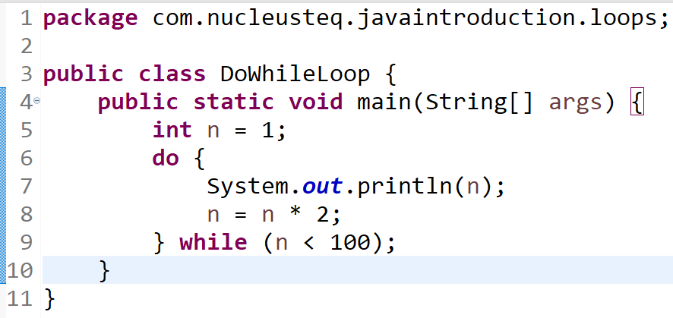
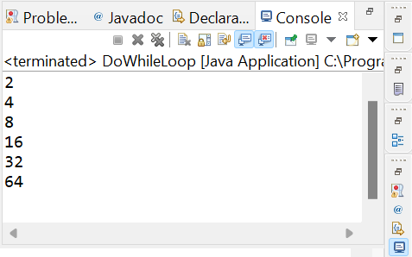
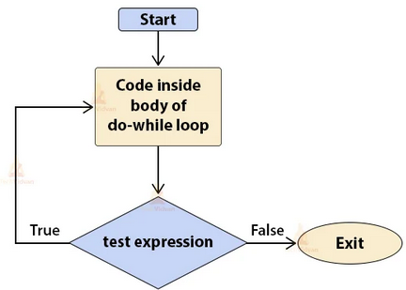
Iteration Statements (Loops)
Loops - “Do-While” Loop
The do-while loop is an exit-controlled loop which means a do-while loop evaluates its test-expression or test-condition at the bottom of the loop after executing the statements in the loop-body.
The syntax or general form of do-while loop is:
The following figure outlines the working of a do-while loop:

Slide 34
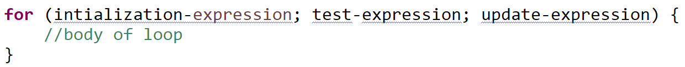
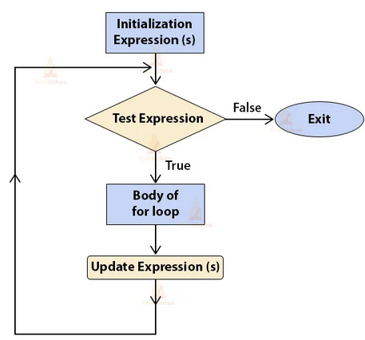
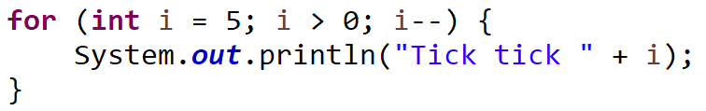
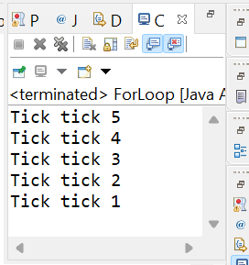
Iteration Statements (Loops)
Loops - “For” Loop
The for loop in Java is an entry controlled loop that allows a user to execute a block of a statement(s) repeatedly with a fixed number of times on the basis of the test expression or test-condition.
There are two forms of the for loop. Traditional and “for-each”
The syntax or general form of traditional “for” loop is:
The following figure outlines the working of a for loop:

Slide 35
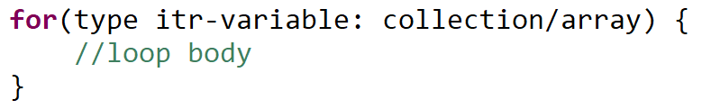
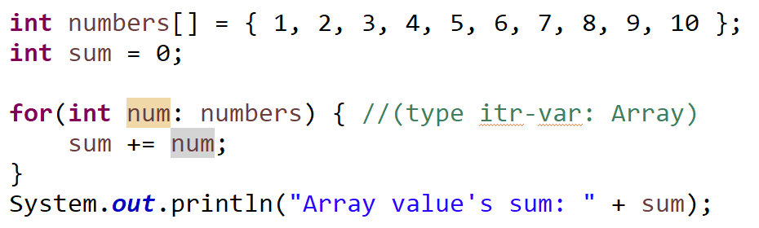
Iteration Statements (Loops)
Loops - “For-Each” Loop (enhanced for loop)
A foreach style loop is designed to cycle through a collection of objects, such as an array, in strictly sequential fashion, from start to finish.
The syntax or general form of “for-each” loop is:
Refer the following figure for example:

Slide 36
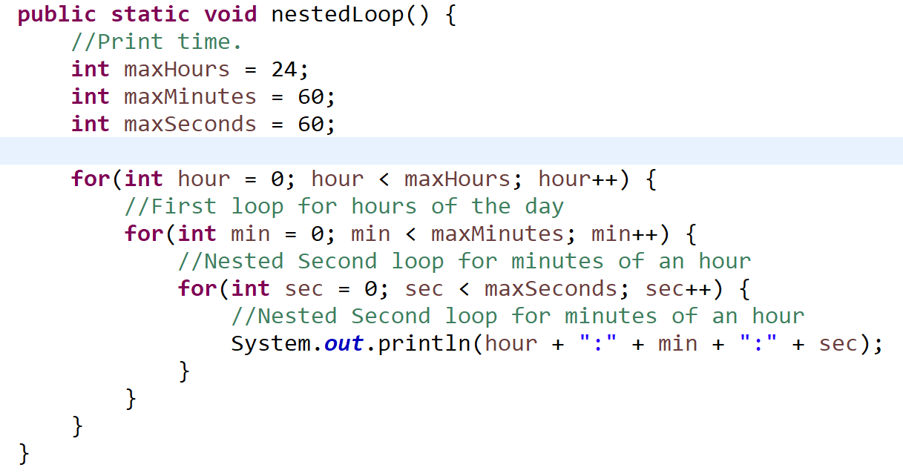
Iteration Statements (Loops)
Loops - Nested Loop
When a loop contains another loop in its body than it is called a nested loop.

Slide 37
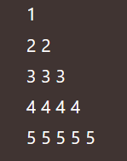
Iteration Statements (Loops)
Exercise
Display Multiplication Table (Take number as input for table display)
Find sum of first n Numbers
Factorial of a Number
Check whether a number is Armstrong or not
Reverse a number
Check whether a number is palindrome or not
Print below pyramid pattern
Note: Make decision, which loop to use and why.

Slide 38
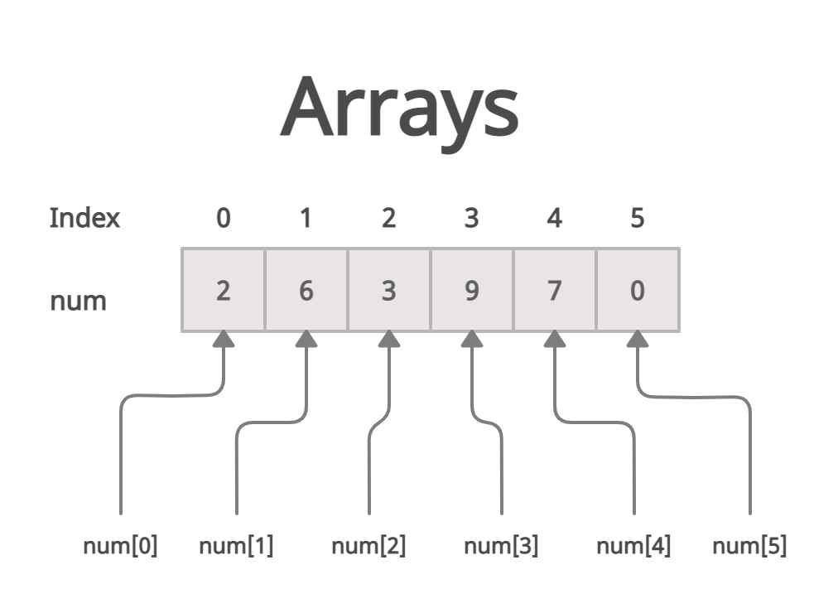
Arrays
Array
An array is a collection of like-typed data. Arrays offer a convenient means of grouping related information.
For example, if we want to store the names of 100 people then we can create an Array of the String type that can store 100 names.
Array in Java is index-based, a specific element in an array is accessed by its index. The 1st element of the array is stored at the 0th index, 2nd element is stored on 1st index and so on.

Slide 39
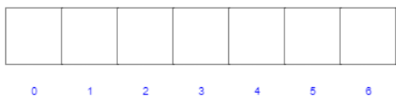
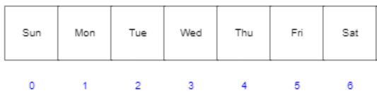
Arrays
Array - One-Dimensional
One-dimensional array is, essentially, a list of like-typed variables. The general form of a one-dimensional array is:
datatype variable_name[] = new datatype[size] Example: String weekDays[] = new String[7]
OR
datatype[] variable_name = new datatype[size] Example: String[] weekDays = new String[7]
Once we declare the 1D Array, it will look like as shown in the picture below:
Declaration and Initialization of a One Dimensional Array in Java:
String weekDays[] = new String[7] {“Sun”, “Mon”, “Tue”, “Wed”, “Thu”, “Fri”, “Sat”}
String weekDays[] = {“Sun”, “Mon”, “Tue”, “Wed”, “Thu”, “Fri”, “Sat”}

Slide 40
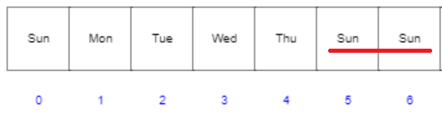
Arrays
Array - One Dimensional
We can access any stored value in a 1D array using the following syntax:
array_name[index];
weekDays[0] // Sun
weekDays[5] // Fri
We can set or update the value in 1D array using the following syntax: weekDays[5] = “Sun”
weekDays[6] = “Sun”

Slide 41
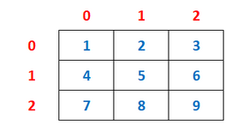
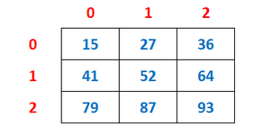
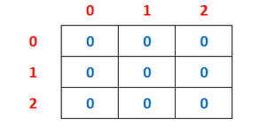
Arrays
Array - Multi Dimensional
In Java, multidimensional arrays are actually arrays of arrays.
One-dimensional array is, essentially, a list of like-typed variables. The general form of a one-dimensional array is:
datatype variable_name[][] = new datatype[row_size][column_size]
Example: int hourMinutes[][] = new int[24][60]
Declaration and Initialization of a Two Dimensional Array in Java-
Example 1: int a[][]= new int[][] {{1,2,3}, {4,5,6}, {7,8,9}};
Example 2: int a[][]= {{15,27,36}, {41,52,64}, {79,87,93}};
Example 3: int a[][]= new int[3][3]; //with data type specific default values

Slide 42
Arrays
Exercise
Find largest number in an Array of Integer
Find average of numbers in an Array of Integer
Rotate an Array by 2 positions
Add Two Matrices.

Slide 43
String Handling
String
In Java a string is a sequence of characters. Generally, String is a sequence of characters. But in Java, string is an object that represents a sequence of characters. The java.lang.String class is used to create a string object.
Java provides built-in String object, which allows various string handling capabilities like -
compareTo(), compare() [String Comparison], substring(), concat(), equals(), split(), length(), replace() etc.
Various ways of creating String -
String Literal
String str = “Some String Literal”
String Object (new keyword)
String str = new String(); // Empty String created using constructor
Create a String by an array of characters
char chars[] = { 'a', 'b', 'c' }; //characters Array
String str = new String(chars); //This constructor initializes str with the string "abc".

Slide 44
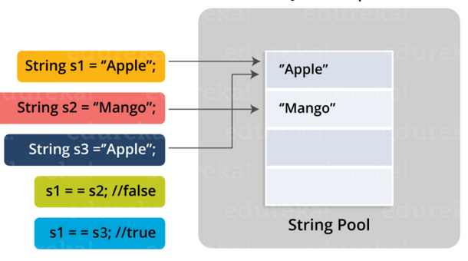
String Handling
String - String Pool
In Java String Pool is a storage area in Java heap.
Each time a string literal is created, the JVM checks the string literal pool first. If the string already exists in the string pool, a reference to the pooled instance returns. If the string does not exist in the pool, a new String object initializes and is placed in the pool.
How String Pool work in Java -
The class is loaded when JVM is invoked.
JVM looks for all the string literals in the program.
First, it finds the variable s1 which refers to the literal “Apple” and it gets created in the memory.
A reference for the literal “Apple” is then placed in the string constant pool memory.
Then it finds another variable s2 which refers to the string literal “Mango”.
Then it finds another variable s3 which refers to the literal “Apple”.
Now that JVM has already found a string literal “Apple”, both the variables s1 and s3 will refer to the same object i.e. “Apple”.

Slide 45
String Handling
Exercise
Find out what is difference between String and StringBuilder classes? What are the scenarios to prefer StringBuilder over String?
Explore below String operations and write a program for each -
String length
String concatenation
Get character at a given position from String
Check if a String starts with a given character or String
Find index of a given character or string from a String.
Replace a character from a String
The java.lang.String class provides many useful methods to perform operations, explore and write program for 5 more methods apart from mentioned above.
Write a program to explain the difference between “equals” method and == operator when used with Strings.

Slide 46
Thank You!!! Any questions?

