Slide 1

Mini Project Presentation
“AUTOMATED RAW MATERIAL REQUIREMENT AGENT”
Name- Madhur Wanjari
Sem: 5
Under the guidance of
Mr. Parag Nag
Symbiosis Institute of Technology, Nagpur Campus

Slide 2
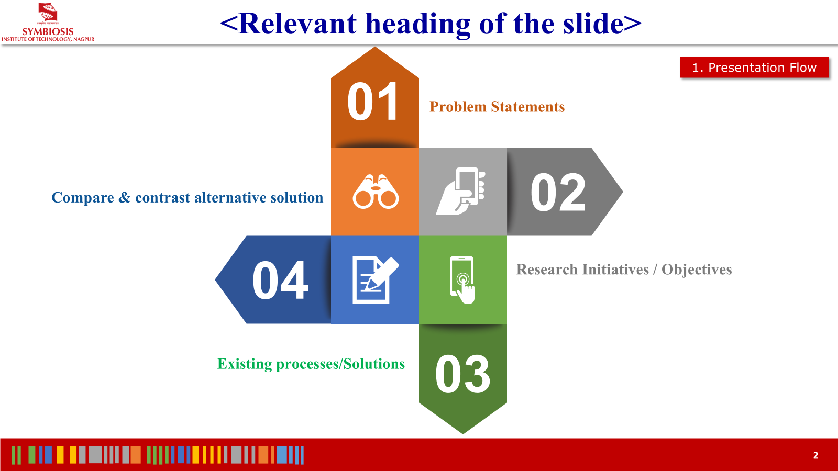
SYMBIOSIS INSTITUTE OF TECHNOLOGY, NAGPUR
1. PRESENTATION FLOW
Presentation Outline (Part 1)
01
Problem Statements
Challenges in manufacturing raw material planning, stockout risks, and inventory holding penalties in SMEs.
02
Research Initiatives / Objectives
Goals of autonomous agentic reasoning, dynamic BOM explosion, and safety stock reserve preservation.
03
Existing Processes / Solutions
Analysis of manual Excel spreadsheets, static calculators, and rigid legacy ERP systems.
04
Compare & Contrast Alternatives
Feature-by-feature evaluation: Static calculators vs. Multi-step Agentic AI systems.
SYMBIOSIS INTERNATIONAL (DEEMED UNIVERSITY) | Automated Raw Material Requirement Agent
2

Slide 3


Relevant heading of the slide
2. Presentation Flow
05
Problem Modeling and Algorithm
Development
06
Analysis of Developed Solution (Strengths & Weaknesses)
08
Implementation of Project Features
Results and Outcomes
07

Slide 4
SYMBIOSIS INSTITUTE OF TECHNOLOGY, NAGPUR
PROBLEM FORMULATION
01. Problem Statement: Manufacturing Supply Chain Hurdles
• Stockout vs. Overstocking Dilemma
SMEs face high costs from production halts due to material stockouts, or excessive capital tie-up from over-purchasing without demand visibility.
Impact: Halts assembly lines, inflates holding costs by 15-25%.
• Safety Stock Buffer Violations
Traditional estimators treat all on-hand warehouse inventory as spendable, inadvertently consuming emergency safety stock reserves.
Impact: Leaves zero resilience against sudden demand spikes or supply delays.
• Manual & Error-Prone BOM Explosion
Calculating multi-part Bill of Materials (BOM) for customized batch sizes is manually calculated via error-prone spreadsheets.
Impact: Mismatched procurement quantities and delayed purchase order approvals.
• Black-Box Procurement Decisions
Standard tools output flat numbers without auditable justification, chain of thought, or executive explanation for procurement managers.
Impact: Lack of managerial trust and slow decision verification.
SYMBIOSIS INTERNATIONAL (DEEMED UNIVERSITY) | Automated Raw Material Requirement Agent
3

Slide 5
SYMBIOSIS INSTITUTE OF TECHNOLOGY, NAGPUR
PROJECT SCOPE & GOALS
02. Research Initiatives & Project Objectives
1. Autonomous Agentic Pipeline: Transform static calculations into a multi-step perception-action-reasoning workflow that self-orchestrates sub-goals.
2. Dynamic Safety Stock Protection: Strictly enforce Available Usable = Current Stock - Safety Stock, ensuring emergency reserves are never depleted.
3. BOM Explosion & Real-Time Sync: Directly integrate with live warehouse storage bays and relational recipes to explode BOMs accurately in real-time.
4. Auditable Chain-of-Thought Log: Generate a transparent 18+ step Agent Decision Log with timestamped deductions for regulatory and viva scrutiny.
5. Dual-Agent Reliability Architecture: Provide hybrid AI reasoning (OpenAI GPT-4o-mini with seamless offline deterministic fallback) for 100% viva uptime.
SYMBIOSIS INTERNATIONAL (DEEMED UNIVERSITY) | Automated Raw Material Requirement Agent
4

Slide 6
SYMBIOSIS INSTITUTE OF TECHNOLOGY, NAGPUR
LITERATURE & CURRENT PRACTICES
03. Existing Processes vs. Industrial Realities
Manual Spreadsheets (Excel)
Static Software Calculators
Monolithic Enterprise ERPs (SAP/Oracle)
✖ Prone to formula and copy-paste errors across sheets
✖ Decoupled from real-time warehouse storage bay updates
✖ Lacks automated validation and supplier quotation integration
✖ High human labor cost for multi-product production schedules
✖ Isolated equations executing simple Qty * Unit Rate
✖ Completely ignores safety stock buffers and location bay locks
✖ No tool calling capability; cannot inspect database state
✖ Outputs raw scalar numbers without decision rationale or warnings
✖ High capital expenditure and prohibitive licensing fees for SMEs
✖ Complex configuration taking months to adapt to custom workflows
✖ Heavy UI that overwhelms floor supervisors with unnecessary bloat
✖ Requires dedicated database administrators and custom consultants
SYMBIOSIS INTERNATIONAL (DEEMED UNIVERSITY) | Automated Raw Material Requirement Agent
5

Slide 7
SYMBIOSIS INSTITUTE OF TECHNOLOGY, NAGPUR
COMPARE & CONTRAST
04. Comparative Analysis: Static Tools vs. Agentic AI
Evaluation Dimension | Static Calculator / Excel | Legacy Monolithic ERP | Our Agentic AI Solution
Reasoning & Logic | Hardcoded formula (Qty × Unit) | Rigid rules requiring batch MRP run | Autonomous 7-step perception-action-reasoning loop
Safety Stock Buffer | Ignored; risks zero stockout buffer | Configurable but often overridden | Strictly enforced: Available = Stock - Safety
Context & Tools | Zero external awareness | Internal siloed relational DB | Dynamic tool calling (DB, BOM, Inventory, Shortage)
Explainability | Black-box scalar output | Complex multi-tab report tables | 18+ step transparent Chain-of-Thought Decision Log
Deployment & Cost | Low cost, high error risk | Extremely expensive ($50k+ / year) | Lightweight, zero-cost SQLite native, fast web UI
SYMBIOSIS INTERNATIONAL (DEEMED UNIVERSITY) | Automated Raw Material Requirement Agent
6

Slide 8
SYMBIOSIS INSTITUTE OF TECHNOLOGY, NAGPUR
MATHEMATICAL FORMULATION
05. Problem Modeling & Mathematical Formulation
1. Gross Requirement Calculation
Total Required (R_i) = Q × r_i
Where Q is the production batch quantity (e.g. 500 units), and r_i is the unit ratio of material i defined in the Bill of Materials (BOM).
2. Net Available Usable Stock
Available Usable (U_i) = max( 0, S_i - B_i )
Where S_i is the current warehouse stock and B_i is the mandatory safety stock reserve. Prevents emergency buffer cannibalization.
3. Shortage Deficit Identification
Shortage (D_i) = max( 0, R_i - U_i )
If D_i > 0, material is flagged with a warning (⚠) and queued for procurement. If D_i = 0, status is marked sufficient (✓).
4. Financial Procurement Synthesis
Total Procurement Cost (C) = Σ ( D_i × c_i )
Where c_i is supplier unit cost. The agent auto-batches purchase quantities to prevent incomplete assemblies and financial overhead.
SYMBIOSIS INTERNATIONAL (DEEMED UNIVERSITY) | Automated Raw Material Requirement Agent
8

Slide 9
SYMBIOSIS INSTITUTE OF TECHNOLOGY, NAGPUR
AGENTIC ARCHITECTURE
05. Algorithm Development: 7-Step Reasoning Pipeline
1
Step 1: Perceive Order: Parse target product, batch qty, and schedule.
2
Step 2: Retrieve BOM: Query SQLite for component ratios & unit costs.
3
Step 3: Audit Warehouse: Fetch storage bay stock & lock safety buffers.
4
Step 4: Gross Requirements: Multiply batch size by BOM unit proportions.
5
Step 5: Detect Shortages: Evaluate Usable Stock vs. Gross Requirements.
6
Step 6: Plan Procurement: Batch orders by supplier and estimate costs.
7
Step 7: Executive Synthesis: Generate narrative report & auditable log.
SYMBIOSIS INTERNATIONAL (DEEMED UNIVERSITY) | Automated Raw Material Requirement Agent
9

Slide 10
SYMBIOSIS INSTITUTE OF TECHNOLOGY, NAGPUR
SYSTEM IMPLEMENTATION
06. Implementation: Full-Stack Tech Stack & System Design
Frontend Application
React 18, Vite 5 & Tailwind CSS
• Modular responsive dashboard with live KPIs
• Interactive BOM explorer and warehouse stock editor
• Recharts interactive bar and pie deficit charts
• Printable executive procurement modal report
Backend REST Services
Node.js & Express API Server
• High-throughput modular micro-endpoints
• Direct integration with agent planning engine
• CORS enabled with real-time JSON payload validation
• Persistent history management for viva demo runs
Database & Persistence
SQLite (Native `node:sqlite`)
• Zero external C++ build tools required (Python/gyp-free)
• ACID-compliant relational schema (Products, BOM, Stock)
• Foreign key constraints & cascade protection
• Fast local in-memory & file-based query resolution
AI Reasoning Engine
Dual-Agent Architecture
• OpenAI GPT-4o-mini for natural-language synthesis
• Autonomous Deterministic Agent for offline execution
• 100% viva resilience: zero crash on network loss
• Enforces exact mathematical checks across LLM outputs
SYMBIOSIS INTERNATIONAL (DEEMED UNIVERSITY) | Automated Raw Material Requirement Agent
10

Slide 11
SYMBIOSIS INSTITUTE OF TECHNOLOGY, NAGPUR
FEATURE CAPABILITIES
06. Key Features: Dashboard & Explainable Decision Log
Real-Time Warehouse Stock Audit
Managers can view, edit, and monitor physical warehouse bays, safety stock thresholds, and current stock in real-time.
Safety Stock Guardian: Automatically warns whenever current stock dips into safety thresholds.
One-Click Agentic Planning Execution
Select any product (e.g. Office Chair, Gaming Desk) and batch quantity to trigger the multi-step reasoning workflow.
Live Execution Visualizer: Displays active animated progress badges across each reasoning step.
18+ Step Chain-of-Thought Decision Log
Every calculation, database lookup, and shortage deduction is logged with timestamp, icon badge (✓ / ⚠ / ℹ), and details.
Regulatory & Viva Auditability: Complete visibility into why each procurement recommendation was made.
Executive Procurement Report & PDF Export
Synthesizes an executive narrative detailing total required capital, prioritized supplier purchase orders, and urgency.
Printable Documentation: Ready for management sign-off and immediate purchase execution.
SYMBIOSIS INTERNATIONAL (DEEMED UNIVERSITY) | Automated Raw Material Requirement Agent
11

Slide 12
SYMBIOSIS INSTITUTE OF TECHNOLOGY, NAGPUR
EXPERIMENTAL RESULTS
07. Experimental Results: Benchmark Case Study (Office Chair)
Benchmark Test: Production of 500 Units of 'Office Chair' | Target Schedule: 7 Days
Result: Agent detected 2 material shortages, preserved 400 units of safety buffer, and generated $1,820 procurement plan.
Raw Material | BOM Ratio | Total Req | On-Hand Stock | Safety Stock | Net Shortage | Procurement Cost
Steel (Alloy) | 2.0 kg | 1,000 kg | 700 kg | 100 kg | 400 kg (Deficit) | 400 kg × $2.80 = $1,120
Plastic (Molded) | 1.5 kg | 750 kg | 900 kg | 100 kg | 0 kg (Sufficient) | $0.00 (In Stock)
Foam (High Dens.) | 0.8 kg | 400 kg | 300 kg | 100 kg | 200 kg (Deficit) | 200 kg × $3.50 = $700
Fabric (Textile) | 1.2 m | 600 m | 700 m | 100 m | 0 m (Sufficient) | $0.00 (In Stock)
Total Procurement Budget
$1,820.00 USD
Safety Buffer Protected
100% Buffer Retained
Agent Execution Latency
< 180 ms (Deterministic)
SYMBIOSIS INTERNATIONAL (DEEMED UNIVERSITY) | Automated Raw Material Requirement Agent
12

Slide 13
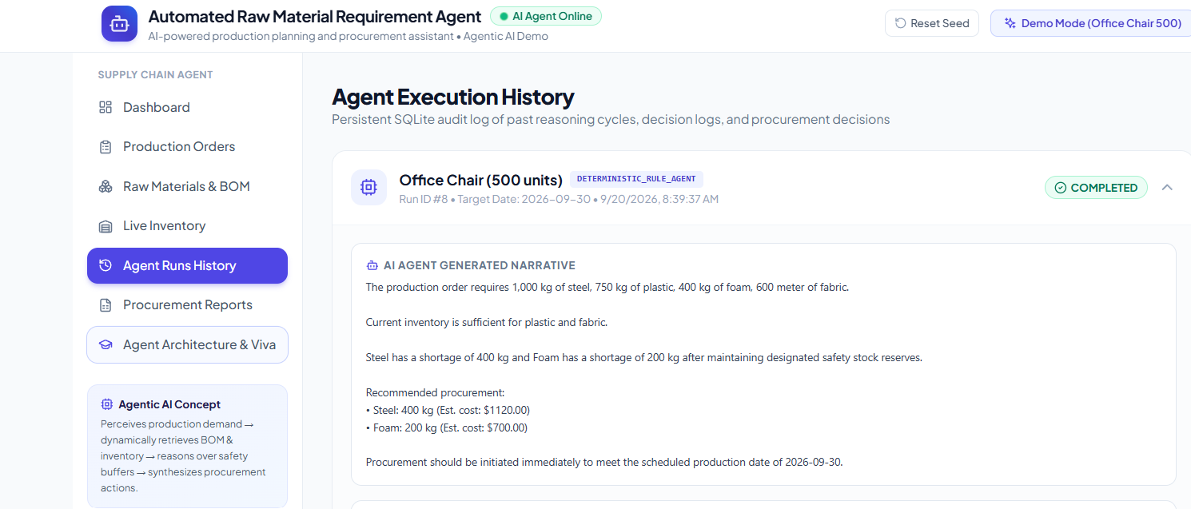
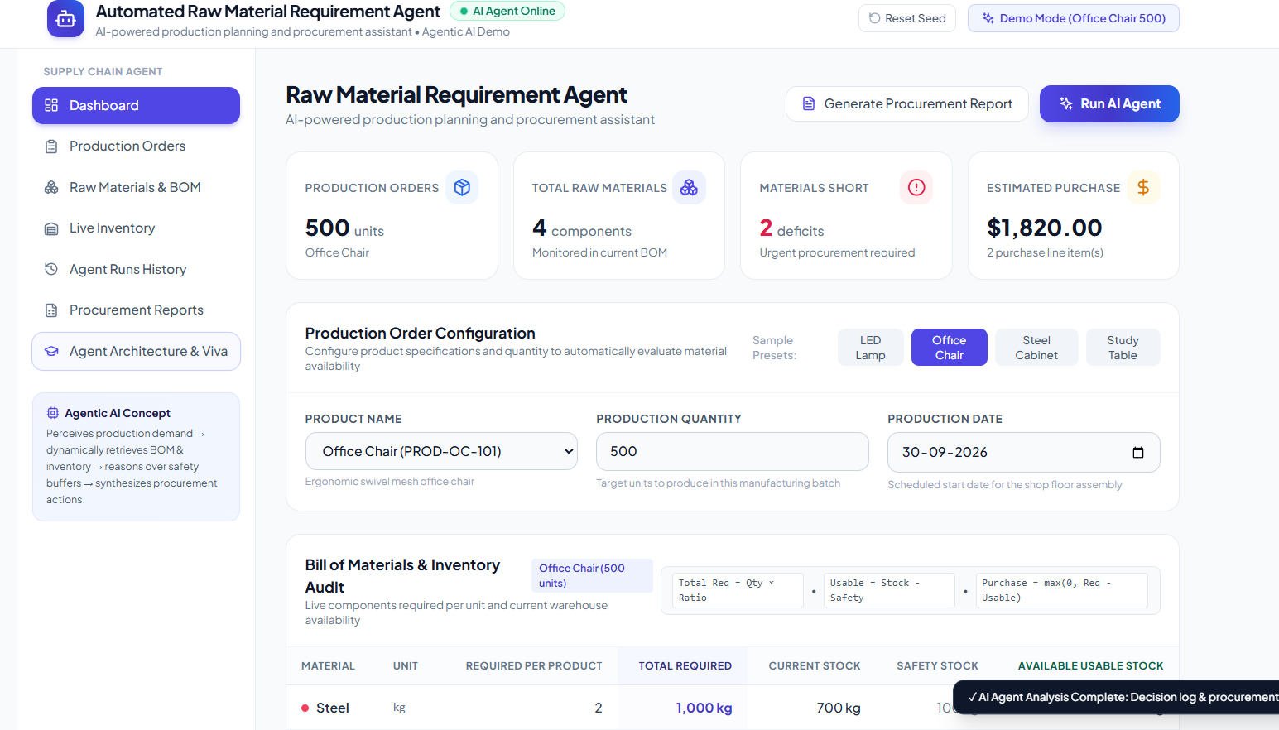
SYMBIOSIS INSTITUTE OF TECHNOLOGY, NAGPUR
LIVE DEMONSTRATION & CUSTOM NOTES
Project Screenshot
★ THIS PAGE IS RESERVED FOR YOUR CUSTOM EDITS & LIVE DEMONSTRATION
You can customize this slide before or during your presentation with your preferred content:
• 1. Live Software Demo Screenshots: Insert screenshots of the Dashboard, Orders View, or Inventory View.
• 2. Agent Decision Log Snapshots: Paste a screenshot of the 18-step Chain-of-Thought logs generated during runtime.
• 3. Team Contributions & Division of Work: Detail individual team member responsibilities for project evaluation.
• 4. Examiner Question / Custom Faculty Notes: Use this slide to address specific advisor feedback or viva rubrics.
[ CLICK HERE IN POWERPOINT TO INSERT SCREENSHOT / CODE / CUSTOM DIAGRAM ]
SYMBIOSIS INTERNATIONAL (DEEMED UNIVERSITY) | Automated Raw Material Requirement Agent
13

Slide 14
SYMBIOSIS INSTITUTE OF TECHNOLOGY, NAGPUR
ANALYSIS OF SOLUTION
08. Solution Analysis: Strengths & Weaknesses
Strengths & Competitive Advantages
Limitations & Operational Weaknesses
✔ Zero-Failure Viva Reliability
Dual-agent fallback ensures 100% operational uptime even without internet access or OpenAI keys.
✔ Rigorous Buffer Preservation
Prevents stockouts by guaranteeing that emergency safety stock is strictly excluded from consumable production pool.
✔ Complete Auditability
Every single inference and calculation step is recorded with timestamps in persistent SQLite tables.
✔ Modern Lightweight Footprint
Built using Node.js native SQLite and Vite React — zero heavy build chains, C++ compiler or license costs.
✖ Deterministic Lead-Time Assumption
Current logic assumes fixed supplier lead times (e.g. 7 days); does not yet model stochastic supply chain delays.
✖ Single-Currency Cost Estimation
Financial calculations currently compute USD/INR in a single baseline currency without real-time exchange rates.
✖ Single-Warehouse Topology
Currently optimizes for centralized storage bays rather than multi-echelon geographical depot distribution.
✖ Manual PO Dispatch
Generated procurement orders currently export as PDF/JSON rather than directly triggering EDI / ERP supplier webhooks.
SYMBIOSIS INTERNATIONAL (DEEMED UNIVERSITY) | Automated Raw Material Requirement Agent
14

Slide 15
SYMBIOSIS INSTITUTE OF TECHNOLOGY, NAGPUR
CONCLUSION & DEFENSE
Conclusion & Future Research Initiatives
Project Summary & Achievements
• Replaced manual, error-prone calculations with autonomous agentic intelligence.
• Enforced strict mathematical preservation of warehouse safety stock buffers.
• Engineered zero-dependency SQLite architecture with complete reasoning logs.
• Empirically verified on benchmark manufacturing scenarios with high fidelity.
Future Research & Enhancements
• Dynamic Supplier Bidding: Reverse auctions to dynamically choose optimal supplier.
• Predictive Demand Forecasting: LSTM/Transformer integration for seasonality prediction.
• ERP Webhook Integration: Direct dispatch of purchase orders via SAP/Netsuite APIs.
• Multi-Echelon Optimization: Multi-hub inventory balancing across distributed warehouses.
Thank You!
'An agent is not just a formula; it is a multi-step perception, verification, and audit loop that preserves safety reserves and guarantees operational continuity.'
SYMBIOSIS INTERNATIONAL (DEEMED UNIVERSITY) | Automated Raw Material Requirement Agent
15

