Slide 1

Exploratory Data Analysis Course Project Relapsed Patients Sem : IV Batch : D-1 Team No : 09 CP Id : 4EDA_CP_08
Team Members
USN NAME ROLL NO
01fe20bcs185 Lavanya Shahapur 401
01fe20bcs186 Sindhu V Bhat 402
01fe20bcs187 Madhura K Patil 403
01fe20bcs189 Pragathi Pujari 405
Guided by : Dr. P. G. Sunitha Hiremath
Ms. Neha T

Slide 2
Contents: 1.Problem statement. 2.Domain Knowledge. 3.Data Description. 4.Data Preprocessing Techniques. 5.Analysis using Visualizations. 6.Discovery of hidden patterns. 7.Feature Selection. 8.Conclusion.

Slide 3
Problem Statement : To explore and analyze the data of the relapsed patients who have taken treatment for alcohol deaddiction from a rehabilitation organization. Source : Akhila Karnataka Jana Jagruthi Vedike Regional Office ,Ujire, Dakshina Kannada, Karnataka. DOMAIN KNOWLEDGE : 1.Alcoholism and its meaning. 2.Reasons behind people consuming alcohol and getting addicted to it. 3.Reasons why people relapse back to alcohol consumption even after taking treatment for deaddiction. 4.Harmful effects of Alcohol consumptions and effects of the withdrawal symptoms.

Slide 4
DATA SET DETAILS : 1. There are (203 rows X 404 columns )in the data. 2. The data set has multi-valued, single valued attributes. 3. There are 395 null values. 4. The dataset is divided into two, based on the number of times the patient has relapsed. 5. Out of 203 patients there are 186 once relapsed, 15 twice relapsed and 1 thrice relapsed. One patient is undertaking treatment and relapsed condition is not known. Hence we drop the tuple. PRE PROCESSING TECHNIQUES USED : 1. Normalization. 3. Replacing missing values using mean, median and mode. 4. Smoothening the noisy data. 5. Removing the outliers. 6.One hot encoder techniques.

Slide 5
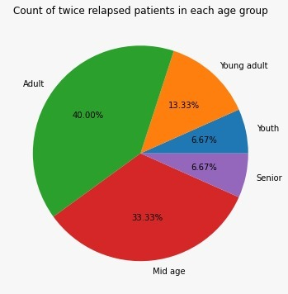
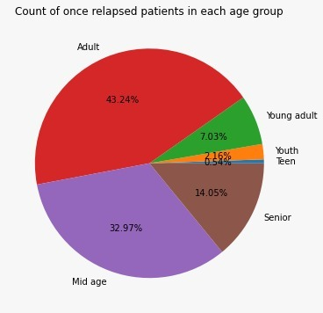

Slide 6
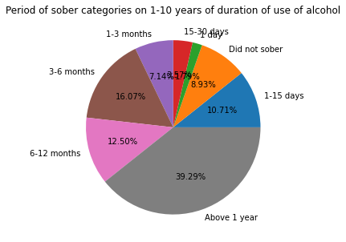
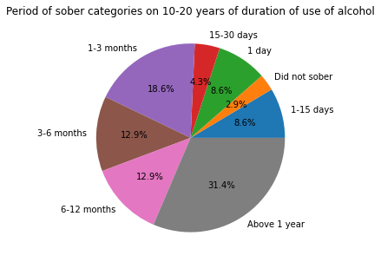
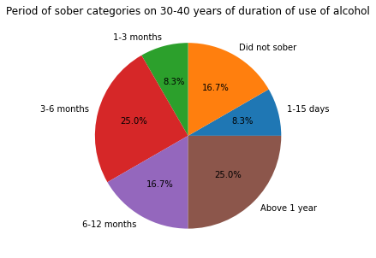
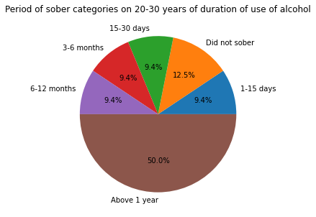
Analysis of Duration of use of Alcohol with sober for patients who relapsed once

Slide 7
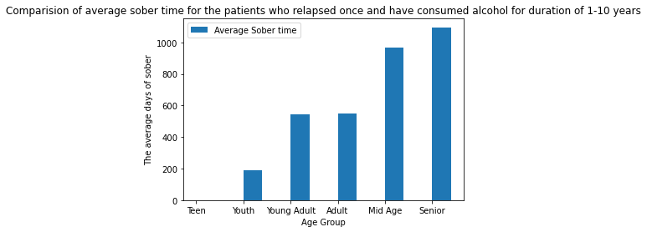
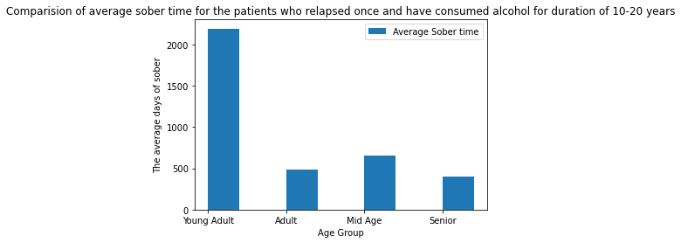
57 people are present who have consumed alcohol for 1-10 years of duration.

Slide 8
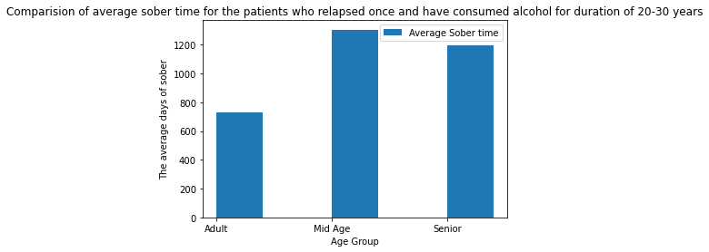
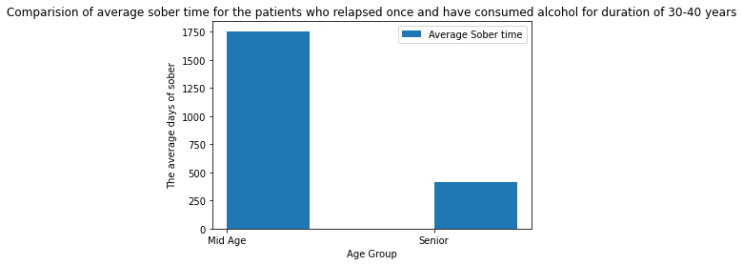

Slide 9
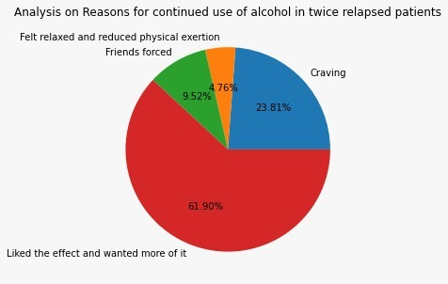
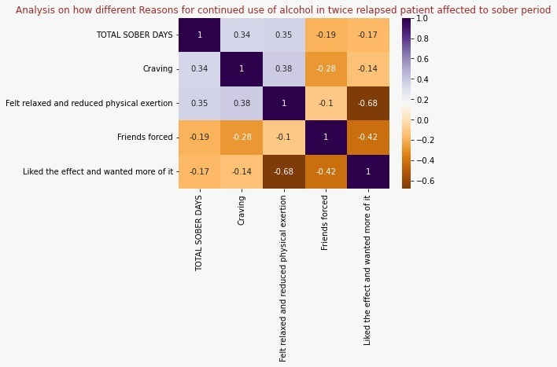
Comparison of sober period of twice relapsed patients with the reason for continued use of alcohol
61.90% of people have continued use of alcohol because they liked the effect and wanted more of it.
The person cannot sober for long days if he continued use of alcohol due to the reason that he liked its effect and wanted to use more of it.

Slide 10
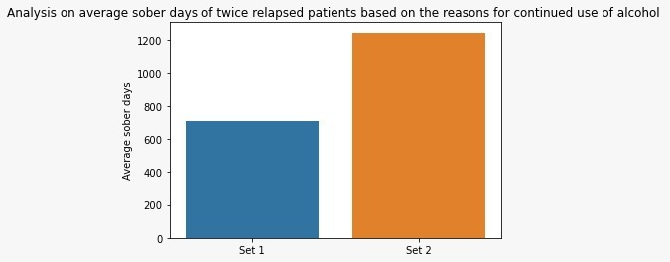
Continued..
Set 1:
Adult – 5
Mid age - 4
Young adult – 2
Youth – 1
Senior - 1
Set 2:
Adult – 1
Mid age – 1
Set 1 – Twice relapsed patients who have continued drinking because they liked it and wanted more of it.
Set 2 – Twice relapsed patients who have continued drinking due to some other reasons like craving, friends forced or to for the relaxation and to reduce physical exertion.
Average sober period of Set 1 people is less than Set 2 people which is according to the analysis made by the heatmap in the previous slide.

Slide 11
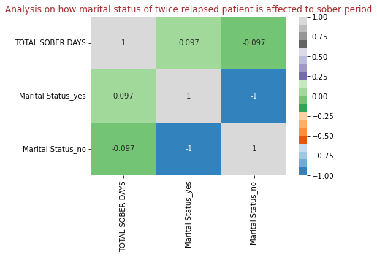
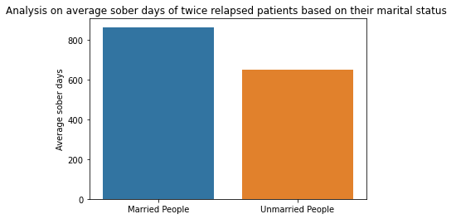
Analysis of Marital Status of twice relapsed patient with his total
sober days
If a person is unmarried, he cannot sober for long period.
If a person is married then his sober of period will be more.
Reason for this is that married people will get more family support than unmarried people.
Married People:
Adult – 4
Mid age – 4
Senior - 1
Unmarried People:
Young adult - 2
Adult – 2
Mid age – 1
Youth - 1

Slide 12
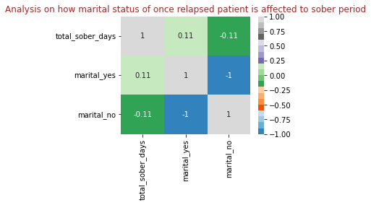
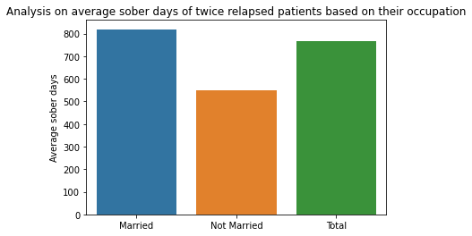
Analysis of Marital Status of once relapsed patient with his total
sober days
1. Sober period is high in Married patients as compared to unmarried patients.
2. The correlation between marital status and sober is positive for married people and negative for unmarried people.
Married People:
Adult - 64
Mid Age - 59
Senior - 25
Young Adult - 2
Unmarried People:
Adult - 16
Young Adult - 11
Youth - 4
Mid Age - 2
Teen - 1
Senior - 1

Slide 13
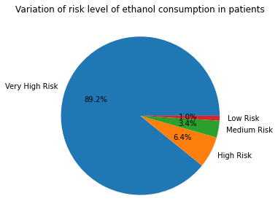
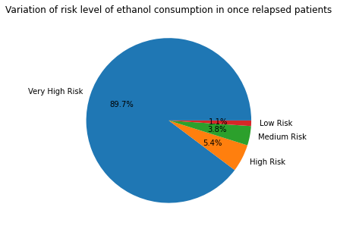
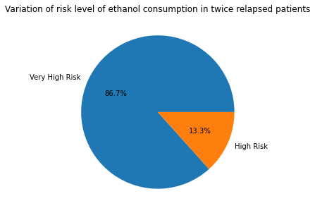
Analysis of Ethanol risk level of patients
1.Amongst 203 patients, 181 patients experience very high risk level i.e 89.2% people of the data.
2.Among these,166 people have relapsed once and 13 people of relapsed twice.
3.The twice relapsed consist of patients only with very high risk and high risk level and not low and medium risk.
Thus, this risk factor is one of the reason for them to relapse twice.

Slide 14
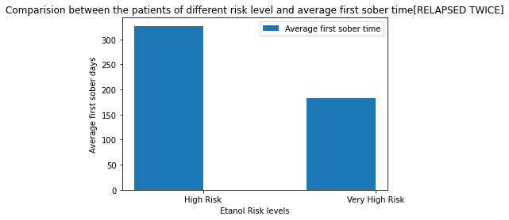
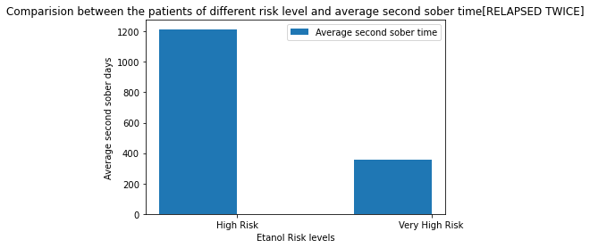
Comparison of Ethanol risk level of twice relapsed patients with
average sober time
The patients with high risk have sobered more on an average than that of patients with very high risk level in both first sober and second sober.
The sober period has increased in second sober time when compared to first sober time.
3. The patients after relapsing back for first time and taking treatment again, have gained more tendency to sober the second time.
4. The risk level of the patients is negatively corelated to the sober period(-0.23) and hence , higher is the risk level, lesser is the tendency to sober for long and thus patients relapse.

Slide 15
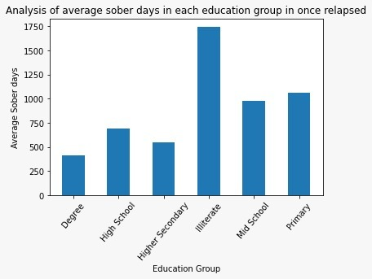
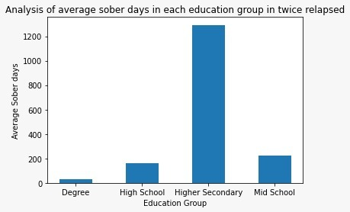
Analysis of Education level of patients with their average sober time
1.The people with illiteracy are more in once relapsed patients and they are found to sober for more average time than any other education group.
2.The people of higher secondary education group have sobered for more average time in twice relapsed patients.
3.The degree people have sobered less in both once and twice relapsed patients.

Slide 16
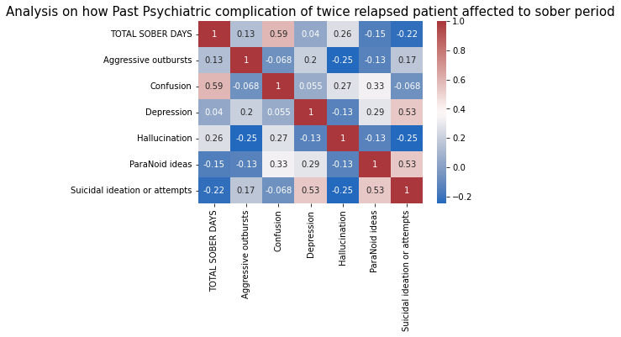
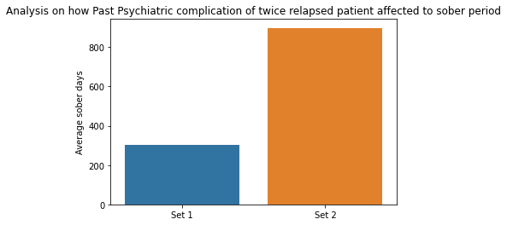
Analysis on how Past Psychiatric complication of twice relapsed patient affected to sober period
People who have past psychiatric complications like paranoid ideas or suicidal ideation or attempts will sober of lesser days.
People who have other complications like aggressive outbursts ,depression, hallucination or confusion will sober for more days.
Set 1 : People who have past psychiatric complications like paranoid ideas or suicidal ideation or attempts. There are, 3 - adults in Set 1.
Set 2 :People who have other complications like aggressive outbursts ,depression, hallucination or confusion. There are, 5 - mid age, 3 - adults, 2 - young adults, 1 – youth and 1 – senior in Set 2.

Slide 17
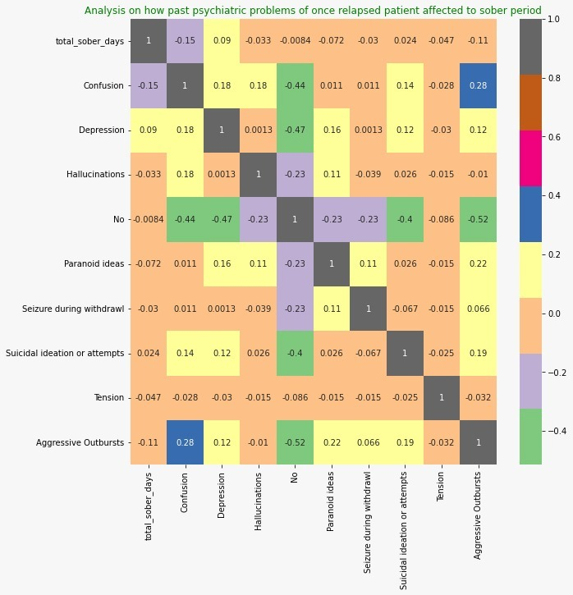
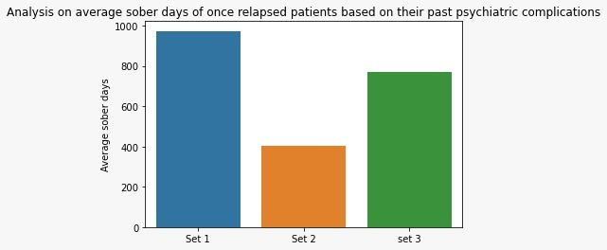
1. Confusion and Depression are the major past psychiatric problems that has affected sober period in once relapsed patients.
2. People with Confusion couldn’t sober for longer time.
3. People who are depressed have sobered for longest time.
Confusion:
Adult 12
Mid Age 10
Senior 1
Depression:
Adult 13
Mid Age 7
Senior 5
Young Adult 1

Slide 18
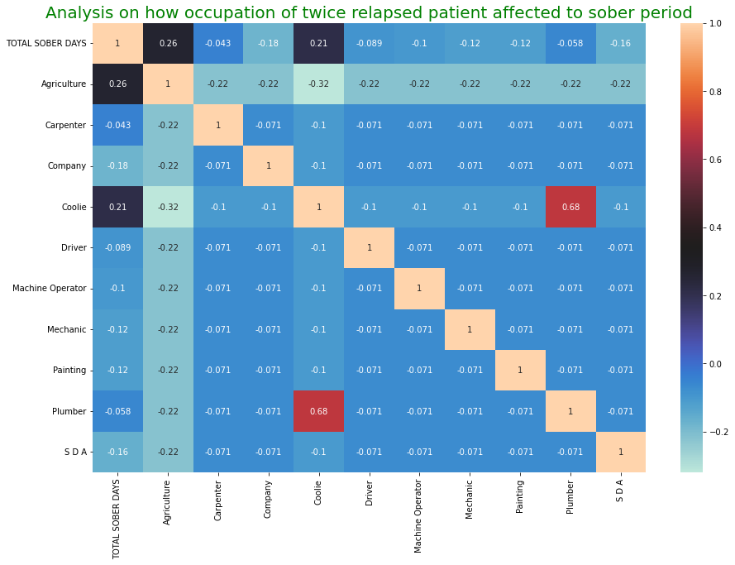
Analysis on how occupation of twice relapsed patient affected to sober period
Agriculture and Coolie are positively corelated to total sober days whereas remaining factors are negatively corelated to sober days.
Agriculturist and coolie person can sober for a longer days.
Person’s whose occupation is other than agriculture or coolie will not able to sober for longer time.
4. There are,
6 agriculturists, 1 carpenter, 1 working
in company , 2 coolie people, 1 driver,
1 machine operator, 1 mechanic, 1
painter, 1 plumber and 1 S D A.

Slide 19
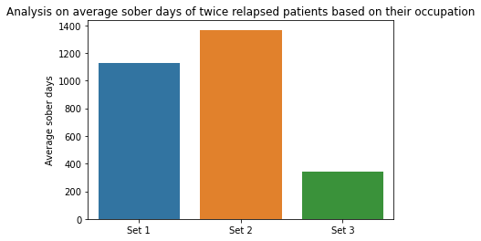
Continued..
Set 1 Set 2 Set 3
Mid Age : 2 Mid age : 2 Mid age : 2
Adult : 1 Adult : 5
Young Adult : 1 Young Adult : 1
Youth : 1
Senior : 1
Set 1 – Twice relapsed patients who are all agriculturists.
Set 2 – Set of all coolie people.
Set 3 - Twice relapsed patients who are all like carpenter, working in company , driver, machine operator, mechanic, painter, plumber or S D A.
Sober period of Set 3 people is lesser than Set 1 and Set 2 people and this is according to the previous analysis that we have made through heatmap.

Slide 20
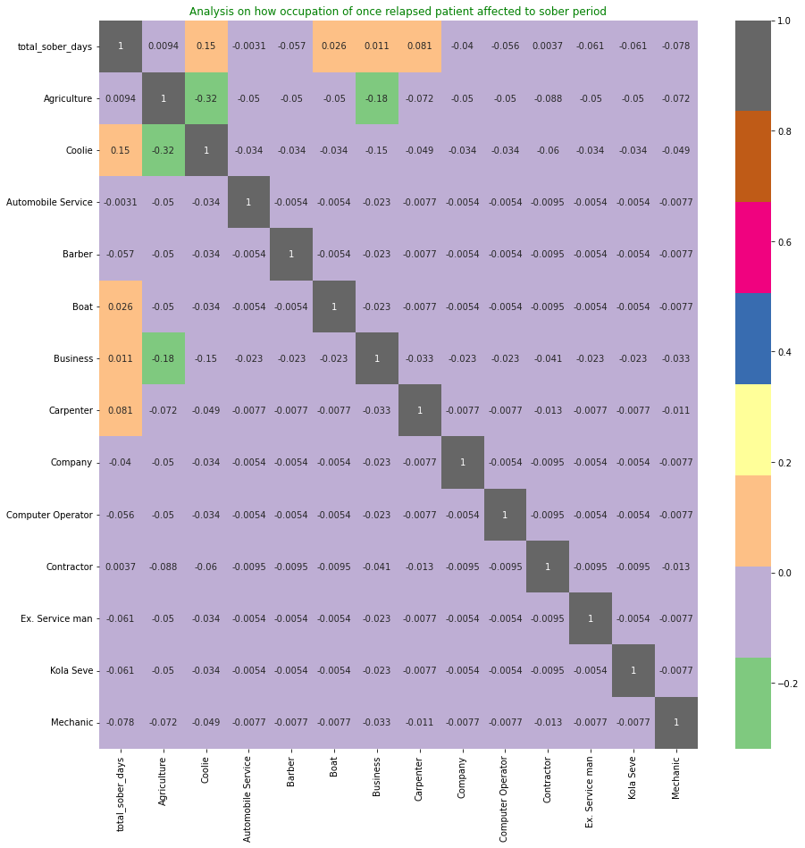
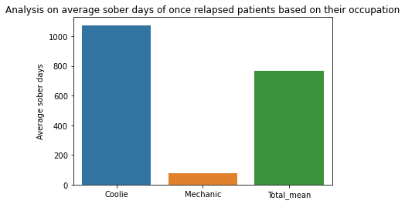
Analysis on how occupation of once relapsed patient affected to sober period
1. Coolies have sobered for longer time in once relapsed patients.(average 1075 days)
2. Mechanics have sobered the least.(average 79 days)
Coolie:
Adult - 14
Mid Age - 12
Senior - 4
Young Adult - 3
Mechanic:
Mid Age 1
Senior 1

