Slide 1
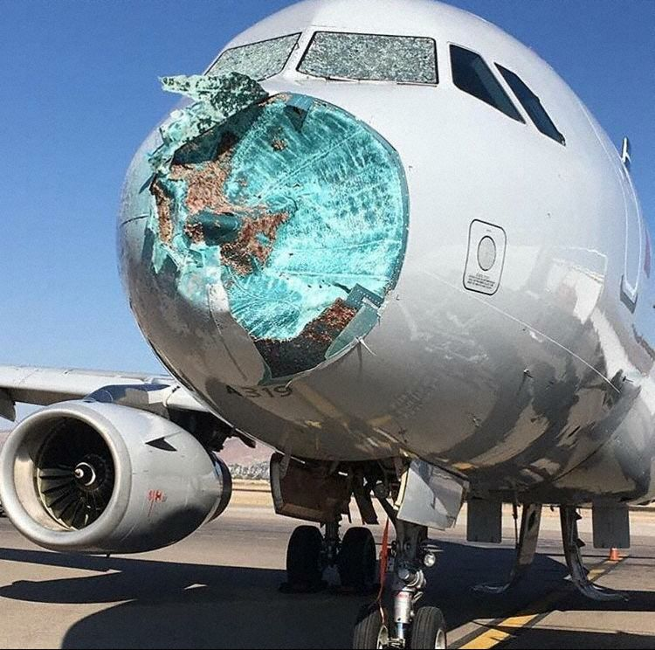
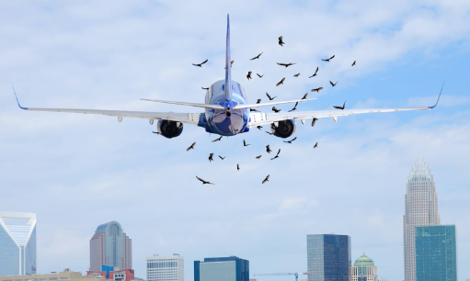
Comprehensive Analysis Bird Strikes between
2000 – 2011

Slide 2
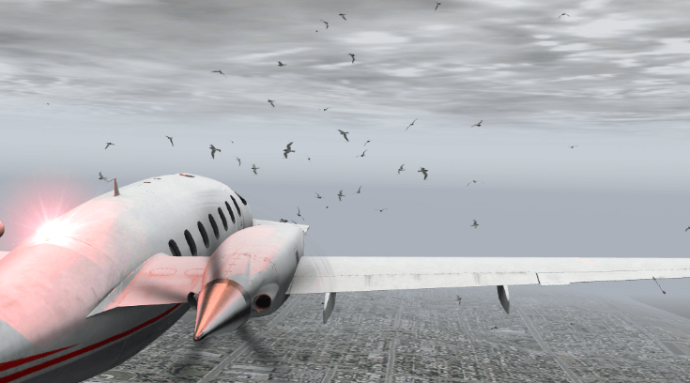
The interaction between aircraft and wildlife, particularly bird strikes, has been a longstanding concern in aviation safety. This analysis delves into a dataset spanning from 2000 to 2011, providing insights into the patterns, risks, and implications of bird strikes in aviation.
Project Overview:
The project focuses on analyzing bird strike data, which occurs when birds collide with aircraft engines.
The goal is to predict future bird strikes and enhance flight safety by understanding patterns and risk factors.
This project aims to analyze past years’ bird strike data concerning the phase of flight, time of day, pilot warning status, and various other parameters.

Slide 3
Parameters Analyzed:
The analysis considers parameters such as:
The phase of flight: When during the flight the bird strike occurred.
Time of day: The time window when bird strikes are more likely.
Pilot warning status: Whether the pilot received any warnings related to bird activity.
The aviation industry: aircraft and passenger safety is of utmost importance. Bird strikes pose a threat to the same.
Analyses of the parameters that affect their occurrence would be of great assistance to the aviation industry in preventing future bird strikes, thereby increasing flight safety.

Slide 4
Key Findings:
Rising Trend of Bird Strikes: The data reveals a concerning upward trend in bird strikes over the years. In 2000, there were 4,434 incidents, which escalated to 7492 by 2010. This increase highlights the growing challenge bird strikes pose to aviation safety. While considering the cost of damage, the highest damage occurred in 2001 when repairs cost $21m while the lowest was in 2000 at over $5m.
Pilot Awareness: In a significant number of incidents, pilots were warned about the presence of wildlife, suggesting awareness but also the limitations of preventative measures.
Seasonal Variations: The analysis shows a clear seasonal pattern in bird strike incidents. August emerged as the most dangerous month, with 13,868 incidents, followed closely by September and October. This seasonal surge aligns with bird migration patterns.
Bird strikes by Airport name. Dallas/Fort Wort International Airport was mostly affected at about 10% followed by Sacramento International Airport in the top 20.
The number of bird strikes by flight phase shows Approach as the most occurring period at over 42%, followed by Landing roll at 17% with Parked at less than 1%.

Slide 5
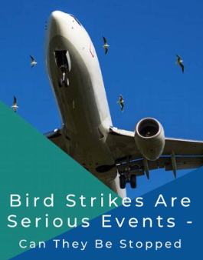
Implications:
The findings underscore the need for improved wildlife management strategies around airports and enhanced aircraft design to mitigate bird strikes. The data-driven approach provides a foundation for targeted policies and research, aiming to enhance aviation safety in the face of wildlife hazards.
Conclusion:
This analysis of bird strikes from 2000 to 2011 not only highlights the increasing frequency of such incidents but also sheds light on seasonal trends and the effectiveness of pilot warnings. As aviation continues to evolve, understanding and addressing these challenges becomes crucial for ensuring the safety of both passengers and wildlife.

Slide 6
